Slide 1
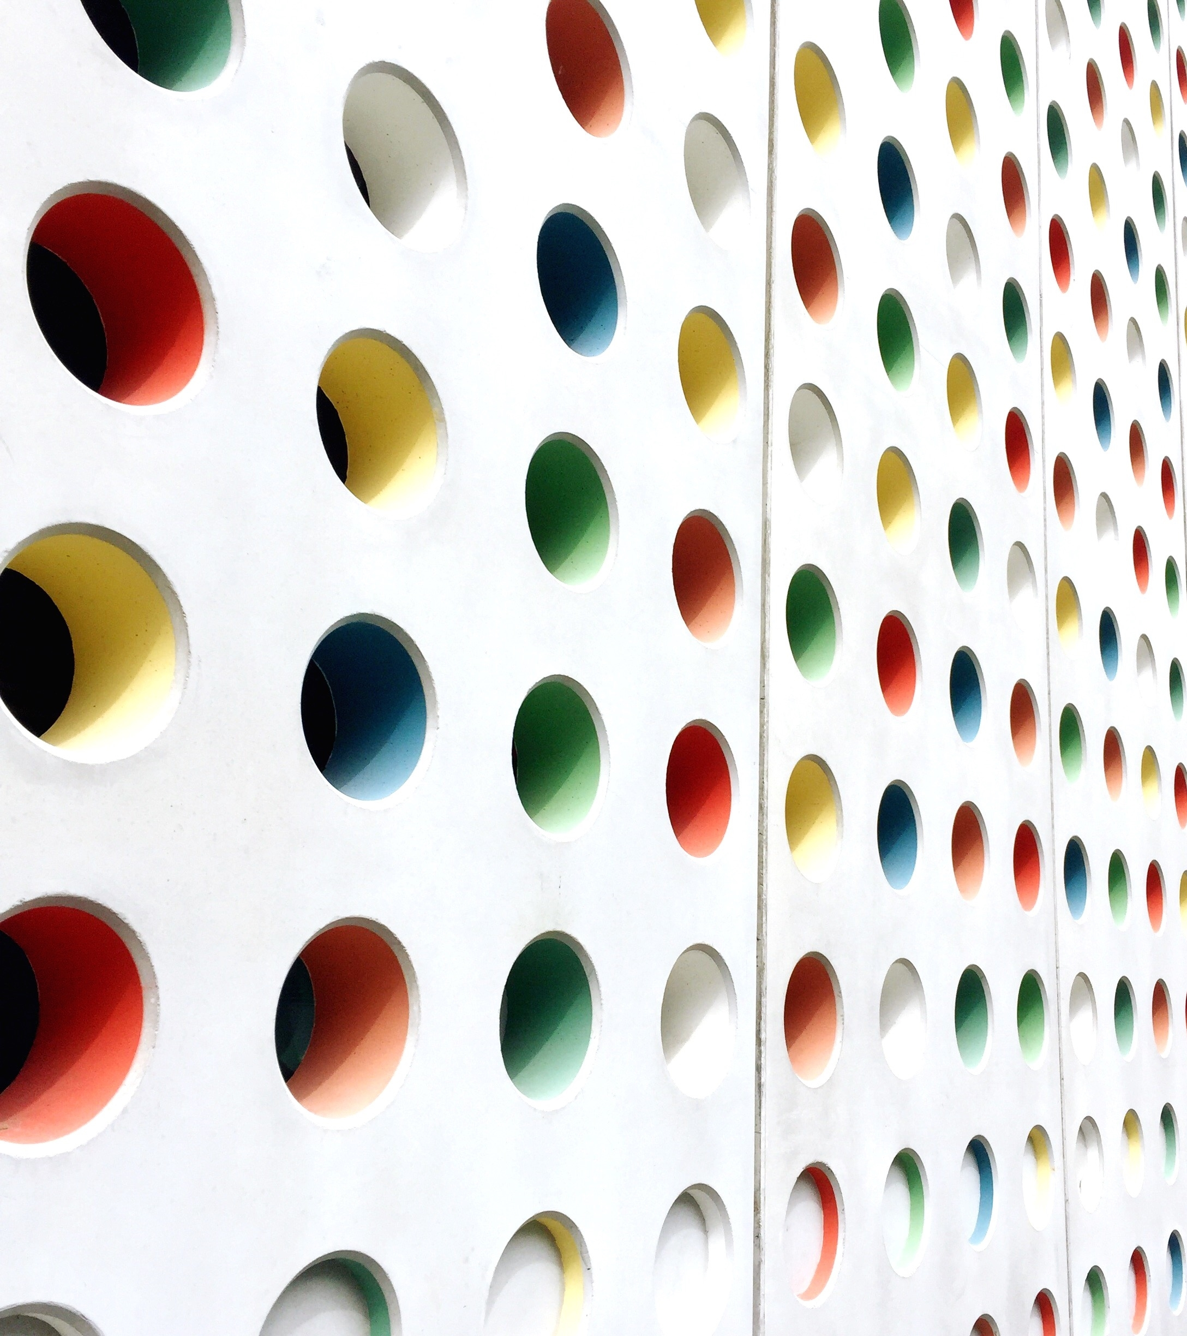
Shaping Young Minds; A Nutritional and Motivational Approach
U. HAMRAYEVA
Y. LORENZO
C. VALENTIN
F. ETIENNE
N. CARELA
A. UTEVOVA

Slide 2
Introduction
Healthy eating habits contribute to overall health and good oral health
The effects of proper eating socialization: setting an example as a parent and a teacher
Incorporating healthy eating habits into in a social circle with peer classmates
The community program: reading food labels and proper home care and be involved in the food cultivation process.
Today we will implement our community program to a certain extend. However, due to various circumstances we will be unable to have access to a community garden.

Slide 3
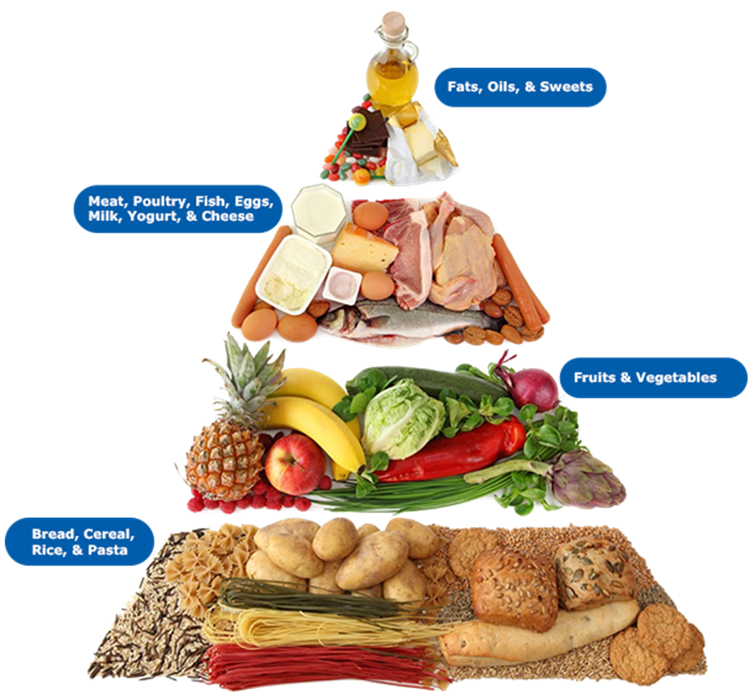
Food Pyramid
“Food pyramid” with four layers, each layer focusing on one of the nutrients.
Explain what carbohydrates, fats, protein
Now let’s try to match the food on the picture with four major nutrients
Benefits of eating vitamins and the causal relationship between carbohydrates and caries lesions.

Slide 4
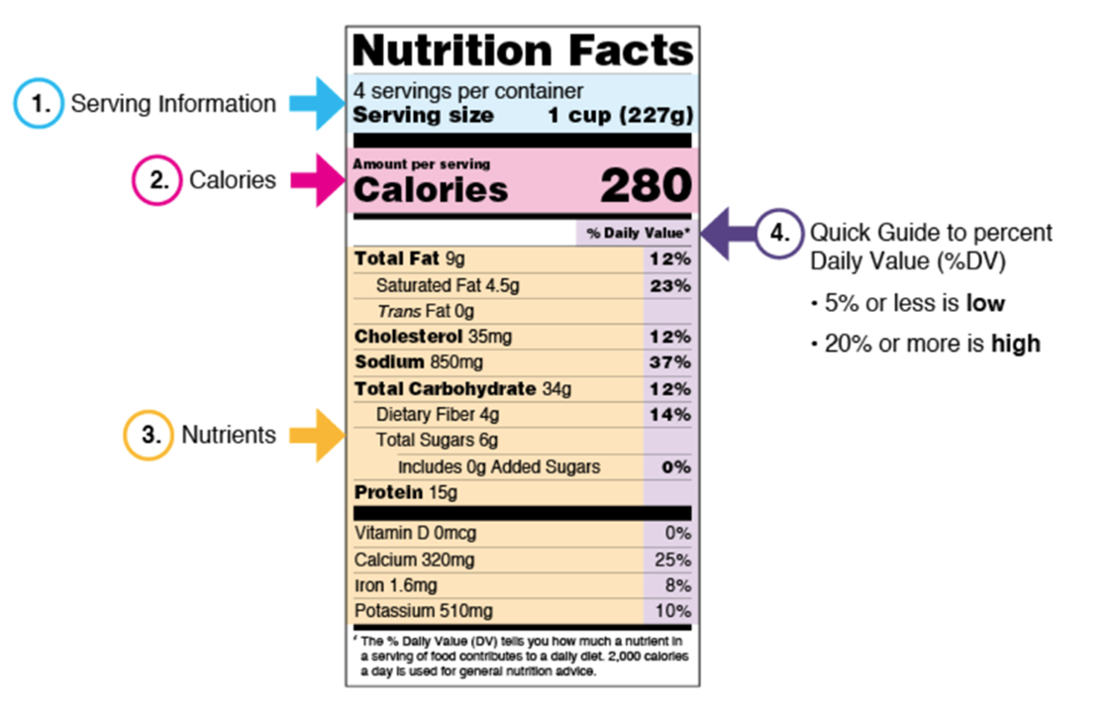
Reading Labels
Serving size: what people typically eat
2,000 calories a day; eating too many calories is linked to obesity.
Nutrients to get less of: Saturated Fat, Sodium, and Added Sugars; added during processing
Nutrients to get more of: Dietary Fiber, Vitamin D, Calcium, Iron, and Potassium.

Slide 5
Nutrition and Eating Habits Questionnaire
How often do you consume sugary drinks and candies?
How often do you consume healthy foods like fruits and vegetables?
Do you know how to read nutritional labels? And how do we know if a food is healthy or not based on this label?
Do you know what happens to our body when we eat “junk food”?
Do you prefer to eat the school’s lunch, or do they pack their own?
How many times a day do you brush your teeth? How often do you floss?
Do you know what happens to our teeth when we don’t brush or floss?

Slide 6
Trip to Local Community Garden
A plot at garden was reserved
Parental permission obtained
Every Friday, the class will travel to the garden to tend to the plants.
On the second to last Friday before summer break, the produce will be harvested.
The produce will be used to make salads which would be served with the school lunch on the final day of school.
https://www.onegreenplanet.org/environment/how-growing-your-own-food-can-benefit-the-planet/

Slide 7
Eating Socialization
Each week, We will choose 5 children and ask you to Bring a fruit or vegetable to school.
Be ready to tell us about your fruit, including what food group it belongs to.
We will then combine everything into a salad and share it for snack time.

Slide 8
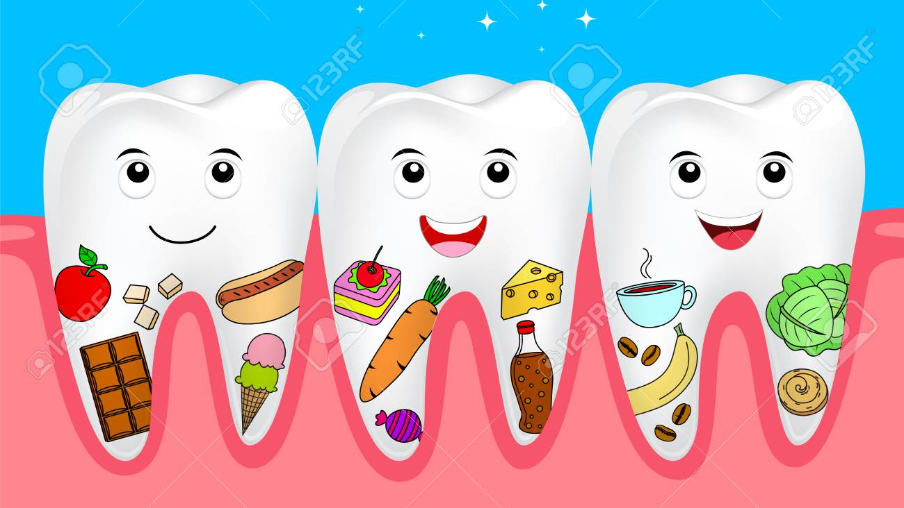

Slide 9
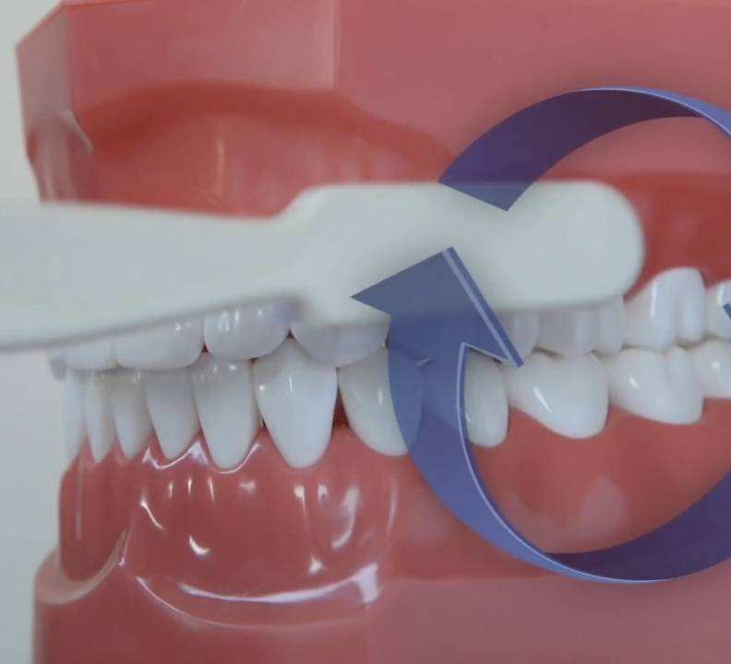
Brushing Demo
Fone’s/Circular Brushing Method:
Place the brush over 2-3 teeth at a time, then brush 4-5 times with gentle, circular motions

Slide 10
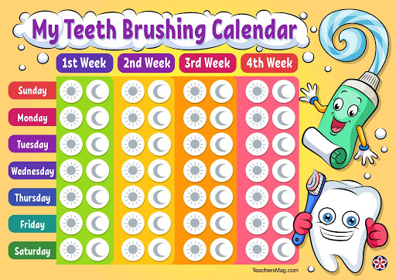

Slide 11
Any Questions?

