Slide 1
Review Of CDA ½ and Landmarks

Slide 2
True Anodontia

Slide 3
Partial True Anodontia Most common missing 3rd molars and lateral incisors

Slide 4
Partial false Anodontia

Slide 5
Mesiodens/ Supernumerary

Slide 6
Microdontia

Slide 7
Marcrodontia

Slide 8
Gemination/ Right Fusion/ left

Slide 9
Peg- Lateral

Slide 10
Fusion two roots/two crowns

Slide 11
Dens in dente

Slide 12
Dilaceration

Slide 13
Concresences

Slide 14
Taurodontia

Slide 15
Hypercementosis

Slide 16
Amelogenesis Imperfecta

Slide 17
Dentinogenesis Imperfecta

Slide 18
Hutchinson Incisors

Slide 19
Mulberry Molars

Slide 20
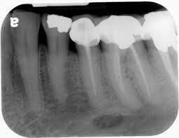
Mental Forman
Radiolucent

Slide 21
Incisive Foramen/Incisive canal Radiolucent

Slide 22
Nutrient Canal Radiolucent

Slide 23
Mental Ridge Radiopaque

Slide 24
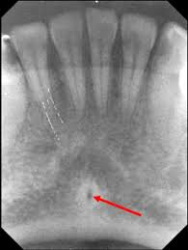
Lingual Foramen
Radiolucent

Slide 25
Genial Tuberical Radiopaque

Slide 26
Submandibular gland fossa
Radiolucent

Slide 27
External Oblique ridge
Radiopaque

Slide 28
Internal Oblique Ridge/ Mylohyoid Ridge
Radiopaque

Slide 29
Mandibular canal/ inferior alveolar canal Radiolucent

Slide 30
Inferior border of the Mandible
Radiopaque

Slide 31
Median Palatine Suture Radiolucent

Slide 32
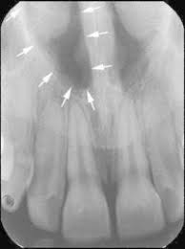
Nasal Fossae/ cavity
Radiolucent

Slide 33
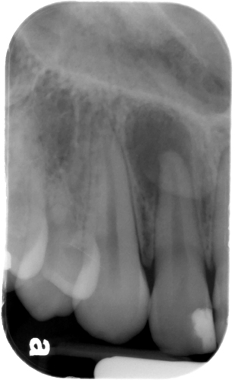
Lateral Fossae/ Canine Fossae
Radiolucent

Slide 34
Canine Fossa

Slide 35
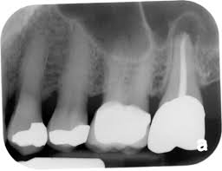
Maxillary Sinus (Atrium of Highmore)
Radiolucent
The W shape = Walls/floor
Of the max. sinus and
Sinus septum

Slide 36
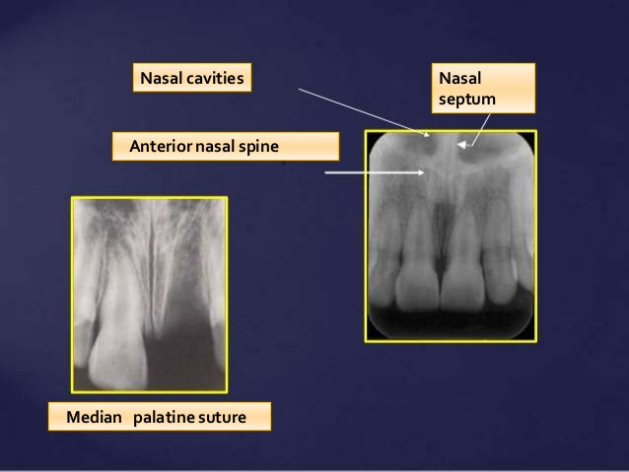
Nasal Septum and Spine Radiopaque
Radiopaque

Slide 37
Soft tissue shadow of the nose radiopaque

Slide 38
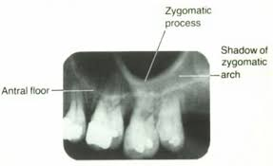
Zygomatic Process
Radiopaque

Slide 39
Hamulus
Radiopaque
Lateral (external)
Pterygoid Plate
(Purple)
radiopaque

Slide 40
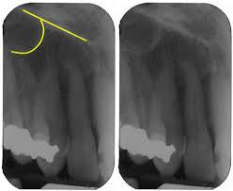
Inverted Y (Floor of nasal fossa/ Anterior border of max. sinus)
Radiopaque

Slide 41
Coronoid Process
Radiopaque

Slide 42
Maxillary Tuberosity
Radiopaque

