Slide 1
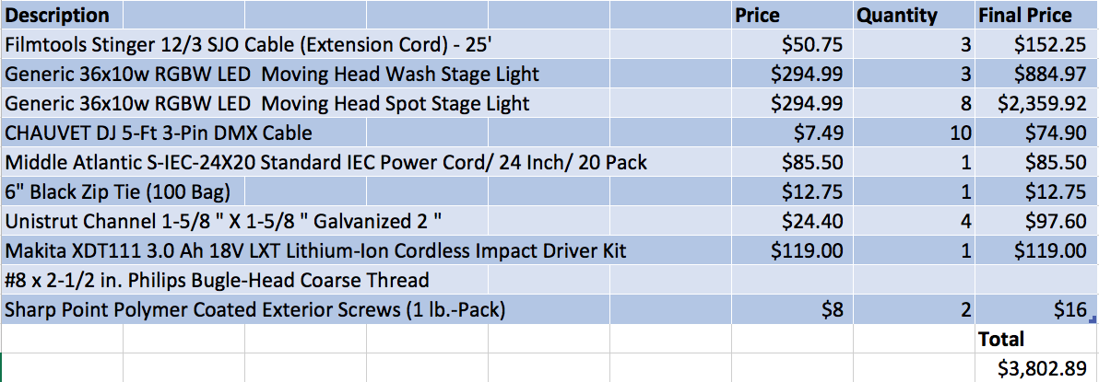
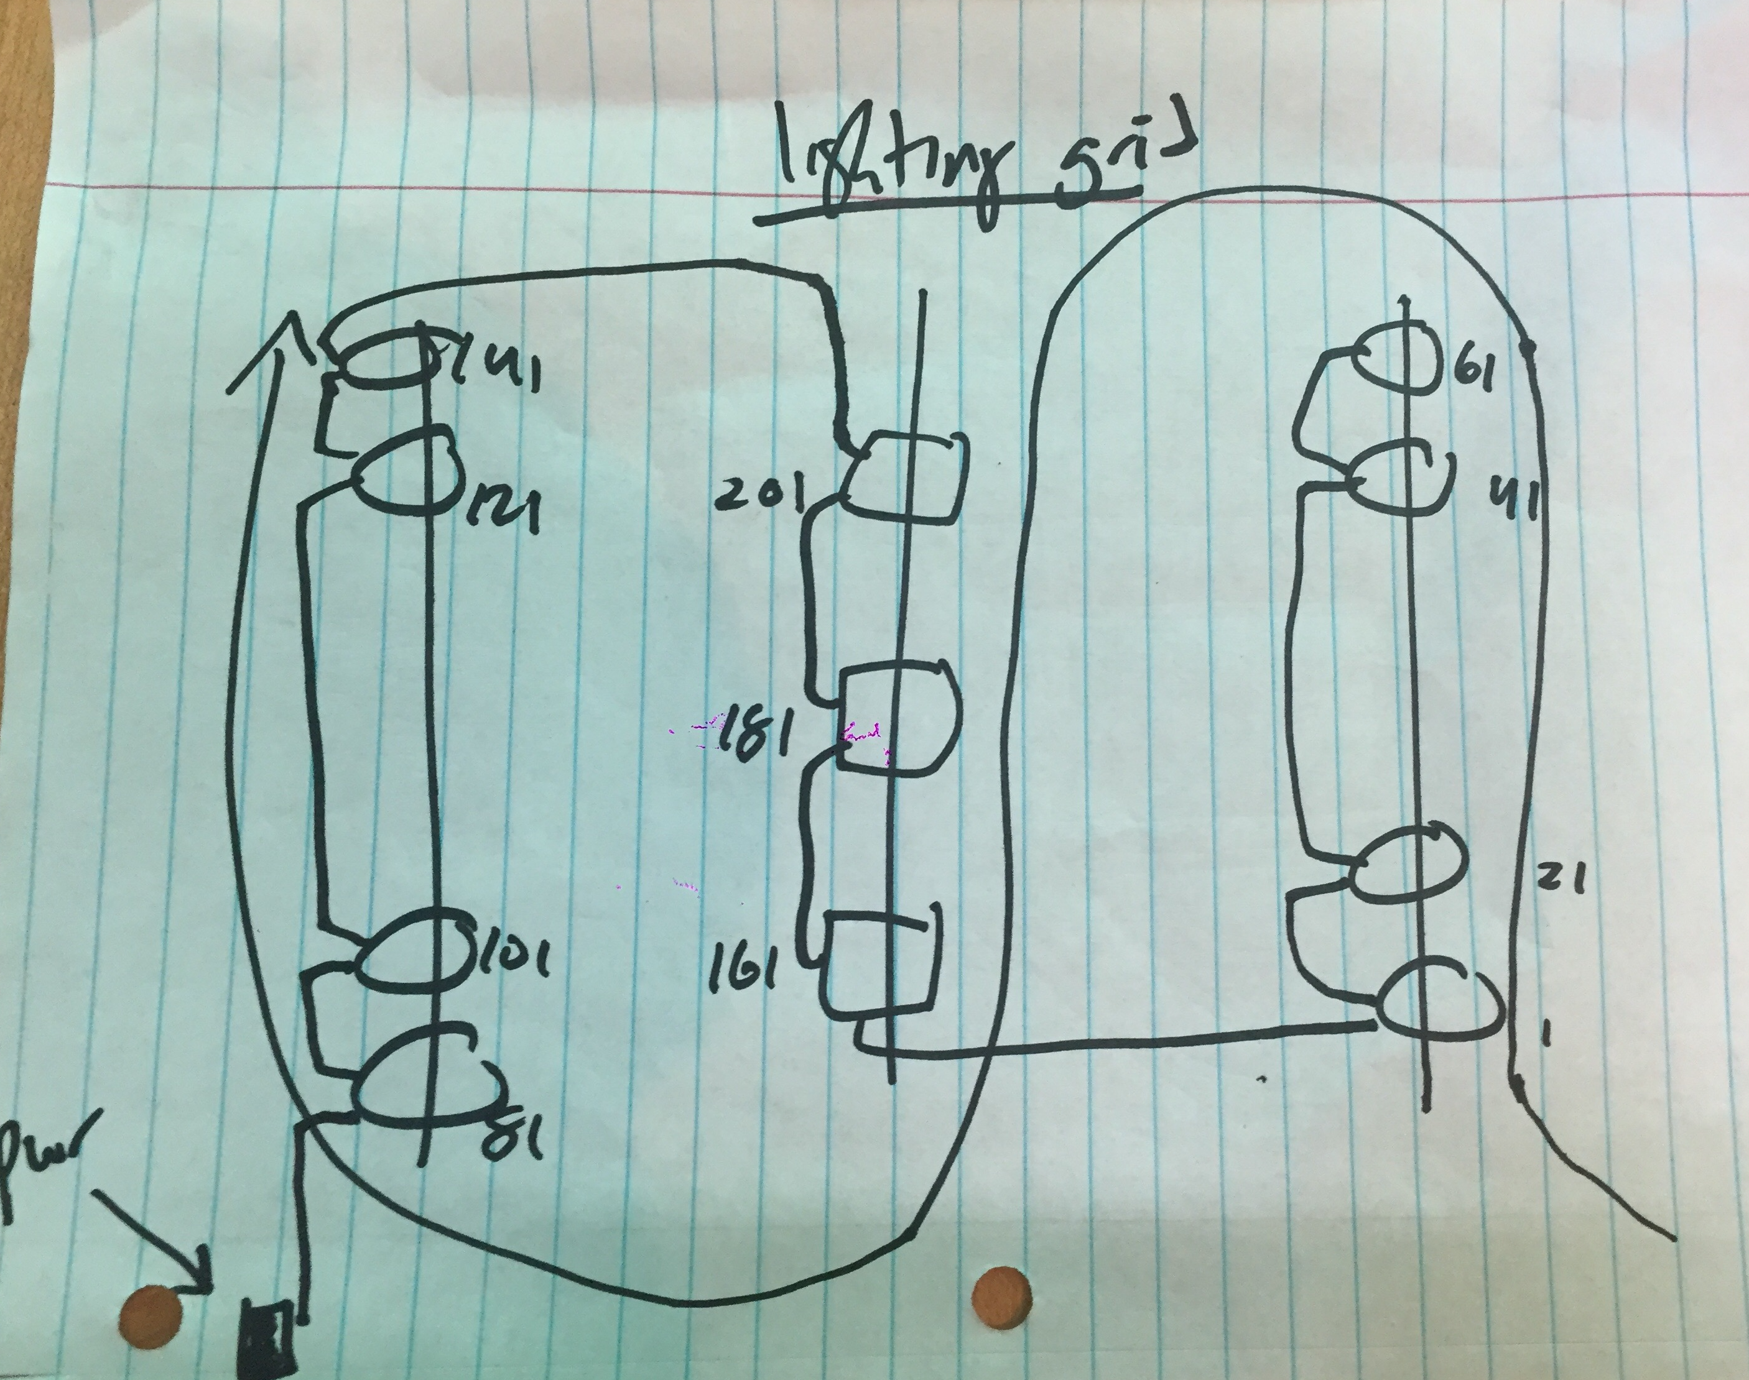
In-House Virtual Lighting Grid Christian Rosario: Lighting Designer/Master Electrician Department of Entertainment Technology
Introduction
`At my stay at City Tech, I have practiced and learned a multitude of new skills and talents that I will take with me when I graduate. Of all those abilities, I chose to specialize and hone my focus onto lighting & video. By focuses on these two aspects I can successfully visualize outcomes before they aren’t even physically set up. I have always been fascinated with the way certain lighting effects can warp the perceived reality of the viewer as well as present the world in a way they had not seen previously. Lighting and Video go together so it was only natural to study video as well to learn how to accurately capture the world realistically, and edit that footage into a coherent piece of media. Being knowledgeable of how sound and audio works is a by-product of attending such an industrious university, so logically it is also involved in my culmination as well.
The Process
During my time in my Lighting Controls class with John Robinson, we worked with a fully functional lighting lab setup and had to learn how to integrate and work very closely with this system to correctly manipulate and handle all the various moving parts that are involved. While working at my internship at Nitemind studios an idea occurred to me, which was to build a lighting lab like the one in V119 in the studio uses older extra fixtures that they had lying around. There are a total of 11 fixtures. The plan is to mount them to the ceiling in the studio, power them successfully, address them, and build a space to connect it to a portable GrandMA2 system so we can train the staff on the specifics of the GrandMA2 platform. While also creating the space virtually using the visualization software.
Conclusion
When conducting an experiment which should work in theory, there exists plenty of factors which could cause you to stumble and not be successful with your vision. In this experiment I had to make sure I had the correct materials, and that they were all positioned in a way that it would allow it to work. Sometimes in the field, you can do all the pre-production in the world, there will be one seemingly hidden factor that can hinder your progress and it is up to you to overcome and succeed. That is why one must be fully knowledgeable on their subject to fully have a tight grasp on what should or what might happen in any given situation when dealing with unpredictable variables.
Various obstacles such as scheduling, weather,
Methods
1. Schedule; timeline
2. System of Communication and Documentation
Email
Slack Messaging Software
Face to face meetings
Budget/Materials:
Elevation Diagram
Gantt Chart
Literature cited:
Richard Cadena (2010) Automated Lighting - 2nd edition. Focal Press, Inc.
James L. Moody (2017) Concert Lighting: The Art and Business of Entertainment Lighting
Results
What happened: I was able to gather legacy fixtures and set them up in a lighting grid formation in my internship’s studio.
2. My measure of success was whether or not I could get the rig up and running, all the while controlling it through the GrandMA2.
3. My outcome definitely overcame my measure of success as I was able to produce exactly what I had in mind when I was beginning this experiment.
Hypothesis
Will it be difficult to train a staff member on the intricacies of the GrandMA2?
Using a combination of light & video to create a fulfilled project.
Acknowledgements
1. Nitemind
2. Michael Potvin
3. New York City College of Technology

