Slide 1
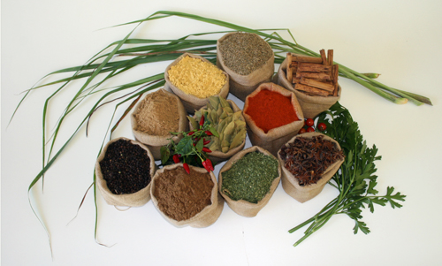
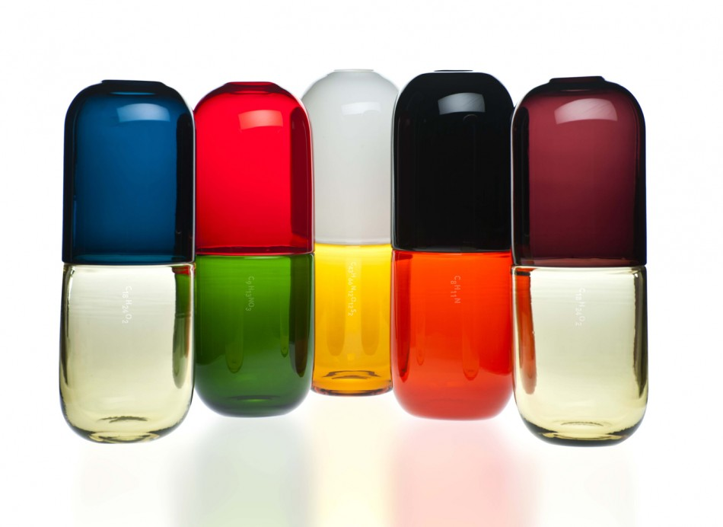
Drug Interactions with Vitamins & Herbs
Belina Kasa
Carol Truong
Dhora Gjoni

Slide 2
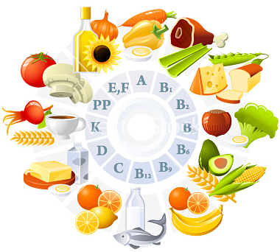
What are Vitamins?
A group of organic substances that are essential for normal cell function, growth, and development.

Slide 3
Vitamins
52% of Adults take dietary supplements
It is typically a safe and effective method of maintaining a healthy body
Essential Vitamins cannot be produced by the body and must be ingested in the diet

Slide 4
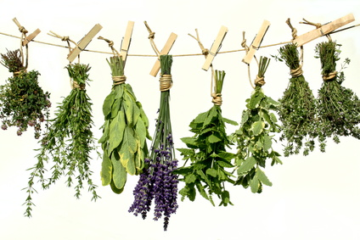
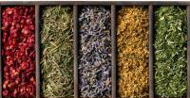
What are Herbs?
Plant Origin
Used for their
- scent
- flavor
- therapeutic properties

Slide 5
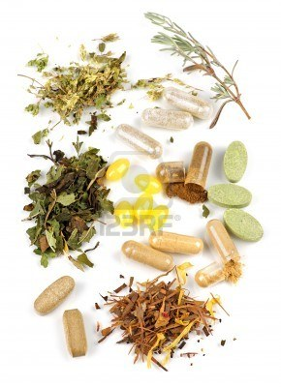
Herbs
Dietary supplements to improve health
They are sold as
- tablets
- capsules
- powders
- teas
- extracts
- fresh or dried plants

Slide 6
Contraindications of Vitamins & Herbs
Can cause health problems
Some are not effective
Not regulated by any agency (FDA)
Not evidence based

Slide 7
Herbs and Vitamins may antagonize the actions of prescription (Rx) and non prescription drugs (OTC)

Slide 8
Herb – Drug Interactions
Vitamin– Drug Interactions
Vitamin A
B – Complex
Vitamin K
St. John’s Wort
Garlic
Ginkgo Biloba

Slide 9
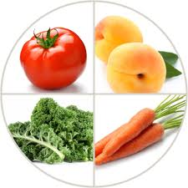
Vitamin A
Role in:
vision, bone growth, cell differentiation,
and the immune system
Drug Interactions:
Retinoids, such as isotretinoin (Accutane) and acitretin (Soriatane)
which are used for acne and psoriasis
Effect of Interaction :
vitamin A toxicity, such as nausea, vomiting, dizziness, blurred vision, and poor muscle coordination.

Slide 10
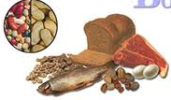
Vitamin B6 (pyridoxine)
Uses:
treat deficiencies in vitamin B6 and some types of anemia
Drug Interactions:
Phenytoin
Levodopa
Effect of Interaction:
decrease efficacy leading to parkinsonian symptoms and risk of seizure

Slide 11
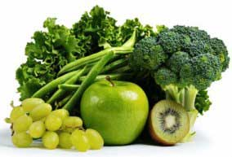
Vitamin K
Role:
Necessary for blood coagulation
Drug Interactions:
Warfarin
Effect of Interaction:
decrease efficacy and risk of thromboembolism

Slide 12
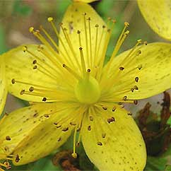
Saint John’s Wort
Uses: treatment for depression, anxiety, and sleep disorders
Drug Interactions:
Tetracycline/Achromycin, sulfa- containing
medications such as, piroxicam (Feldene)
Effect of Interaction : sun sensitivity
Serotonin Reuptake Inhibitor medications (SSRIs) such as, fluoxetine (Prozac) and paroxetine (Paxil)
Effect of Interaction : headaches, dizziness, sweating, and agitation

Slide 13
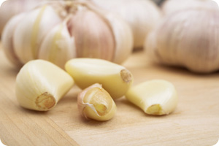
Garlic
Uses: treatment for hypertension and high cholesterol
Drug Interactions:
Anticoagulants, such as warfarin (coumadin)
Effect of Interaction :
Allergic reactions, skin inflammation, stomach upset and prolongation of bleeding

Slide 14
Ginkgo Biloba
Uses: treatment for dementia and to improve thinking
Drug Interactions:
Anticoagulants, such as warfarin (Coumadin) Aspirin, NSAIDs, such as ibuprofen (Advil)
Anticonvulsant, such as phenytoin (Dilantin), carbamazepine (Tegretol), and phenobarbital
Effect of Interaction :
Increased Risk of Bleeding, stomach upset, headache, weakness and dizziness

Slide 15
To use vitamins and herbal products as safely as possible
Consult your doctor first
Do not take a bigger dose than the label recommends
Take it under the guidance of a trained medical professional
Be especially cautious if you are pregnant or nursing

Slide 16
Role of a Dental Hygienist
Knowledgeable about most common vitamins & herbs
Knowing most vitamin/herb - drug interactions
Inform patients about supplement adverse affects with certain drugs
Reinforce the importance of consulting a medical physician
Remind patients to consume supplements as directed by the manufacturer

Slide 17
Question 1
An adverse effect of Vitamin A would be?

Slide 18
Question 2
What role does Vitamin K plays in?

Slide 19
Question 3
St. John’s Wort is being used to treat?

Slide 20
Question 4
Garlic’s drug interaction with what result in a prolongation of bleeding?

Slide 21
References
“Beware of risky herb-drug combos.” ConsumerReports. ConsumerReports, Jan. 2009. Web. 4 Dec. 2012.
Gardiner, Paula, and Russell Phillips. “Herbal and Dietary Supplement-Drug interactions in Patients with Chronic Illnesses.” American Academy of Family Physicians 1 (2008): 73-78.
“Herbal Medicine.” National Institutes of Health. MedlinePlus, 30 Nov. 2012. Web. 4 Dec. 2012.
Shiel Jr., William C.. “Herbs: Toxicities And Drug Interactions.” MedicineNet. MedicineNet, 29 Aug. 2012.
Sulli, Maria M., and Danielle C. Ezzo. “Drug Interactions with Vitamins and Minerals.” US Pharm 1 (2007): 42-55. US pharmacist. Web. 23 Jan. 2007.

