Slide 1
City Tech 101
Summer Session 1
Christopher Tarbell
christopher.tarbell22@citytech.cuny.edu
City Tech 101 by Karen Goodlad and Sarah Paruolo is licensed under a Creative Commons Attribution-NonCommercial-ShareAlike 4.0 International License.

Slide 2
SESSION FOUR:
#aMAJORdecision
+
Looking Back and Looking Forward
Session 4
Date
Professor
City Tech 101 by Karen Goodlad, Sarah Paruolo , and Jessica DeCoux is licensed under a Creative Commons Attribution-NonCommercial-ShareAlike 4.0 International License.

Slide 3
Today’s Topics
Part A:
Registration: Commitments and Responsibilities
University Structure
Your Major Matters
Academic Advisement vs. Registration
Preparing for Advisement
DegreeWorks Degree Audit
My Academic Career Planner
Academic Advisors
Part B:
Vocabulary Review/Activity
Setting Effective Goals
Create an Action Plan

Slide 4
Part A: #aMAJORdecision
Advisement, Registration,
+ Degree Planning

Slide 5
Registration:
Commitments and Responsibilities

Slide 6
Registration is…
A financial commitment to the college
If you do no drop your classes BEFORE the start of the semester, you are required to pay some or all of the tuition, even if you drop the classes later or stop attending.
A Financial Aid commitment
Most financial aid is conditional upon you completing your courses successfully. If you fail all or almost all of your courses, your financial aid for that semester can be revoked, and you may have to pay a bill.
An opportunity to plan your studies wisely!
Choose your courses well so you have a smooth path to getting your degree!
Notes:
This section is short but important. Many students do not understand the financial commitment they are making by registering, and many students end up in debt because they are faced with a bill at the end of the semester that they are not expecting. Help lay out the basics here, and encourage students to follow the links on the next page for more information.

Slide 7
For more information on college finances:
An introductory guide in The Companion to the First Year at City Tech
The Bursar’s Office
The Financial Aid Office
The Student Success Center (for support and guidance)
Notes:
This section is short but important. Many students do not understand the financial commitment they are making by registering, and many students end up in debt because they are faced with a bill at the end of the semester that they are not expecting. Help lay out the basics here, and encourage students to follow the links on the next page for more information.

Slide 8
University Structure

Slide 9
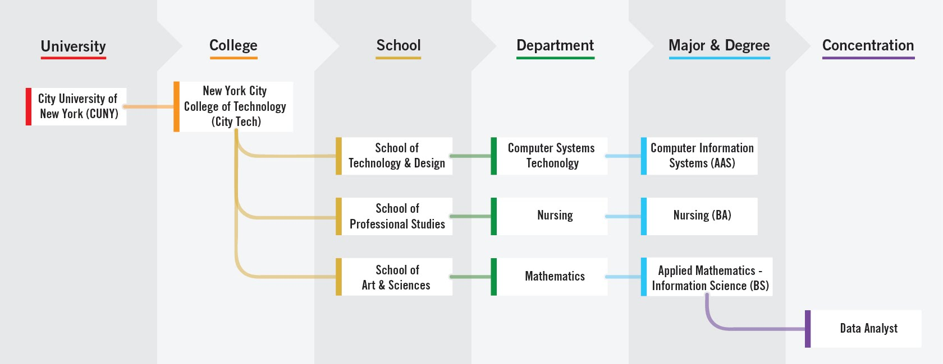
Notes:
4 minutes
Explain the foundation of the organizaiton and where each student fits into the organization. Ask there they fit into the organizaion.
It is exciting to announce that the college now offers New for fall 2021, Minors!
I asked this question using polls so that we can use the information in discussion during the session
1.How confident are you that you chose the right major? (Single Choice)*
I am Not Confident
I am Somewhat Confident
Neutral
I am Confident
I am Very Confident

Slide 10
Your Major Matters

Slide 11
Your Major Matters...
What is your major and why did you choose it?
Notes:
Create a JamBoard or other collaborative tool, and ask people to answer this question.As with any Google tool, make sure the people with the link have editing access (not just viewing access). Encourage creativity and variety in expression. If you’re meeting in person, you can also have students write answers on the board or on slips of paper, etc.

Slide 12
Academic advisement and registration, is there really
a difference?
Notes:
This slide brings in important vocabulary. Initially it is the difference between advisement and registration. Next it will be examples of questions that are related to both registration (the act of enrollment, something students do on their own, PM will guide them through the process), academic advisement is the act of discussing ones path to graduation, which includes advice on which classes to register for, but is more. Students work with an Academic Advisor who is a full time faculty member in their department. Academic Advisors should be able to
Discuss prerequisites
Which clubs are available and how to join
Guide a student who is struggling or who is excelling
Offer career advice
Discuss programs available to students.
Advisors will NOT talk about financial aid issues
Some students have additional advisors if they are in SEEK or ASAP programs.

Slide 13
Academic advisement and registration, is there really
a difference?
Which classes should I register for?
How do I enroll in classes?
Which activities will support my academic and career goals?
How can I maximize the value of tuition?
Besides class, what else does City Tech offer me?
How can I connect my education with my future?
Notes:
Peer Mentors helped develop this list of questions.
To engage students, ask if they think these questions are more academic advisement or registration

Slide 14
Find Information about
Your Department and Major
Sample Course of Study on your Department Site
Course Descriptions are found in the College Catalog
Talk to an Academic (Faculty) Advisor
Explore the Academic Advising Webpage
Become better prepared by using The Companion
Notes:
Sample Course of Study on your Department Site
Each department offers a sample course of study. This is exactly what it says, a sample. Students should use the sample as a guide but should consider their own specific plan towards graduation
For instance, some students will be enrolled in MAT1272CO but their sample states the first course as MAT1375. An example: https://www.citytech.cuny.edu/computer-engineering/computer-engineering-btech.aspx
Course Descriptions are found with in the department the course if offered

Slide 15
Preparing for
Academic Advisement
(planning your schedule)

Slide 16
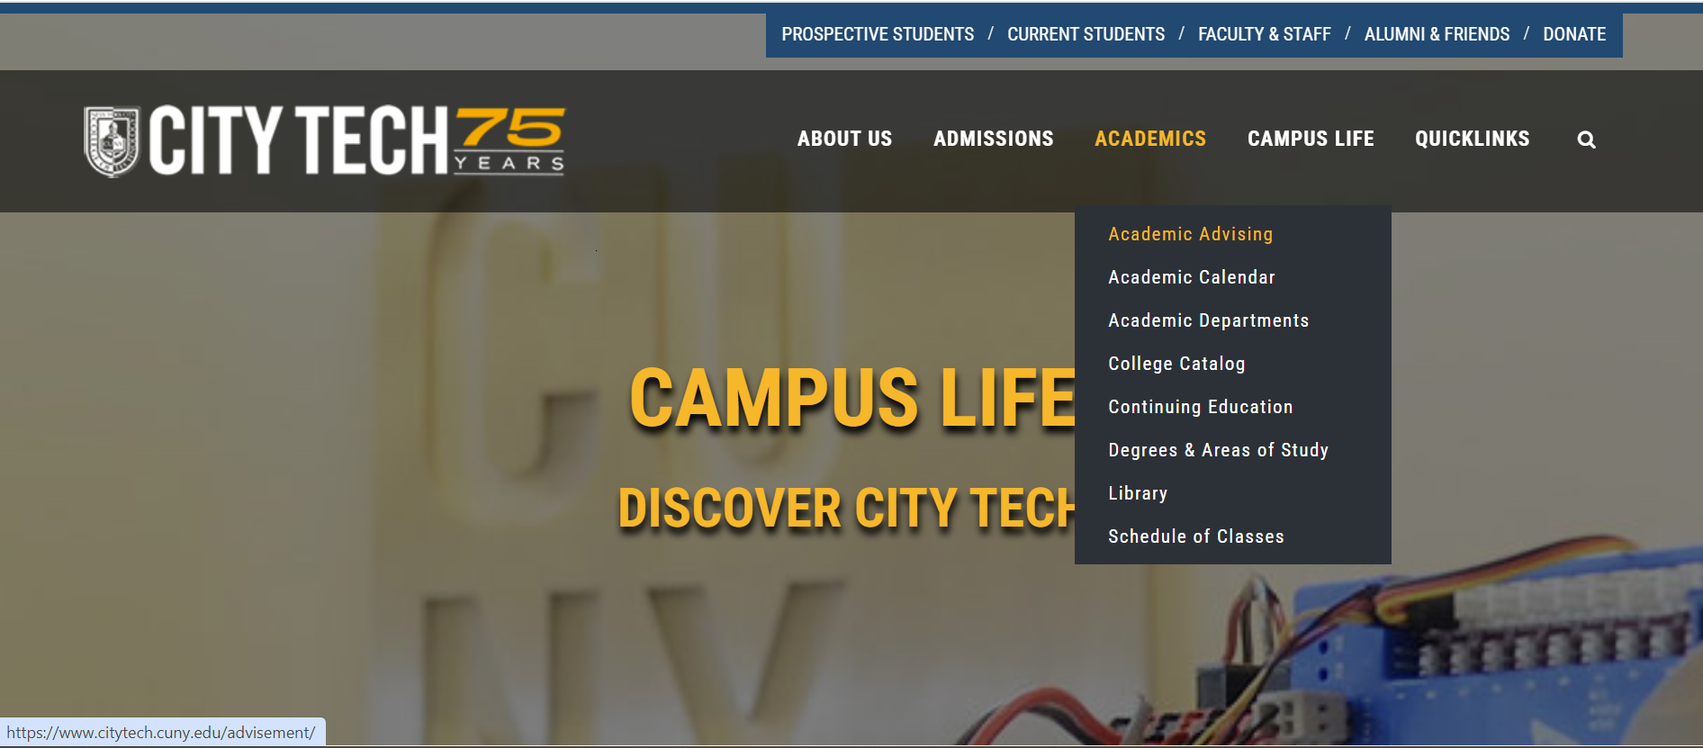

Slide 17
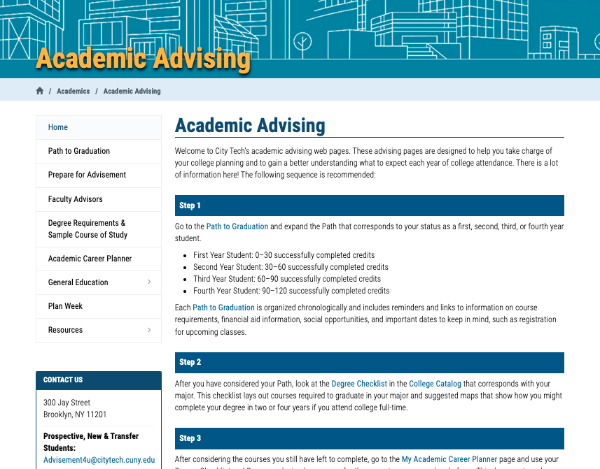
http://www.citytech.cuny.edu/advisement/

Slide 18
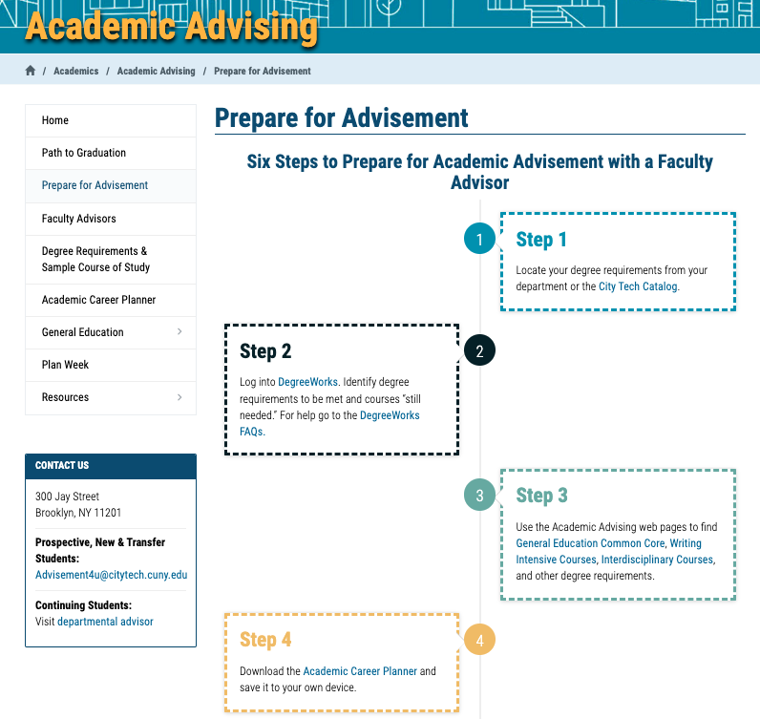
http://www.citytech.cuny.edu/advisement/six-steps.aspx

Slide 19
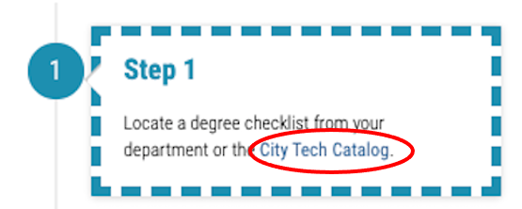

Slide 20
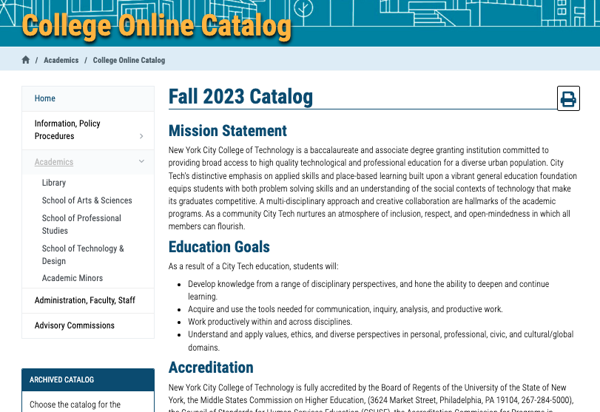

Slide 21
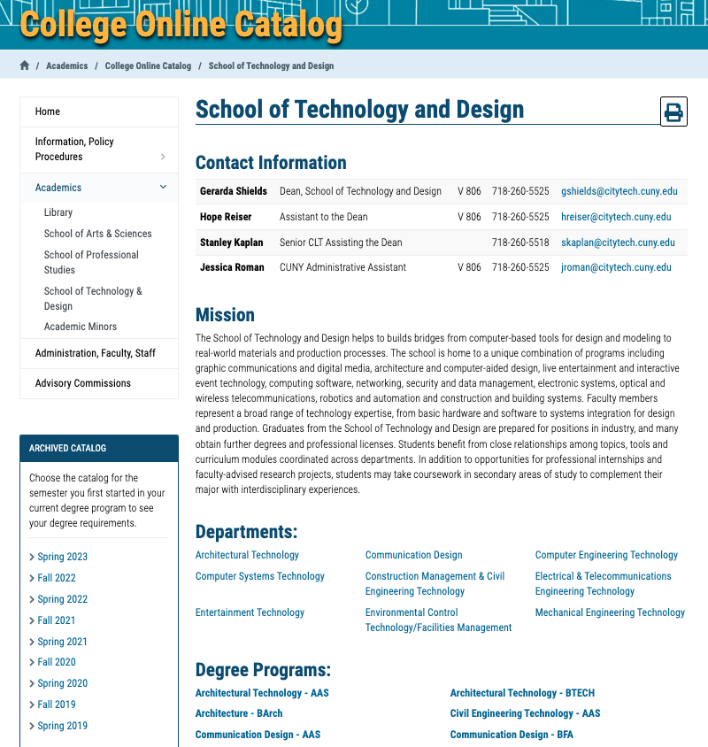

Slide 22
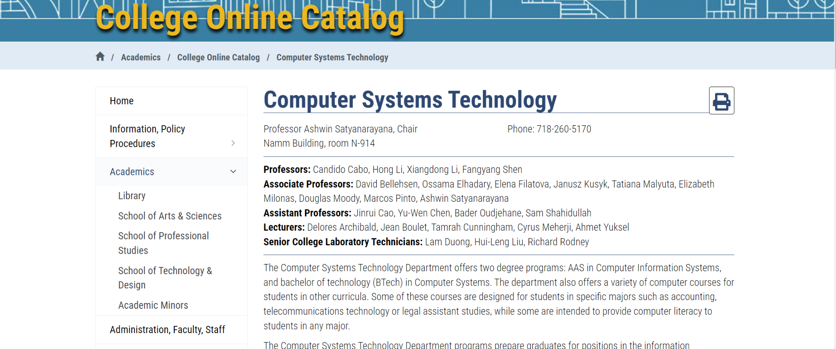
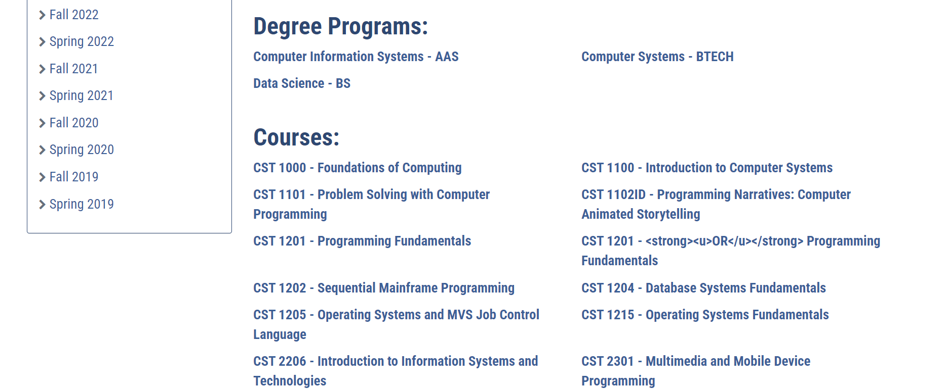

Slide 23
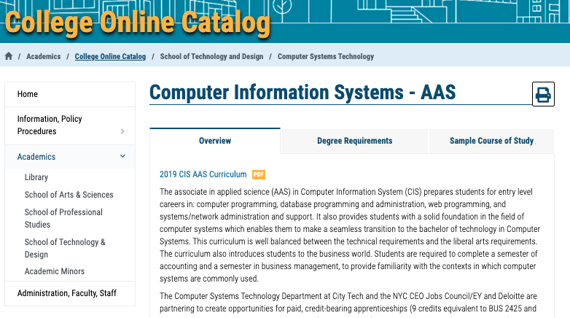

Slide 24
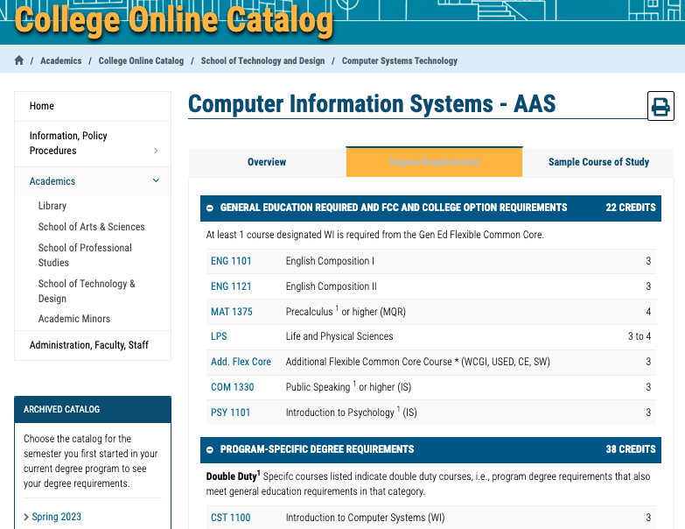

Slide 25
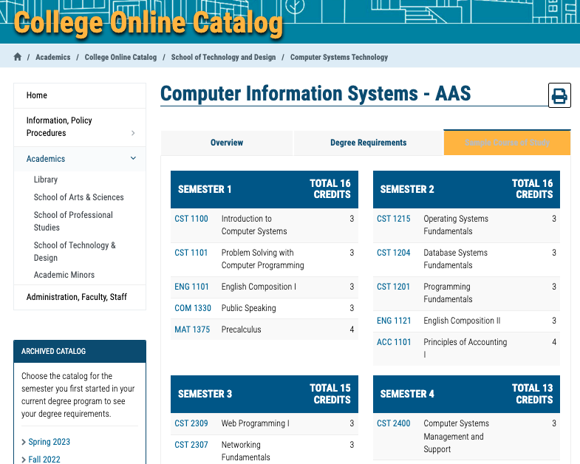

Slide 26
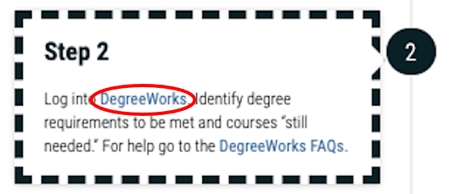

Slide 27
DegreeWorks
Degree Audit

Slide 29
https://www.citytech.cuny.edu/registrar/docs/Student_Guides/How_to_Read_your_DegreeWorks_Presentation.pdf

Slide 30
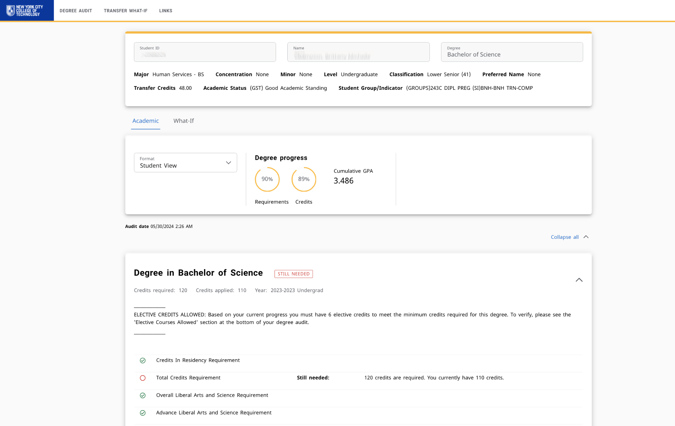

Slide 31
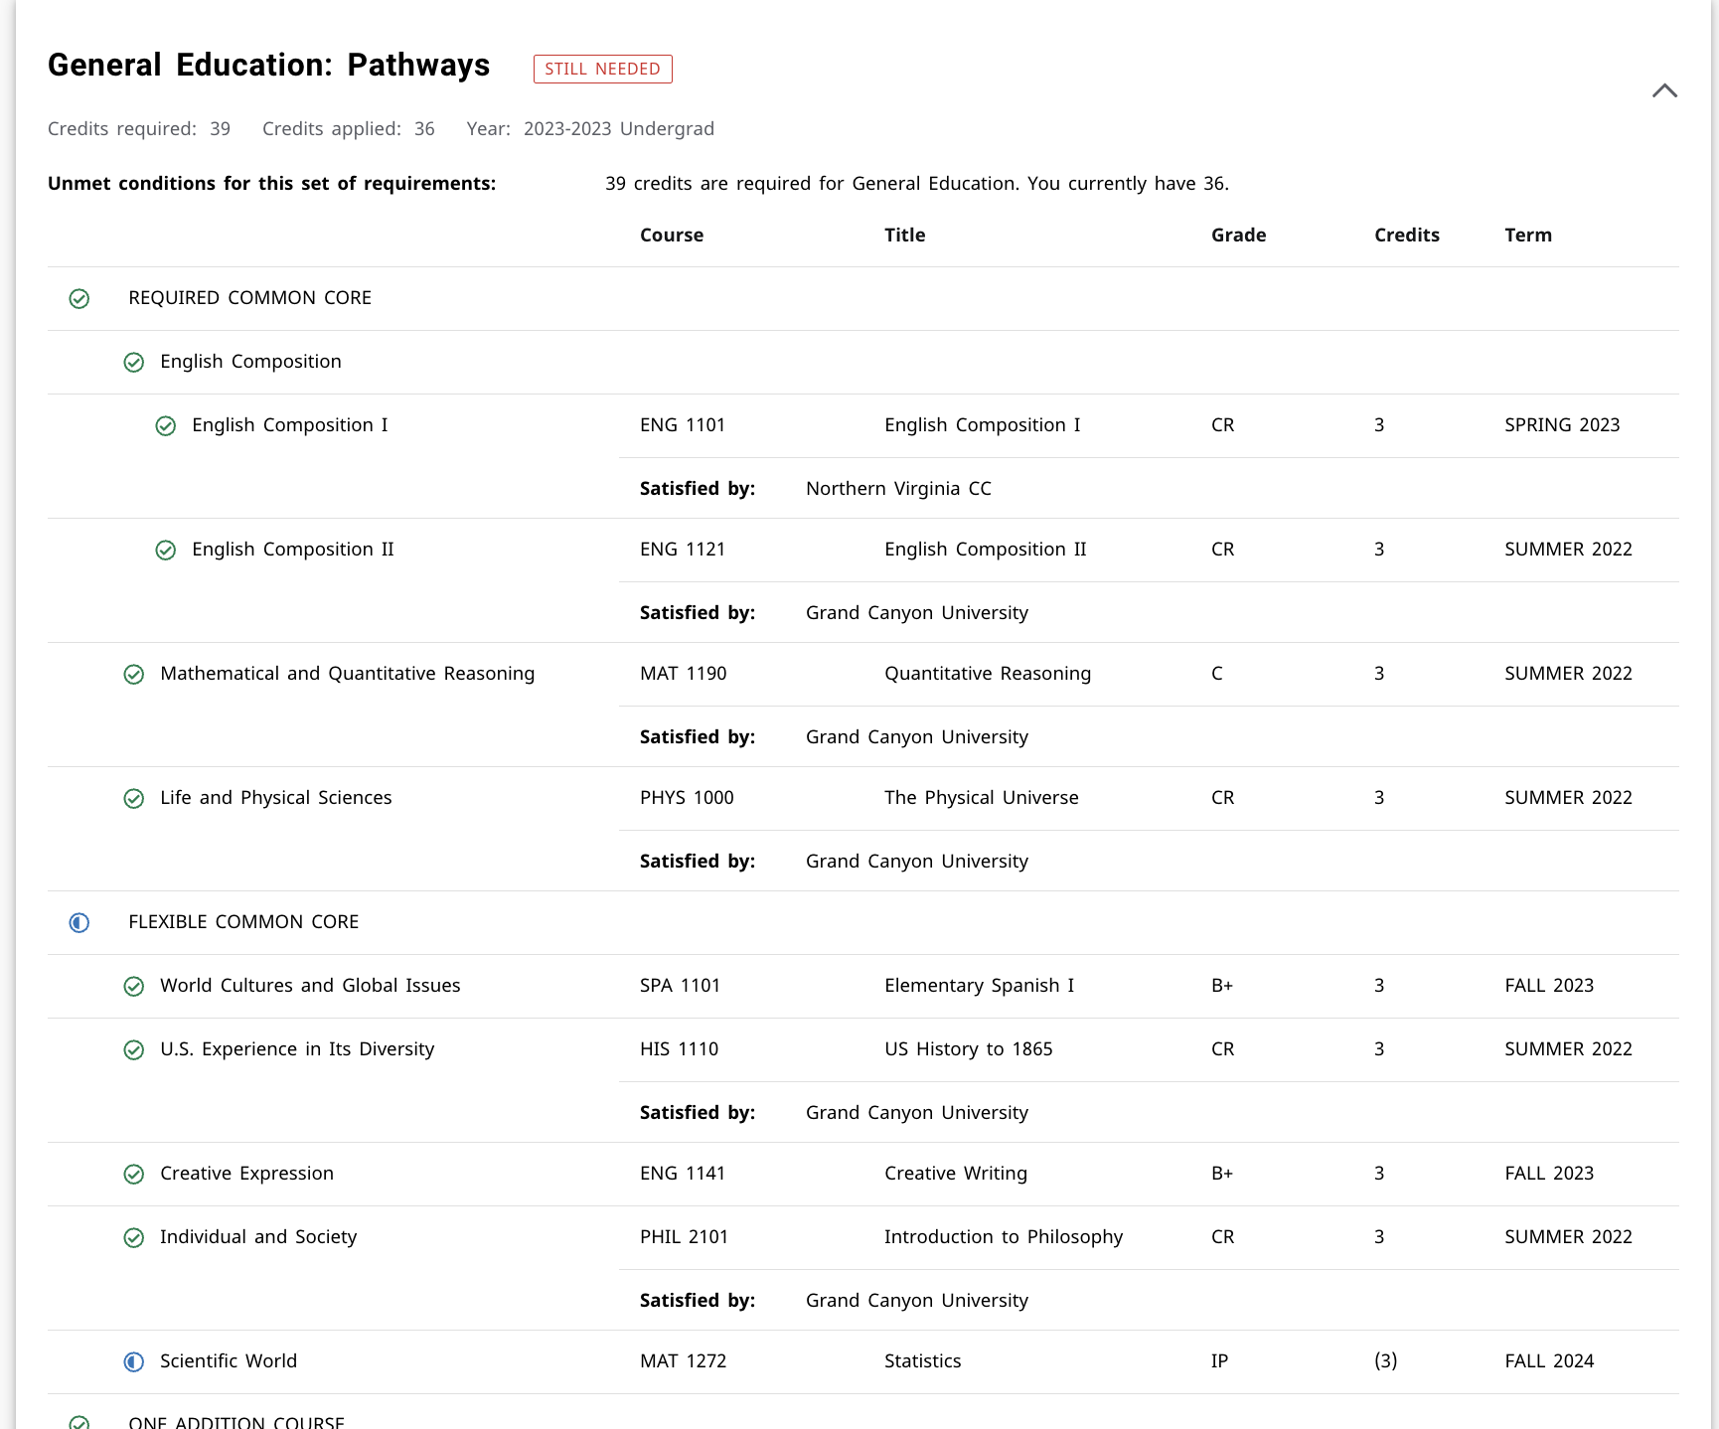

Slide 32
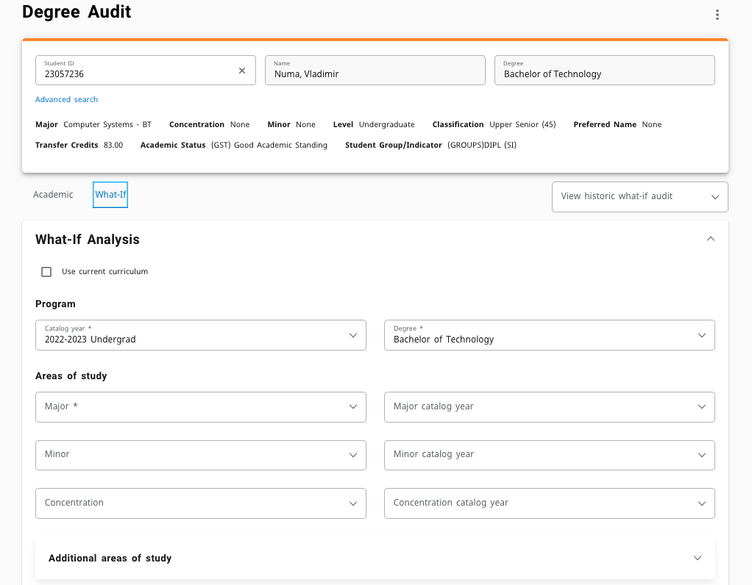

Slide 33
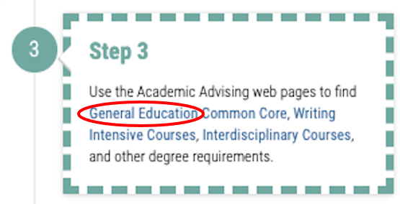

Slide 34
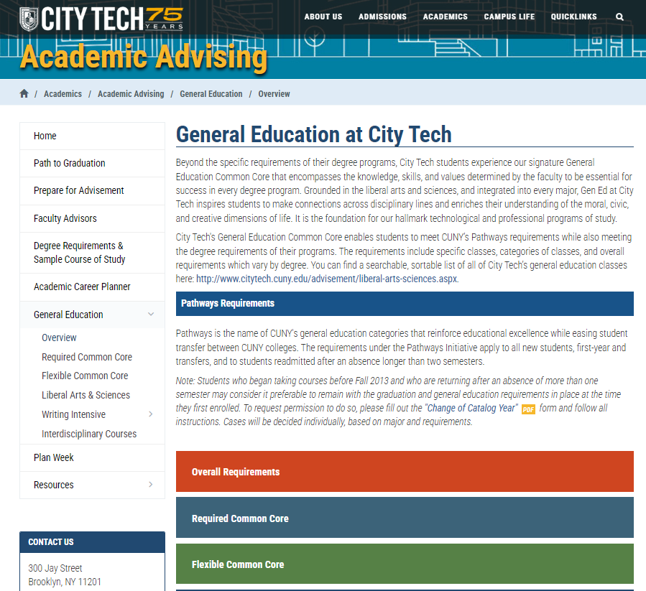
General Education
Writing Intensive
Interdisciplinary
College Requirements
http://www.citytech.cuny.edu/advisement/gen-ed.aspx

Slide 35
Schedule
Builder
https://www.citytech.cuny.edu/registrar/docs/Student_Guides/How_to_Use_Schedule_Builder_Presentation.pdf

Slide 36
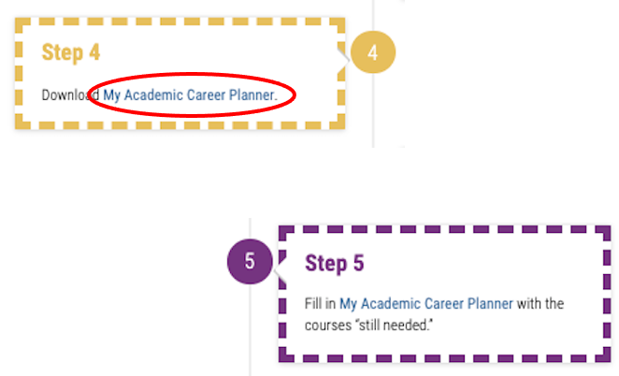

Slide 37
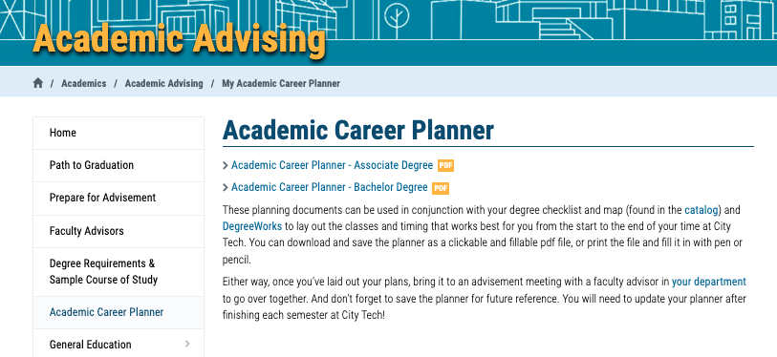
http://www.citytech.cuny.edu/advisement/planner.aspx

Slide 38
My Academic Career Planner

Slide 39
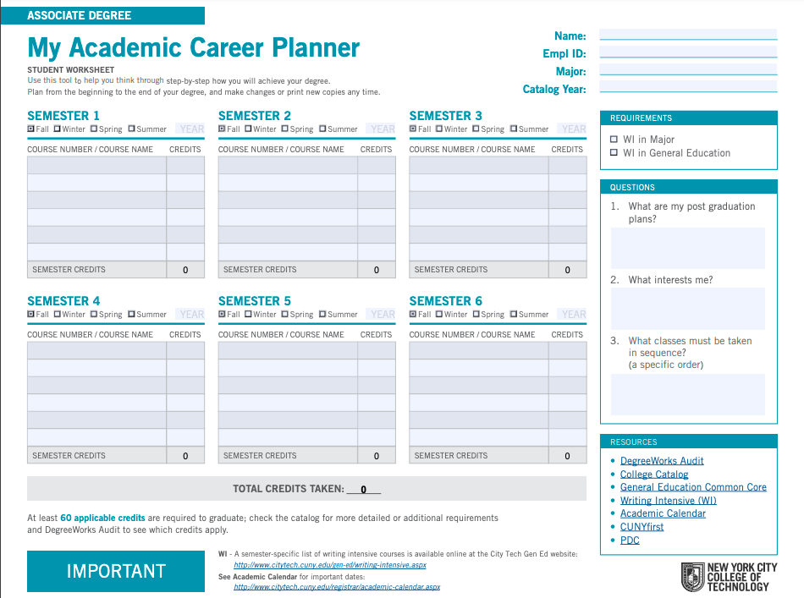
My Academic Career Planner
Download the PDF
(do not complete it on the web; you will lose all your work)
What else will you need?

Slide 40
My Academic Career Planner Review
First fill out your current course enrollment.
Complete the next three semesters of the My Academic Career Planner using the sample course of study as a guide.
Consider which Gen Ed courses you will consider to fulfill the required categories.

Slide 41
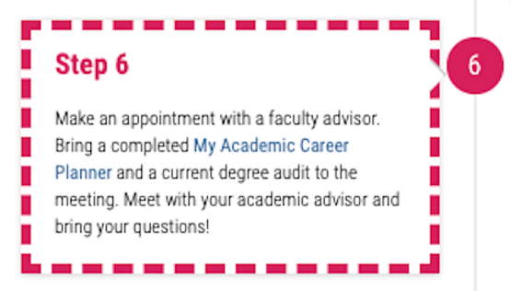

Slide 42
Academic Advisors

Slide 43
Who is your
Academic Advisor?
https://www.citytech.cuny.edu/advisement/virtual-advisors.aspx
Notes:
4 minutes
Share this link with students: https://www.citytech.cuny.edu/advisement/virtual-advisors.aspx
They will need to know the department/degree
It leads to the Academic Advising page and all departments will have something posted. Note, there is no consistency in the listing of the department’s information.

Slide 44
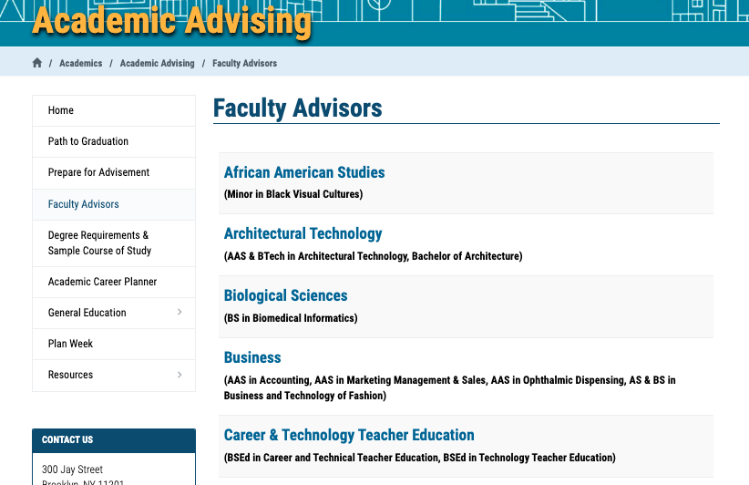

Slide 45
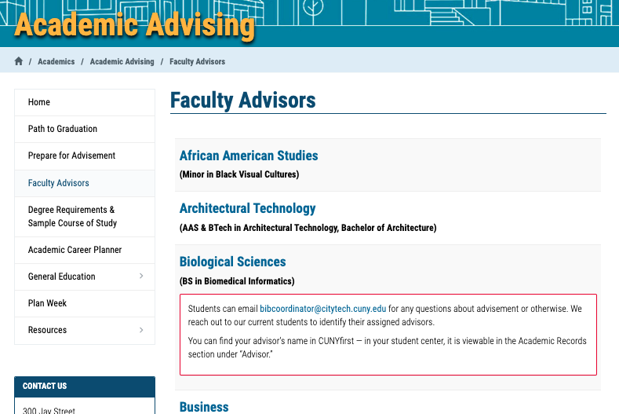

Slide 46
You found your Academic Advisor
Name
Emplid
Email
Phone number
Reason for advising appointment
What do you do now?
Notes:
I asked the PMs to talk about this slide
Remind students to use the city tech email address.

Slide 47
If you are in:
ASAP/ACE
SEEK
CUNY Edge
Crear Futuros (??)
ST else?
You have an advisor assigned to you through those programs!

Slide 48
Part B: Looking Back and Looking Forward
Review College Vocabulary and Make a Plan for What Comes Next

Slide 49
Vocabulary Review

Slide 50
Academic Alert
Academic Calendar
Academic Dismissal
Academic Integrity
Academic Probation
Admissions Criteria
Advisement
Advisor
Alumnus/Alumna/Alum
Appeal (grade, dismissal, loss of fin. aid)
Associate Degree
Attempted Hours or Credits
Baccalaureate Degree
Bursar’s Office
Catalog
Certification/Licensing
Clinical
Club/Activity Hours
Co-Curricular
Corequisites
Credits
Credit Hours
Department
Credit/No Credit Policy
Curriculum
Dean
Department Chairperson/Chair
Earned hours or credits
Electives
Empl ID
Feedback
Financial Aid
Full Time
General Education/Gen Ed/Common Core
Good Academic Standing/ Satisfactory academic progress
Grade Point Average (GPA)
Graduation Honors
Hold
Honors
Interdisciplinary
Lab
Learning Center
Leave of Absence
Major
Part Time
Pathways
Prerequisites
Provost
Record
Registration
Requirement
School
Semester
Sequential
Service Indicator
SPARC
Syllabus
To-Do List (CUNYFirst)
Transcript
Transfer Student
Welcome Center/HelpDesk
Withdrawal/W/WN/WU Grades
Writing Intensive

Slide 51
Setting Goals

Slide 52
Setting Goals
Why is it important to set goals for yourself?

Slide 53
Setting Goals
Short-term Goals vs. Long-term Goals
SMART Goals
Specific
Measurable
Achievable
Relevant
Time-bound

Slide 54
Which of these goals are specific, measurable, and achievable? Which are not?
I will take time to look up grammar rules
I will get better at math
I will visit the writing center five times this semester
I will study twenty hours per week
I will improve my writing skills
I will raise my hand in class once a week
I will study fifty hours per week
I will get get an A+ in Trigonometry
I will put my phone away at the start of class.

Slide 55
Which of these goals are specific, measurable, and achievable? Which are not?
I will take time to look up grammar rules
I will get better at math
I will visit the writing center five times this semester
I will study twenty hours per week
I will improve my writing skills
I will raise my hand in class once a week
I will study fifty hours per week
I will get get an A+ in Trigonometry
I will put my phone away at the start of class.

Slide 56
Action Plan for the Semester

Slide 57
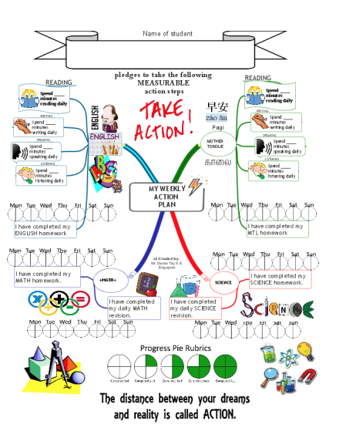
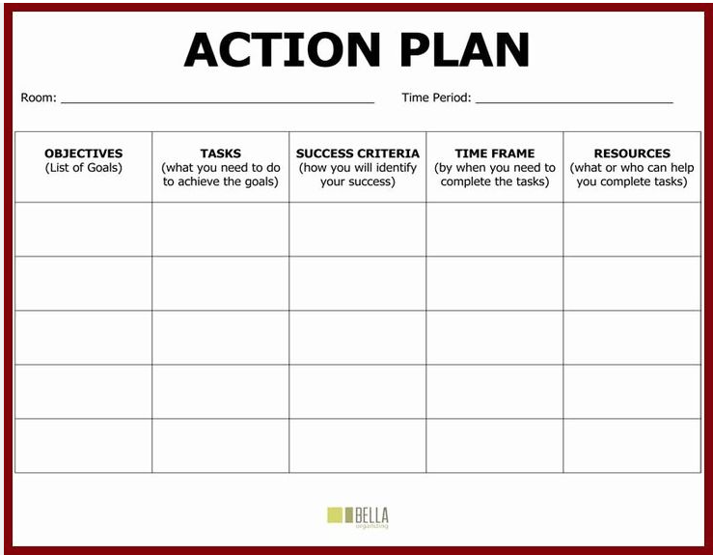
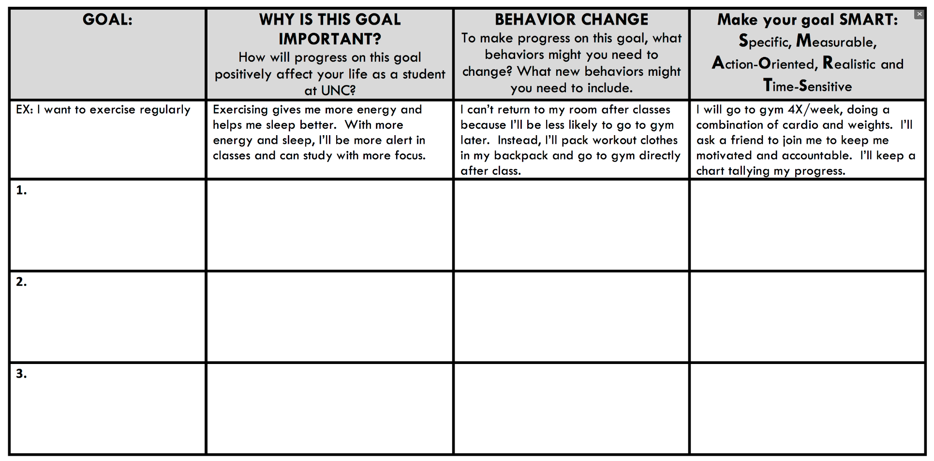
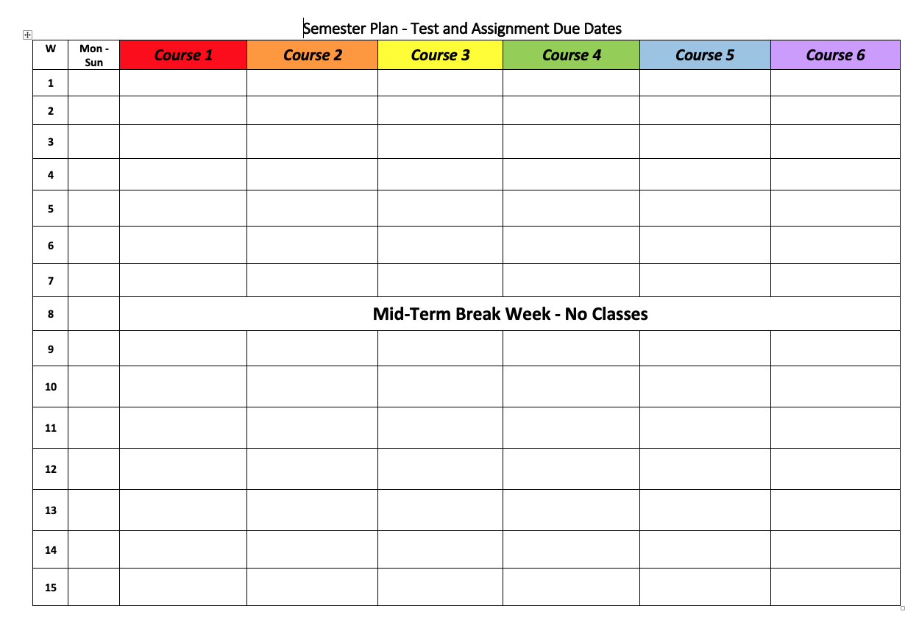
Creating an Action Plan
What does an Action Plan look like?
There is no one correct way to make an Action Plan
They can look like calendars, lists, charts, maps…the possibilities are endless!
Pick what makes the most sense to you

Slide 58
Creating an Action Plan
What should you include?
SMART Goals
Practical Scheduling
Means to achieve your goals
Concepts you have learned in CT101
Notes:
Sample action plan templates can be found here and here

Slide 59
Creating an Action Plan
What do you need to prepare before the first day of the semester?
What do you want to accomplish by the end of week one? Week two? Week eight? Week fourteen?
How will you manage your energy and time to accomplish these goals?
How will you motivate yourself?
How will you assess your progress during the semester?
How will you evaluate your Action Plan throughout the semester?
What will you do when parts of your plan are not working as you hoped?
How will you get support when you need it?
What will get you over the finish line?

Slide 60
Recap
Part A:
Registration: Commitments and Responsibilities
University Structure
Your Major Matters
Academic Advisement vs. Registration
Preparing for Advisement
DegreeWorks Degree Audit
My Academic Career Planner
Academic Advisors
Part B:
Vocabulary Review/Activity
Setting Effective Goals
Create an Action Plan

Slide 61
You have TWO things left to do!
Complete Post-Workshop Survey
https://forms.gle/o9pkfkjH7zFn184D6
2) Complete Reflection #4:
Research has shown that first-semester students often worry about their transition to college, yet eventually they become comfortable and find a community of people with whom they are close and feel they belong. Share your own story of preparing to be a college student. *
* This reflection is inspired by the “Our Stories” project.

Slide 62
SESSION FOUR:
#aMAJORdecision
+
Looking Back and Looking Forward
Session 4
July 18th, 2024
Professor Christopher Tarbell
City Tech 101 by Karen Goodlad and Sarah Paruolo is licensed under a Creative Commons Attribution-NonCommercial-ShareAlike 4.0 International License.

Slide 63
City Tech 101
Congratulations!
Summer Session 1
Christopher Tarbell
christopher.tarbell22@citytech.cuny.edu
City Tech 101 by Karen Goodlad and Sarah Paruolo is licensed under a Creative Commons Attribution-NonCommercial-ShareAlike 4.0 International License.

Slide 64
Hello, Future Me
OPTIONAL ACTIVITY: insert after slide 54 (delete current slides 55-57)

Slide 65
Activity: Hello, Future Me
OPTIONAL ACTIVITY: insert after previous slide
Write yourself a note planning for your success next semester.
What is your success plan for next semester?
Consider how you will use the strategies explored during the CT101 workshop.
Which strategies and concepts will be most effective for you during your second semester as a college student?
What do you want to get out of your next semester at City Tech?
When you are finished, address the envelope to yourself and return to the professor. Your letter will be mailed to you at the beginning of the next semester.
Notes:
If you do this activity, please get letterhead and City Tech envelopes in advance from Iman in the FYP office. Make sure to give students a tutorial on how to address an envelope! Most students do not know how to do this.

