Slide 1
City Tech 101
Welcome!
Summer Session 1
Christopher Tarbell
christopher.tarbell22@citytech.cuny.edu
City Tech 101 by Karen Goodlad and Sarah Paruolo is licensed under a Creative Commons Attribution-NonCommercial-ShareAlike 4.0 International License.

Slide 2
SESSION ONE:
Academic Basics
+
Classroom Expectations
Summer Session 1
July 15th, 2024
Professor Christopher Tarbell
City Tech 101 by Karen Goodlad and Sarah Paruolo is licensed under a Creative Commons Attribution-NonCommercial-ShareAlike 4.0 International License.

Slide 3
Today’s Topics
Part A
Introductions
CT101 Schedule Review
Learning Tools
Instructional Modalities
Part B
Where College Happens, pt 1
Learning Etiquette + Engagement
Contents of a Syllabus
Duties + Responsibilities of a Student/Professor

Slide 4
Part A: Academic Basics
#WelcometoCityTech

Slide 5
Introductions

Slide 6
Connect with your Professor
Prof. Name and Email
(For example, my name is Prof. Tarbell, my e-mail is christopher.tarbell22@citytech.cuny.edu)
Notes:
Personalize this slide with your name and City Tech email address

Slide 7
What is a Peer Mentor?
Notes:
Please give your peer mentors time to introduce themselves–their names, years, majors, any other relevant info.

Slide 8
What is a Peer Mentor?
Peer Mentors are role models who are eager to share their experiences and knowledge to help incoming City Tech students adjust to college life.
Attend CT101 with you every day
Answer questions via email + office hours
Notes:
Please give your peer mentors time to introduce themselves–their names, years, majors, any other relevant info.

Slide 9
Connect with your
Peer Mentor
Nazia Mahmud
Nazia.Mahmud@mail.citytech.cuny.edu
Sindy Ariza
Sindy.Ariza@mail.citytech.cuny.edu
Notes:
Personalize this slide with your peer mentor names and CT email addresses.

Slide 10
Ice Breaker Activity
Notes:
Feel free to use any of the icebreaker activities from the CT101 faculty handbook, or use one of your own choosing.

Slide 11
What will we do during the four sessions?
This workshop focuses on helping new students transition to college life, and specifically to City Tech. The workshop will enhance the new student experience with information, activities, and various opportunities to connect with faculty, staff, and current City Tech students. In addition to learning how to access a variety of college services and resources, students will develop personalized plans for their college career.

Slide 12
Syllabus + Schedule Review (4-Session)
Session 1 > Monday July 15th 9:30 AM-12:30 PM
PART A: Academic Basics: #WelcomeToCityTech
PART B: Classroom Expectations: The Syllabus and
More
Session 2> Tuesday July 16th 9:30 AM-12:30 PM
PART A: Studying and Scheduling: #RiseAndGrind
PART B: Get Your Head in the Game: Mindset
Session 3> Wednesday July 17th 9:30 AM-12:30 PM
PART A: You Paid For It; Use It: Resources + Services
PART B: #YellowJacketLife: The Buzz on Getting
Involved
Session 4> Thursday July 18th 9:30 AM-12:30 PM
PART A: Advisement and Registration:
#aMAJORdecision
PART B: Looking Back and Looking Forward

Slide 13
Have you completed the pre-workshop survey?
To get credit for successful completion of this workshop, you must complete it by today!
Notes:
Give students a few minutes to find and complete the survey if they haven’t done it

Slide 14
Learning Tools

Slide 15
Electronic Platforms Used at City Tech
Administrative Apps
CUNYFirst
Schedule Builder
DegreeWorks
General College Activities
Campus Wifi
City Tech Email (Outlook)
Microsoft Office
OneDrive (Microsoft)
DropBox
In the Classroom
Brightspace
Zoom
OpenLab
Which of these are you familiar with?

Slide 16
How to Access Campus Computers
Navigate to: https://forgot.citytech.cuny.edu
Enter username. Username: Firstname.Lastname
Enter default password.
(For New Users Only) First name initial UPPERCASE, last name initial lowercase, your Date of Birth (MMDDYYYY), followed by the last four digits of your CUNYfirst EMPL ID. Default Password: JdMMDDYYYY9367
(Current Users): password you set up for your Active Directory account
Select four Security Questions and Provide Answers, click Save Answers. • The answers are not case sensitive. • Answers must be more than four characters.
Answer both Helpdesk Security Questions, click Save Answers.
Enter and confirm your new password, click Change Password.
Notes:
Students will not be accessing campus computers at any time during the CT101 Workshop, so no need to go through this in detail. Please just let students know that there is a special sign-in process the first time they use a computer on campus, and that the instructions are here. (and please make sure you post these slides on OpenLab as a pdf so students can access this info later!)

Slide 17
How to Access Campus Wifi on a
Personal Device
Connect your device to CityTech-WiFi network.
Open a browser, enter: http://ecsa.citytech.cuny.edu
Click on “Faculty, Staff and Students.”
Enter username: Firstname.Lastname
Enter password: City Tech Active Directory (AD) password.
Click Continue and wait for the progress bar to complete your network connection.
Notes:
Please give students a few minutes to go through the steps on this slide and the next one in order to connect to campus wifi.

Slide 18
How to Access Campus Wifi on a
Personal Device (alternate option/continued)
Download the free “geteduroam” app onto your device
Search for the institution “City University of New York,” then click “next.”
Login using your CUNYFirst credentials

Slide 19
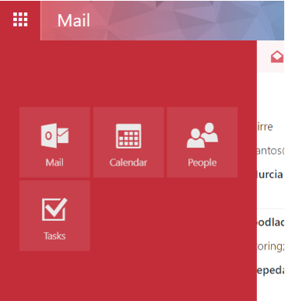
City Tech Email (Outlook)
Email
Calendar
Teams
Tasks

Slide 20
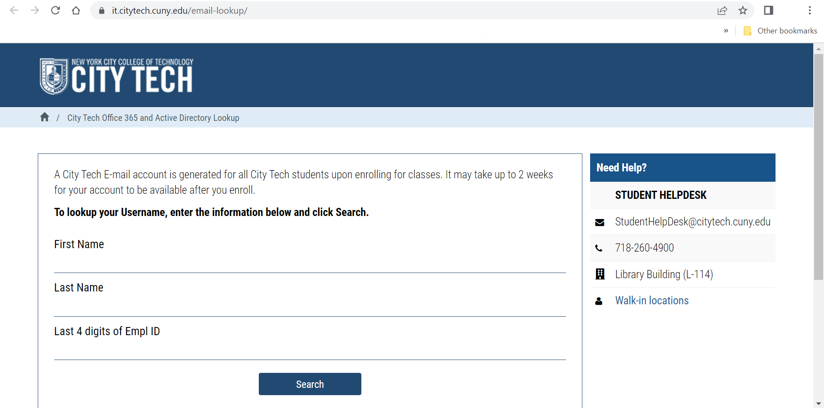
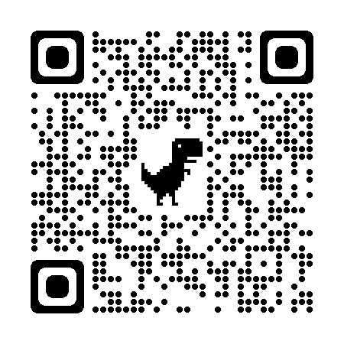
City Tech Email (Outlook)
Have you activated your email?
Notes:
http://cis.citytech.cuny.edu/Student/it_student_findemail.aspx

Slide 21
Activating Your City Tech Email (Outlook)
Visit Email Address Look Up to find your email. (https://cis.citytech.cuny.edu/Student/it_student_findemail.aspx)
Go to the Microsoft Office 365 email login at https://myapps.microsoft.com/
Log in using the following:
YourPassword: First initial of first name UPPERCASE + first initial of last name lowercase + MMDDYYYY + last 4 of your EMPL ID.
For example: If your name is John Doe and your date of birth is 01/06/1986 and the last four digits of your EMPL ID are 1234, your password is: Jd010619861234
You will be asked a number of security questions. If prompted to create a new password, do so, but make sure to write it down!
You will also need to complete your e-mail security verification, which will enable you to reset your password if you forget it. To do this:
Open a new tab in your browser and type https://myapps.microsoft.com in the address line.
Click Verify Now.
Set up authentication for cellphone and email and verify them. Set up security questions and answers. Click Finish.
Click the Outlook icon to access your email.
Notes:
Please give students time to activate their email accounts if they have not already done so. The peer mentors can help any students who need support. Please make sure students understand that their City Tech login is NOT the same as their email address!

Slide 22
Log in. What is the most recent message you have received?
Have you received emails from any of your professors?
What can you do in Outlook besides email?

Slide 23
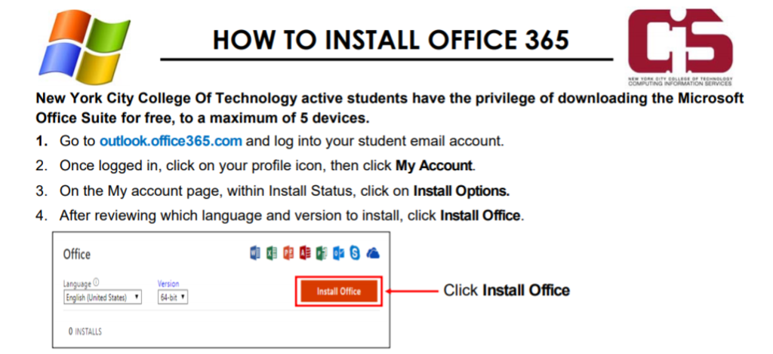
Students have access to Microsoft Word, Excel, Powerpoint, and
One Drive (cloud storage)!
Notes:
You should mention this option, but you do not need to give students time to do this in class, unless you find time at the end or in another session.

Slide 24
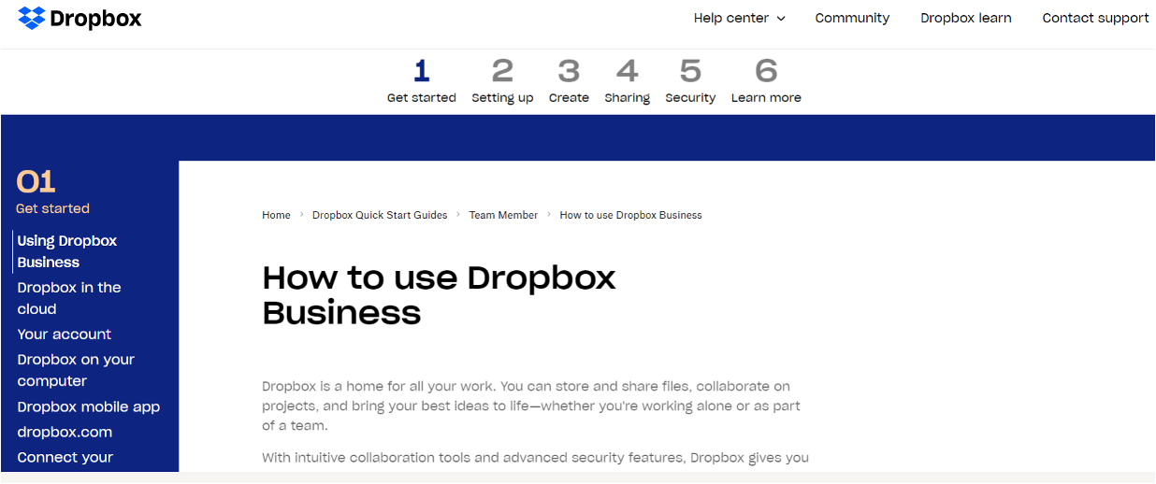
Some professors use DropBox for course materials and collecting student work.
Notes:
https://help.dropbox.com/guide/team/how-to-use-dropbox#how-to-use-dropbox-business

Slide 25

Brightspace is a Learning Management System– this is where many of your courses live online. Professors will use Brightspace to post syllabi, schedules, assignments, homework, quizzes, grades, etc.
For online synchronous classes, your professor may embed the Zoom link for the class in Brightspace.

Slide 26
Log in to Brightspace…
What features do you notice?
Are any of your classes available yet?
Have any professors posted a welcome message or other info?

Slide 27
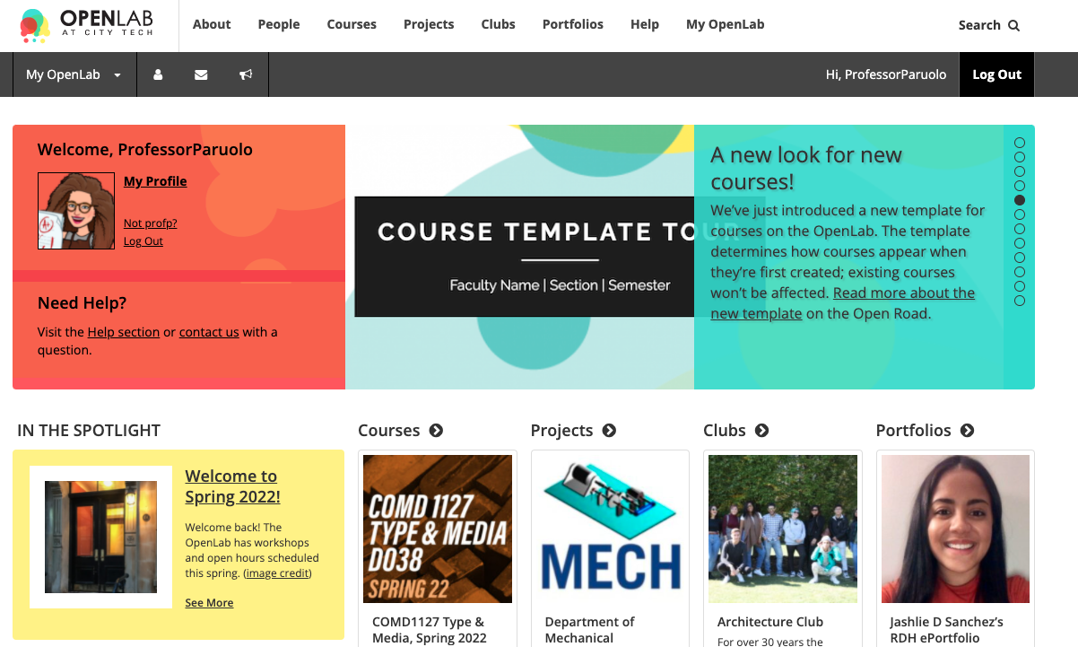
OpenLab (OL) is similar to Brightspace– this is a place where your courses live online. Some professors may use it in the same way as Brightspace. OL also has projects, clubs, and portfolios, which you will not find on Brightspace.
Notes:
https://openlab.citytech.cuny.edu/

Slide 28
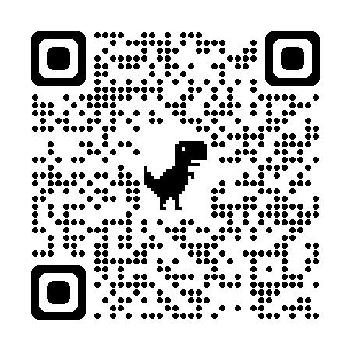
We will be using OpenLab as the classroom management tool for our CT101 Workshop.
Please take a moment now to go to openlab.citytech.cuny.edu to set up your account and join this course!
[City Tech 101 Summer Professor Tarbell]
Notes:
Add your OpenLab course name to the slide so students can more easily search for the site. If you have time, students can create their accounts and join your course during class. If not, give students time after class to get help with technology.

Slide 29

Students may use Zoom to attend online or hybrid classes, meet with professors, attend school events, and more.
Notes:
Again, no need to give students time to do this in class. Just make sure they know that the link to the instructions is embedded in these slides. https://it.citytech.cuny.edu//docs/Login_CUNY_Zoom.pdf

Slide 30
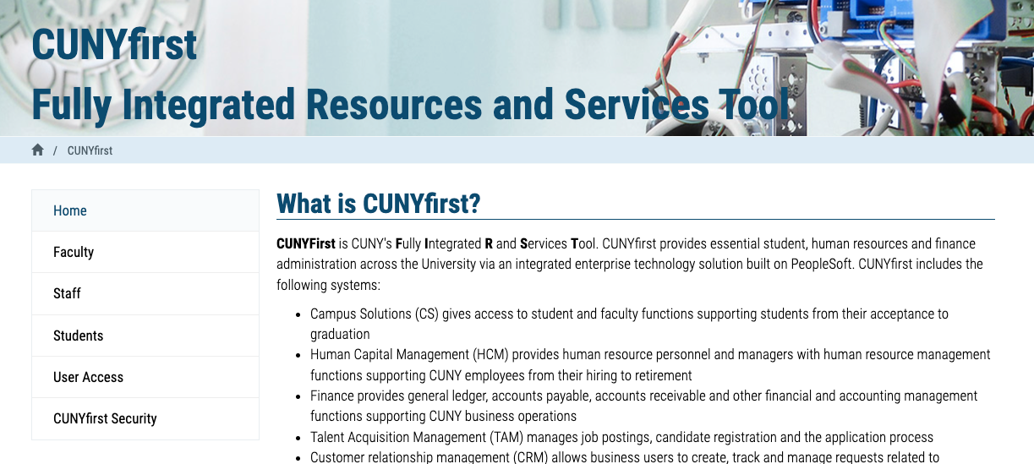
Students use CUNYfirst for management of almost all personal records.
Notes:
Many students have already accessed CUNYFirst when they come to CT101. If any students have not, you can ask the peer mentors to make sure they can do so. https://home.cunyfirst.cuny.edu/oam/Portal_Login1.html

Slide 31
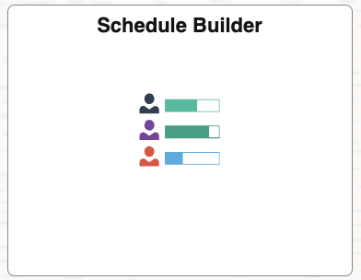
Schedule Builder is a tool you can find within CUNYFirst. You can use it to help register for classes.
Notes:
Again, you do not need to give students time to look at Schedule Builder–they will have time to navigate it during the session on advisement and registration. Just mention that it is a part of CUNYFirst, and let them know they will look at it soon.

Slide 32
Schedule Builder is a planning tool that can contain draft versions of your schedule.
Do NOT use Schedule Builder to look up your schedule for the upcoming semester! Instead, use the “Course Planning and Enrollment” tile in CUNY First.
Notes:
Please MAKE SURE STUDENTS DO NOT USE SCHEDULEBUILDER TO CHECK THEIR FALL SCHEDULES. Schedulebuilder can contain tentative schedule options that are not part of their official schedule. They should use the “Academic Records” tile to find their schedule.”

Slide 33
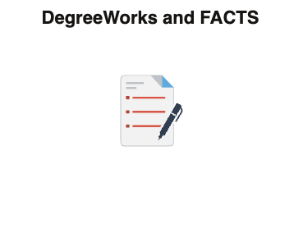
DegreeWorks can also be found within CUNYFirst. Use it to track academic progress and degree requirements.
Notes:
Treat DegreeWorks the same as Schedule Builder–a quick mention is enough. Students will get to know ScheduleBuilder and DegreeWorks in Session 4.

Slide 34
Instructional Modalities
Notes:
Using the following slides, help students to decode the information on their schedules. Make sure they are clear on the differences between in-person, hybrid, and synchronous/asynchronous classes.

Slide 35
Instructional Modalities at City Tech
In person
Online
  Synchronous
  Asynchronous
Hybrid
  Synchronous
  Asynchronous

Slide 36
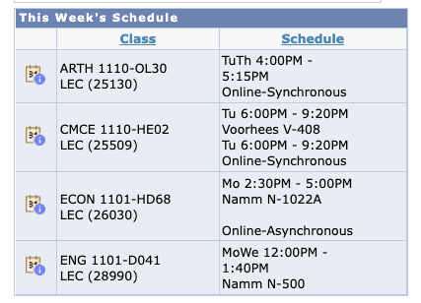
Modalities
Which class is fully in person?
Which class is Online, Synchronous?
Which class is Online, Asynchronous?
Which class is Hybrid?

Slide 37
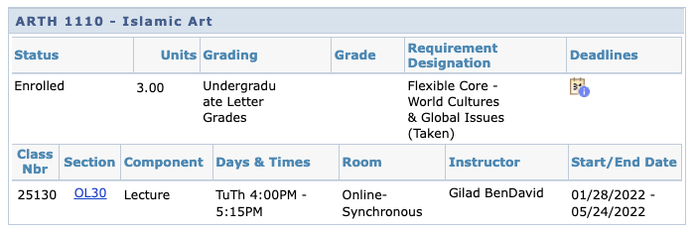
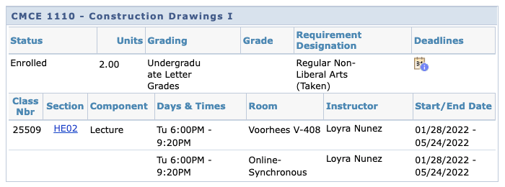

Slide 38
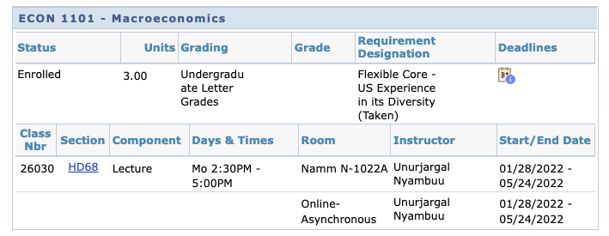
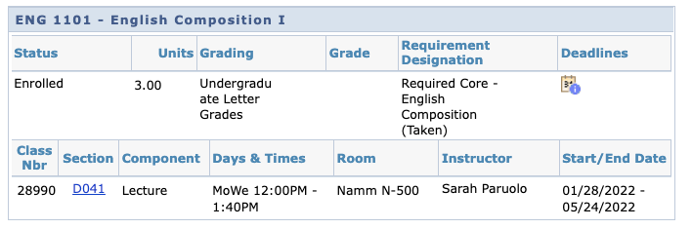

Slide 39
Schedule Issues?
Need help logging onto any apps?
Stay at the end of the session today for help.

Slide 40
Part B: Classroom Expectations
The Syllabus and More

Slide 41
Where does
college happen?
Notes:
We want students to understand that college isn’t just going to class and leaving. Getting a full college experience means that learning and growth happen in many different spaces and in different ways. Variations on these slides will appear in each of the next several units.

Slide 42

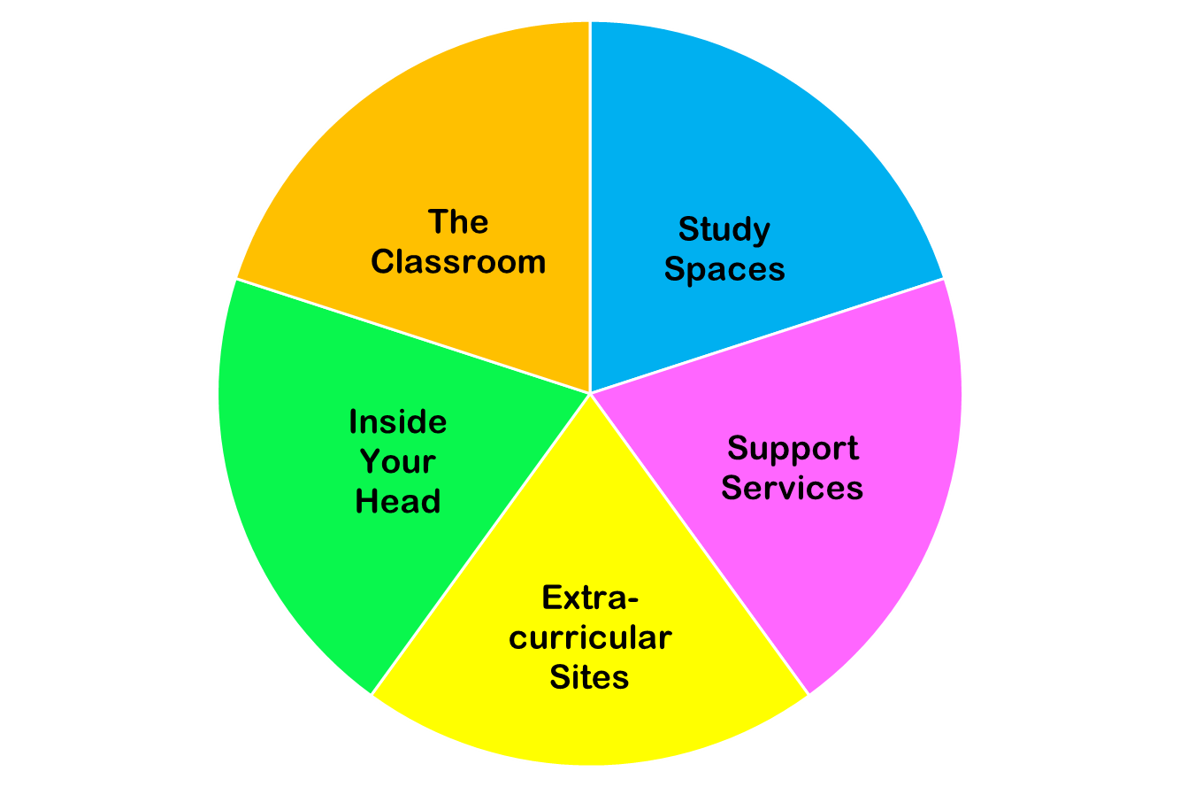
College happens in lots of places
These
are all necessary parts of college!
Notes:
You do NOT need to discuss each piece of this pie in detail. Just point out the “pie wedge” for the current session and let students know that we will go over each of these pieces in subsequent sessions.

Slide 43
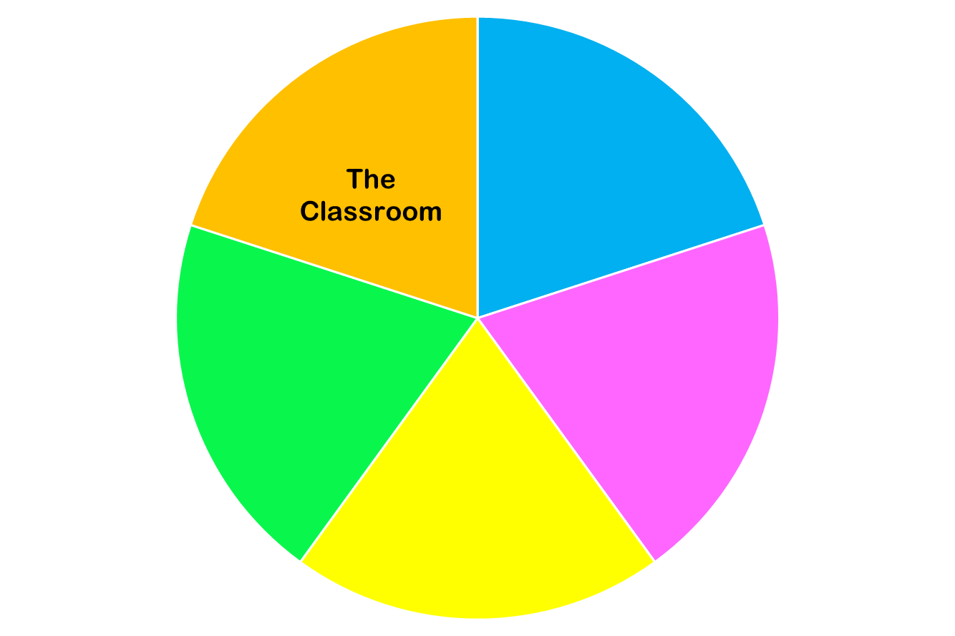
Now we are focused on…

Slide 44
Learning Etiquette + Engagement
Notes:
Use this section as a way to introduce the cooperative role students and teachers play in the classroom. Student may consider how not living up to their end of the social contract of the classroom might disrupt their learning and the learning of those around them.

Slide 45
Classroom Learning:
The Necessities of Etiquette
Arrive on time
Leave the classroom only for emergencies
Pay attention
Be prepared to participate
Take notes (have a pen and paper at all times)
Headphones off/out!
Phones on silent and put away
Communicate with your teacher if you need to break these rules regularly.
Notes:
Please make it clear to students that these are basic, non-negotiable rules of classroom etiquette, not optional behaviors. Breaking these rules breaks the social contract of classroom behavior.

Slide 46
Classroom Learning:
The “Good-to-Haves” of Engagement
Asking and answering questions
Addressing your professors
Active learning doesn’t always mean speaking up
Choose your seat wisely
Notes:
Emphasize to students that these behaviors, while not required, will go a long way to fostering goodwill and a supportive relationship with the professor.

Slide 47
Online Learning: Etiquette + Engagement
Everything from Classroom Learning plus…
Does your Professor require you have your camera on? This should be discussed with you on the first day. It will also be written in the syllabus.
Mute your microphone, not your voice!
Chat to stay connected throughout class.
Breakout Rooms–be active and participate
Notes:
This is a good opportunity to highlight to students that online learning requires levels of motivation, discipline, and ability to focus beyond those required for classroom learning. ALSO: be sure to inform students that profs. May now require them to keep their cameras on during synchronous online sessions. Students

Slide 48
Contents of a Syllabus

Slide 49
Why is a syllabus so important?
Notes:
Take a minute to ask students to define/describe a syllabus. Can anyone answer these questions?

Slide 50
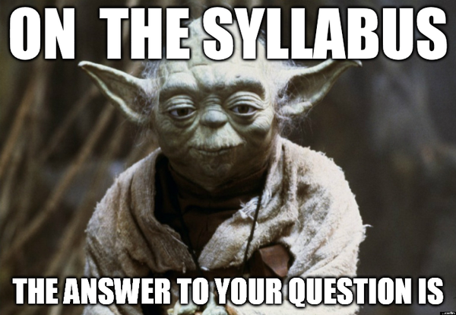

Slide 51
The syllabus is an informal contract between a student and a professor.
Lays out requirements and expectations for the student
Lays out commitments and standards for the teacher
Notes:
Remind students that this works both ways–they are responsible for upholding the standards laid out in the syllabus, and so are instructors.

Slide 52
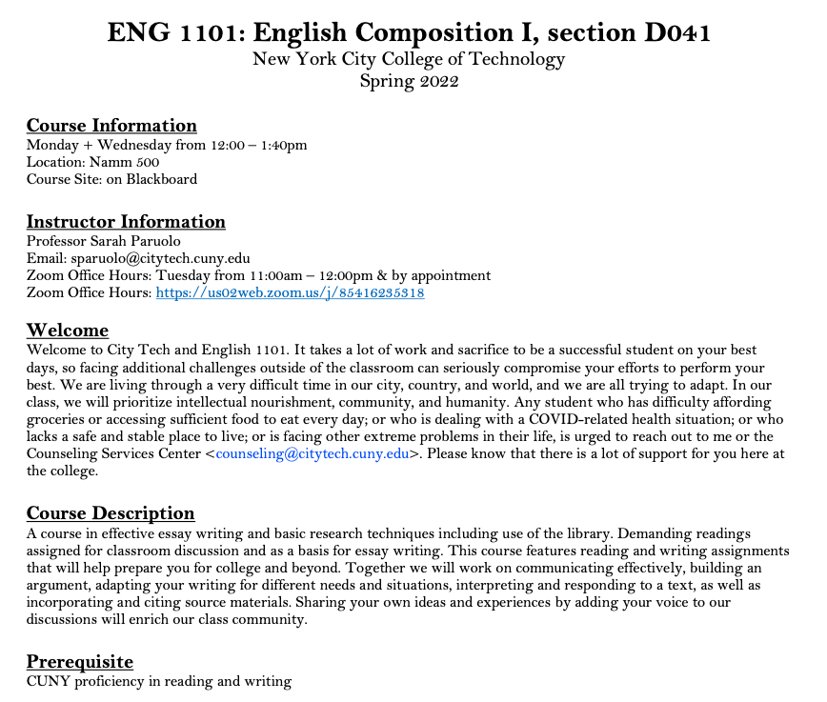
Department Abbreviation
Course Number
Course Name
Course Meeting Information
Course Site Information
Instructor Contact Information
Office Hours Information
Course Description
Pre/Co- Requisites
Notes:
These images of a syllabus on slides 52-56 are there as a sample. Please use these ONLY if you cannot, for some reason, give students access to electronic or hard copies of sample syllabi. Please do not go through the information on the slides in great detail. If you need to use these slides, you can highlight a few parts and also give students a chance to study selected images and talk about the details or features that they notice.

Slide 53
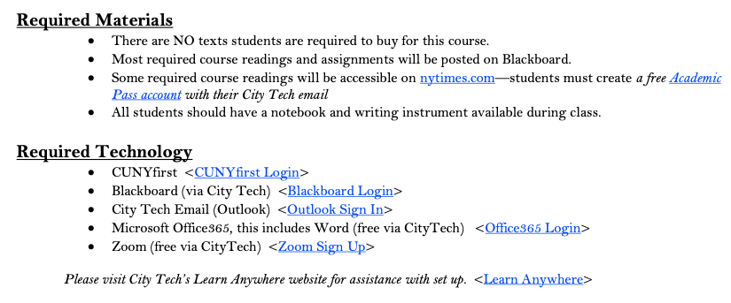
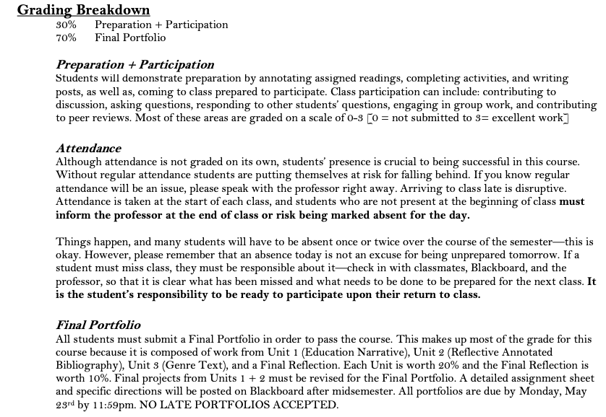
Required Texts
Required Materials
Required Technology
Grading Breakdown
Course Assignment Descriptions

Slide 54
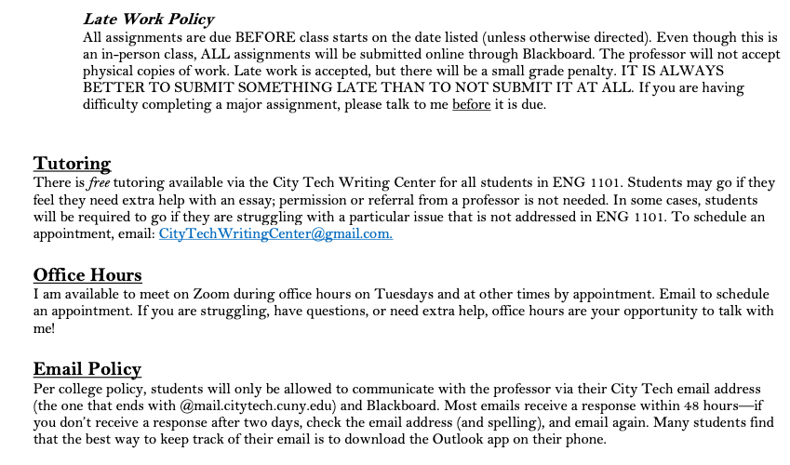
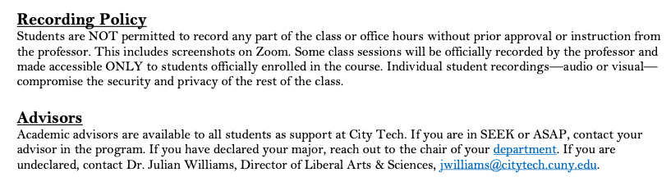
Course Policies

Slide 55
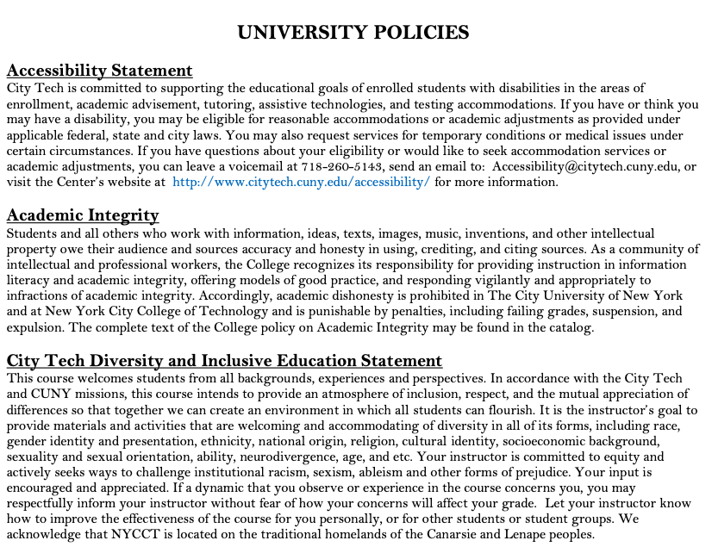
Accessibility Statement
Academic Integrity Statement
Diversity and Inclusive Education Statement

Slide 56
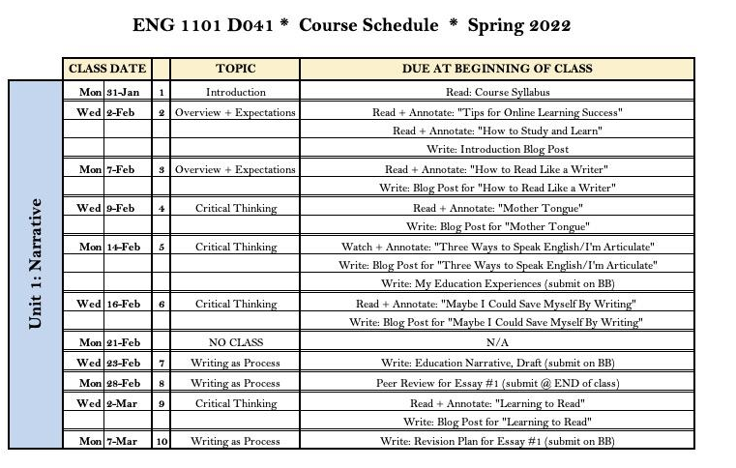

Slide 57
Sample Syllabi
Biology 1101 Syllabus
Hospitality 1101 Syllabus
Human Services 1102 Syllabus
Math 1190 Syllabus
Notes:
In addition to using the syllabus from your own section of CT101 as a model, you can use these syllabi or provide others of your choosing. If you choose to use others, please make sure they conform to the standard set by CIty Tech and include all required text. Make sure students have access to the syllabi by printing hard copies or by making links/files available to them before class.

Slide 58
Group Work 101 (checklist PDF)
Here are some basic requirements for working in a group in class. Make sure you are ready to work with others!
You are facing everyone else in your group, and your back is to no one in your group.
You are sitting close enough to every other person in your group that they can hear or understand you and you can hear or understand them if they speak at a normal volume.
You have introduced myself to your group.
You know the names of everyone else in your group.
You are prepared to look at others when they speak and/or to show interest and engagement in other ways.
Your group has made sure that you all understand the directions and are ready to work.
You have designated a secretary or note-taker, if necessary. (If no one volunteers, draw numbers, count off, use “rock, paper, scissors,” etc. to pick someone.)
Notes:
If you have time to do the activity on the next slide (or in the following segment) as a group project, you may want to take this opportunity to introduce the basic etiquette of group work. You may also choose to use the worksheet linked here as a guide for students to help them complete the activity while practicing how to work in a group.

Slide 59
Syllabus Scavenger Hunt
Let’s look through a sample syllabus and answer the following questions:
If you want to email your professor, where on the syllabus are you likely to find their email address? What is this professor’s e-mail address?
Where should you look to find a breakdown of how your final grade will be calculated? How is the final grade calculated in this sample class?
If you want to know what you will be discussing in class on a certain day, where are you likely to find that information? What did this class read in Week 6?
Where will you be likely to find the time and location of your professor’s student hours (office hours)? When are this professor’s office hours?
What is the class policy on late/missing work? Where did you find it in the syllabus?
Notes:
If you have enough time, you can divide students into groups to do this, and if you like you can make this into a competitive game. If not, just take a few minutes to let students look through the syllabi on their own and ask them to find different types of information.

Slide 60
Duties + Responsibilities
of a Student

Slide 61
Question: What are a student’s responsibilities when taking a class? Brainstorm your answers and collect them as a group.
Directions:
5-7 minutes to discuss questions in breakout rooms
Assign scribe to take notes while you all discuss (or use GoogleDoc to share with group)
Assign reporter to share your answers
We will come back as group to discuss-- be prepared!
Small Group Discussion
A Student’s Classroom Responsibilities
Notes:
Instead of dividing students into groups, you may just want to discuss this as a class and write students’ answers on the board. If you do have time to do this as a group activity, and you didn’t divide students into groups for the syllabus activity, then you may want to have a quick intro to “Group Work 101.” (See Slide 58.)

Slide 62
A Student’s Job Includes...
Contributing to an Inclusive Classroom + Campus Environment
Completing All Major Assignments + Exams
Submitting Work On Time
Learning Course Content, as Taught by Professor
Studying Course Content
Asking Questions and seeking help (in class, via email, + during office hours)
Reading All Announcements and Directions Thoroughly
Being Prepared for All Classes
Understanding and being responsible for the information in the Syllabus + Course Schedule
Asking Questions about Course Requirements, Assignments, Policies, + Grading Criteria
Attending Class Regularly + On Time
Taking Notes
Informing Professor of Absences in a Timely Manner
Completing All Work in Accordance with City Tech’s Academic Integrity Policy
Using any Online Class Sites Fully
Notes:
Feel free to edit this slide to conform with your own teaching style.

Slide 63
Duties + Responsibilities
of a Professor

Slide 64
A Professor’s Job Includes...
Creating and Distributing a Syllabus + Course Schedule (1st week of semester)
Notifying Students of Any Changes to the Course Schedule in a Timely Manner
Providing Clear Grading Scheme + Criteria
Grading Student Work Fairly
Informing Students of Midsemester Grades (8th week of semester)
Providing Clear Expectations for Students
Addressing All Learning Objectives for Course
Teaching Students Course Content in a Clear Manner
Holding Weekly Office Hours for Students
Answering Student Emails in a Timely Manner
Answering Student Questions
Assigning Final Grades
Treating All Students with Respect + Fairness

Slide 65
What can you do if your professor doesn’t fulfill their responsibilities?

Slide 66
Start with the professor!
Then speak to the department chair (head)
The academic dean is the last step
The student affairs office can give you advice

Slide 67
Course Information
Next Meeting: Tomorrow, July 16th, 9:30 AM – 12:30 PM
Workshop Location: Namm 1004 (Right here!)
Open Lab site: https://openlab.citytech.cuny.edu/ct101-summer-24-tarbell/
Prof. email: christopher.tarbell22@citytech.cuny.edy
Peer Mentor 1 Email: nazia.mahmud@mail.citytech.cuny.edu
Peer Mentor 2 Email: sindy.ariza@mail.citytech.cuny.edu

Slide 68
Recap
Part A
Introductions
CT101 Schedule Review
Learning Tools
Instructional Modalities
Part B
Where College Happens, pt 1
Learning Etiquette + Engagement
Contents of a Syllabus
Duties + Responsibilities of a Student/Professor

Slide 69
Before Session 2…
Download and review any syllabi (plural of syllabus) posted on OpenLab.
Complete Reflection on OpenLab by replying to Reflection #1 Post.
  Remember, you must have an account and be logged in to OpenLab to reply to a post.
  How to Respond to a Reflection
Read the Reflection post.
Click on Comment.
Write your comment in the box.
Click Post.
Reflection #1
What do you want your classmates to know about you? Consider
sharing your goals as a college student, why you chose City Tech,
what you hope to learn in your first semester at City Tech, or
anything important to you.
Read other classmate’s posts and help welcome each other by
writing a response.
Notes:
ADD LINK

Slide 70
SESSION ONE:
Academic Basics
+
Classroom Expectations
Summer Session 1
July 15th 2024
Professor Christopher Tarbell
City Tech 101 by Karen Goodlad and Sarah Paruolo is licensed under a Creative Commons Attribution-NonCommercial-ShareAlike 4.0 International License.

