Slide 1
CASE 2
Hypertension and low-density lipoprotein

Slide 2
Initial visit

Slide 3
Patient Profile
43 yrs. old
African America Female
Medical History: Hypertension and High Cholesterol
Patient Oral Hygiene Home Care: uses manual med toothbrush, uses Listerine twice daily. No floss used.
Chief Complaint: periodontal maintenance.

Slide 4
HYPERTENSION
Hypertension(high blood pressure)- is a common condition in which the long-term force of the blood against your artery wall. It is high enough that it may eventually cause health problem such as, heart disease.
Patient Treatment: Amlodipine/Benazepril and Hydralazine Hydrochlorothiazide.

Slide 5
CHOLESTROL
“Blood Cholesterol is a waxy, fat like substance made by your liver”. The human body needs cholesterol to make hormones and digesting fatty food.
There are two types of cholesterol: LDL and HDL.
LDL(low density lipoprotein)=“bad cholesterol”. It is the major of the two cholesterols found in the body. It can cause heart disease and strokes.
HDL(high density lipoprotein)=“good cholesterol”. “It absorbs the cholesterol and carries it back to the liver. HDL can lower a person risk of heart disease.”
Patient Treatment: Atorvastatin

Slide 6
ASSESSMENT
Extra/Intra oral exam: EO: Raised bilateral submandibular lymph nodes. Skin tags bilateral on neck. IO: Maxillary torus.
Dental Charting: patient class of occlusion-bilateral I with crossbite on #7 and #26. Overbite 5% and overjet 1mm. Missing #2-3 and #13-14.
Patient had heavy supra and light subgingival calculus.

Slide 7
DENTAL CHARTING

Slide 8
PERIODONTAL CHART

Slide 9
Gingival Description & Periodontal Status.
Gingival was pink pigmented and interdental papillae was pointed in shape. It was firm, shiny, stripped. The gingiva margin was floppy around tooth #32.
Moderator Bleeding.
Caries Risk: High
Periodontal status classification: Stage II/Grade A.

Slide 10
RADIOGRAPH

Slide 11
TREATMENT PLAN
Patient treatment was completed in four visit.
Treatment was done by hand scaling with Area specific Gracey curets, SCNEVI49, SN135 scaler and universal anterior scaler. Each visit oral hygiene instruction was giving; toothbrush with Modified bass technique , flossing using the wax string floss with c-shape technique, oral antiseptic mouth rinse was used to reduce inflammation.
Pain management : Oraqix (2.5% lidocaine and 2.5% prilocaine)

Slide 12
TREATMENT PLANNING

Slide 13
Recare
5 mths

Slide 14
ASSESSMENT
Patient had no changes in age and medical history.
Patient reported that they incorporate flossing as part of the home care routine.
The gingiva had shown signs of healing with light bleeding upon probing. There was also reduce periodontal depths in certain areas.
Patient had moderate calculus deposit.
Treatment was completed by hand scaling with Gracey curets, SCNEVI49, SN135 scaler and Universal Anterior scaler.
Pain Management: Oraqix (2.5% lidocaine and 2.5% prilocaine).

Slide 15
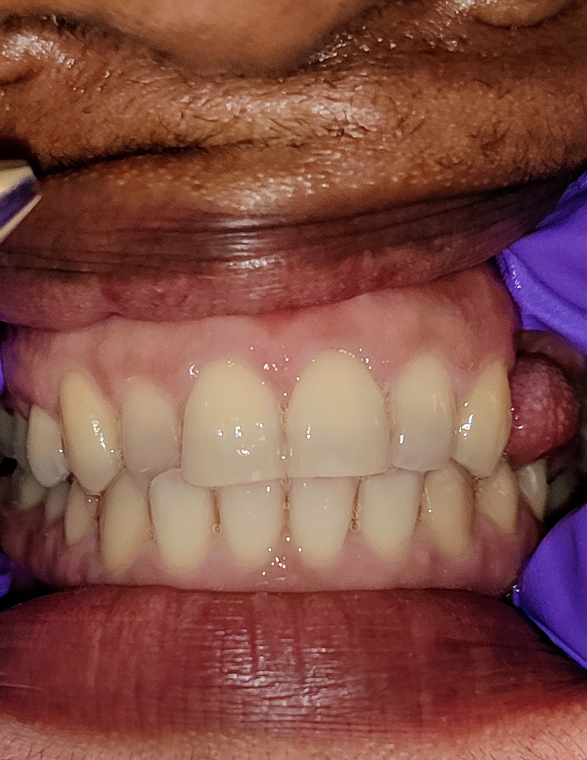
Pictures Before Treatment

Slide 16
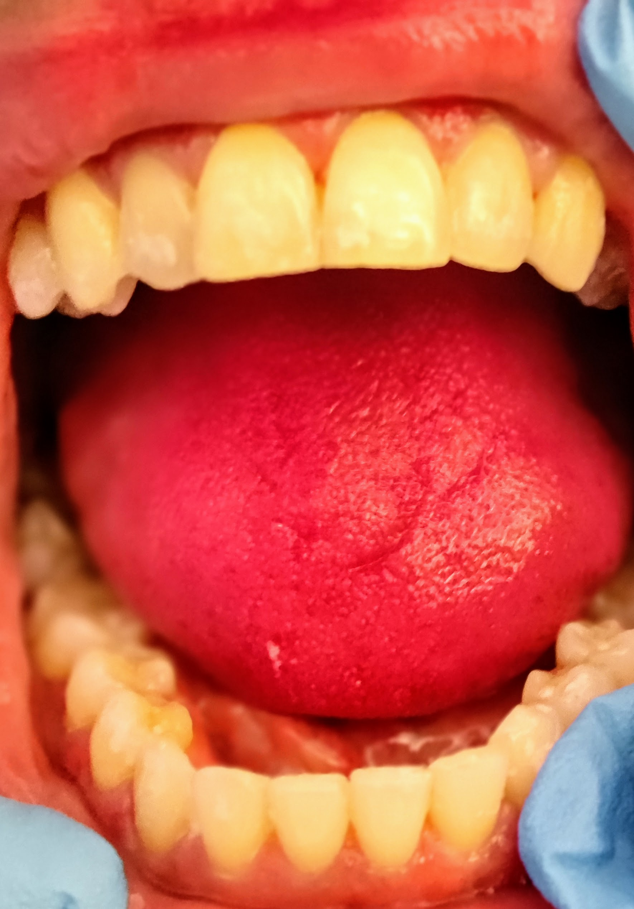
Pictures After Treatment

Slide 17
Reference
https://www.mayoclinic.org/diseases-conditions/high-blood-pressure/symptoms-causes/syc-20373410
https://www.cdc.gov/cholesterol/ldl_hdl.htm

