Slide 1
Brushing is Cool
With
the Right Tool !
By: Yeny Chong,
Saba Haggagi,
Lucidania Naranjo,
Elizabeth Ramirez,
Khadra Shihadeh
Candice Superville

Slide 2
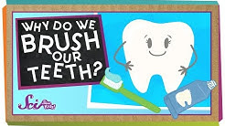
Does anyone here like brushing their teeth?
Did you know that if you don't brush, floss and rinse then germies live on your teeth?
https://www.andnextcomesl.com/2015/03/autism-quotes.html
Notes:
Autism

Slide 3
Trivia time!
A.
B.

Slide 4
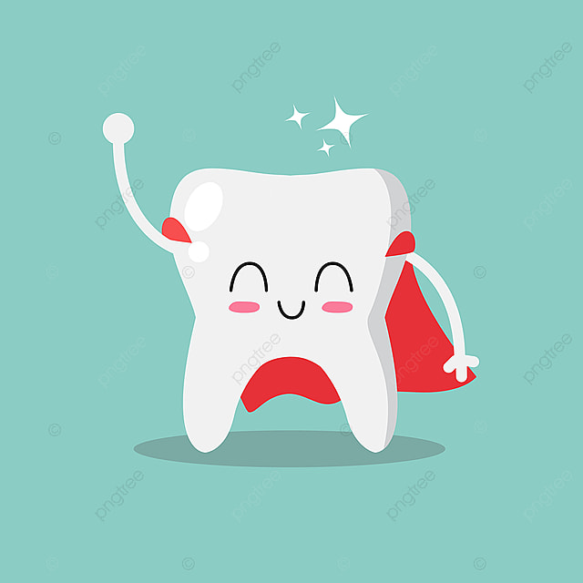
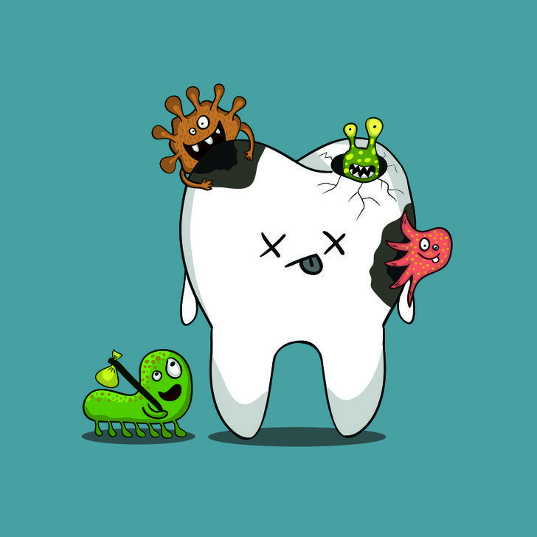
Cavities? What is that? How does it happen?

Slide 5
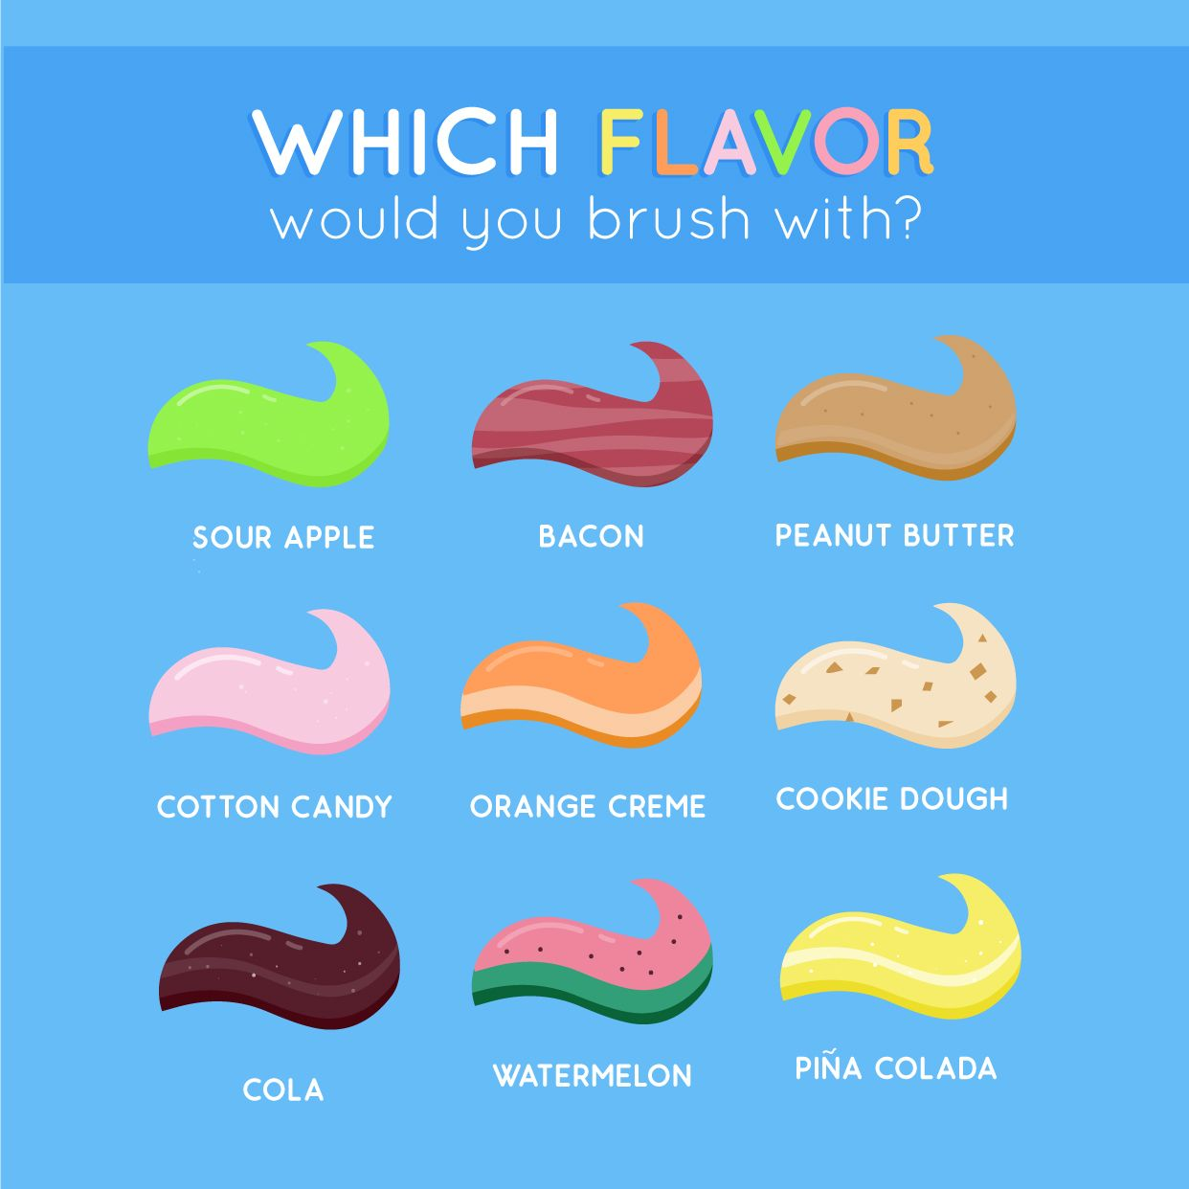
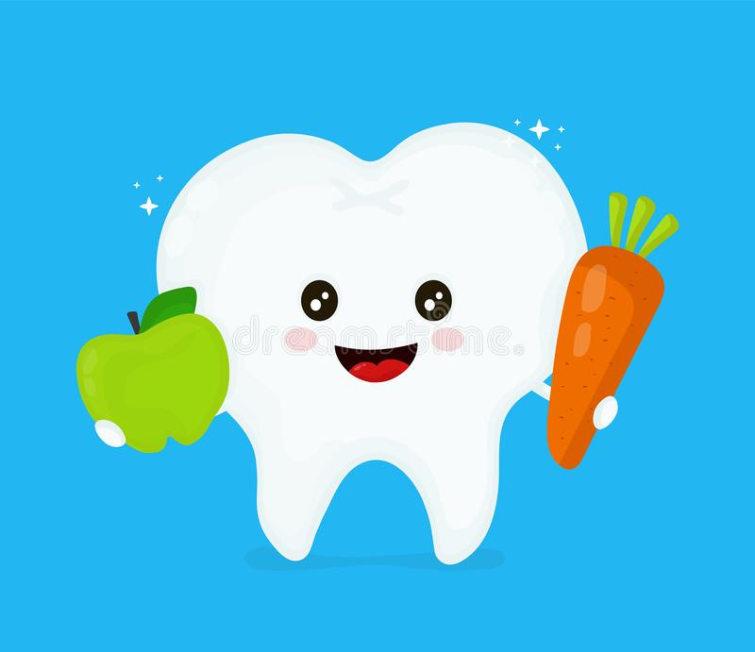
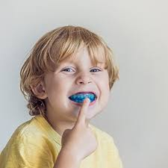
How we can get a big bright smile 😃
Certain toothbrushes, toothpastes, songs, and methods can help us achieve a happy smile!
Nutritional recommendations and oral appliances can also help reach our goal

Slide 6
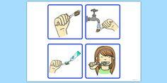
How do we brush?
Notes:
Today we are going to first talk about brushing your teeth. Can someone show me how they brush their teeth at home? Do you brush before bed.Who here have seen blippi videos? Let’s watch a fun video on how to brush our teeth.
Now let us show you how to brush your teeth like Blippi.

Slide 8
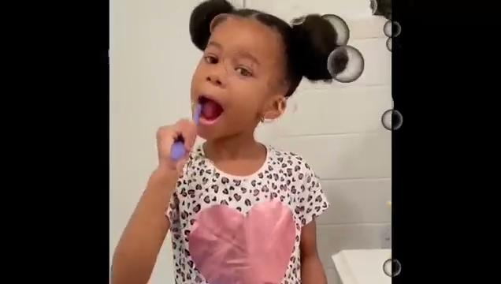
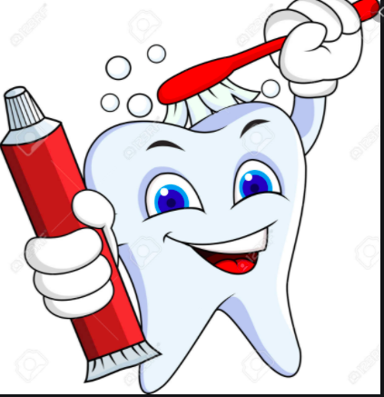
Can you tell me how do you brush your teeth?
The ABC’s of brushing your teeth
Avoid
Brush
Clean

Slide 9
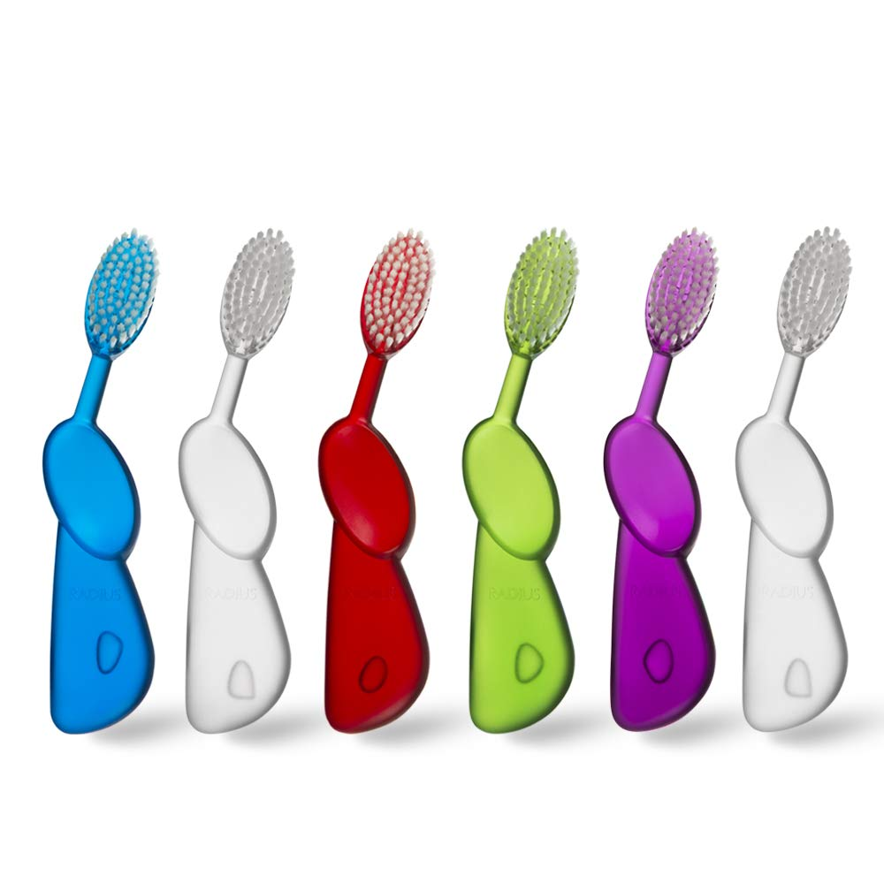
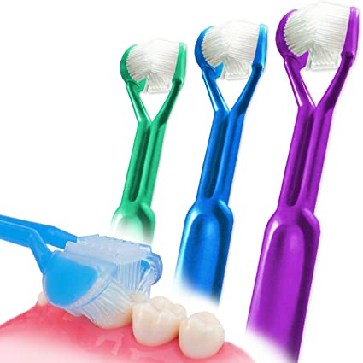
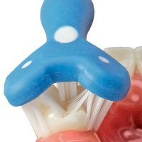
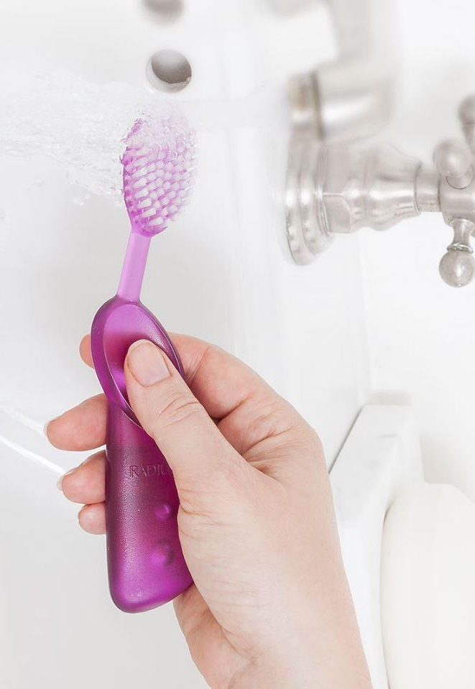
Choosing the right toothbrush!
Radius toothbrush
Surround Brush

Slide 10
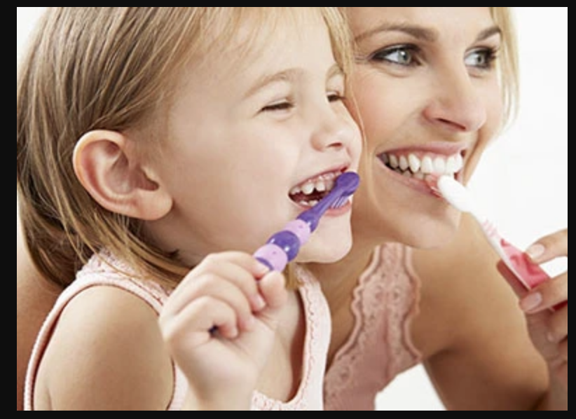
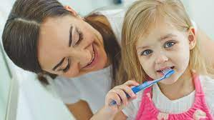
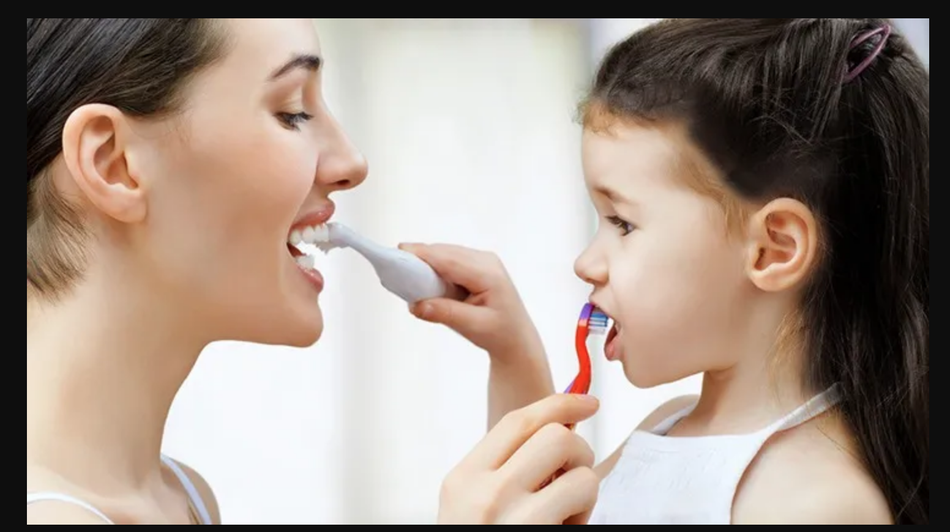
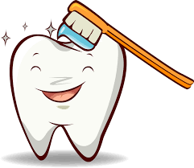
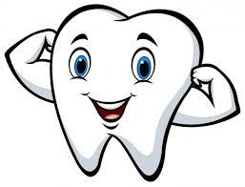
How do we implement ways to improve brushing...
We play songs like “This is the Way We Brush Our Teeth”
-
We stand behind them as we show the the proper way to brush
We help them get familiarized and visualize the different types of toothbrushes

Slide 11
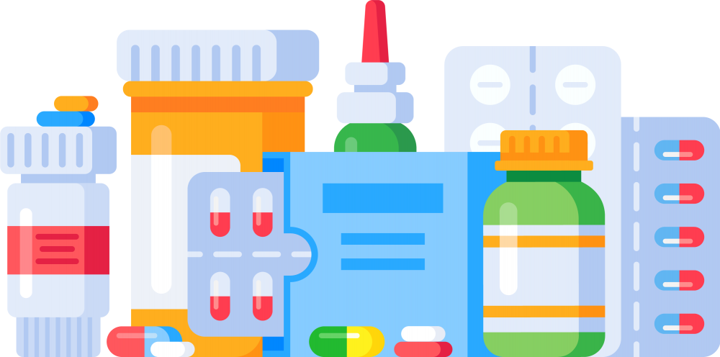
Dental Considerations
Common oral healthcare considerations: caries, gingivitis, bruxism, xerostomia
Why are these the most common complications experienced?
Notes:
Focusing on children with autism from grades 4-5 For the question ( rhetorical, say we looked into it and we’ve seen … )we can discuss the meds and the self injury and also the visual evaluation that helped us get to the conclusion.

Slide 12
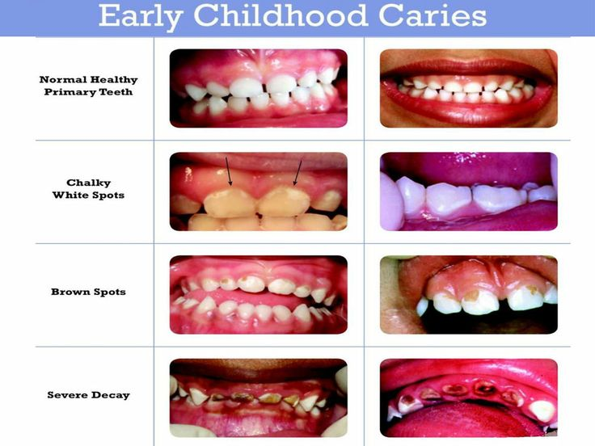
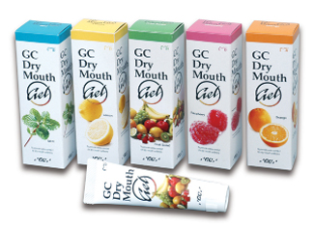
Autistic children are prone to ECC due to:
Xerostomia caused by medication
GERD
Prolonged baby bottle usage.
GC Dry Mouth Gel is an OTC solution to use on children with xerostomia.
All flavors are sugar free
Apply a small amount on the finger and gently apply the product around the oral tissue and teeth of the child.

Slide 13
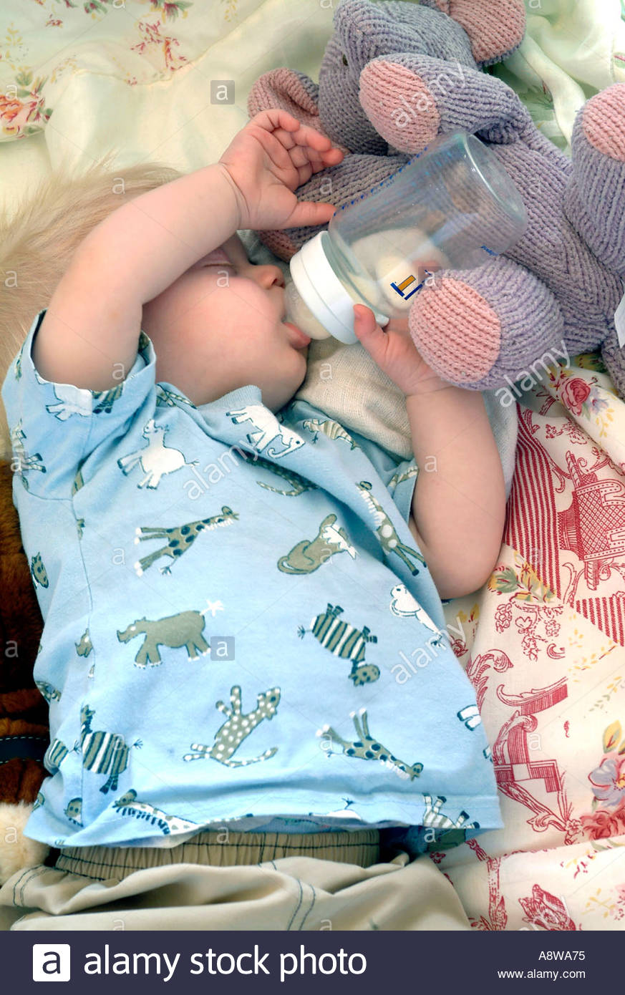
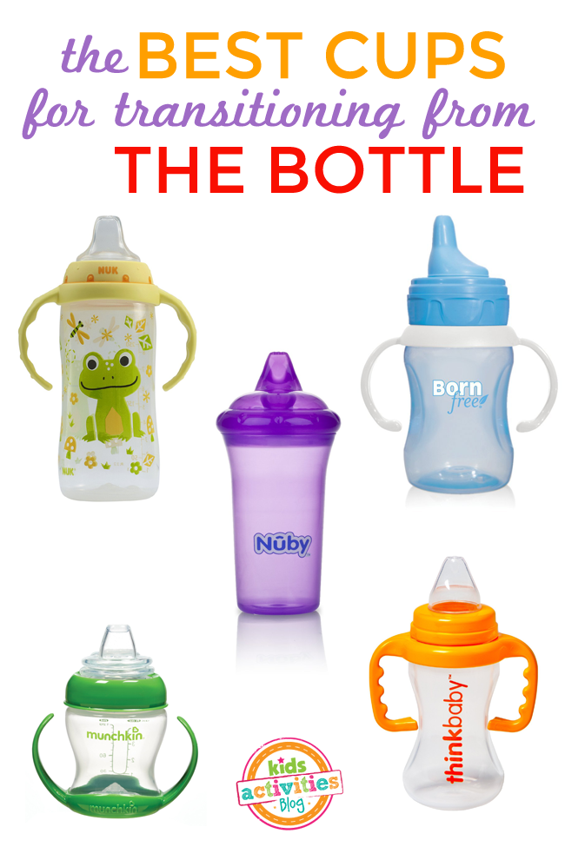
Baby Bottle Weaning Methods
Prolonged bottle use can lead to ECC (early childhood caries)
Remove bottle before baby falls asleep
Begin weaning methods at 6 months old.
Progressively replace bottle with sippy cup
At first, drop 1 bottle from the schedule and replace it with a sippy cup
Serial dilution: less formula/milk in bottle and the rest given in sippy cup
#1- Patience and positive reinforcement

Slide 14
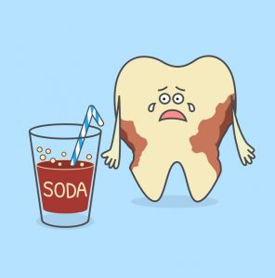
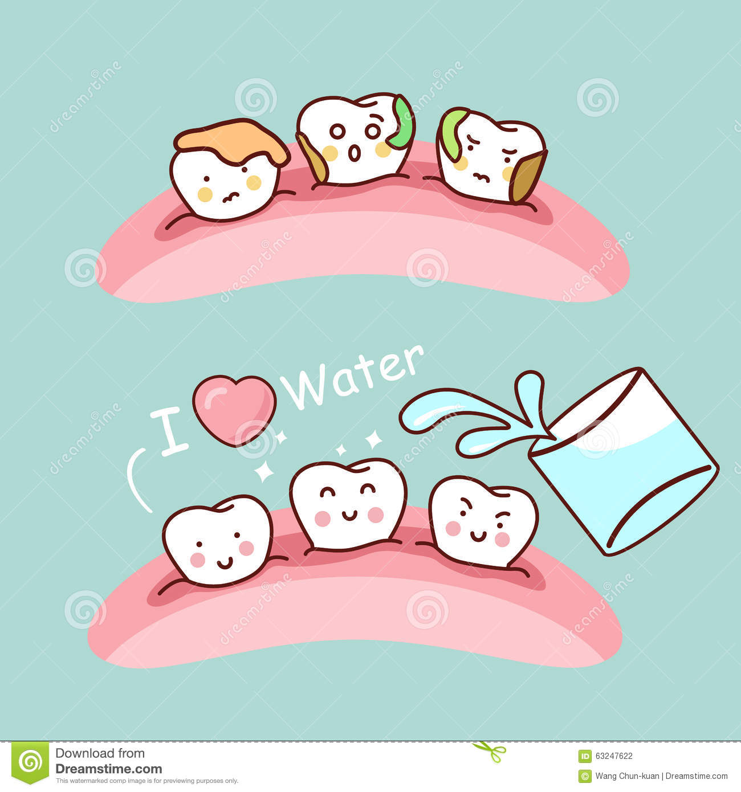
Which is the healthiest drink to have after every meal/snack?
https://www.dreamstime.com/stock-illustration-water-cute-cartoon-tooth-gargle-great-health-dental-care-concept-image63247622

Slide 15
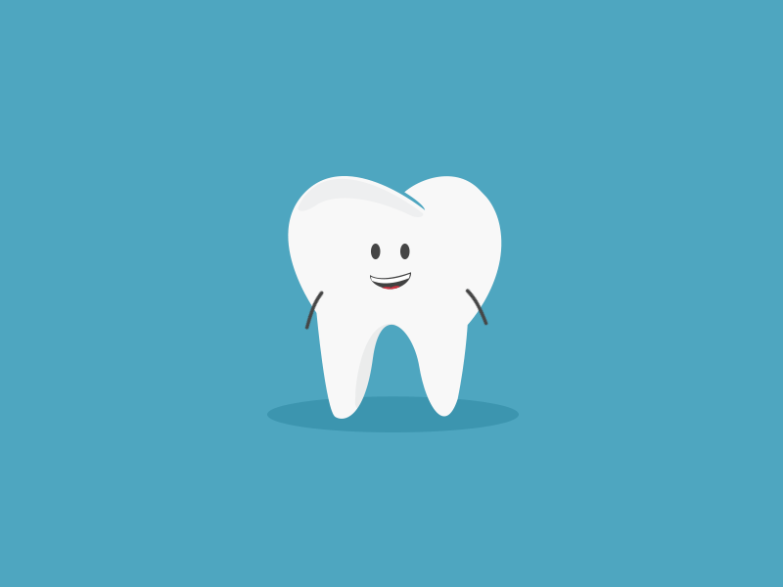
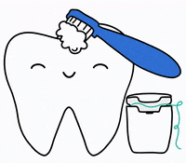
Who can tell me one way to get a big bright smile?

Slide 16
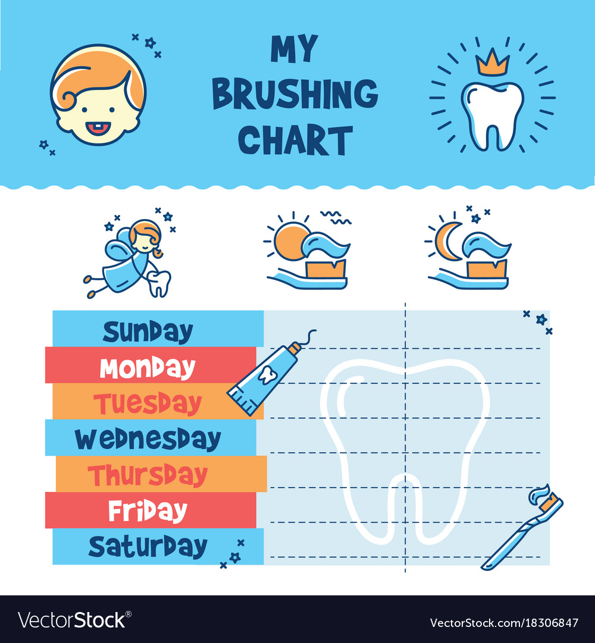
Notes:
This is a brushing chart, for every time you brush your teeth you put a sticker next to the day of the week. One sticker for every morning and one sticker for every night you brush your teeth. Whoever collects the most stickers will get a special gift at the end of the week

Slide 17
Thank You All!
Dont forget to Brush!!

