Slide 1
ANATOMIC LANDMARKS OF THE MANDIBLE
By: Diana Diaz and Candice superville

Slide 2
Teeth!
Teeth will appear radiopaque, because they are dense bone!
Enamel appears the most radiopaque, dentin follows as slightly less opaque and the dentinoenamel junction separates between the outline of the two structures.
The pulp chamber appears radiolucent, and pulp sizes also vary within teeth and individuals. Usually, the patient with primary dentition will have much larger pulp chambers than those of patients with permanent dentition.

Slide 3
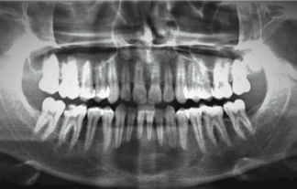
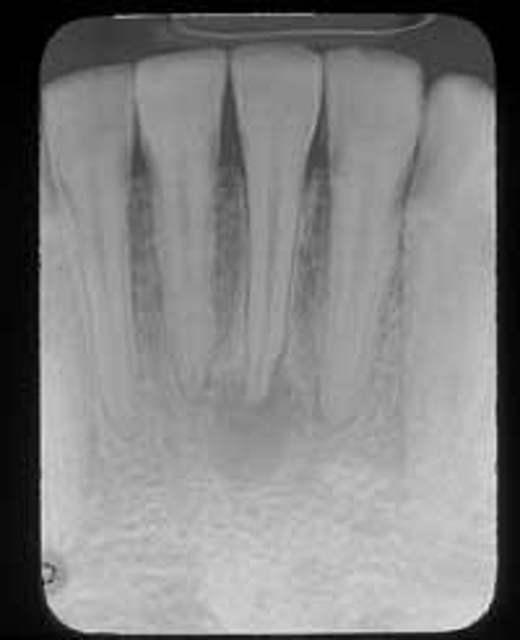
The mandibular incisors’ crowns are much smaller in width compared to its maxillary counterparts.
Compare the crowns side by side in this panoramic image. The mandibular crowns are about 2/3 the width of the maxillary crowns.

Slide 4
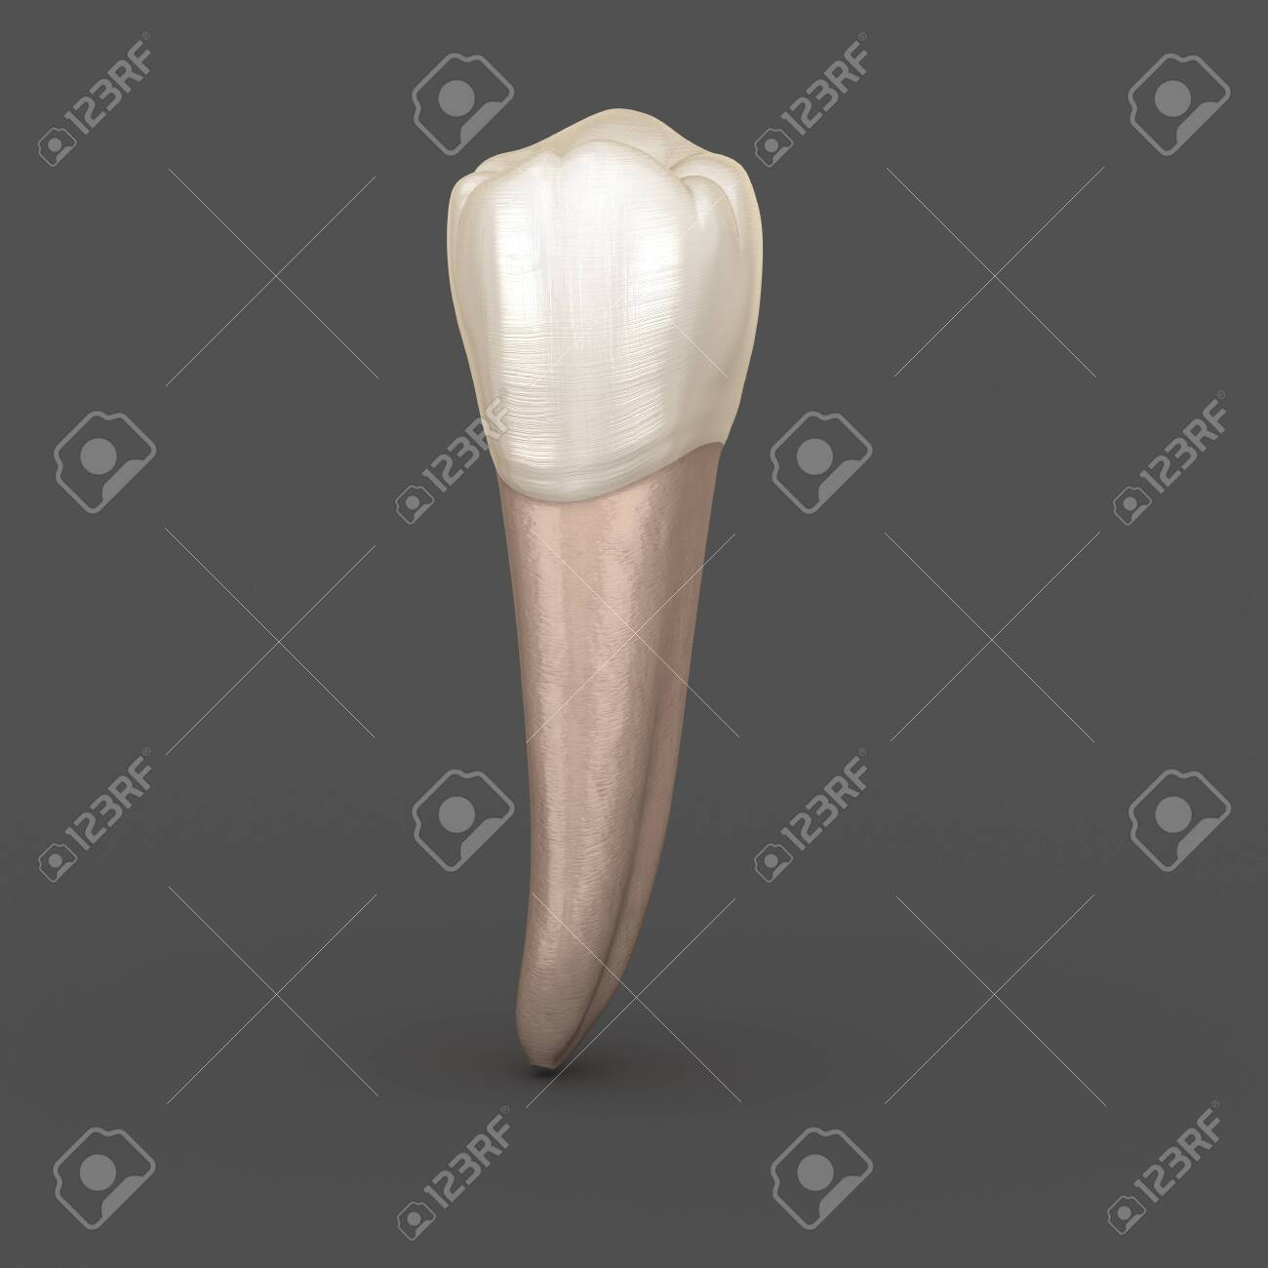
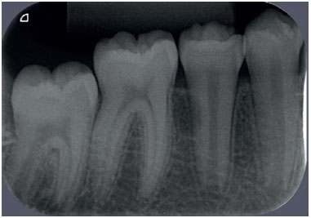
Premolars of the mandible
Are single- rooted.

Slide 5
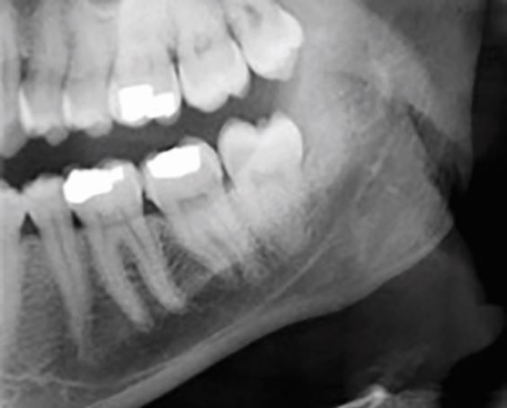
The Mandibular molars
Are double rooted!

Slide 6
Mandibular Landmarks

Slide 7
Lingual Foramen
Visible only on the lingual view of a mandibular anterior periapical, the lingual foramen appears as a small radiolucent opening. The genial tubercles usually surround the opening.

Slide 8
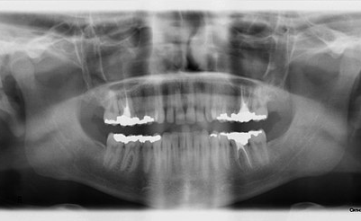
Submaxillary Fossa
The submaxillary fossa holds the submandibular salivary glands. It appears as a radiolucent space inferior to the mylohyoid ridge.
Radiolucency can vary among individual's due to bone density variations.

Slide 9
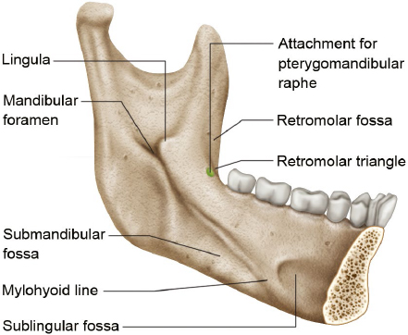
Note the Mylohyoid line.
This is a lingual view in cross section of the mandible.

Slide 10
Mylohyoid ridge
AKA the Internal Oblique ridge, this landmark runs from the third molar region down to the second premolar.
It will usually appear superimposed over the mandibular posterior tooth apices.
This dense radiopaque band runs right below the external oblique ridge, and in some radiographs, only one is distinguishable.

Slide 11
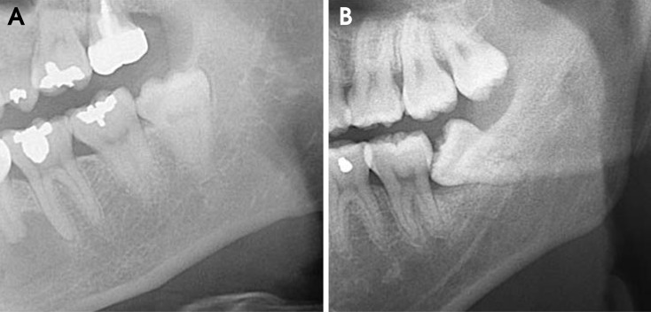
Walls of the Mandibular canal
There are two radiopaque lines that run parallel to each other extending from the mandibular foramen to the mental foramen. The radiopaque lines outline the mandibular canal.

Slide 12
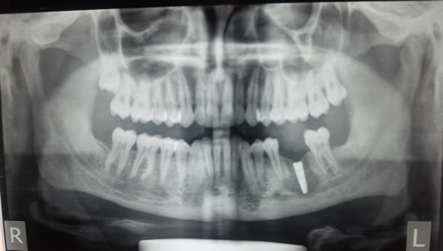
Did you spot the walls?

Slide 13
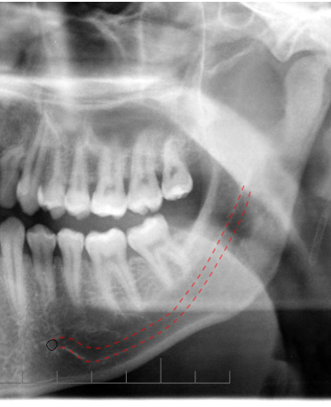
The Inferior Border of the Mandible
The inferior border of the mandible may appear if the radiographic image is foreshortened.
It is very dense (cortical bone) and therefore appears radiopaque.

Slide 14
External Oblique ridge
The external oblique ridge appear as a radiopaque band in radiograph,
It is extended downwards and forward from the anterior border of the ramus and ends at the third molar region.
https://coursehero.s3.amazonaws.com/file_upload/flashcards/6f215bc80ce0f79f27c770b1cbefb7cafc2eef2a.png

Slide 15
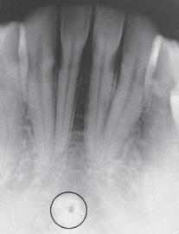
Genial Tubercles (Mental Spine)
Genial Tubercles appears as a circular shape radiopaques. It is located between the apices of the central incisors.
Genial Tubercles allows for the attachment of the genioglossus and geniohyoid

Slide 16
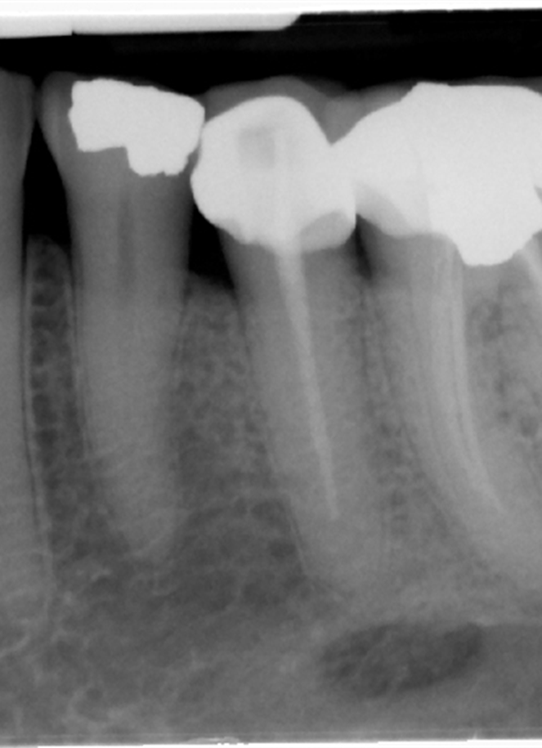
Mental Foramen
MENTAL FORAMEN IN A RADIOGRAPH APPEARS AS AN OVAL OR ROUND RADIOLUCENT IMAGE.
IT IS LOCATED BETWEEN THE MANDIBULAR PREMOLARS ROOT APICES.
https://oralradiology.files.wordpress.com/2012/10/mental-foramen-1.jpg

Slide 17
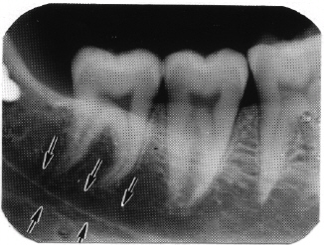
Mandibular Canal
MANDIBULAR CANAL APPEARS AS TWO RADIOLUCENT LINES THE RUNS FROM THE MANDIBULA FORAMEN TO THE MENTAL FORAMEN.
IT APPEARS A BELOW OR SUPERIMPOSED OVER THE APICES OF THE MANDIBULAR MOLAR TEETH.
MANDIBULA CANAL IS WHERE THE INFERIOR ALVEOLAR NERVE AND BLOOD VESSELS PASSES THROUGH.
https://www.waybuilder.net/sweethaven/MedTech/Dental/DentalRad/pics/fig0328.jpg

Slide 18
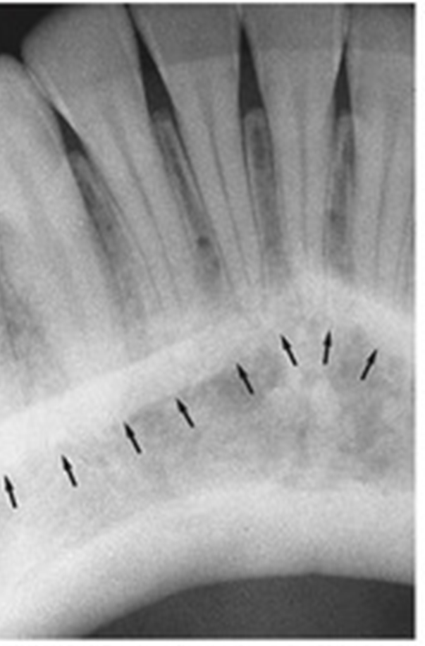
Mental Ridge
MENTAL RIDGE APPEAR AS A ROUND OR OVAL RADIOLUCENCY ON DENTAL RADIOGRAPH.
IT IS LOCATED BELOW AND BETWEEN THE APICES OF THE MANDIBULA PREMOLARS.
https://www.studyblue.com/notes/note/n/normal-anatomy-part-i/deck/15835074

Slide 19
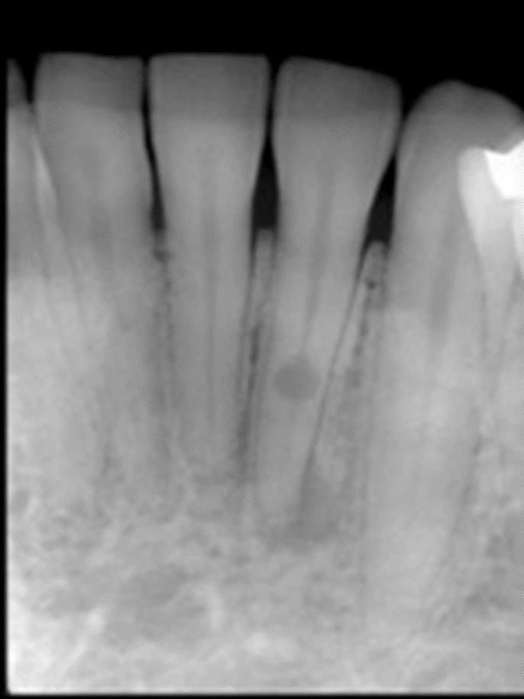
Soft Tissue Shadow of the Tongue
THE SOFT TISSUE SHADOW OF THE TONGUE CAN BE SEEN ON THE ANTERIOR TEETH OF THE MANDIBULAR OF RADIOGRAPHS.
THE SHADOW OF THE TONGUE CAN APPEAR SLIGHTLY RADIOPAQUE.
www.dentistrytoday.com/Media/EditLiveJava/Ruddle-Figure-9a.jpg

Slide 20
SOURCES
http://www.jordi.com.br/detalhe_artigo.asp?id=62
http://www.scielo.br/scielo.php?script=sci_arttext&pid=S0103-64402016000500609
http://drgstoothpix.com/2018/10/22/anatomy-monday-anatomy-on-mandibular-periapical-radiographs/
https://media.springernature.com/full/springer-static/image/art%3A10.1038%2Fs41415-020-1324-1/MediaObjects/41415_2020_1324_Fig1_HTML.jpg
https://www.memorangapp.com/flashcards/47747/INTRA-ORAL+Radiographic+Anatomy+of+the+Maxilla/
https://upload.wikimedia.org/wikipedia/en/6/66/Lingual_foramen.JPG
https://www.researchgate.net/figure/A-Interruption-of-the-mandibular-canal-wall-appears-at-the-border-of-the-mandibular_fig2_232715244
https://www.123rf.com/photo_127605131_stock-illustration-dental-anatomy--mandibular-second-premolar-tooth-medically-accurate-dental-3d-illustration.html
https://plasticsurgerykey.com/mandible-and-masticatory-muscles/
https://en.wikipedia.org/wiki/Panoramic_radiograph

Slide 21
End!

