Slide 1
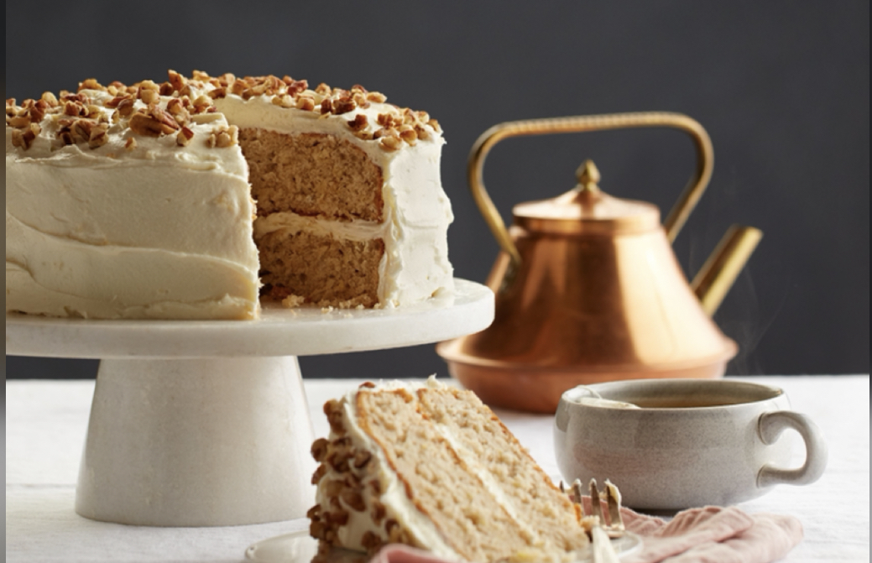
Hummingbird Cake
By: Stephanie Gonzalez

Slide 2
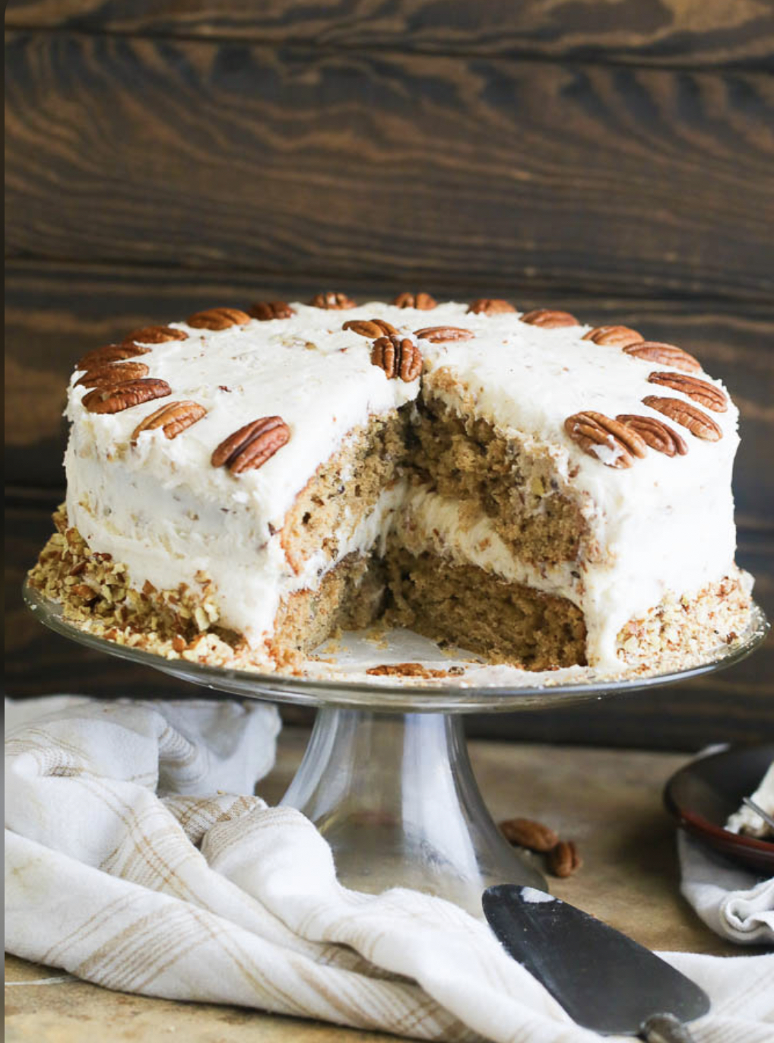
Doctor Bird Cake AKA Hummingbird cake
Hummingbird originated in Jamaica, in the 1960’s, where Hummingbird cake is known as Doctor Bird Cake
It was named after the island’s national bird.
Hummingbird cake started to be known and popular in the South since the 1970’s, when L.H. Wiggin’s recipe was released out in the world
Hummingbird cake has been said to receive its name from hummingbirds, who only eat nectar and its yellow streaks from bananas are implicative of the bird’s plumage( birds feathers collectively.)

Slide 3
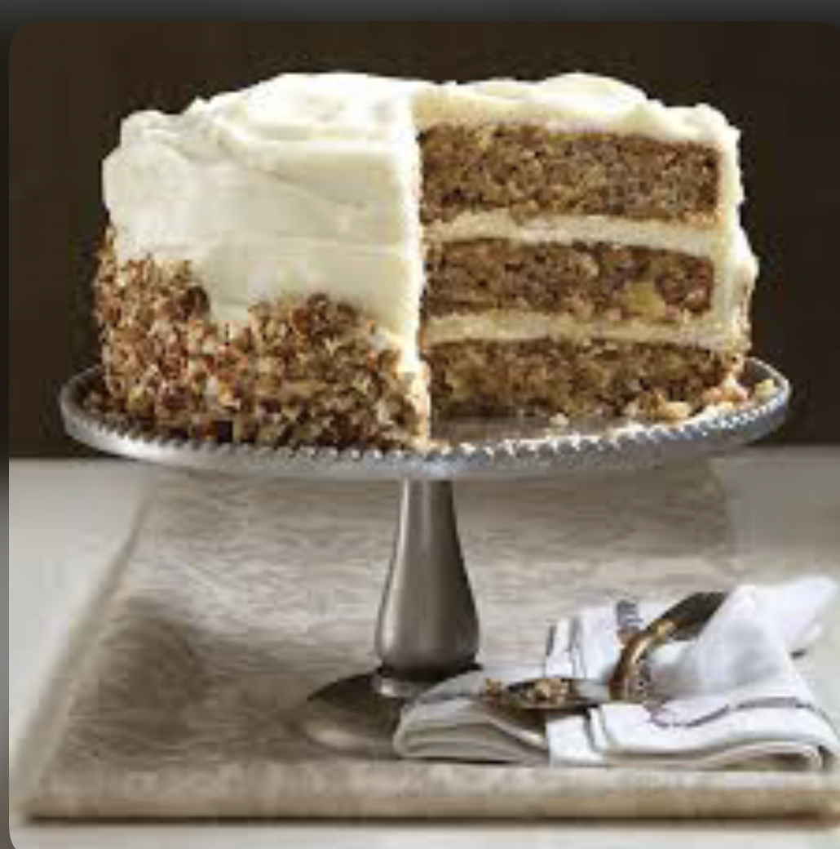
Recipe
Hummingbird cake has special ingredients which include, cinnamon, vanilla extract, crushed pineapple with its juice, pecans, and cream cheese.

Slide 4
https://www.bakefromscratch.com/origin-classic-hummingbird-cake/2/ https://www.southernliving.com/recipes/hummingbird-cake-recipe
Mrs. L.H. Wiggins from Greensboro, North Carolina recipe for Hummingbird was submitted to Southern Living in 1978 by a loved one.
That same year it won the favorite cake award in a state fair at Kentucky.
Was voted The Southern Living websites most popular cake in 1990.
I love how she left an impression on the world and still famous for her cake until this day.
When you search Hummingbird Cake she comes up multiple times.

Slide 5
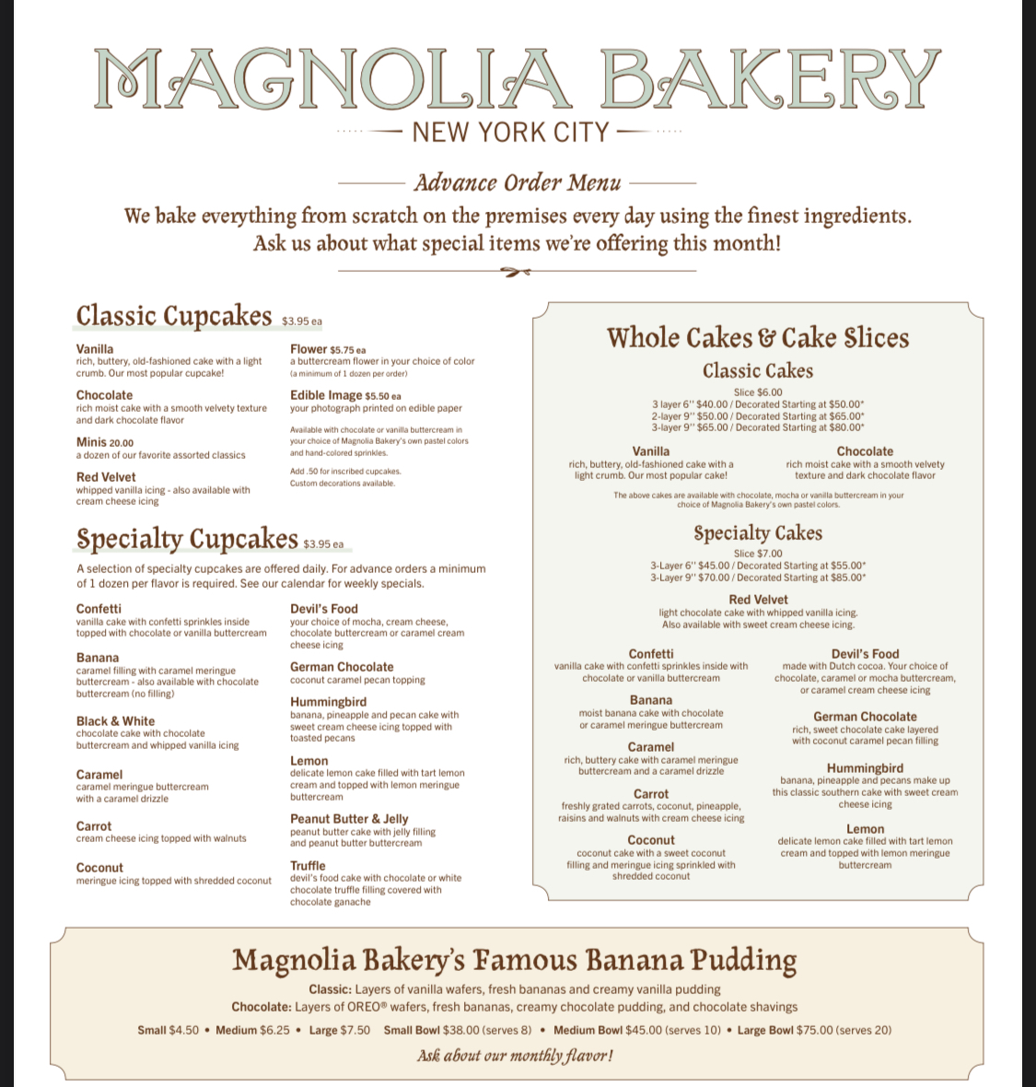
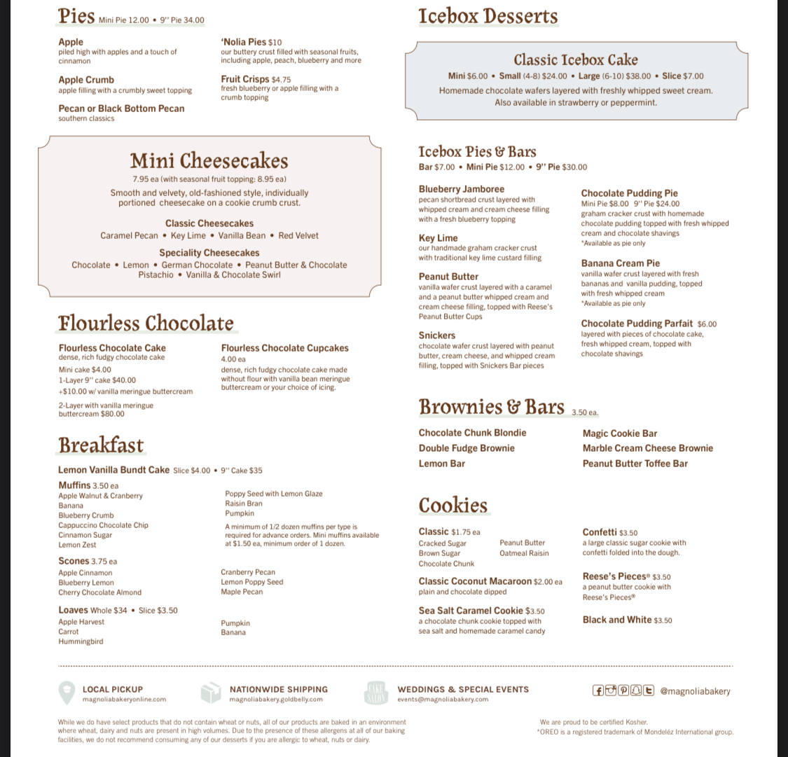

Slide 6
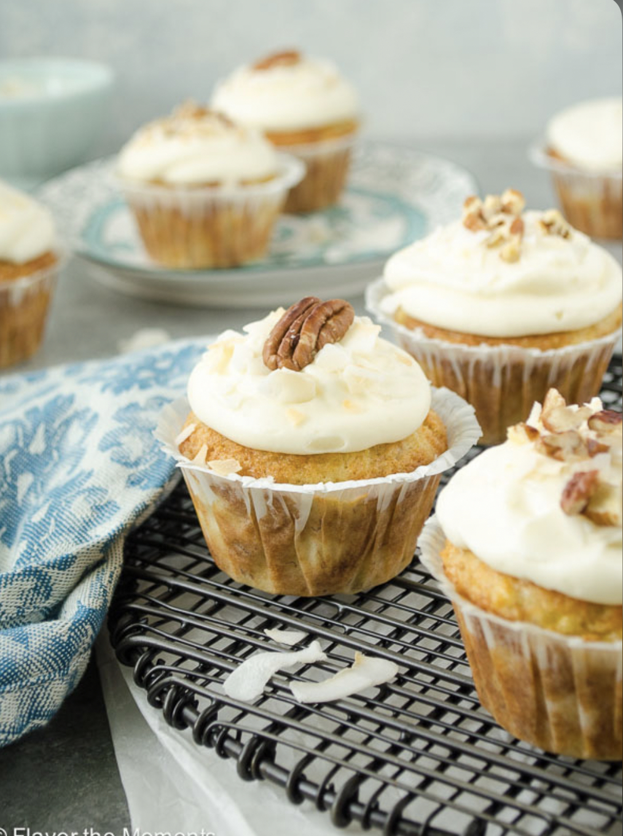
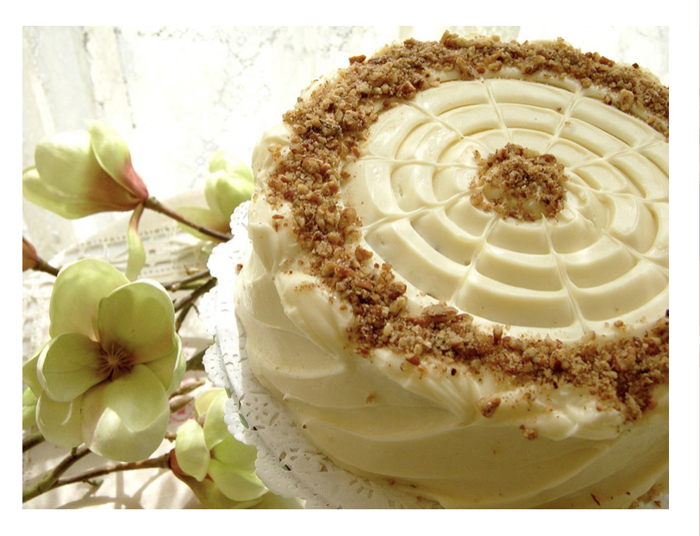

Slide 7
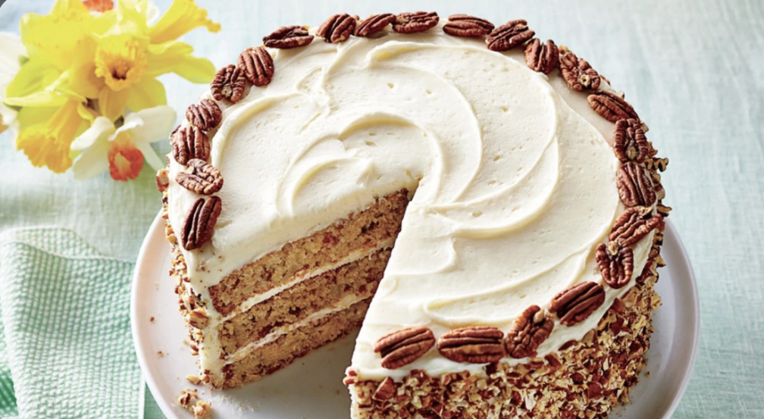
https://www.youtube.com/watch?v=W7ISgHCh0-w
https://www.youtube.com/watch?v=W7ISgHCh0-w

Slide 8
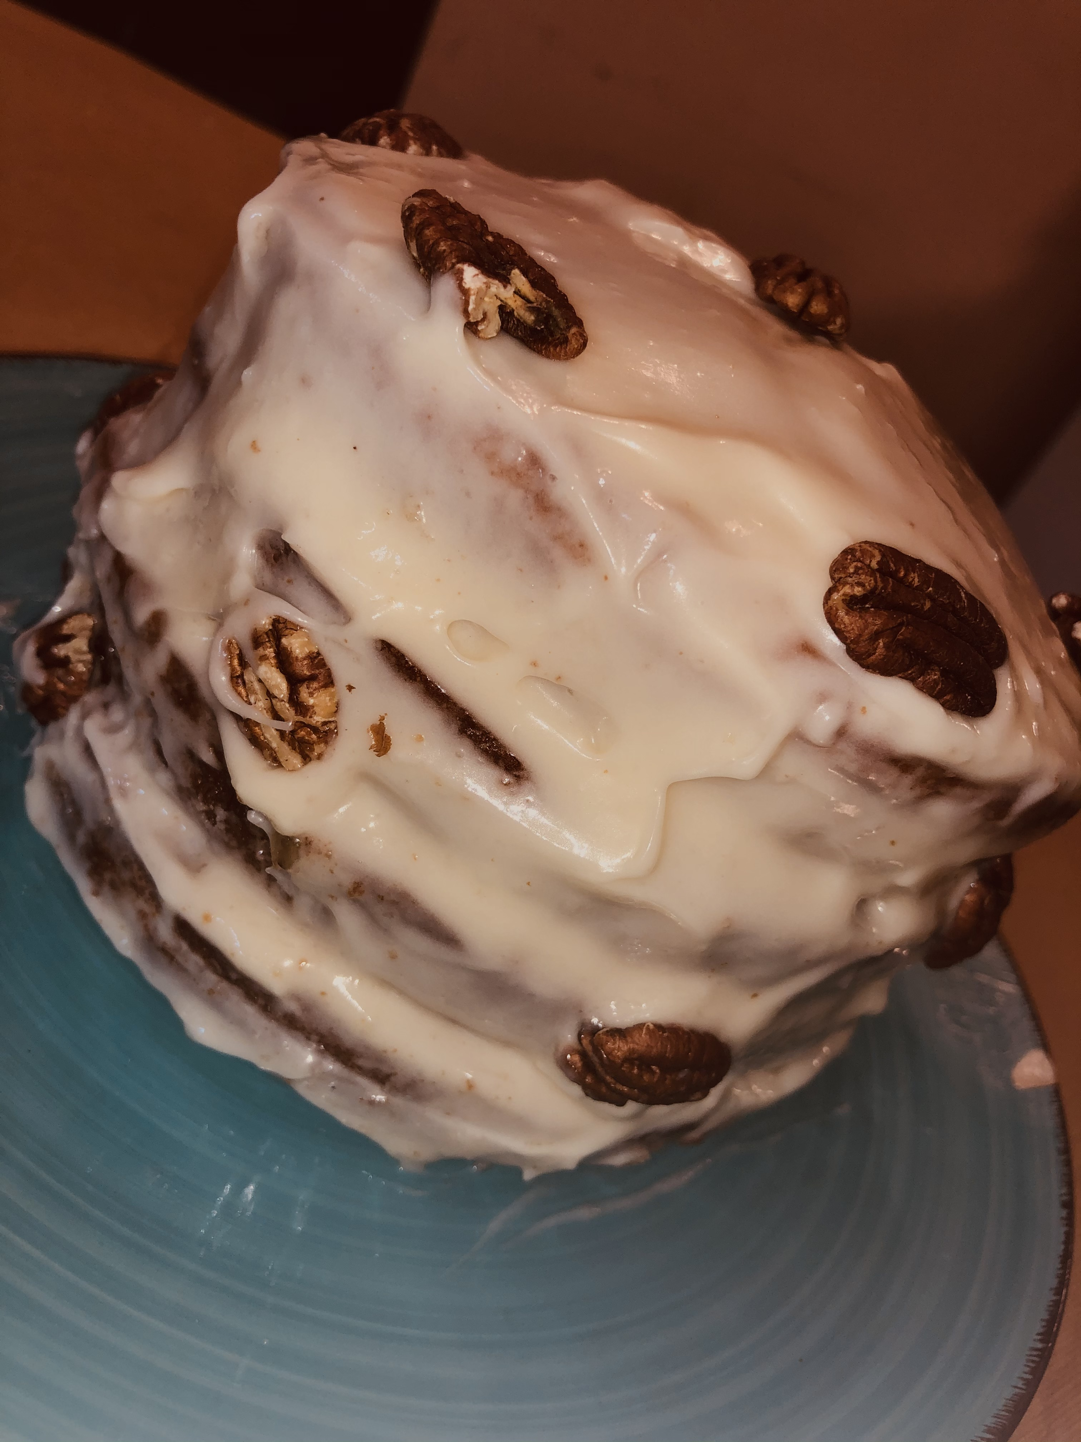
My first attempt at hummingbird cake, following L.H. Wiggins recipe.

