Slide 1
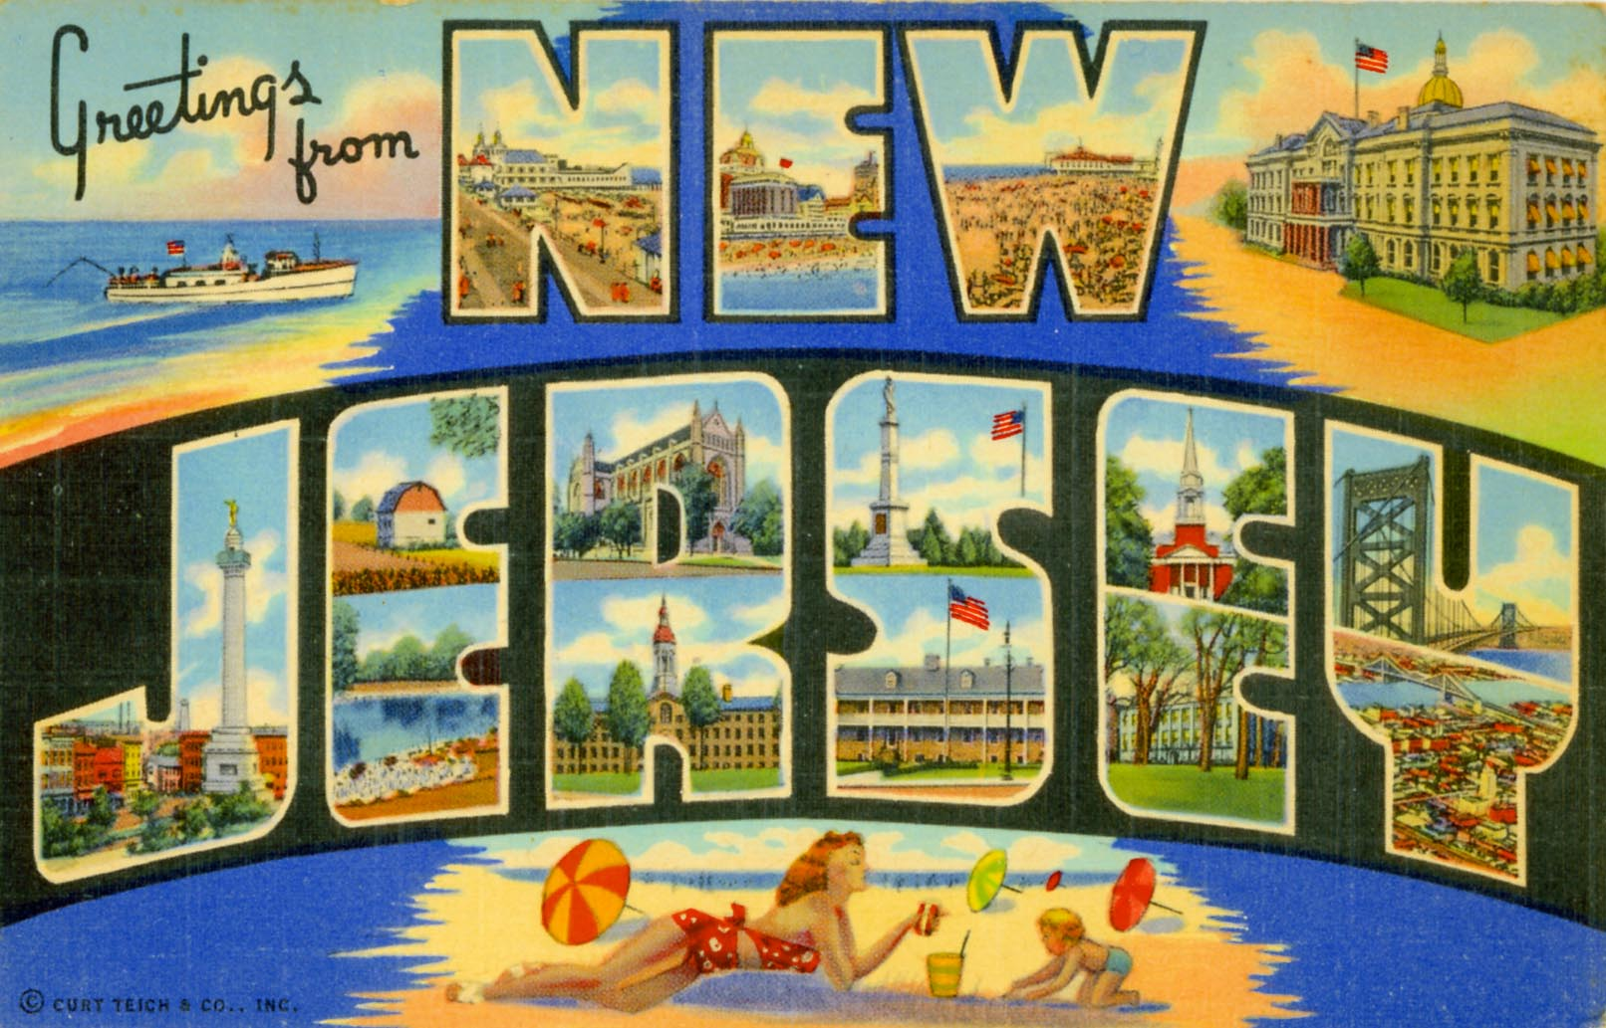
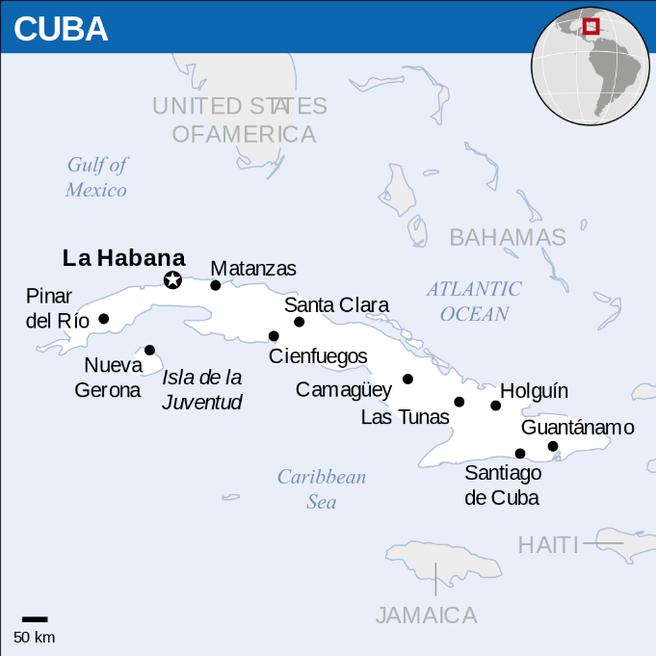
SLOPPY JOES- not what you think they are in New Jersey!
Claire Stewart
HMGT 1102

Slide 2
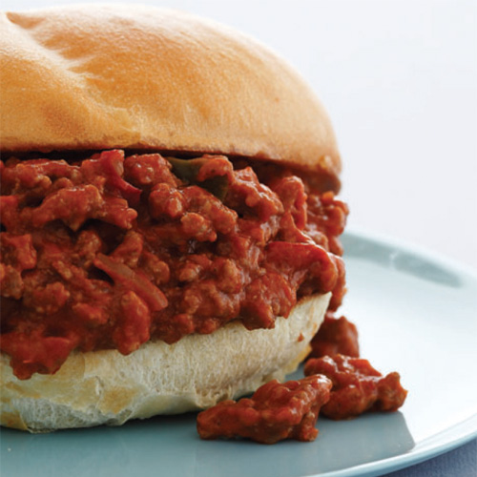
Sloppy Joes? In most of the U.S. you picture this, right?

Slide 3
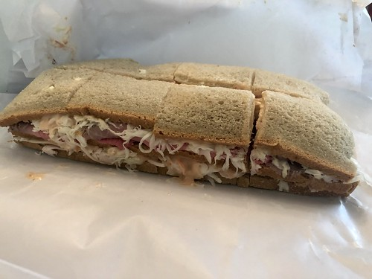
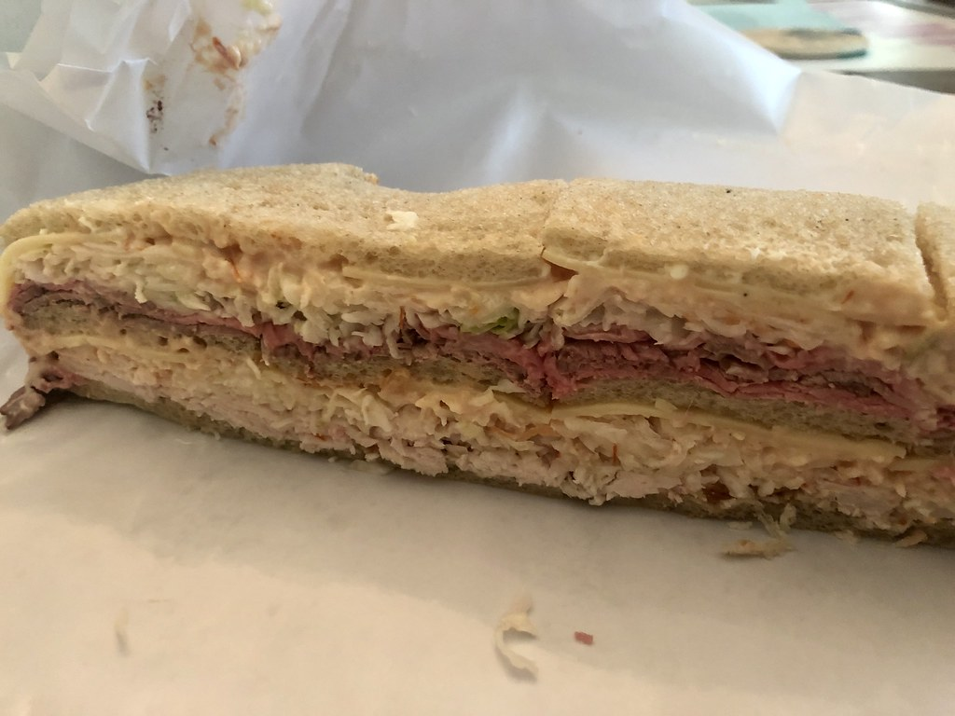
Not in Northern New Jersey!
In New Jersey, Sloppy Joes have a whole different definition!

Slide 4
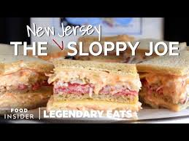
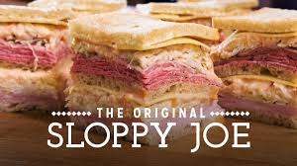
In the 1930s,
the mayor of Maplewood, New Jersey, was at a bar in Cuba called Sloppy Joe’s. He was served a sandwich made with ham, beef tongue, and Swiss cheese. He liked the sandwich so much that when he returned to New Jersey he had friends who owned a deli re-create it. It became a local favorite and is still served at the same deli called Town Hall. It’s popularity spread, and Sloppy Joes can now be found all over Northern New Jersey.
Town Hall delivers their sandwiches all over the country. They have been featured in numerous food shows and mentioned in many blogs and websites.

Slide 5
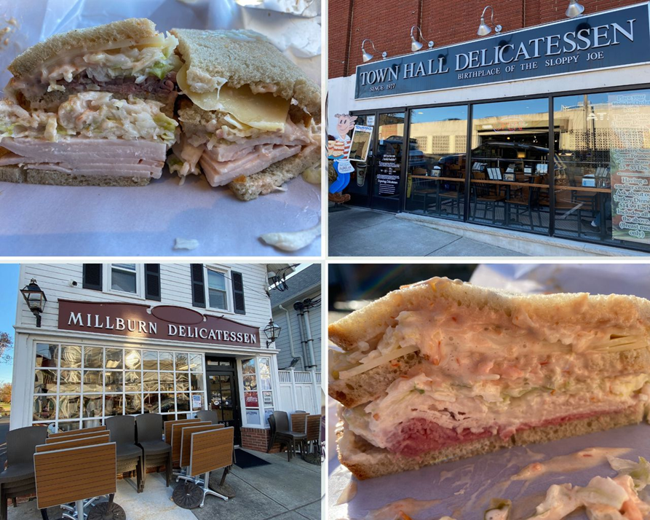
What is in a Sloppy Joe?
The sandwich must be made on three slices of rye with two meats, Swiss cheese, coleslaw, and Russian dressing. Traditionally it was made with tongue, but now it is often made with turkey and ham.

Slide 6
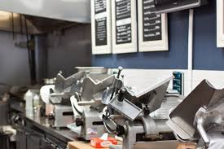
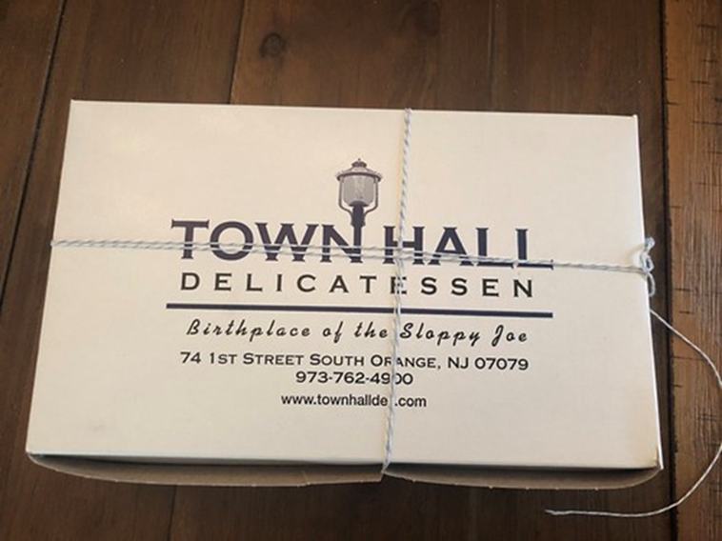
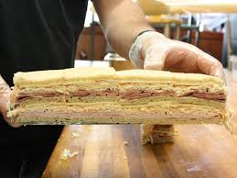
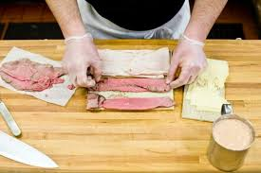
At Town Hall Deli…
They do not make the sandwich until you order it. They slice the bread in front of you and then slice the meat and cheese. They mix the Russian dressing as you watch. Then they make the sandwich while you stand in line.
They slice the sandwich, then wrap carefully in wax paper. Then the sandwich is put in a box and tied with a string.

Slide 7
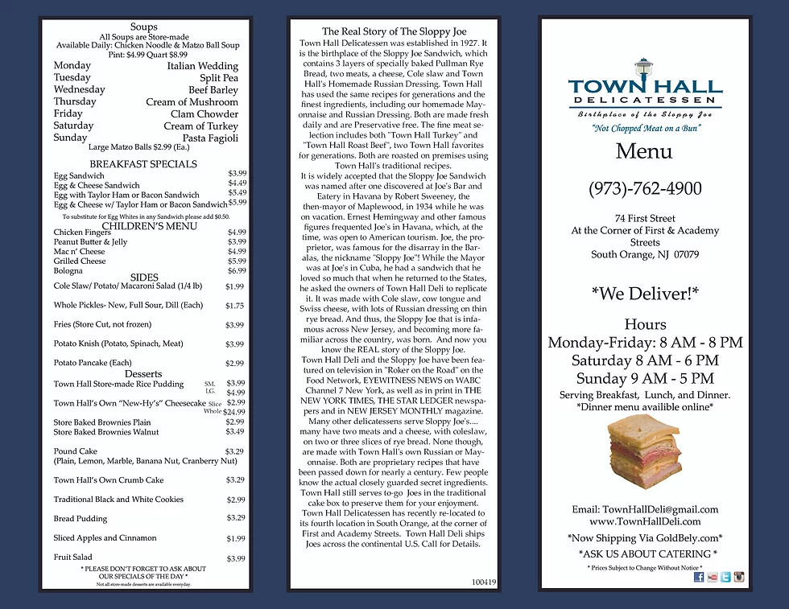

Slide 8
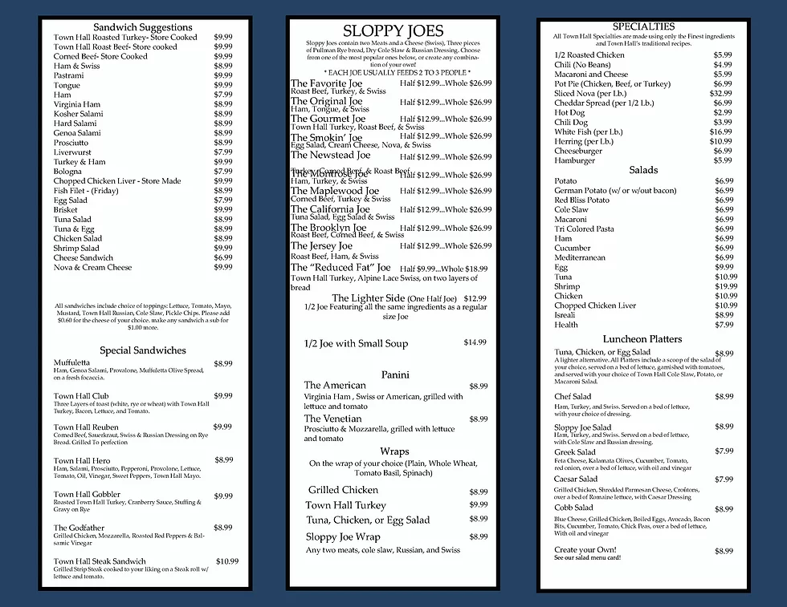

Slide 9
Pricing
A full Sloppy Joe at Town Hall costs $26.99.
That seems like a lot, but one sandwich has 12 pieces, so one sandwich easily feeds 3 people.
All the ingredients are fresh and everything is homemade. Many people go to Town Hall for the experience of watching the sandwich be made, and to take part in a tradition they grew up with.

Slide 10
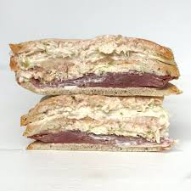
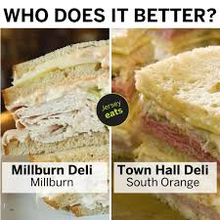
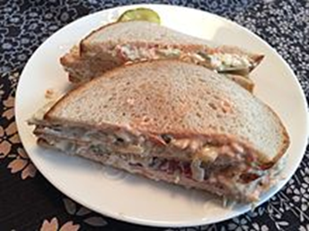
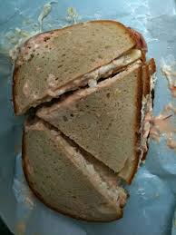
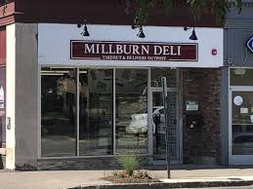
The Millburn Deli is also famous for their sandwiches
The two businesses compete to be known as having the best Sloppy Joes. The Millburn Deli makes their Sloppy Joes on pre-sliced rye bread, so they are oval, unlike the square ones from Town Hall.

Slide 11
The Millburn Deli has a Sloppy Joe category on it’s menu

Slide 12
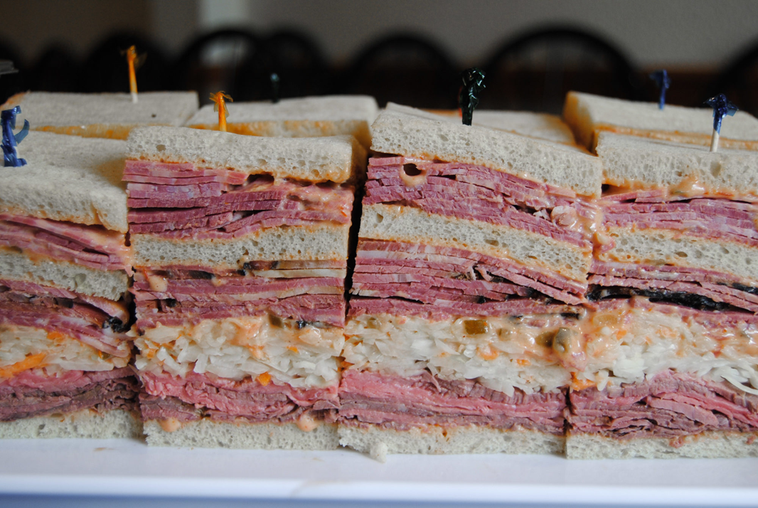
Hungry yet?

Slide 13
Link to video
https://www.youtube.com/watch?v=8EWUdXk7IWQ
(1:26)

Slide 14
That’s my presentation. Thank you!
Anyone have questions?

Slide 15
References
https://www.atlasobscura.com/foods/new-jersey-sloppy-joe
https://www.millburndeli.com/
https://www.seriouseats.com/2015/06/new-jersey-sloppy-joe.html
https://www.tapinto.net/towns/clark/sections/food-and-drink/articles/the-origins-of-the-sloppy-joe-sandwich-in-new-jer-6
https://www.tastecooking.com/new-jersey-sloppy-joe-not-sloppy-joe-know/
https://www.townhalldeli.com/
https://www.washingtonpost.com/recipes/new-jersey-sloppy-joes/14457/

