Slide 1
Making your resume great
ONE PAGE, PEOPLE!
-I am twice as old as you and worked as a professional chef for over many years. I can STILL make my resume fit one page if I really need to
-Managers have a stack of resumes in front of them or they are scrolling a screen- they are browsing quickly to lessen the stack
-They honestly might not bother to “turn the page over”

Slide 2
Safety first
Get rid of your home address NOW!
There is NO reason to share this. You have an e-mail address. Home addresses and social security numbers come AFTER you have been hired
PLEASE do not distribute your resume with personal information, especially if you are issuing on-line to servers such as Craig List

Slide 3
LinkedIn
Add the link to your LinkedIn profile up top with your contact information
A potential employer can click on this and go right to your profile
This Photo by Unknown Author is licensed under CC BY-NC-ND

Slide 4
CUNY!
You are graduating from the City University of New York
This is a big deal
It is a respected institution
You should be PROUD of this! Your resume should list:
New York City College of Technology, City University of New York
Bachelors Degree, Hospitality Management

Slide 5
Great student? Add this puppy!
Summa Cum Laude is GPA of 3.8-4.0
Magna Cum Laude is GPA of 3.5-3.79
Cum Laude is GPA of 3.25-3.49
Cum Laude means with “honor” or “praise”
Magna means with “great honor”
Summa means with the “highest honor”
These terms should not be used until after you have Bachelor’s Degree, previous to that, note that you were Dean’s List. The above terms do not apply to Associates Degrees
Notes:
Page 39 College Catalog

Slide 6
We know you went to high school!
Unless you went to a specialized high school that you are particularly proud of, drop it from your resume
You went to college so we know you went to high school
Why should you tell the world exactly how old you are?

Slide 7
Specialized Skills
Languages? SUPER important!
Unusual travel or special experience skills?
Think about your personal life….you have special experiences that can be valuable to potential employers!
Volunteer work is great. But remember the outside world doesn’t know what the Anna Nurse Club is. Explain what this was, for example. If you were a club officer make sure to convey your responsibilities.

Slide 8
Certifications
Who issued it? Their formal name.
Examples-
ServSafe Food Protection Program, National Restaurant Association, Certified May, 2016.
Certificate in Food Protection, New York City Department of Health, Lic.# 00-67654, Conferred June, 2015.
etc. Be specific and make it sound professional

Slide 9
HOLD IT!
Don’t use big words when simple language will do. Do you really need to “utilize your skills.”
Don’t be vague. Give specific tasks that you did at work.
Spellcheck like crazy.
Don’t make too long
and be concise

Slide 10
If you have a job description from a potential employer READ it
Then take their language and use in your resume or cover letter. They may be looking for someone who works in a very busy restaurant who handles pressure well. Maybe you worked in a very busy place but it is not famous. How would the reader know you have this experience?
Your resume maybe could say “high volume casual restaurant with 500 seats.” Be SPECIFIC to highlight your skills!

Slide 11
Chronological Order
You list from now (fall 2023) at top and then go down. The first job listed is the present or most recent.
If the job was in the past then it is written in the PAST tense. I stocked, I cooked, I did, I was, I handled etc.

Slide 12
Social media is not a skill.
Do you really think Facebook is a skill? I’m just saying….
A blog or a Twitter/Meta account with many followers is different. Include a link and amount of followers etc.
Using Word and Excel is not really impressive. Do you really need to include this? A specific HMGT program is good, such as Chef Tec, hotel booking programs etc.

Slide 13
What’s Up?
You think your resume is OK? Why not have it be outstanding? Your resume is more important than ever. Make yours perfect. Listen to me please? I know what I am talking about.

Slide 14
Here’s the deal…
I feel leaving the college now with a strong, professional, mature resume is incredibly important.
Your updated resume is due Week 13- this is just a reminder that you will want to make a new one that reflects your internship site

Slide 15
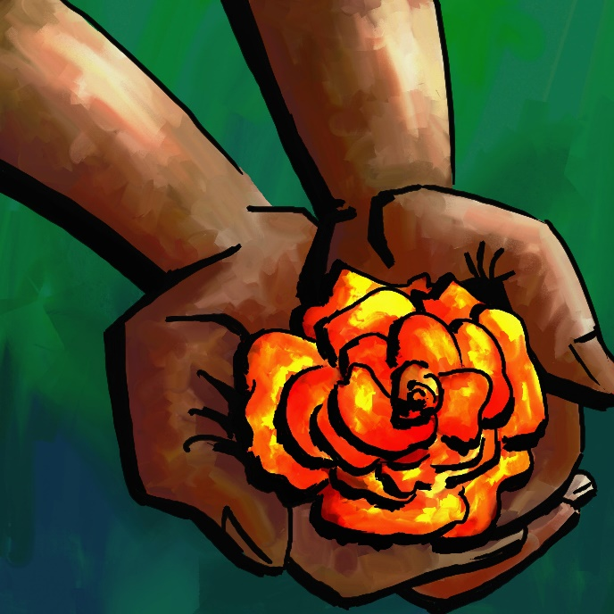
Great resume?
I am happy to meet with you on Collaborate and to go through the resume with you line by line. It is my pleasure to do this with you.
It’s on you! Let me know! I am here if you want help.

