Slide 1
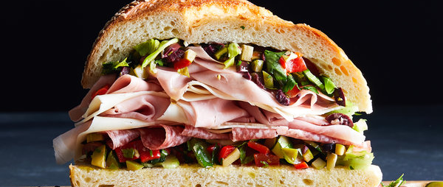
MUFFALETTA
By: Yaritza Hernandez
HMGT 1102

Slide 2
What region of the U.S. or the world does this item originate?
The muffaletta originated in New Orleans at Central Grocery where it is still made today. The Italian sandwich was created by Salvatore Lupo, a Sicilian immigrant that ran the central grocery with a sandwich counter in New Orleans.
He created the sandwich to feed Sicilian truck farmers who sold their produce at the nearby farmers' market.

Slide 3
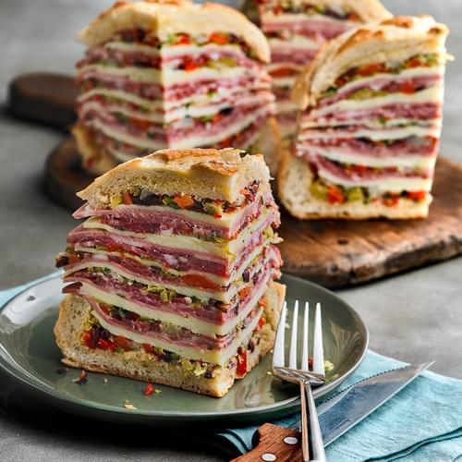
What Is Muffuletta?
Is an Italian sandwich made with Italian charcuterie and a spicy Creole olive salad.
The word “Muffuletta” is the name of both the round, large bread topped with sesame seeds, and the sandwich it’s built on, that originated in the French Quarter in 1906.
Sicilians would go to the grocery store and order some salami, some ham, a piece of cheese, a little olive salad, and either long braided Italian bread or round muffuletta bread.

Slide 4
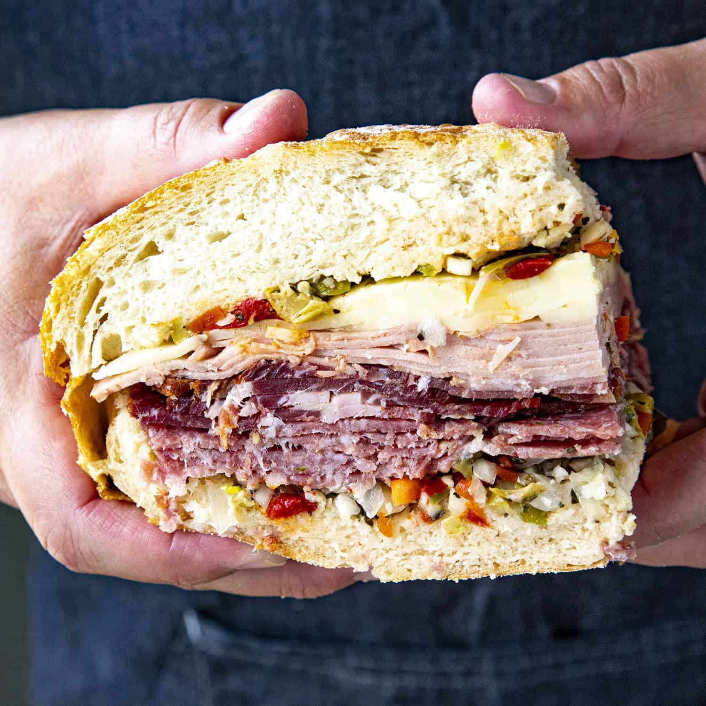
What is interesting about this item?
This sandwich feeds more than farmers today, it’s made its way to restaurants across the nation
February is an exciting time for muffaletta. Mardi Gras, when the city of New Orleans is filled with tourist and fun festivals this sandwich becomes one of the main attractions.
There’s nothing like that marriage of ham, salami, provolone, and one crucial ingredient: the olive salad (a combination of olives, diced pickled vegetables, roasted red peppers, garlic, chili flakes, and dried oregano)
Where to find the BEST muffaletta sandwich in New Orleans : Central Grocery & Deli
(923 Decatur Street; 504-523-1620)

Slide 5
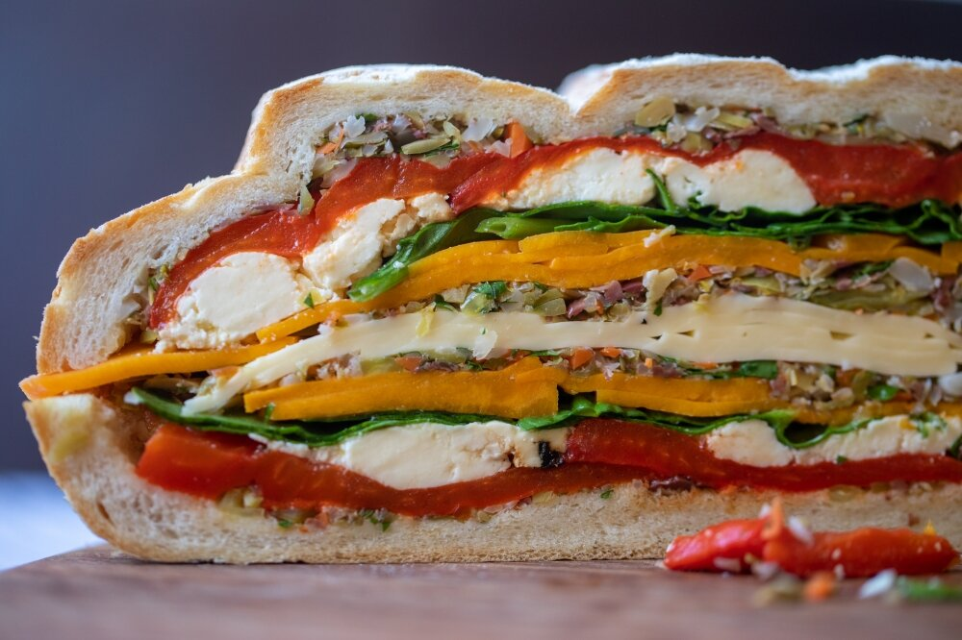
What is interesting about this item? It can a be made into a vegetarian muffaletta:
INGREDIENT
Italian style round cob loaf bread 400g pumpkin, peeled, sliced into thin wedges 20 slices provolone cheese 3 large red bell peppers, sliced into thick strips 1 cup of fresh ricotta cheese 100g baby spinach leaves
Olive Salad 1 cup pimento stuffed olives, drained ¾ cup pitted olives 1 tablespoon capers, rinsed 1 cup of pickles, drained ½ cup flat leaf parsley 1 tablespoon red wine vinegar 2 tablespoon olive oil

Slide 6
Pisillo Italian Panini
Carmello and Antonella owners and founders of Pisillo. This place was created to give the community a little taste of Italy.
There bread comes from one of the finest bakeries in Bensonhurst, Brooklyn, which has been in business for 30 years.
They serve about thirty-five different sandwich varieties, and you can add additional ingredients. You could find a great muffaletta there.
Address: 124 W 25th St, New York, NY 10001

Slide 7
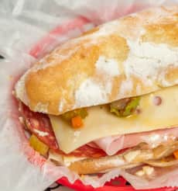
BOBBI'S ITALIAN BEEF
Bobbi’s Italian beef is one of the top ten shops to find a great muffaletta sandwich.
228 Smith St Brooklyn, NY 11231 (718) 873-1480
Lil Brooklyn Muffaletta
Salami, mortadella, ham, Swiss cheese, provolone, spicy olive tapenade and olive oil
$11.00

Slide 8
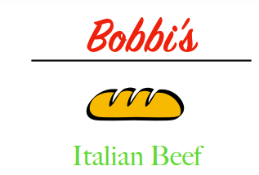
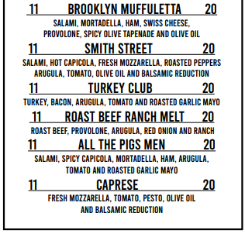
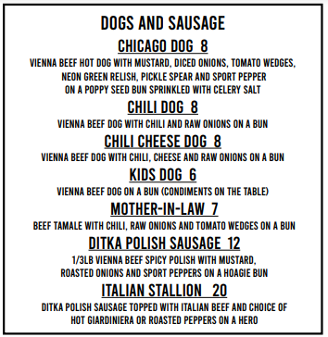
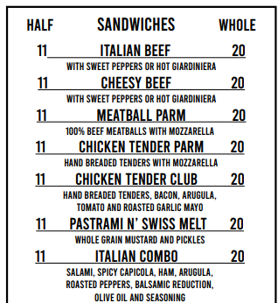
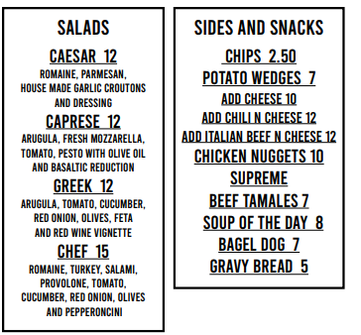
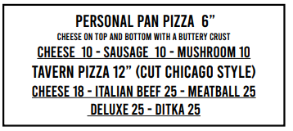

Slide 10
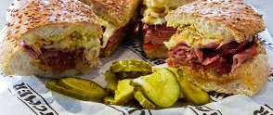
Thank You!!

Slide 11
References:
https://celebrationgeneration.com/muffaletta-sandwich-recipe/
https://www.farmersalmanac.com/heck-muffuletta-20455
https://food52.com/blog/23679-best-muffuletta-new-orleans-central-grocery
https://mostlovelythings.com/muffaletta-sandwich-recipe/
https://pisillopanini.com/
https://www.farmtofork.com.au/recipe-index/vegetarian-muffaletta

