Slide 1
Python
Functions

Slide 2
Methods versus functions
There are several terms used to refer to blocks of code that are “called” from other instructions. Some terms are : Procedures, subroutines, functions , methods.
Pathway2Code uses the term methods, because it is a more general case of a block of code called from other instructions. Method is also a term used more frequently in a style of programming referred to as Object Oriented programming.
In Python , the term function is used. There are some subtle difference between methods and functions. For our course though we can view them as equivalent.
One additional feature in Python and other languages , that is not present in Pathway2Code is “returning” values from a function / method.

Slide 3
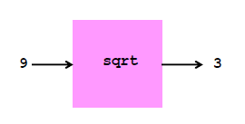
Common understanding of a function
In math the term function is used frequently. For example y=f(x), where the function f does some math operations on the value of x
A function always returns the same value for a certain x (unless there is a random number as part of the processing).
Functions have inputs , processing and outputs. Inputs are the parameters provided to the functions , the processing is the body of the function and the output is the value returned from the function
Sometimes functions are directly written by the programmer, while other times, we can use functions already included in Python.

Slide 4
Benefits of Functions
Functions , especially those included in Python, hold some complicated logic that would be tedious and difficult for us to implement. For example, sqrt is a function tha we can use without understanding exactly how Python figures the result.
r = (sqrt(250+110*sqrt(5))/20
This instruction would be very long if we included all the step to figure the square root.
Functions also help eliminate duplication. We can name a set of instructions as function, and use it in many other lines of code.

Slide 5
Defining functions
Function name parameter
Function definition begins with def
No declaration of types of arguments or result
(
)
First line with less indentation is considered to be outside of the function definition
return indicates the value to he sent back to the caller

Slide 6
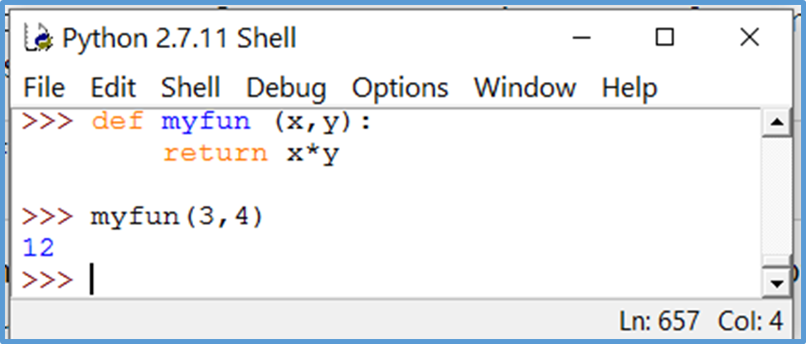
Returning Function Values
What would print here?
def f(x):
return x*x
Print (f(3))
print (f(3) + f(4))

Slide 7
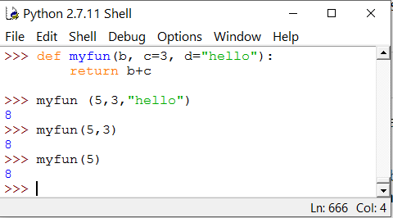
Default Values for Arguments
You can provide default values for a function’s arguments
These arguments are optional when the function is called

Slide 8
A function using a local variable
Variables used in a function are “local” to the function, meaning they do not share value with variables of the same name outside the function
Variables can be shared across functions by using the global keyword to define the variable in the function.
def lastFirst(firstName, lastName):
separator = ', ‘
global result
result = lastName + separator + firstName
return result
result = ‘Hello ’
name = lastFirst('Benjamin', 'Franklin'))
print(result)
def lastFirst(firstName, lastName):
separator = ', ‘
#result not global
result = lastName + separator + firstName
return result
result = ‘Hello ’
result = result + lastFirst('Benjamin', 'Franklin'))
print(result)
Prints : Hello Franklin,Benjamin
Prints : Error : result used before initialized

Slide 9
Some Python function facts
All functions in Python have a return value even if no return line inside the code. Functions without a return return the special value None. This value will not be printed.
Some languages allow the same function (or method) name to be used with different sets of parameters. Python does not allow this technique, each function name can only be used once.
A Python method must be defined before it is referenced in an instruction.

