Slide 1
Inputs / Outputs

Slide 2
Input – Process - Output
Many programs involving capturing input from the user, processing that data, and presenting some form of output.
Examples include:
Accepting an amount of money in dollars, doing calculations to determine the amount of euros, outputting the amount in euros.
Capturing all the test scores for a student, calculating the average an determining the letter grade, displayin the letter grade on the screen.
Inputting a building address, figuring the set of directions from the current location to that address, showing the sequence of directions.

Slide 3
Input
When the input() function is called, the program flow will be stopped until the user has given an input and has ended the input with the return key.
The input() provided by the user will be interpreted:
If the user puts in an integer or float value, the input() function returns this integer value. NO QUOTES WHILE SUBMITTING THE VALUE.
If the user puts in a string, the input() function returns a string value. QUOTES
The raw_input() function ALWAYS returns a string (irrespectively whether your submission had or did not have quotes)

Slide 4
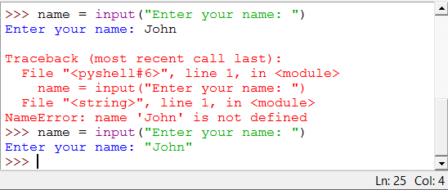
Input
Built-in function input() takes a string argument. This string is used as a prompt. Returns:
String if the submitted information was in quotes
Int or Float if the submitted information was a number
Error otherwise

Slide 5
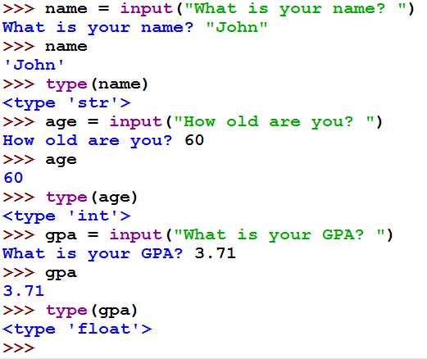
Example Sequence

Slide 6
Type Conversion Functions
int() | String, float → integer | >>> year = int("2014") >>> year 2014 >>> type(year) <type 'int'> >>> newPi = int (3.14) >>> newPi 3 >>> type(newPi) <type 'int'>
float() | String, integer → float | >>> float("3.14") 3.14 >>> float(5) 5.0
str() | Integer, float → string | >>> year = str(2017) >>> year '2017'

Slide 7
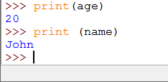
Output
Built-in print() function.

Slide 8
print() function
In Python 3, print()is a function* (in Python 2 it was a statement / function) ➔ print() requires, the value(s) to be printed should be submitted in parenthesis.
The (default) arguments of the print function are the following ones:
print(value1, ..., sep=' ', end='\n', file=sys.stdout, flush=False)
The print function can print an arbitrary number of values ("value1, value2, ..."), which are separated by commas.
* more on functions later

Slide 9
print() function
The print function can print an arbitrary number of values ("value1, value2, ..."), which are separated by commas.
print(value1, ..., sep=' ', end='\n', file=sys.stdout, flush=False)
by default Python will forcibly flush the stream
list all the values (variable names, or surface values) separated by a comma
by default Python will go to the next line after the print statement
by default Python will put a white space between the listed variables
by default Python will print the values on the screen

Slide 10
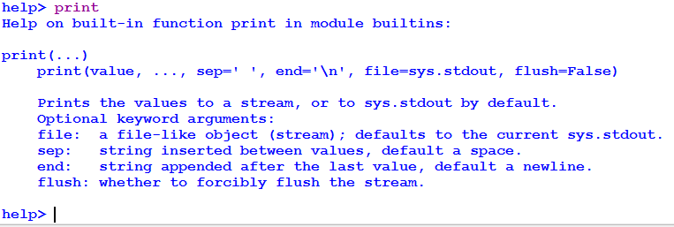
Python help for the print() function

Slide 11
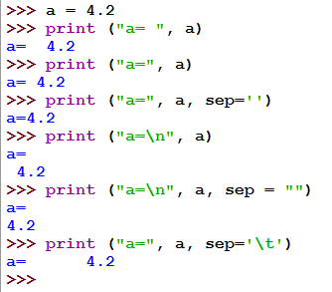
print() function
by default, the value of the separator (sep) is a white space; to change this behavior you need to assign the desired value to the sep variable
“\n” is a special character that forces the Python interpreter to go to the next line and is not printed on the screen
“\t” is a special character for tabulation

Slide 12
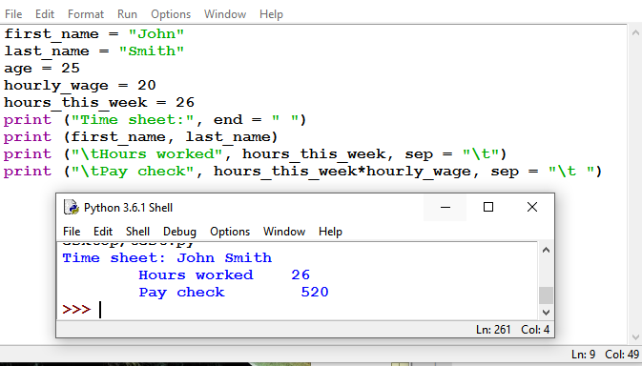
print() function
by default, the print call is ended by a newline; to change this behavior you need to assign the desired value to the end variable

