Slide 1
TOPIC:
Variables

Slide 2
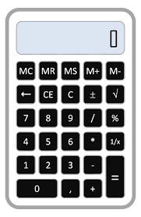
Computer Storage
Computers can remember or store information for later retrieval
Calculators use this concept with the Memory store function
14
Memory:
14
Value: current number stored or remembered for the Calculator memory location
We can view the Memory “value” as a value stored somewhere in the computer (or calculator) memory.

Slide 3
Example
We want to add the differences between two students test scores.
One approach:
Enter test score for Student 1
Hit subtract
Enter test score for Student 2
Press Equal
Press M+ or Memory Add
Do next test scores
14
Memory:
34
The memory location holds the total score differences up to the current test being processed
The value stored at the memory location can change. It will likely be a different value after every test is processed. Hence the value at the memory location varies – so the memory location is referred to as a “variable”

Slide 4
Example - Continued
One approach:
Enter test score for Student 1
Hit subtract
Enter test score for Student 2
Press Equal
Press M+ or Memory Add
Do next test scores
14
Memory:
34
Many storage locations of a computer do not change, so these locations would not be variables.
Generally, a calculator has one “memory” location that can be used. In a computer, we have access to hundreds and thousands of memory locations
To distinguish a memory location, and to document what type information might be there, we give the storage location a variable name. In our example “Total Difference” might be a good description of the value at that location

Slide 5
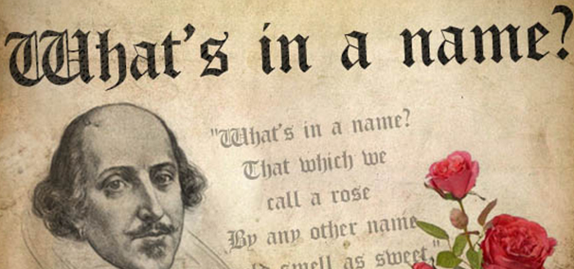
Variable Names
Our instructions will be referring to the variable names, so it name should have some meaning within the problem
Generally, a variable name has some rules about its syntax:
Begins with a letter, but may have numbers after it.
Does NOT contain blanks
Does not use special characters except for the underscore ____ or dash --
Actual naming rules differ slightly depending upon the instruction or programming language being used.
Programming languages also have “reserved” words that the language uses such as loop, if, then, else. These words can not be used as variables.
GOOD NAMES
BAD NAMES
Last_Score
1Place
else
lastNAME
Next Number
Total2018
!!SurpriseDate

Slide 6
Variable Usage in previous topics
We have indirectly used variables for:
Method Parameters – P1, P2, P2
Loop Index
for i in range (1,10):
i:
(value)
SEW
MOVE RIGHT
(NEXT ITERATION)
MAIN
P1:
(value)
METHOD1

Slide 7
Using Variables
Example – Calculate the area of a rectangle that is 7 inches by 9 inches.
Will use 3 variables:
Length – will hold the length of the rectangle
Width – wil hold the width of the rectangle
Area – Value will be the area of a rectangle , based upon the values of Length and Width.
Steps:
Assign the value of 7 to length
Assign the value of 9 to width
Assign the value of length to Area
Multiply the the value in Area by width.

Slide 8
Assignment Statements
Example – Calculate the area of a rectangle that is 7 inches by 9 inches.
Steps:
Assign the value of 7 to length
Assign the value of 9 to width
Assign the value of length to Area
Multiply the value in Area by width.
Giving a variable a value is referred to “Assigning” a value. An instruction that set the value of a variable is an Assignment statement
Assignment statements are generally expressed with an equals sign =
The steps in our problem could be written as:
length = 7
Width = 9
Area = length
Multiply Area by width

Slide 9
Assignment Statements
Example – Calculate the area of a rectangle that is 7 inches by 9 inches.
Steps:
Assign the value of 7 to length
Assign the value of 9 to width
Assign the value of length to Area
Multiply the value in Area by width.
length = 7
Width = 9
Area = length
Multiply Area by width
Don’t view assignment statements in the same way you have seen equations in algebra
The last instruction Multiply Area by width could be thought as:
Area = Area * width
This should read to you as: (looking at the right side) – Multiply Area and Width and take the result and store it into Area.
Note: the right side of the assignment statement will only have one operator until we move to the Python environment

Slide 10
Variables
Challenges
Calculate the perimeter of a rectangle that is 5 inches by 3 inches.
What is the average of these test scores: 94,80, 95
How old is someone born on today’s month and day, but in the year 1993?
How many days are between May 2 and August 13? Hint: create some variables like Days_In_May = 31.

Slide 11
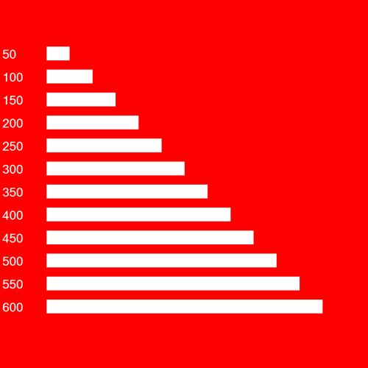
Variables in Loops
Variables can be very useful during the processing of loops
Often a variable can be used to hold a value that is a function of the loop index.
Example: Draw a set of rectangles that 50,100,150…600 in length
MoveDown(100)
For loopindex in range(1,12):
len = loopindex
len = len * 50
WriteText( len , 20)
MoveRight(100)
FillRectangle(len,30)
MoveLeft(100)
MoveDown(50)
# end of loop: loopindex

Slide 12
Challenges
Create a pattern of progressively larger squares
Make a lotter card as shown above. Use Loops. Calculate the number to print by using the 2 loop indexes of your nested loop.

Slide 13
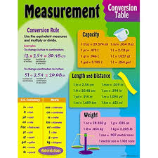
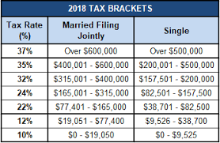
“Constant” variables
At times , variables are used to store value that will not change, during this execution of the instruction set
Examples include 98.6 (body temperature), tax rates, conversion measures (2.2 pounds per kilogram).
Generally these variables are referred to as constants. Some programming languages promote defining constant variables with special syntax.

Slide 14
Data Types
Variables also can hold different “types” of data.
Common data types are:
Integer – the variable value is a whole number without decimals
Decimal – the variable value is a number that can include decimals
String – the variable value is a set
Boolean – the variable value is either True or False
Date - the variable value is a date (MM/DD/YY).
In Pathway2Code, we will only use Integer and Decimal. All variable are integer, unless the variable name starts with “dec”, then its value could hold a decimal.
Total_amount
52
decBill_Amount
74.28
count:
49922
decCash:
14.0

Slide 15
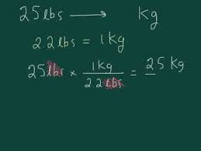
Convert your weight (in pounds) to kilograms
dec_conv_rate = 2.2
dec_myWeight = 178.5
WriteText( "My weight in pounds is: " , 24)
MoveRight(400)
WriteText( dec_myWeight , 24)
dec_kiloweight = dec_myWeight
dec_kiloweight = dec_kiloweight / dec_conv_rate
MoveDown(80)
MoveLeft(400)
WriteText( "My weight in kilograms is : " , 24)
MoveRight(400)
WriteText( dec_kiloweight , 24)

Slide 16
Variables
Challenges
Calculate how many inches are in a 10 kilometer race.
What is the total amount you would pay in a restaurant , if the bill was $70.00, and you first added 8.25% for the tax and then 18% for the tip?
Find out how calculate your Body Mass Index. Find the formula and calculate your own BMI.
A car travels 230 miles on a ¾ of a tank of gas. The tank holds 12 gallons. Using variables for the miles driven, the percentage left in the tank and the size of the tank, calculate the miles per gallon statistic for the car.

