Slide 1
MAIN
METHOD1
TOPIC:
Methods

Slide 2
WORKING WITH METHODS
Methods are blocks of code that can are built to do one specific task. Other names for methods are procedures, functions , and subroutines.
When the same block of instructions is needed at another point in the instruction set , methods can help reduce repetition and make the instruction set clearer.
This technique can be seen in many other types of direction sets.

Slide 3
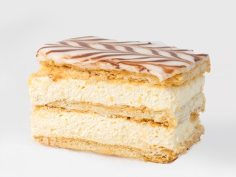
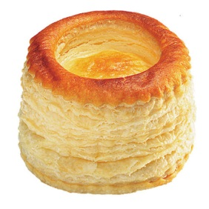
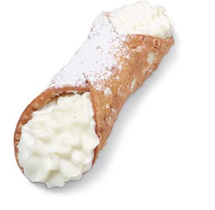
Saving and Reusing Instructions
RECIPE: Napoleons
RECIPE: Pastry Shells
RECIPE: Cannoli's
Preheat Oven
Make Pastry Dough (see A)
Roll out dough
Layer cream
…..
Grease Pan
Make Pastry Dough (see A)
Spread dough on pan
Circle with hands to make puffs
…..
Gather filling ingredients
Make Pastry Dough (see A)
Roll out dough
Spread filling on dough
…..
Cookbook Appendix
How to make Pastry dough
Mix flour and salt
Cut in shortening with blender
Combine eggs and other ingredients
Sprinkle water over rolled pieces
Bake

Slide 4
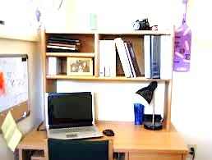
ASSEMBLY DIRECTIONS
DESK ASSEMBLY
Lay top of desk upside down on floor
Attach legs using Bracket (Procedure A)
Stand Desk up
Attach Shelf using Bracket (Procedure A)
Slide in drawer
Insert light shade to light poleAttach Light Pole using Bracket (Procedure A)
PROCEDURE A
Predrill holes in desk
Line up bracket to holes
Insert each screw halfway
Check bracket position
Complete insertion of screw
Tighten with quick twist twice

Slide 5
WORKING WITH METHODS
Methods are blocks of code that can are built to do one specific task. Other names for methods are procedures, functions , and subroutines.
An instruction set has a Main method which is the first block of code to be executed.
Other blocks of codes may be called or invoked from the Main method.
MAIN
METHOD1

Slide 6
Pathway2Code – Create a Method
First choose the New Method Command.
Next enter the method name and the number of parameters. Your method can use parameters like the Pathway2Code commands
Enter the instructions within the command. We entered Method1 as the method name with 2 parameters

Slide 7
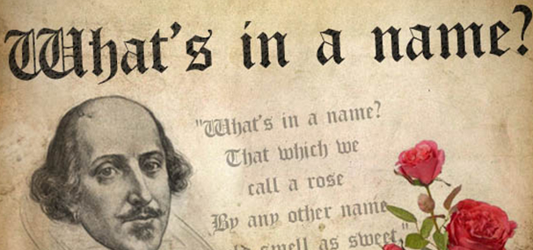
Rules For Methods
Methods must be named. The Name must start with a letter and have no special characters, including blanks. Only exception is _
M2 ok
New M2 not ok (no blanks)
1Method not ok (must start with a letter)
M1** not ok (no special characters except for _ )
M_1 ok
Each instruction set must have a Main method. This is generated for you when a new instruction set is created.
Methods can return a value representing a result of its execution or run. We will look at this capability in the latter stage of the course.

Slide 8
Methods in the Tool
Main
PositionPen(0,0)
MakeBox()
PositionPen(200,200)
MakeBox()
PositionPen(400,400)
MakeBox()
PositionPen(600,600)
MakeBox()
MakeBox()
DrawLine( 50 , "H",10)
MoveRight(50)
DrawLine( 50 , "V",10)
MoveDown(50)
MoveLeft(50)
DrawLine( 50 , "H",10)
MoveUp(50)
DrawLine( 50 , "V",10)

Slide 9
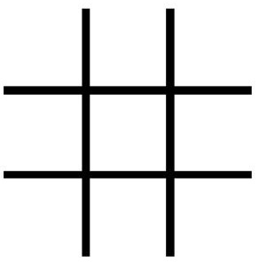
Use a method or two to help generate a Tic Tac Toe Board using the Stitching Tool
Challenges
Use a method or two to help generate the tile pattern below using the Graphics tool.

Slide 10
USING PARAMETERS
Parameters are used to send information from one block to another block of code.
For Pathway2Code, all parameters are integers, or numbers without decimals. In other environment, different types of information can be provided to a method.
For Pathway2Code, up to 3 parameters are allowed
When referencing the values of parameters, use P1, P2 or P3.

Slide 11
Challenges
Main
PositionPen(100,100)
Box(40)
MoveDown(40)
MoveRight(40)
Box(80)
MoveRight(80)
MoveDown(80)
Box(120)
MoveRight(120)
MoveDown(120)
Box(160)
Box(P1)
Method: Box(P1)
DrawLine( P1 , "H",5)
MoveRight(P1)
DrawLine( P1 , "V",5)
MoveDown(P1)
MoveLeft(P1)
DrawLine( P1 , "H",5)
MoveUp(P1)
DrawLine( P1 , "V",5)
What will the following program produce?

Slide 12
Challenges
Use a Symbol to create the shape. In the Main method, call the Symbol method to position each symbol.

