Slide 1
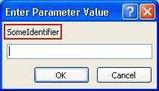
TOPIC:
Parameters
Command ( Parmeter 1 , Parmeter 2)
Drive ( West , 2 miles)
Attach ( Leg , 2 TableTop)
Cook ( 20 minutes , 350 degrees F)

Slide 2
Where can we find instructions in everyday life
Driving Directions
An ordered set of instructions with commands for making various turns.
Assembly Instructions
A description of a set of actions to take to assemble multiple components into one object.
Directions to take actions on ingredients in order to produce an edible product
Recipes
All of these examples have a specific set of instructions, which have a command and accompanying information. You must run or execute these instruction to achieve the target result.

Slide 3
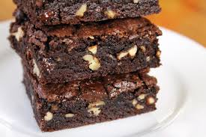
Recipe Example
What are the commands in this recipe?
Challenge
Recipes have a set of sequential ordered instructions
Instructions generally involve a “command” with additional information
Commands are verbs such as Mix , Pour , Cook

Slide 4
Analyzing the Recipe Text
Describing actions that can be taken are often referred to as Commands.
An instruction is a command with additional information. These pieces of additional information are Parameters.
Parameters provide more information about the command. For example Cook for 20 minutes is the Command : Cook, with a parameter of Time.
A common way of writing commands with parameters is Command(Parameter) or Cook(20)
A command may have more than one parameter.

Slide 5
Command Definition
Command Definition | Example | English Translation
Cook(Time, Temperature) | Cook(20,200) | Cook for 20 minutes at 200 degrees
Pour(Ingredient, Container) | Pour(Water, Mixing Bowl) | Pour water into the mixing bowl
Stir (Time, Container) | Stir(20, Wet Ingredients Bowl) | Stir the wet ingredients for 20 minutes
Add(Ingredient, amount, Container) | Add(Water, 2 cups, Wet Ingredients) | Add 2 cups of water to the wet ingredients

Slide 6
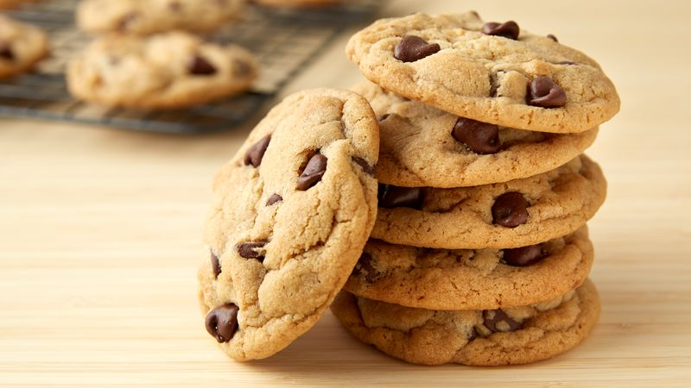
Challenge
Rewrite the following recipe with the commands on the previous slides and any new commands required.
First Step: Melting and Mixing First, in a microwavable dish, melt the 1/4 cup of butter (make sure that the butter is completely melted, otherwise it will not mix in with the other ingredients, and you will have to start over). Then stir this into the 6 Tablespoons of Unsweetened Cocoa.
Second Step: Mixing Brownie Batter Now, combined with the butter and cocoa--mix in thoroughly: I Cup Sugar 2 Eggs 1/2 Teaspoon Vanilla Extract 1/3 Cup Flour 1/4 Teaspoon Salt
Third Step: Brownie Batter This is how your final batter should look. If you would like to add pecans to your batter, do it now. Now, pre-heat oven to 325F degrees.
Fourth Step: Flouring The Brownie Pan You will need to flour the baking pan. First, cover the glass dish with Crisco (vegetable fat) or butter. Then, put a few tablespoons of flour or cocoa in the dish, and shake it until the sides and bottom are covered. This will keep the brownies from sticking to the dish.
Fifth Step: Pouring Brownie Batter Pour the brownie batter into the dish.
Sixth Step: Cooking and Cooling Brownies After your oven has preheated to 325F, put the brownies into the oven for 35-40 minutes. Poke your brownies with a toothpick. If the tooth pick comes out clean, your brownies are done! Now, take them out of the oven and let them cool until slightly warm. You are ready to cut and serve.

Slide 7
Challenge
Rewrite your instruction set for the Stretch X result above to use commands with parameters.

Slide 8
Parameters
Parameter
Commands with parameter have text boxes or list boxes for entry of a command value.
Parameters and commands often have a ? Icon to indicate help text is available for entering the information
Parameter are “edited” or check for a valid value. In this example the number to move must be between 1 and 50 since the Cloth is 50 by 50 set of squares.

Slide 9
World: Music
The Music world allows you to put notes on a musical staff
The music starts at the third space , where the start arrows is located
The command AddNote will add a note to the staff, that is your melody line.
Movement up and down the staff is based upon the number of lines or spaces.
For those who can read music, please note:
- No key signature is used
- Sharps and Flats can be attached to any note
- Dotted notes are not available

Slide 10
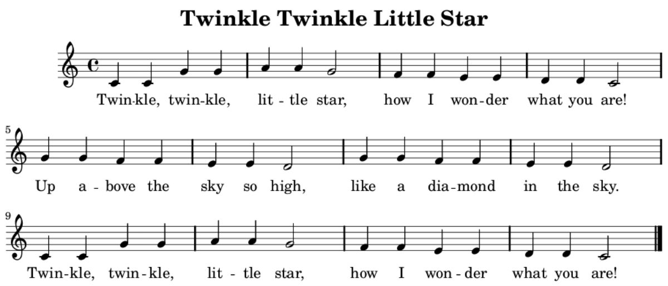
Music Example

Slide 11
Challenge
Finish writing the instructions for Twinkle Twinkle Little Star

Slide 12
Challenge
Pick a song of your own choosing and see if you can develop the melody line.
Some constraints include: dotted notes are not supported, and rests not supported:
AVOID Songs with these rest symbols
Look for this symbol so you do not have hidden sharp and flat notes

