Slide 1
TOPIC:
Random Numbers

Slide 2
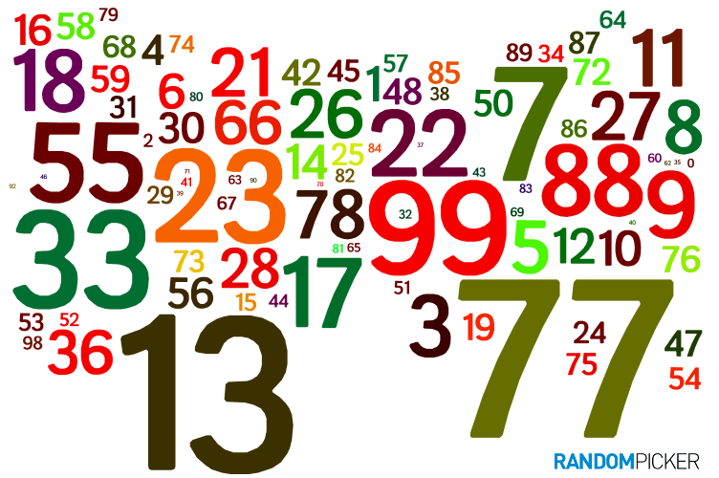
RANDOM NUMBERS
Random numbers are those chosen by the computer. These numbers can make our instruction set more interesting by giving us unexpected values.
Random numbers are essentially parts of :
Computer simulations
Video games
Some graphic displays
Generally we think of a random number in a range from 1 to N, where N is the largest number that can be chosen.

Slide 3
RANDOM NUMBER GENERATION
Random numbers are generated by performing a sophisticated set of math operations on a number and returning the result.
The second number requested uses the results as input for next set of calculations
When the same seed is used each time for an instruction set, the same numbers will be generated. This is helpful for testing. When the instruction set is finished, the setting of the seed can be removed.

Slide 4
RANDOM NUMBER GENERATION
Random numbers in Python can be chosed using the random.randint the function.
random.randint(lowest, highest)
(in Pathway2Code, the lowest is assumed to be 1)
The first parameter is the lowest in the range, where the second is the highest. random.randint(1,10) gives you a number from 1 to 10
To set the seed, we will use the random.seed(N), where N is the seed.

Slide 5
RANDOM NUMBERS
Example: Generate a set of circles with random colors

Slide 6
Practice!
Challenge
Generate an output with 20 circles that have a randomly chosen diameter from 10 to 300. Hint pick a number from 1 to 30 and then multiply by 10 to get the diameter.
Compose music randomly. Pick a number from 1 to 20, subtract 10 so the your number is from – 10 to 10. If the number is negative, move lower that number, if it is positive move higher.
Have the system pick a number from 1 to 100. Have the system prompt you for a guess. If your guess high, output high and guess again. Same for low. Keep guessing until you get the number

