Slide 1
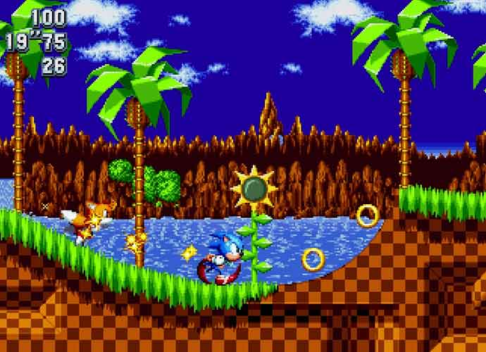
What comes to mind when you see these video games?

Slide 2
Producing Video Game Music & Sound
Culmination Project - Spring 2021
Christopher Riba

Slide 3
The Importance of Video Game Music & Sound
Great video games have fun or unique gameplay but what else is needed to complete the overall experience?
Is it the visuals, story, or characters? Yes, these definitely help but…
The music and sound design of a game is one of the major components that helps tie everything together
It can be off putting when a game lacks music and sound or doesn’t compliment the feel of a game’s scene, world, and player actions

Slide 4
How can music & sound design be implemented into games effectively?
Some game audio artists have different approaches.
Catchy and repetitive to create addicting urges to keep playing
Ambience and immersion within a world to create tension and other emotions
Realism to make for a world that is easier to understand or relate to

Slide 5
My history and experience with music
In school chorus since middle school
Joined many extracurricular clubs in high school like rock club, vocal workshop, and guitar. Performed in several shows
Graduated with A.A.S. in Music production at Queensborough Community College. Continued music in NYCCT under the Emerging Media Music Tech program
Huge liking in 80’s rock music and video game soundtracks
Some of my favorite video game music come from classic Sega games like Sonic the Hedgehog, Super Monkey Ball, Nintendo’s all stars like Super Mario Bros., The Legend of Zelda and many more.
Super Smash Brothers Ultimate is a good example as it has tracks across dozens of game series and genres with an inclusion of over a 1000 songs. THAT’S A LOT!!!

Slide 6
My Culmination Project Process
Research, planning, and team building.
Daily practice and exercise routine
Create music and sound for students' games

Slide 7
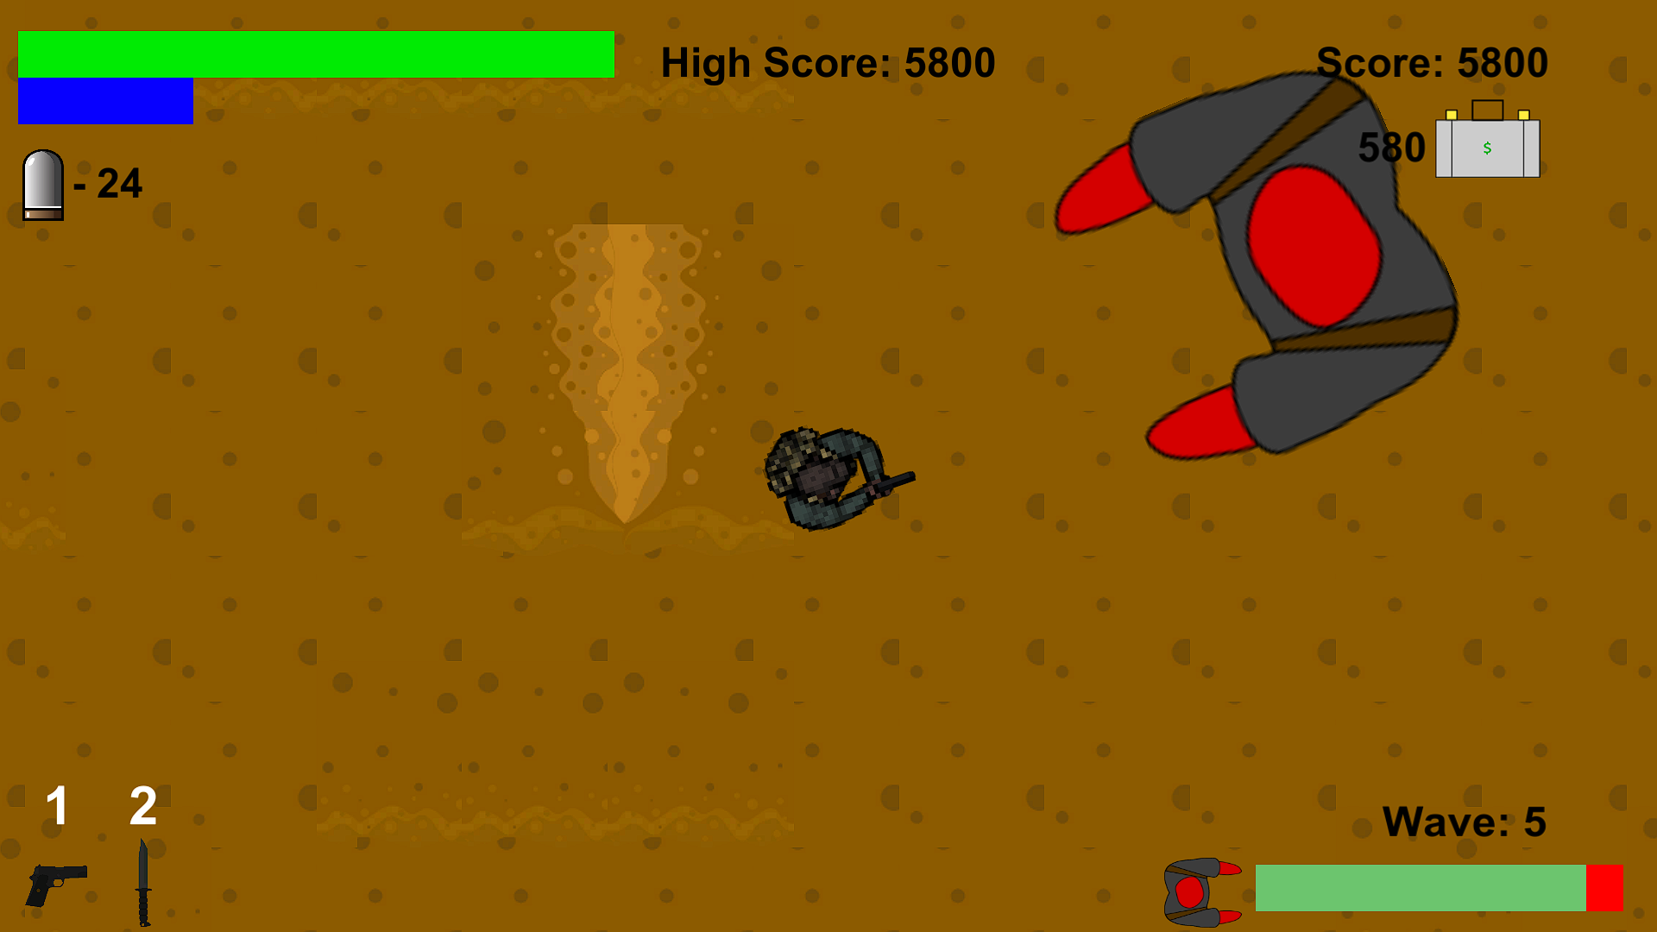
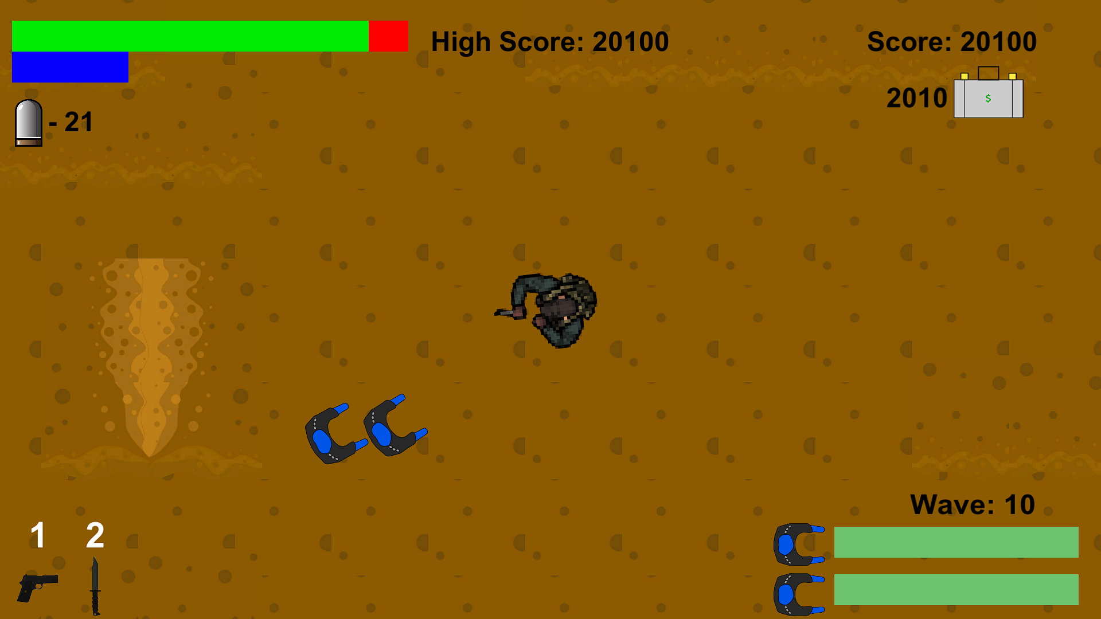
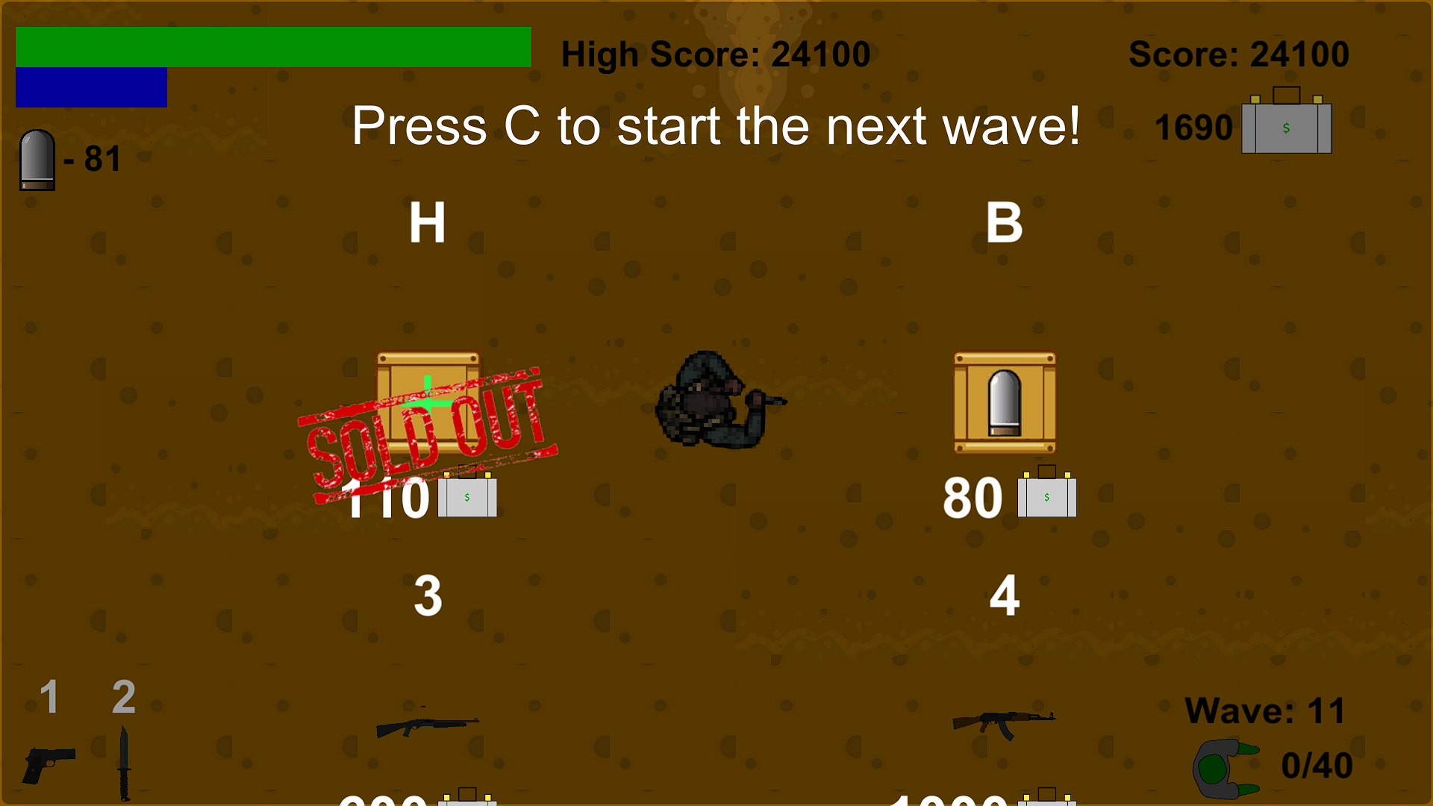
Johnny Colonna’s Game: Area 51 Raid Prototype
What it’s all about
Top-down view alien survival game
Waves of alien hordes appear each round
Every round gets harder by increasing the number of aliens and their movement speed
Killing the aliens earn you points
After a round is completed, you can use these points to purchase ammo, health, and weapons.
Every 5 rounds is a unique enemy boss
Survive for as long as possible by avoiding the zombies reach and get that juicy high score

Slide 8
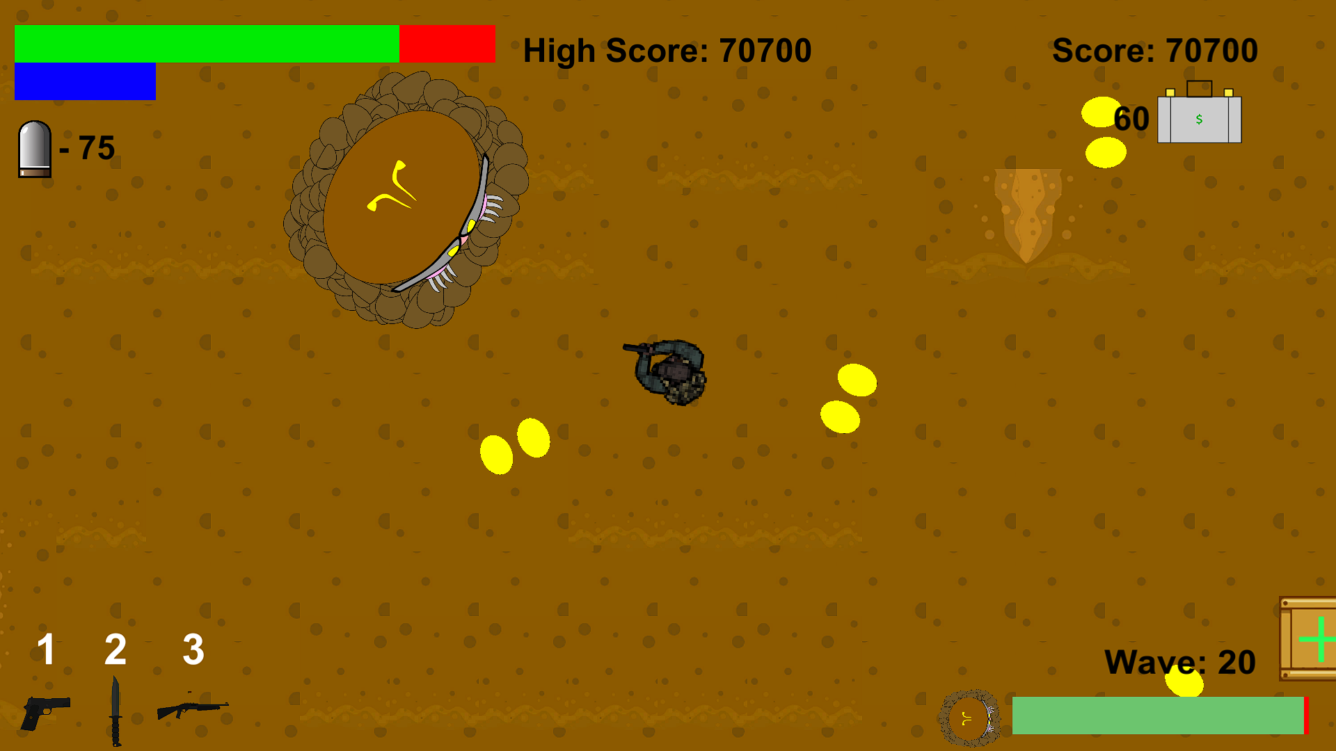
Area 51 Raid(continued)

Slide 9
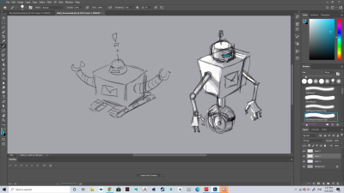
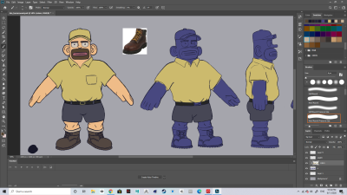
Julian Frost’s Game: Boxed Out
What it’s all about
Beat em’ up style game
AI robots have taken all the Jobs at Zamadon delivery company which he’s worked at for many years now
Jim the protagonist isn’t too happy about this. Jim wants to show a little piece of his mind and get his job back
Travel through town and destroy the robots in your way and make your way to Zamadon factory
Jim is quite old now, he’s also very short. Not only this but he has hypertension so try not to perform too many actions or Jim will faint becoming vulnerable to incoming attacks

Slide 10
How I create sound – Ableton Live 11
The Digital Audio Workstation(DAW) I use is called Ableton Live 11
Here I can write, record, and mix sounds
First, I think of the mood or feel of the game’s setting and I write around that using themes
I can achieve a theme by choosing a specific genre, choosing related instruments or sounds, and setting the pacing or tempo(bpm) of the song
Sometimes I start off with the bass line, sometimes I start out with the drums, or other times I start with the main melody or chord progression.

Slide 11
How I create sound – Ableton Live 11(continued)
I can control sound by using tools like midi instruments and synthesizers (synths)
Midi is digital information that tells the computer when to play a sound, how loud to play a sound, etc.
I can record this by either drawing in notes within the time grid or record it using a midi controller.
A midi controller is basically a piano keyboard that can detect input

Slide 12
How I create sound – Ableton Live 11(continued)
Instead of writing music with midi instruments I can use already recorded sounds a.k.a. samples or audio
I can then manipulate these midi instruments and audio in various ways using effects like reverb, compression, and EQ.

