Slide 1




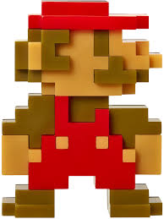
Department of Entertainment Technology
Culmination Project
Christopher Riba – Videogame Music and Sound Producer
Budget Estimate
Physical Equipment | Description | Cost
Desktop Computer System Setup | Custom build including casing, monitor, etc | $1100 (owned)
Professional Headphones | Sony MDR-7506 | $130 (owned)
Audio interface | Presonus Audiobox USB | ? (owned)
Midi Keyboard | Casio | ? (owned)
Microphone | X1 large diaphragm condenser mic | $100
 | Total | $1,430
Software | Description | Cost
Ableton Live Standard Edition (DAW) | Upgrade from trial. Student discount. | $270 (owned)
Syntehsizers/Plug-ins | Virtual instruments and effects | $100
 | Total | $370
 | Grand Total | $1,700

