Slide 1
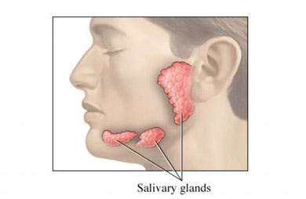
SJOGREN’S SYNDROME
Presented by: Cheryl Ann Peters

Slide 2
DEFINITION
* A chronic, systemic and inflammatory autoimmune disease in which immune cells attack and destroy exocrine glands that produce tears and saliva. Characterized by an unusual accumulation (infiltration) of lymphocytes of the exocrine glands.
* Primary Sjogren’s syndrome: does not develop as a result of another condition.
* Secondary Sjogren’s Syndrome: a condition that coexists with other autoimmune disease such as rheumatoid arthritis, lupus and scleroderma.
* It mainly affects women (90%) with the majority being 40 years of age and older.

Slide 3
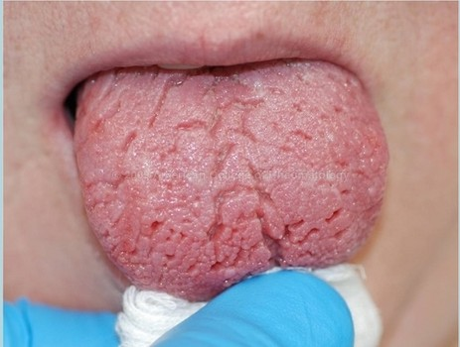
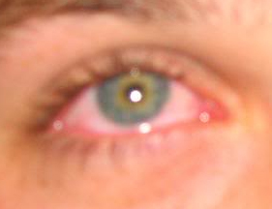
SYMPTOMS
Hallmark symptoms of Sjogren’s Syndrome is generalized dryness, typically dry eyes (Xeropthalmia or Keratoconjunctivitis sicca), dry mouth (Xerostomia) and vaginal dryness.

Slide 4
MANIFESTATIONS
Oral Manifestations: Ocular Manifestations:
* Difficulty speaking, swallowing, eating * Dry, itchy eyes
* Persistent dry cough * Foreign body sensation
* Hoarse voice * Swollen and irritated eyelids
* Dental caries * Photophobia (sensitivity to light)
* Swollen salivary glands * Stinging and burning eyes
* Decreased salivary flow * Mucus discharge
* Recurring fungal infections of the mouth * Grittiness
* Frequent sips of water needed * Redness
* Decreased sense of taste

Slide 5
PHARMACOLOGIC CATEGORY
Etiology of Sjogren’s Syndrome is obscure although several hypotheses exist.
* Environmental stimulus that promotes an autoimmune reaction in genetically susceptible persons.
* Infectious agents have been postulated to trigger the syndrome
Treatment is generally symptomatic and supportive. Medications can help stimulate salivary glands and increase production of saliva.
Pharmacologic Category: Cholinergic Agonists
* Pilocarpine (Salagen)
* Cevimeline (Evoxac)

Slide 6
MECHANISM OF ACTIONS
Cholinergic Agonists :
* Binds to muscarinic (cholinergic) receptors, causing an increase in secretion of exocrine glands – salivary
* Pilocarpine is a nonselective muscarinic agonist
* Cevimeline is a selective muscarinic agonist
* Dosage:
* Oral Pilocarpine - 5 mg twice daily
* Oral Cevimeline - 30 mg three times daily
Adverse effects on dental treatment:
* Excessive salivation, salivary gland pain, ulcerative stomatitis , xerostomia and teeth problems.
* Side effects may include sweating, abdominal pain, flushing and increased urination
Significant Adverse Effects:
* Hypersensitivity to Pilocarpine and Cevimeline are contraindicated in narrow-angle glaucoma, uncontrolled asthma, acute iritis and severe hepatic impairment
Warnings and Precautions:
* Use caution in patients with cardiovascular disease, controlled asthma, chronic bronchitis and bilary tract disease.

Slide 7
IMPACT ON DENTAL HYGIENE CARE
* Good oral hygiene – prevents gum disease and infection
* Salivary stimulation - sugar free (Xylitol ) chewing gum and sour lemon lozenges
* Consume more liquids
* Daily topical fluoride and antimicrobial rinses help prevent caries
* Brush with Biotene toothpaste
* Use of OTC salivary substitute lozenges, gel, rinses, sprays, swabs contain carboxymethylcellulose, mucin or glycerine , which help lubricate the oral mucosa.
* Give up smoking – smoking speeds up the rate at which saliva evaporates and irritates the mouth
* Maintain frequent visits to the dental hygienist.

Slide 8
REFERENCES
Kruszka P, O’Brian R. J. “Diagnosis and Management of Sjogren’s Syndrome”. American Family Physician 2009; 79 (6): 465-470,472.
National Institute of Neurological Disorders and Stroke, Sjogren’s Syndrome Information Page>http://www.ninds.nih.gov/disorder/sjogrens/sjogrens.htm
“About Sjogren’s Syndrome” (http://www.sjogrens.org/home/about-sjogrens-syndrome).

