Slide 1
Traditional Printing New York City college of technology
Professor Bauer
Notes:
This template can be used as a starter file for presenting training materials in a group setting.
Sections
Sections can help to organize your slides or facilitate collaboration between multiple authors. On the Home tab under Slides, click Section, and then click Add Section.
Notes
Use the Notes pane for delivery notes or to provide additional details for the audience. You can see these notes in Presenter View during your presentation.
Keep in mind the font size (important for accessibility, visibility, videotaping, and online production)
Coordinated colors
Pay particular attention to the graphs, charts, and text boxes.
Consider that attendees will print in black and white or grayscale. Run a test print to make sure your colors work when printed in pure black and white and grayscale.
Graphics, tables, and graphs
Keep it simple: If possible, use consistent, non-distracting styles and colors.
Label all graphs and tables.

Slide 2
The 5 traditional forms of printing are:
Letterpress
Offset Printing
Flexography
Gravure or Rotogravure- Intaglio
Silk Screen and
Digital Printing
Notes:
Give a brief overview of the presentation. Describe the major focus of the presentation and why it is important.
Introduce each of the major topics.
To provide a road map for the audience, you can repeat this Overview slide throughout the presentation, highlighting the particular topic you will discuss next.

Slide 3
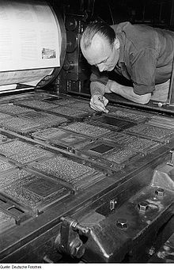
Letterpress printing is a technique of relief printing using a printing press, a process by which many copies are produced by repeated direct impression of an inked, raised surface against sheets or a continuous roll of paper.
https://www.google.com/imgres?imgurl=https://upload.wikimedia.org/wikipedia/commons/thumb/3/30/Fotothek_df_roe-neg_0006317_023_Mitarbeiter_der_Druckerei_Offizin_Haag-Drugulin.jpg/220px-Fotothek_df_roe-neg_0006317_023_Mitarbeiter_der_Druckerei_Offizin_Haag-Drugulin.jpg&imgrefurl=https://en.wikipedia.org/wiki/Letterpress_printing&h=341&w=220&tbnid=wHKiuWhisni50M:&tbnh=160&tbnw=103&docid=HRLzwnSMd9TsiM&hl=en&client=safari&usg=__LEuXrLjQPRrPJVrQUTMNC7DE11U=&sa=X&ved=0ahUKEwi_y5q1_v7LAhWHKx4KHQvIA-AQ9QEIITAA
Notes:
This is another option for an overview using transitions to advance through several slides.

Slide 4
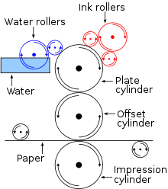
Offset printing is a commonly used technique in which the inked image is transferred (or “offset”) from a plate to a rubber blanket, then to the printing surface
https://www.google.com/imgres?imgurl=https://upload.wikimedia.org/wikipedia/commons/thumb/4/4e/Offset.svg/220px-Offset.svg.png&imgrefurl=https://en.wikipedia.org/wiki/Offset_printing&h=248&w=220&tbnid=sn5hj5J2bTMttM:&tbnh=160&tbnw=142&docid=pkmybpCHnAUZpM&hl=en&usg=__os_5yDiciVMzyZMNgz1pkh_C1Jg=&sa=X&ved=0ahUKEwi4yZHN_f7LAhXJ1R4KHTtZAOUQ9QEIJDAA

Slide 5
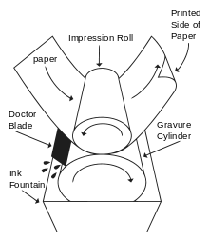
Rotogravure (roto or gravure for short) is a type of intaglio printing process, which involves engraving the image onto an image carrier. In gravure printing, the image is engraved onto a cylinder because, like offset printing and flexography, it uses a rotary printing press.
https://www.google.com/imgres?imgurl=https://upload.wikimedia.org/wikipedia/commons/thumb/a/a1/Rotogravure_PrintUnit.svg/220px-Rotogravure_PrintUnit.svg.png&imgrefurl=https://en.wikipedia.org/wiki/Rotogravure&h=254&w=220&tbnid=ZuJ5ODm24M_HoM:&tbnh=160&tbnw=138&docid=oMrqN-G3kKw65M&hl=en&client=safari&usg=__Hd-A-HgPUcXGX8sAdZRXGDExwyw=&sa=X&ved=0ahUKEwj8nP_s_v7LAhWGGB4KHWh7B-AQ9QEIJDAA

Slide 6
Flexography
flekˈsäɡrəfē/
a rotary relief printing method using rubber or plastic plates and fluid inks or dyes for printing on fabrics and impervious materials such as plastics, as well as on paper.
https://www.google.com/url?sa=t&rct=j&q=&esrc=s&source=web&cd=4&cad=rja&uact=8&ved=0ahUKEwjGj6ix__7LAhUEdx4KHWRyB_IQuAIIPzAD&url=https%3A%2F%2Fwww.youtube.com%2Fwatch%3Fv%3DvuGptR330VU&usg=AFQjCNHTKVrWzPCWKR1UIqEVqZMdWgPdPA

Slide 7
Silk Screen
A silk screen design. Screen printing is a printing technique whereby a mesh is used to transfer ink onto a substrate, except in areas made impermeable to the ink by a blocking stencil.
https://www.google.com/imgres?imgurl=https://upload.wikimedia.org/wikipedia/commons/thumb/a/a8/Silketrykk.svg/2000px-Silketrykk.svg.png&imgrefurl=https://en.wikipedia.org/wiki/Screen_printing&h=959&w=2000&tbnid=Z5l03TPzsU6Q-M:&tbnh=88&tbnw=183&docid=6eic58HOtg4DzM&hl=en&client=safari&usg=__-rgkupVVHGcfhNwTu0YgsahBDFI=&sa=X&ved=0ahUKEwi1m6OdgP_LAhXIFR4KHT64Ad8Q9QEIITAA
Notes:
This is another option for an overview slide.

Slide 8
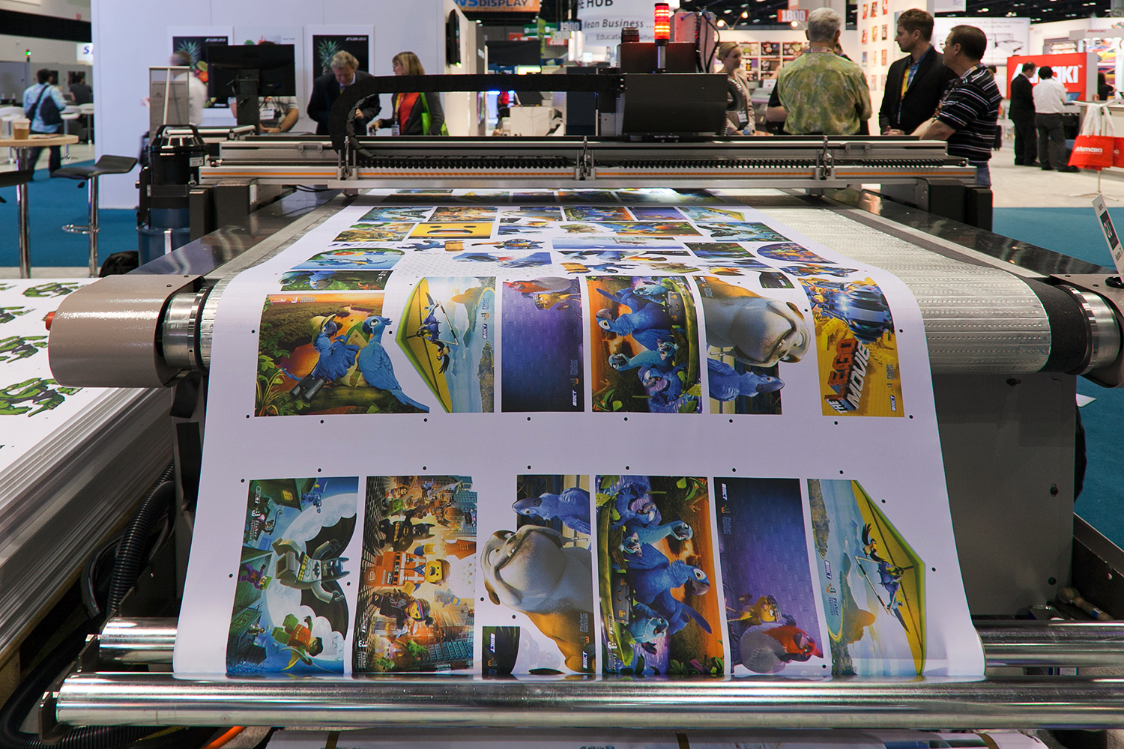
Digital Printing
Image result for what is digital printing
Digital printing refers to methods of printing from a digital-based image directly to a variety of media. It usually refers to professional printing where small-run jobs from desktop publishing and other digital sources are printed using large-format and/or high-volume laser or inkjet printers.
https://www.google.com/imgres?imgurl=https://upload.wikimedia.org/wikipedia/commons/a/a7/Large_format_digital_printer.jpg&imgrefurl=https://en.wikipedia.org/wiki/Digital_printing&h=1000&w=1500&tbnid=y2yXK9grfgb7aM:&tbnh=160&tbnw=240&docid=fmvzlvdvxAe_lM&hl=en&client=safari&usg=__gqePSji3fAmoez0cuhqgyb_X3pw=&sa=X&ved=0ahUKEwjeycibgv_LAhWIFx4KHaBICuAQ9QEIITAA
Notes:
What will the audience be able to do after this training is complete? Briefly describe each objective and how the audience will benefit from this presentation.

