Slide 1
David Carson
Graphic designer, type designer and art director

Slide 2
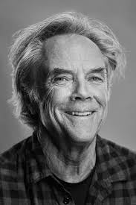
About david Carson
David Carson is a graphic designer, type designer and art director for the magazine Ray gun were he would apply many of the typographic layout approach. He is known to use this method of design he also use a unique aesthetic in graphic design called Grunge typography.

Slide 3
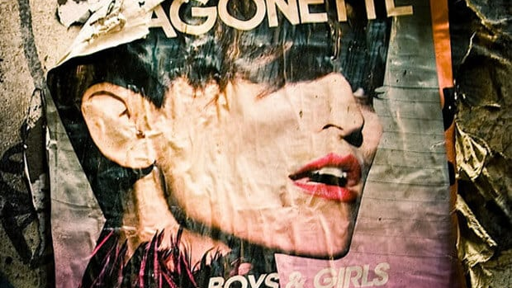
What is grunge typography
Has dirty backgrounds
Layered text on top of backgrounds
Torn edges
Real life imagery and cut outs
Unsettling fonts
Breaks every rule of typical good design
David Carson is the father of grunge typography
Appears the in 70s and 80’s

Slide 4
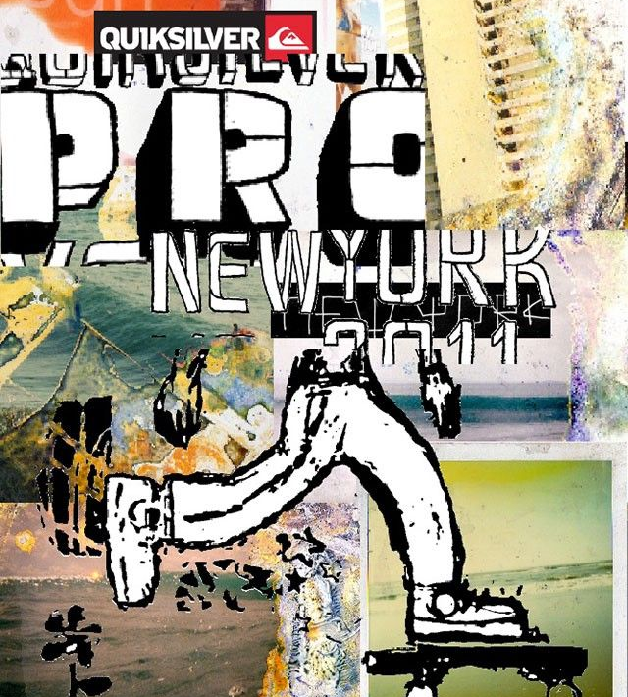
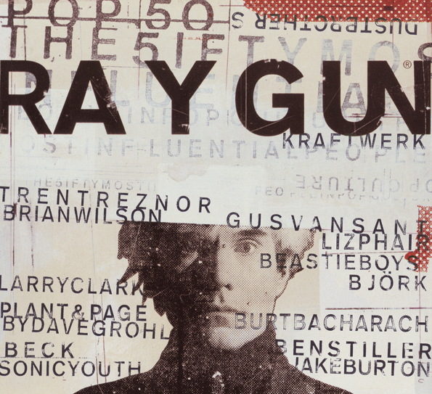
David Carson grunge Typograph

