Slide 1
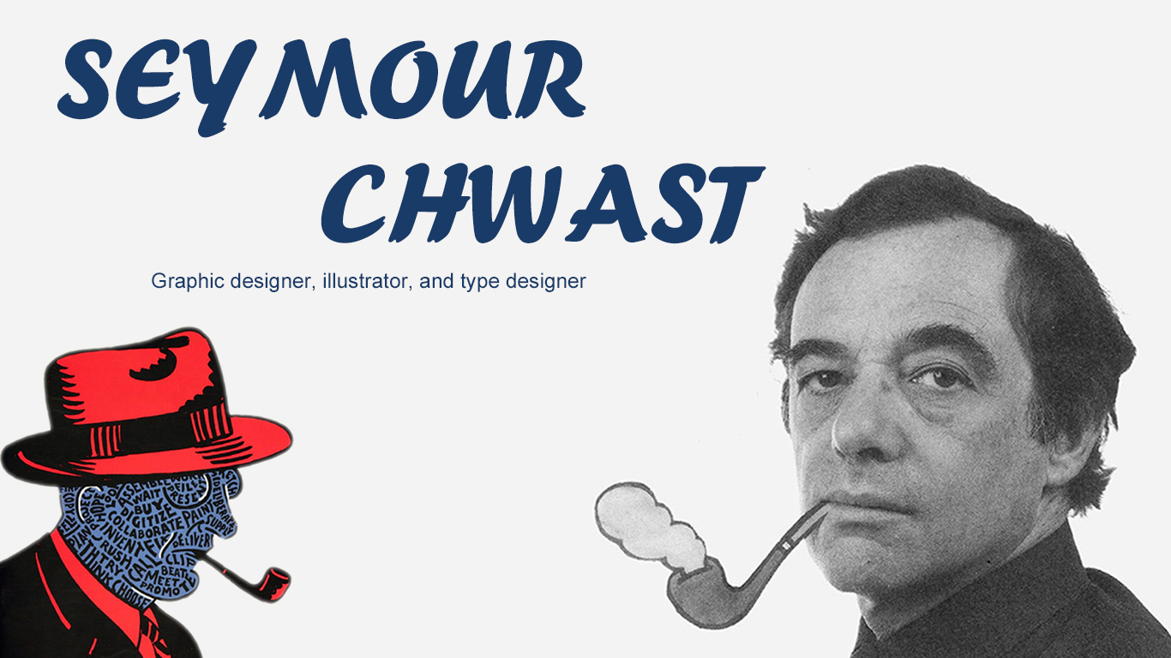
空白演示
单击输入您的封面副标题

Slide 2
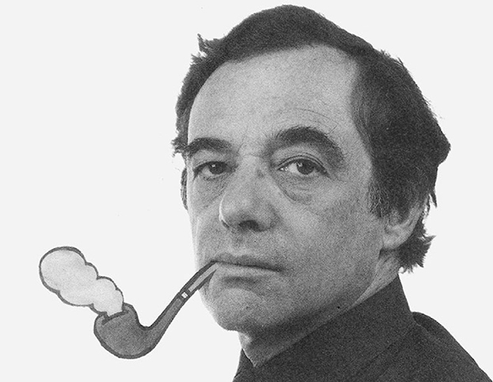
Introduce
Seymour Chwast is a well-known American graphic, illustrator and type designer known for his diverse work as well as outstanding illustrations, typefaces and a notable influence on visual culture. Chwast is best known for his commercial artwork, which includes posters, magazine covers, and propaganda art that is often satirical, humorous or political in nature.

Slide 3
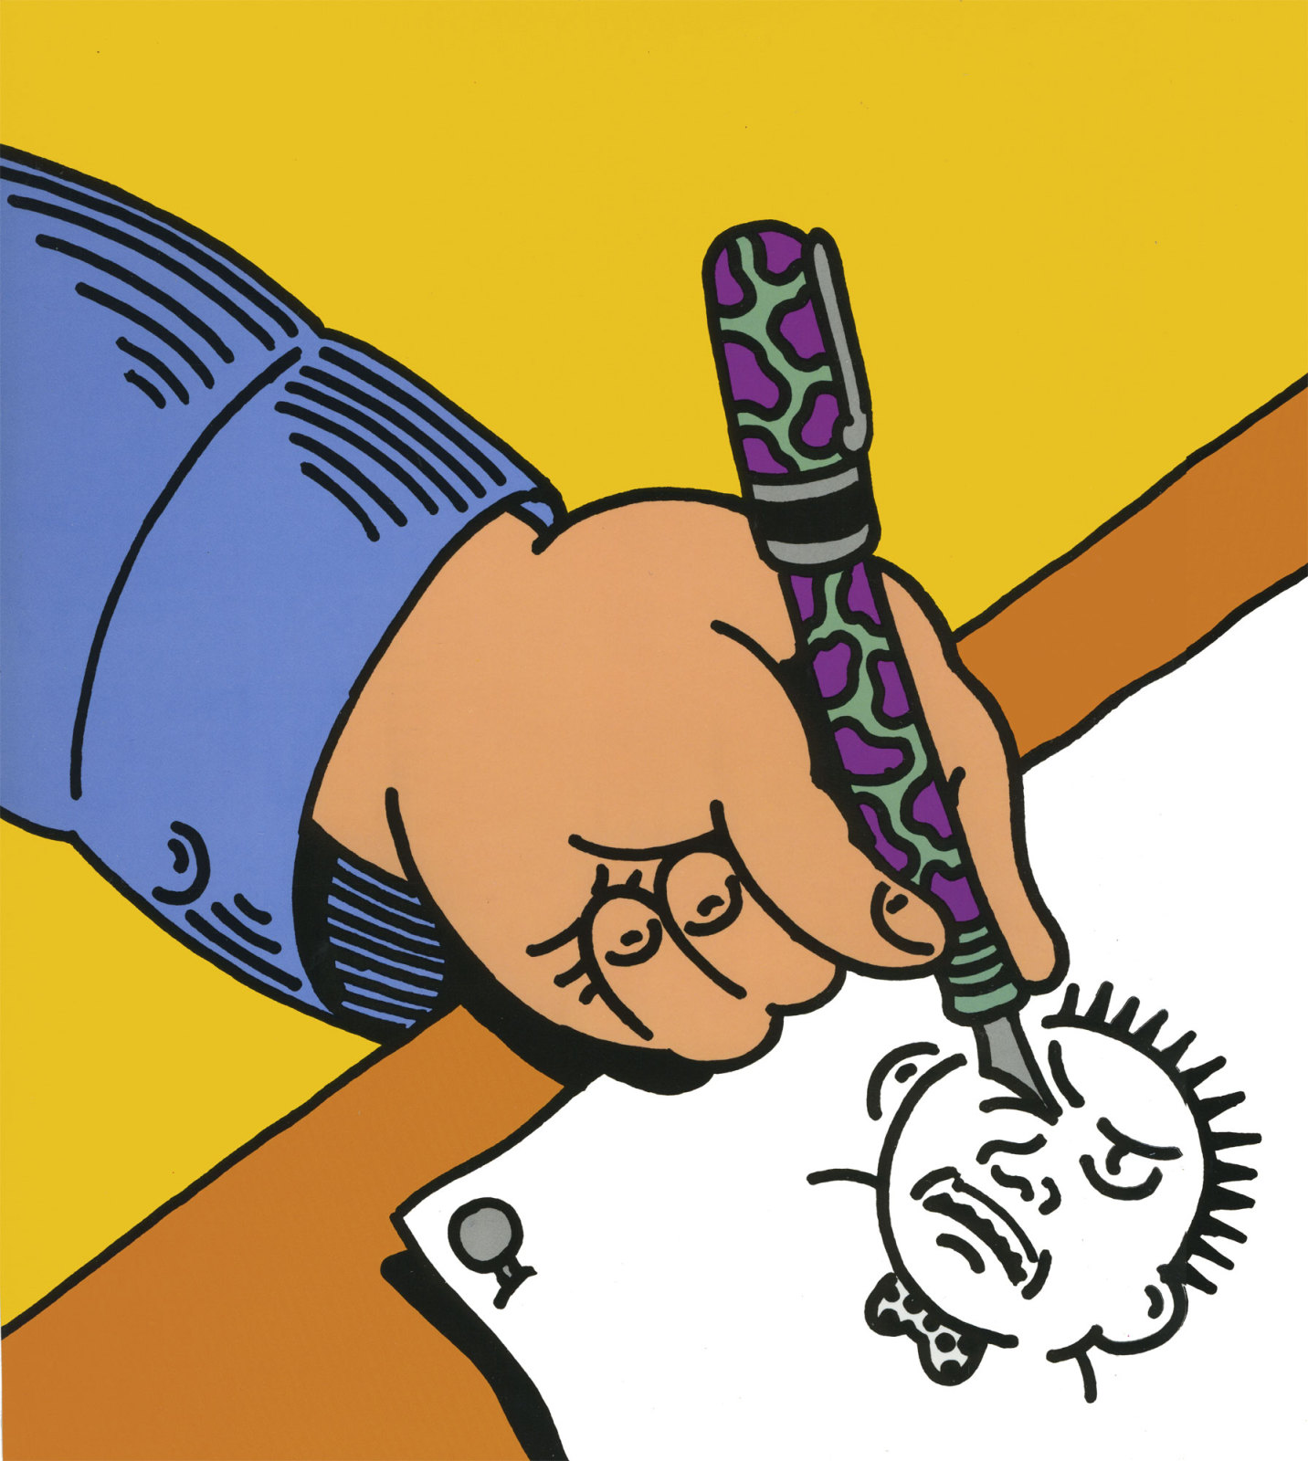
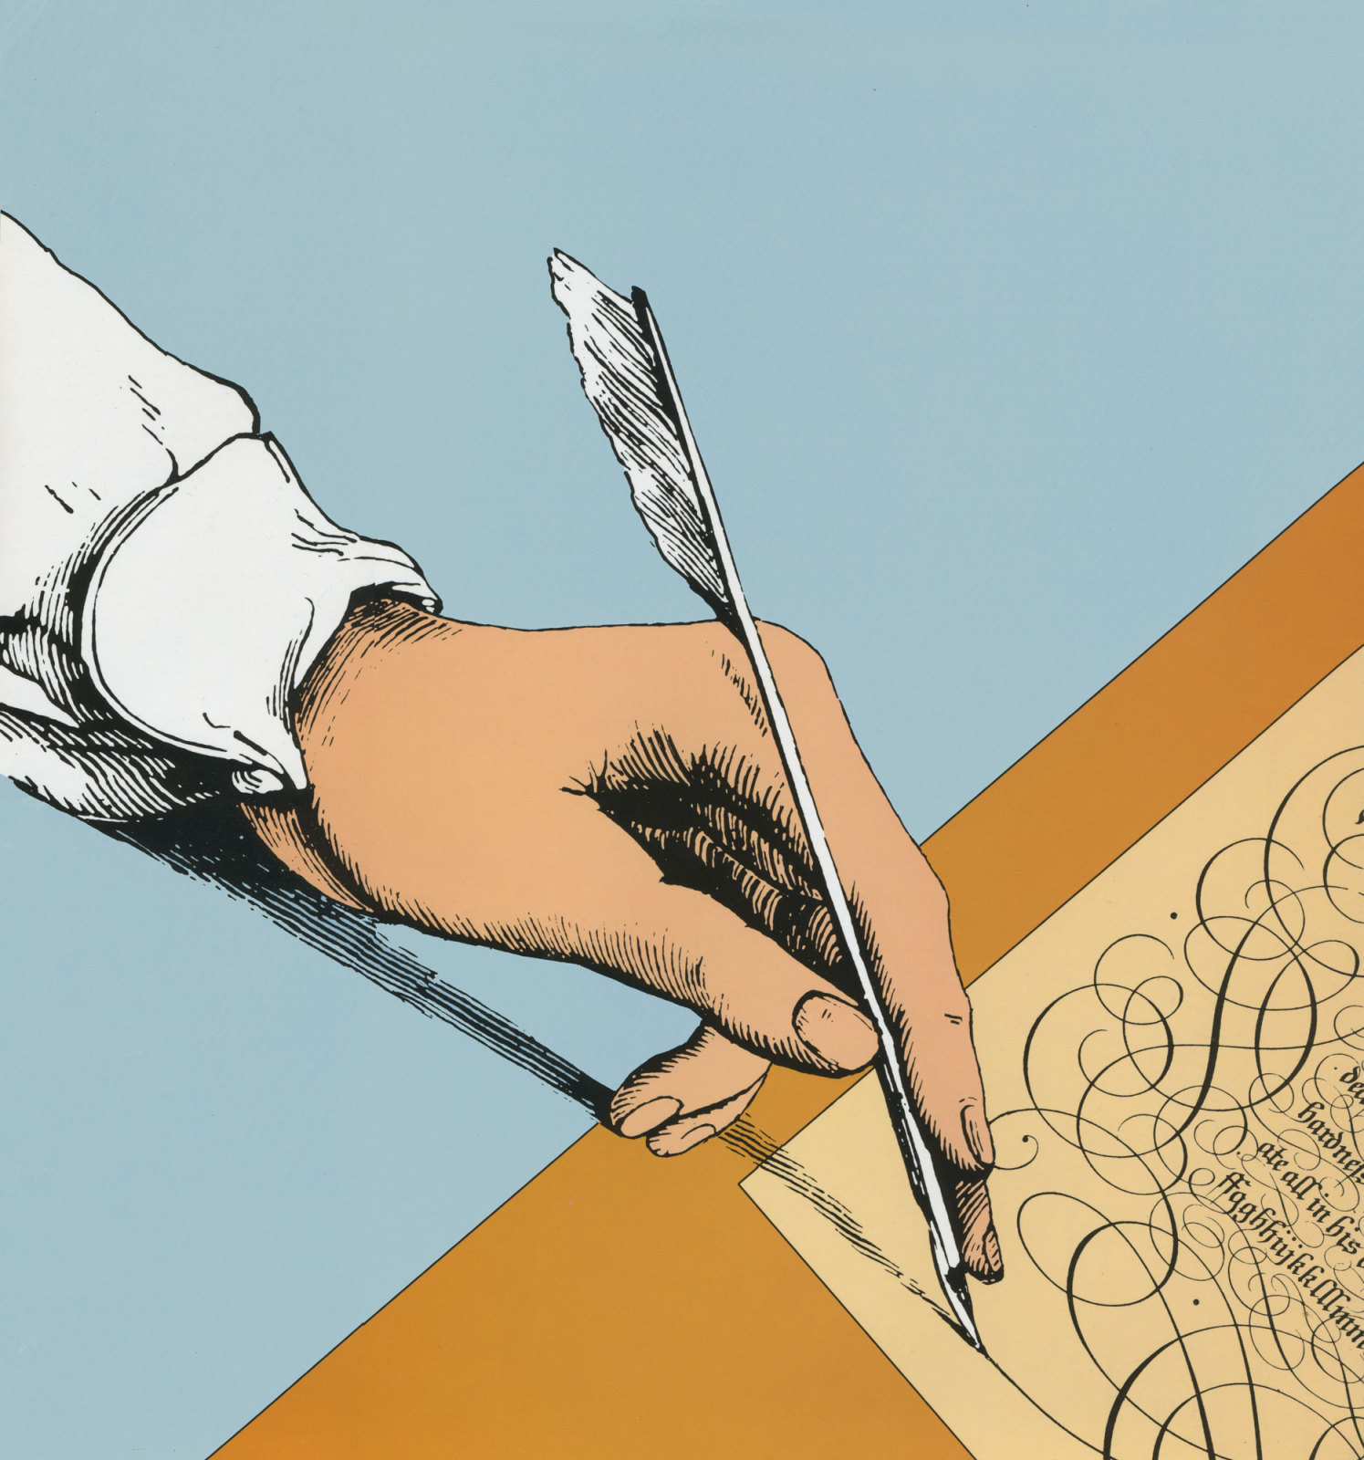
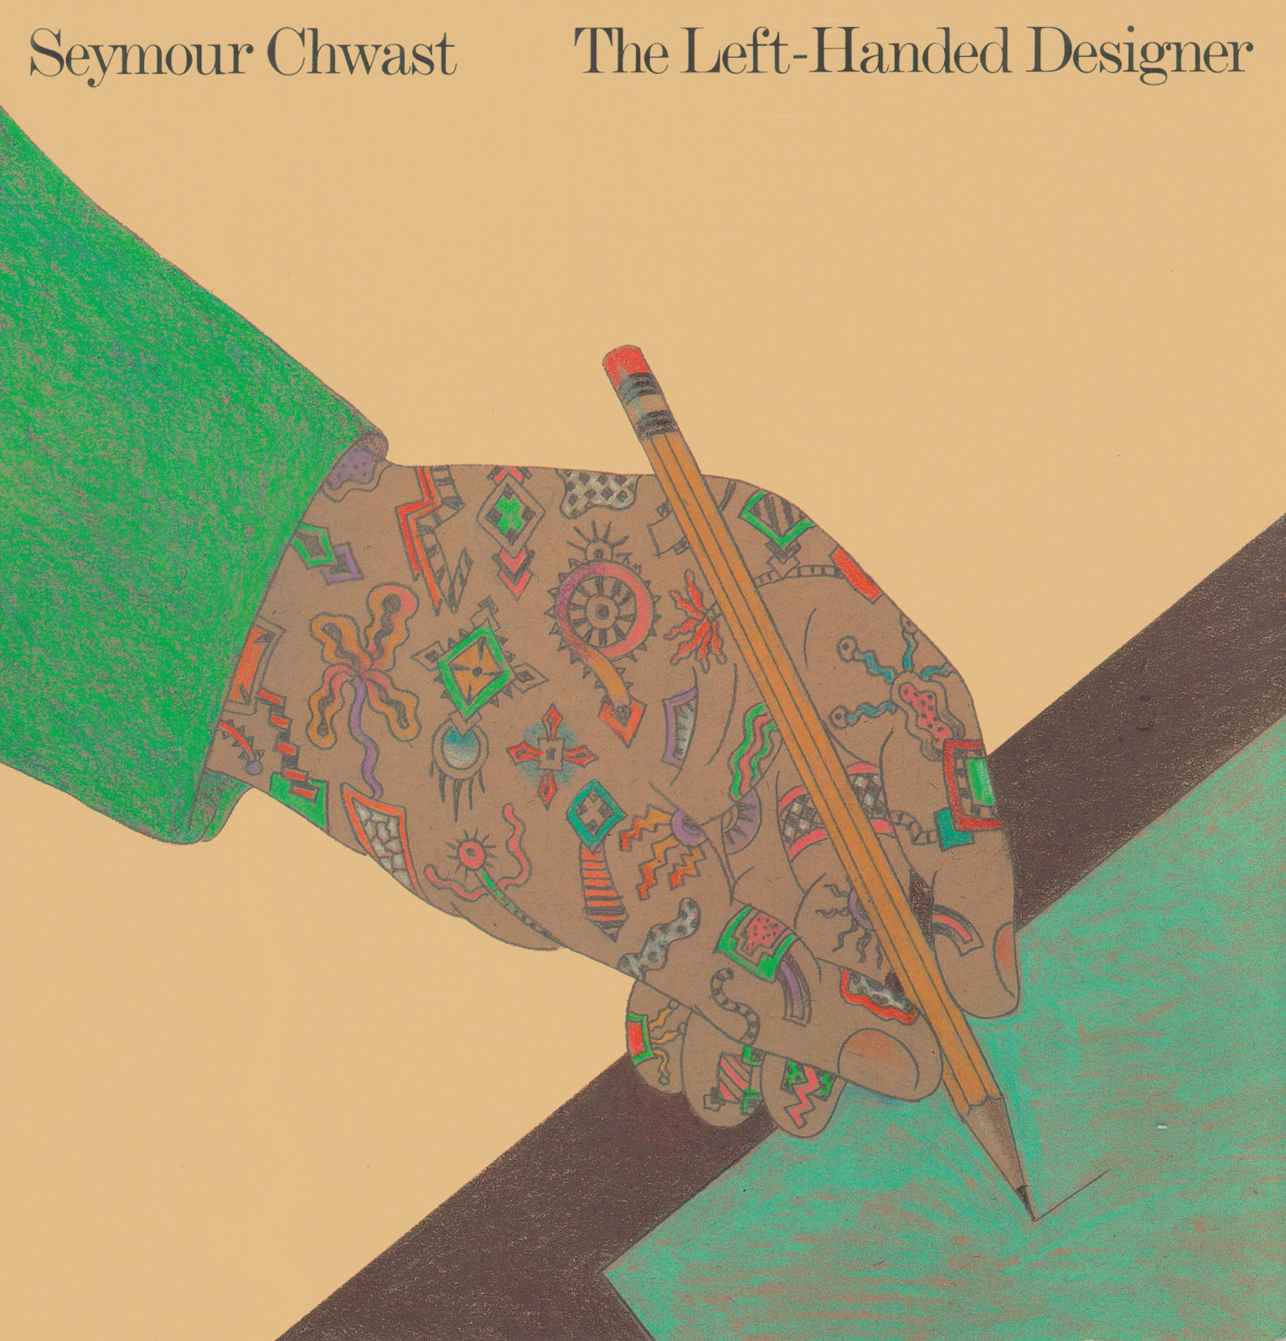
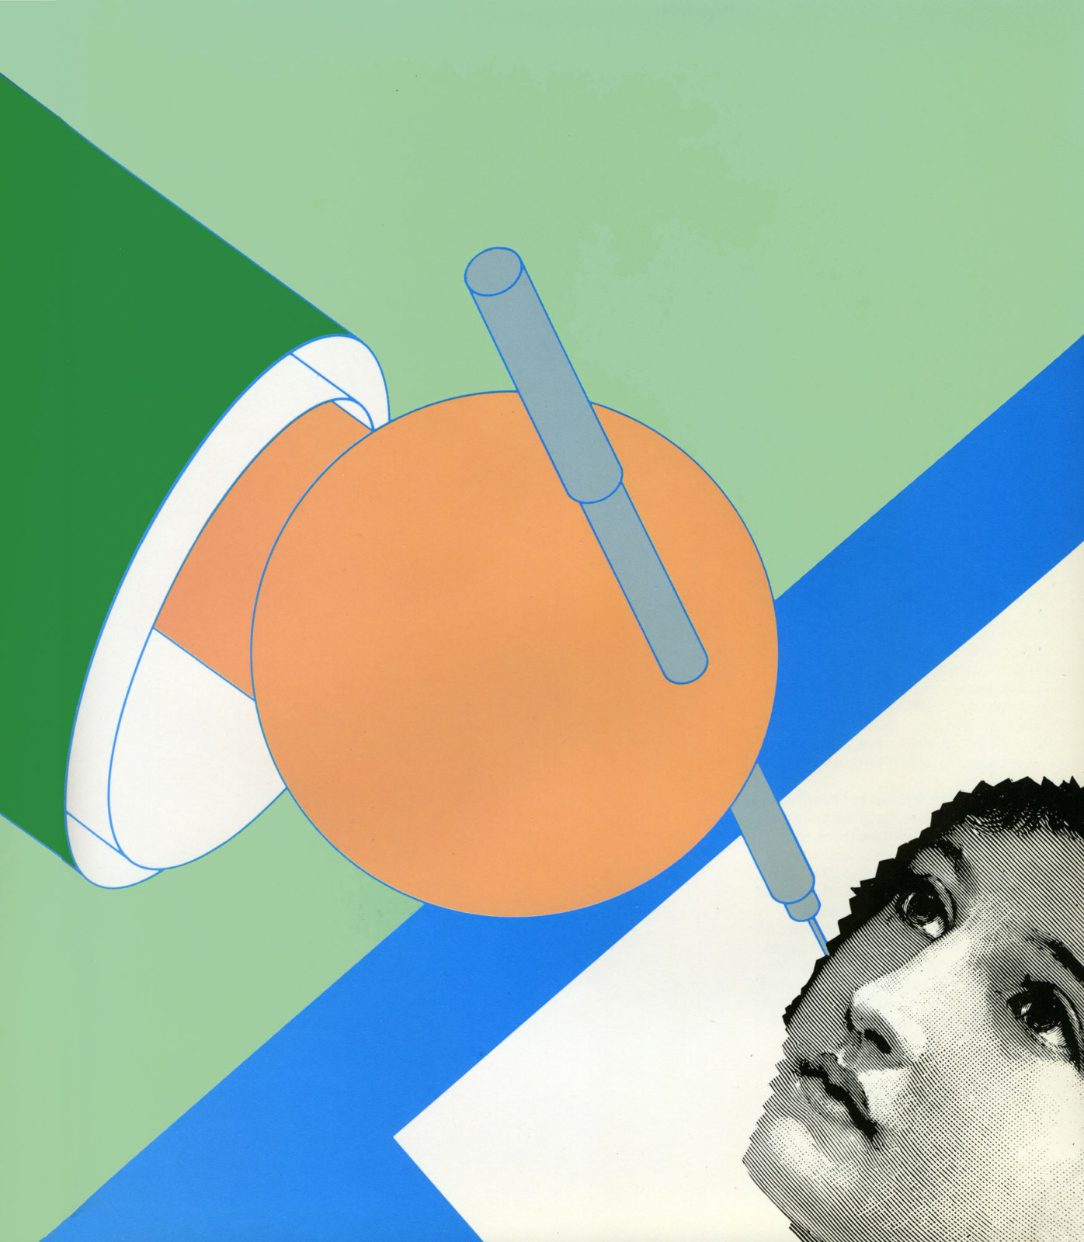
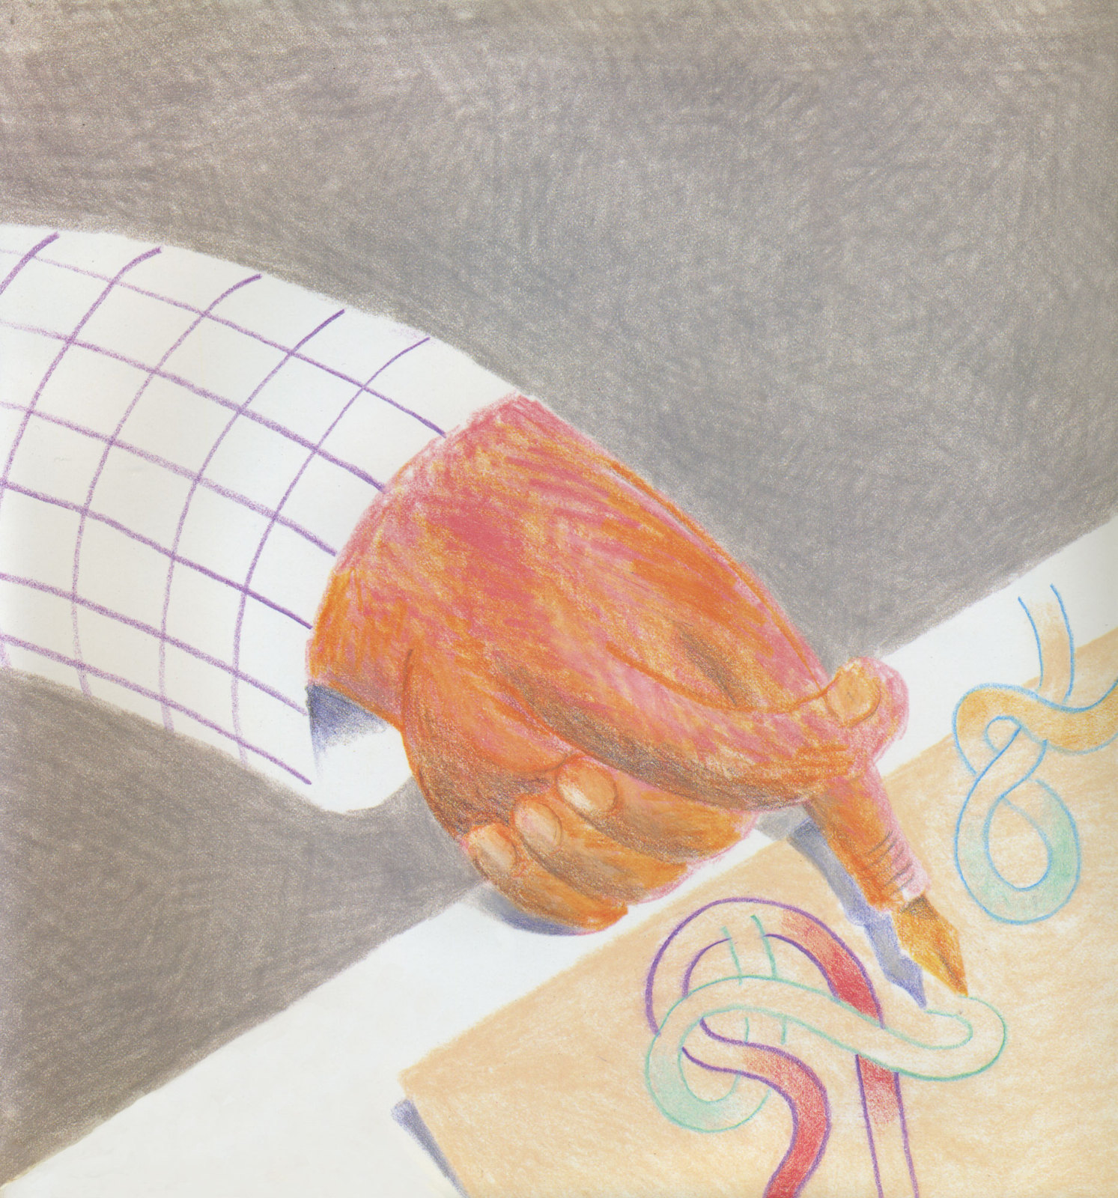
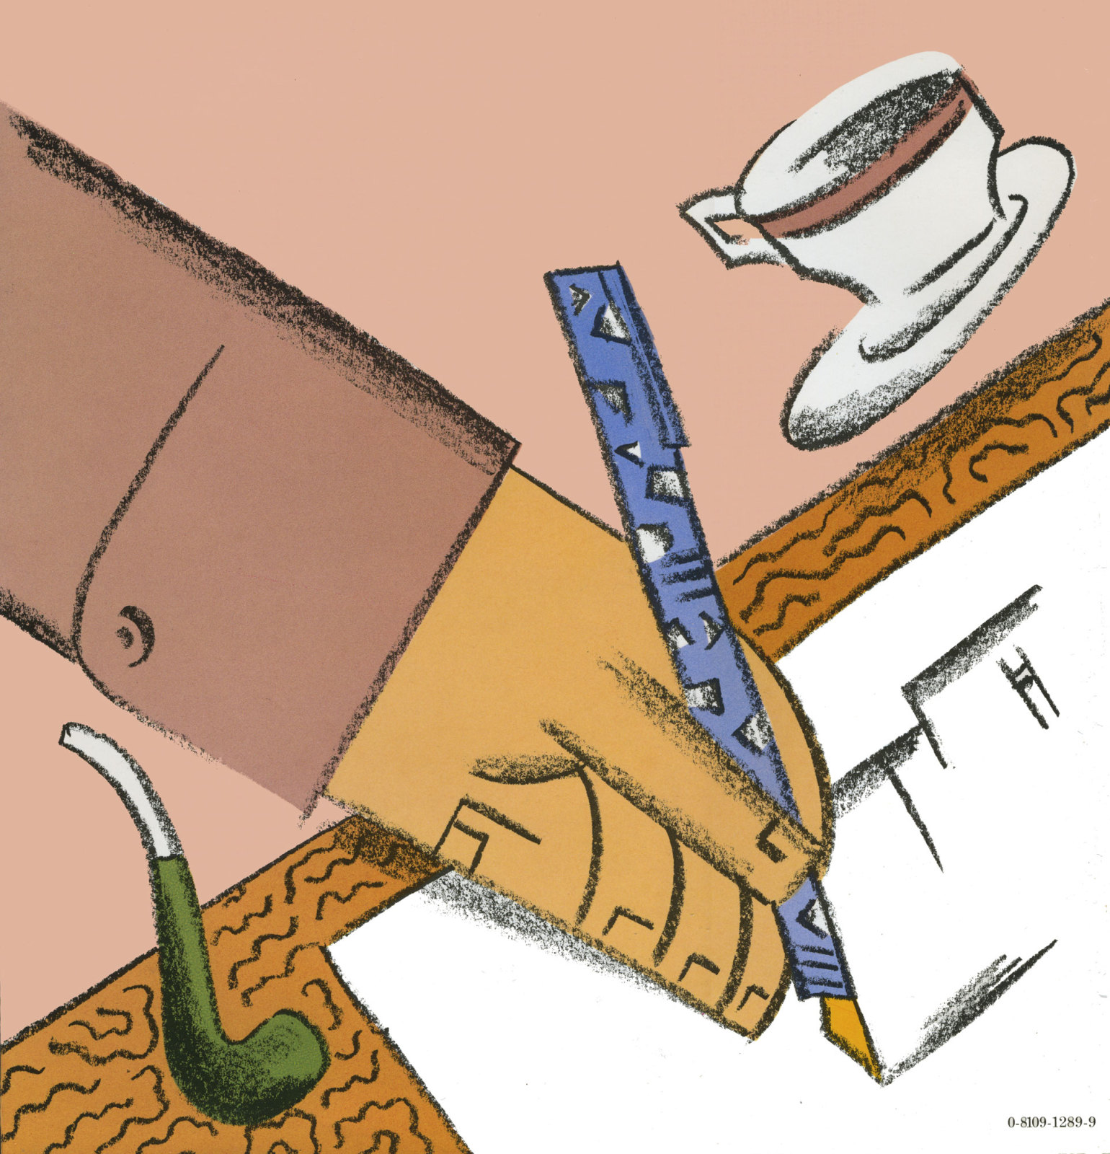
The Left-Handed Designer

