Slide 1
Girls' Life Magazine
Chaochao Lin

Slide 2
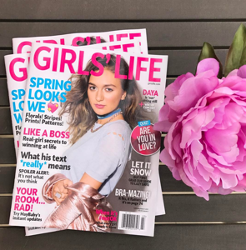
What is Girls’ Life Magazine?

Slide 3
Girls’ Life Magazine
Girls' Life (GL) magazine was founded in August 1994 by Karen Bokram.
GL is committed to inform, inspire and entertain girls around the world - including from entrepreneurship
They like to focus on smart, successful teens, so if you have a great story, share it with them.
Period help (with plenty of tampons to help)
Create a personal look you'll love (with fashion and beauty advice).

Slide 4
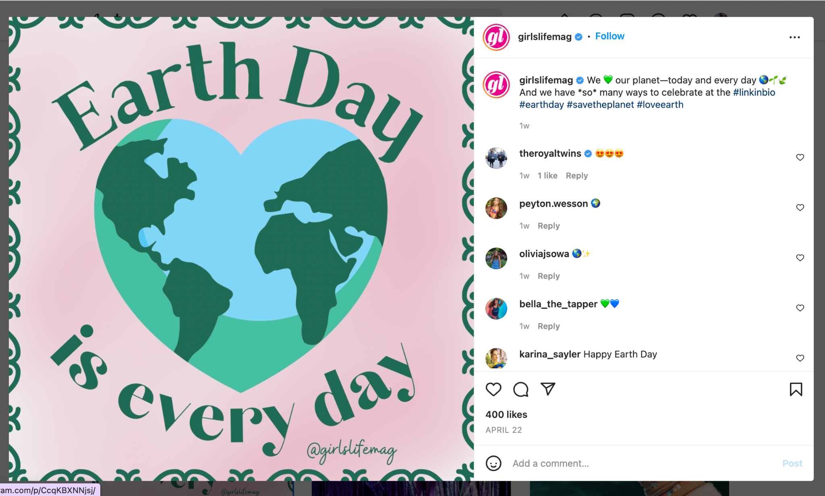
Where can find it?
Print editions of Girls' Life can be found at nearby newsstands each year
Or an email subscription, which runs six times a year. You can read the magazine on your device
There's also a site that posts original content daily across nine verticals (from breakfast recipes to breakup remedies).
They have accounts on many major platforms such as Instagram
They also hold some annual events that you can participate in

Slide 5
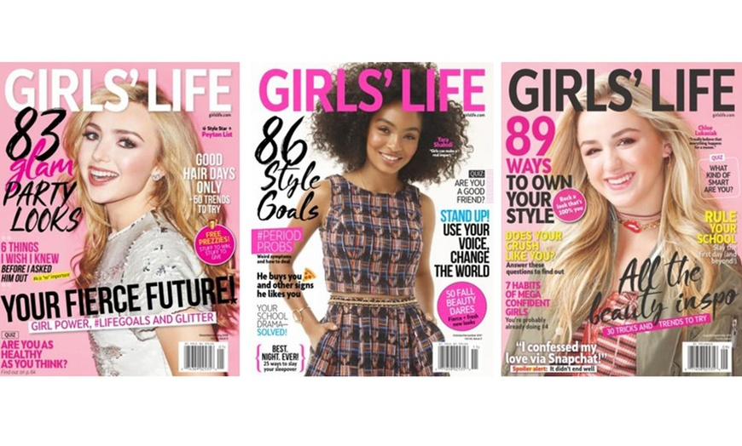

Slide 6
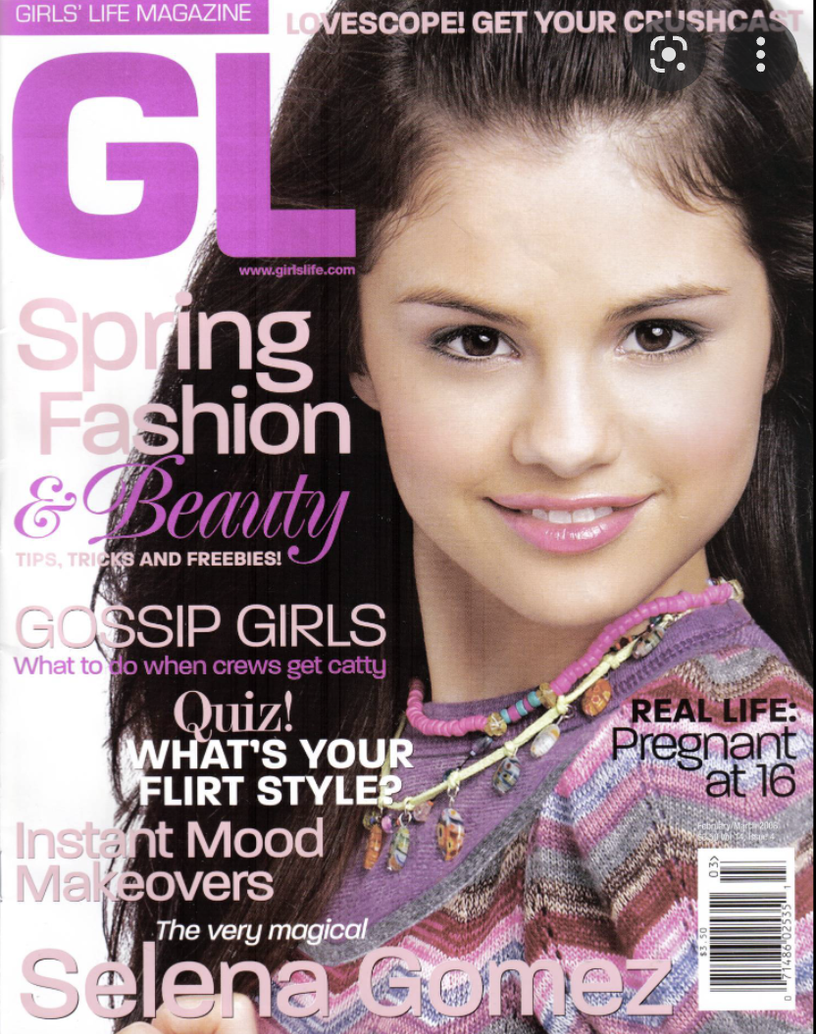
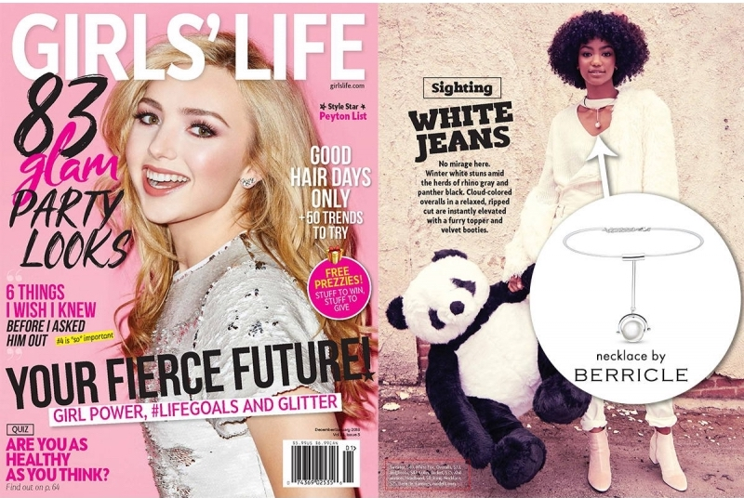
More…
Use pink often
Color matching will be done according to the picture/or character
BYOU uses a cute style, which is the kind of style that girls will like
TeenVOGUE's style is more mature and cool, and includes both men and women

Slide 7
Racist Ideologies
From Stuart Hall’s article ‘The whites of their eyes: racist ideologies and the media’ state that “ ‘racism and the media’ touches directly the problem of ideology, since the media’s main sphere of operations is the production and transformation of ideologies.”
The media we come into contact with every day is a major source of change in our lives and minds, which creates ideology. And in our lives racial and gender discrimination is often present.
I didn't find any obvious racial ideology for this magazine, they used girls from different races as covers. And teach girls how to be beautiful and confident.
Although this is a girl's magazine, there are many topics about boys and love in it. For example, "6 things I wish i knew before i ask him out" and "i confessed my love via snapchat" are both about boys, but they are about helping girls.
There is also a topic on girl power "stand up! use your voice, change the world" to encourage girls to use their power to change the world, because there are still many things that are unfair to girls.

Slide 8
The Underground Mainstream
According to Heller's article "Underground Mainstream," the concepts of mainstream and underground are closely related in contemporary design. Mainstream culture and underground culture are actually the same. The reason why there are mainstream and underground cultures is that some of them are more popular. The magazine is a good leader, usually the topics that appear in the magazine are now popular or about to become mainstream. This is also how magazines can retain customers.
In article "Sounds of the Underground" and “Support the underground: characteristics of beyond-mainstream music listeners”, the topic of mainstream culture is also mentioned. The mainstream culture will always be affected by the environment and change into the previous mainstream, and the underground culture may also gradually become the mainstream for some reasons.

Slide 9
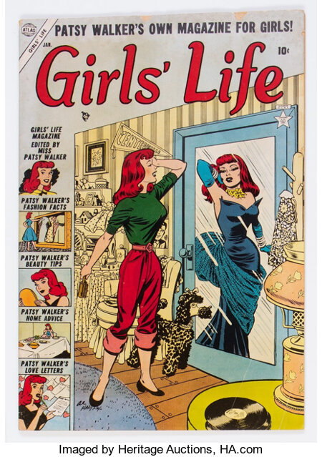
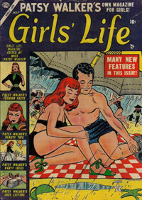
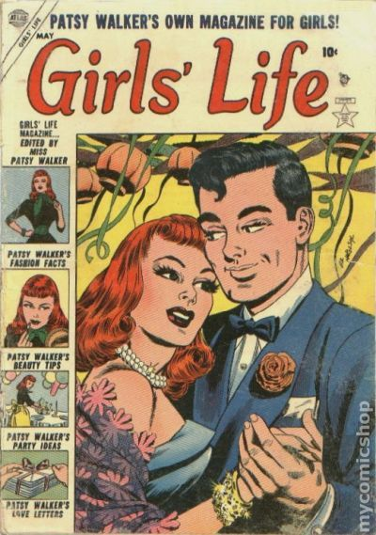
Another Girls' Magazine by Miss Patsy Walker 1954
Although they have the same name, they are not the same magazine. This magazine is Patsy Walker's personal creation for girls. A completely different style, this one presented in a comic style.

Slide 10
My Theory
Although it is an equal society now, once the topic of discrimination arises, it will still be magnified by everyone.
There are many women's/girls' magazines and few men's/boys' magazines that teach boys how to protect girls rather than hurt them. This may become a new market.
Few people now read paper magazines, except on the subway. But there are still many people who subscribe, because good magazines can not only kill time on the subway, but also bring people a lot of useful knowledge and make people stronger.

Slide 11
Bibliography
https://openlab.citytech.cuny.edu/comd3504-ol69-spring2022/files/2022/04/Heller_UndergroundMainstream2008.pdf Heller’s article ‘The Underground Mainstream’
https://directory.doabooks.org/handle/20.500.12854/32684 article “Sounds of the Underground”,
https://epjdatascience.springeropen.com/articles/10.1140/epjds/s13688-021-00268-9 article “Support the underground: characteristics of beyond-mainstream music listeners”
https://www.girlslife.com/
https://www.instagram.com/girlslifemag/
https://twitter.com/girlslifemag
https://openlab.citytech.cuny.edu/comd3504-ol69-spring2022/files/2022/03/Hall_Whites-of-Their-Eyes_1981.pdf Stuart Hall Whites of their eyes
https://comics.ha.com/comic-title-index/girls-life.s?id=1039#
https://www.teenvogue.com/gallery/covers
https://byoumagazine.tumblr.com/

