Slide 2
SCANNERS - Generally, there are four common types of
scanners classified in terms of their mechanisms: Flatbed
scanners: This versatile scanner is the one most com-
monly used for digital media labs, offices, and personal use.
A flatbed usually can scan documents of letter size ( 8.5
11 inches), legal size ( 8.5 14 inches), or even 11 14 inches
on its flat glass plate. The motorized scan head, which
consists of a light source and arrays of sensors, is underneath
the glass. The scan head moves from one end to the other
to capture the image.
Notes:
This slide can be used as a background before the presentation begins.

Slide 3
Chapter 3-Capturing Digital Images
Professor Thelma Bauer
New York City College of Technology
COMD 1112-Digital Media Foundations
Notes:
This template is in wide-screen format and demonstrates how transitions, animations, and multimedia choreography can be used to enrich a presentation.

Slide 4
Digital artists also use flatbed scanners to scan 3- D objects, such as fabrics, keys, dried plants, and hands. In these cases, the flatbed scanner is used like a focus- free camera. When an object is scanned without the flatbed cover, the background appears black, allowing easy extraction of the object to compose with others in a project. Sheet- fed scanners: Many smaller portable scanners are sheet- fed scanners in which the document moves through a fixed scan head. Because of the feeding mechanism, this type of scanner is not able to scan thick objects, such as a page in a book. Sheet-fed scanners are generally designed to scan no larger than letter- size paper.

Slide 5
Handheld scanners: These scanners are also portable. The basic mechanism of handheld scanners is very similar to that of flatbeds, except that handhelds rely on the user to move the scan head. The scanning width of each pass is limited by the width of the device, which usually is less than the width of letter- size paper. For some models of handheld scanners, the image quality may rely on the user’s steady hand movement. In general, handheld scanners do not provide very good image quality, but they offer the most convenient and fastest way of capturing documents. They are most useful for capturing text documents. Drum scanners: Drum scanners are capable of very high resolutions and can handle larger documents. They often are used in the publishing industry, where high- resolution images are required, or for scanning large documents, such as blueprints.

Slide 6
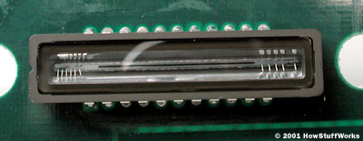
The basic principle of a scanner is to analyze an image and process it in some way. Image and text capture (optical character recognition or OCR) allow you to save information to a file on your computer. You can then alter or enhance the image, print it out or use it on your web page. We'll be focusing on flatbed scanners, but the basic principles apply to most other scanner technologies. You will learn about the different types of scanners, how the scanning mechanism works and what TWAIN means. You will also learn about resolution, interpolation and bit depth.
Anatomy of a Scanner
Parts of a typical flatbed scanner include:
Charge-coupled device (CCD) array
Mirrors
Scan head
Glass plate
Lamp
Lens
Cover
Filters
Stepper motor
Stabilizer bar
Belt
Power supply
Interface port(s)
Control circuitry

Slide 7
The core component of the scanner is the CCD array. CCD is the most common technology for image capture in scanners. CCD is a collection of tiny light-sensitive diodes, which convert photons (light) into electrons (electrical charge). These diodes are called photosites. In a nutshell, each photosite is sensitive to light -- the brighter the light that hits a single photosite, the greater the electrical charge that will accumulate at that site.
The image of the document that you scan reaches the CCD array through a series of mirrors, filters and lenses. The exact configuration of these components will depend on the model of scanner, but the basics are pretty much the same.
Click on the globe to start

Slide 8
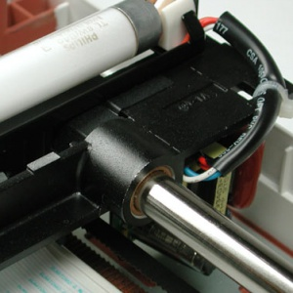
The Scanning Process
Here are the steps that a scanner goes through when it scans a document:
The document is placed on the glass plate and the cover is closed. The inside of the cover in most scanners is flat white, although a few are black. The cover provides a uniform background that the scanner software can use as a reference point for determining the size of the document being scanned. Most flatbed scanners allow the cover to be removed for scanning a bulky object, such as a page in a thick book.
A lamp is used to illuminate the document. The lamp in newer scanners is either a cold cathode fluorescent lamp (CCFL) or a xenon lamp while older scanners may have a standard fluorescent
tamp.

Slide 9
The entire mechanism (mirrors, lens, filter and CCD array) make up the scan head. The scan head is moved slowly across the document by a belt that is attached to a stepper motor. The scan head is attached to a stabilizer bar to ensure that there is no wobble or deviation in the pass. Pass means that the scan head has completed a single complete scan of the document.
The image of the document is reflected by an angled mirror to another mirror. In some scanners, there are only two mirrors while others use a three mirror approach. Each mirror is slightly curved to focus the image it reflects onto a smaller surface.
The last mirror reflects the image onto a lens. The lens focuses the image through a filter on the CCD array.
The filter and lens arrangement vary based on the scanner. Some scanners use a three pass scanning method. Each pass uses a different color filter (red, green or blue) between the lens and CCD array. After the three passes are completed, the scanner software assembles the three filtered images into a single full-color image.

Slide 10
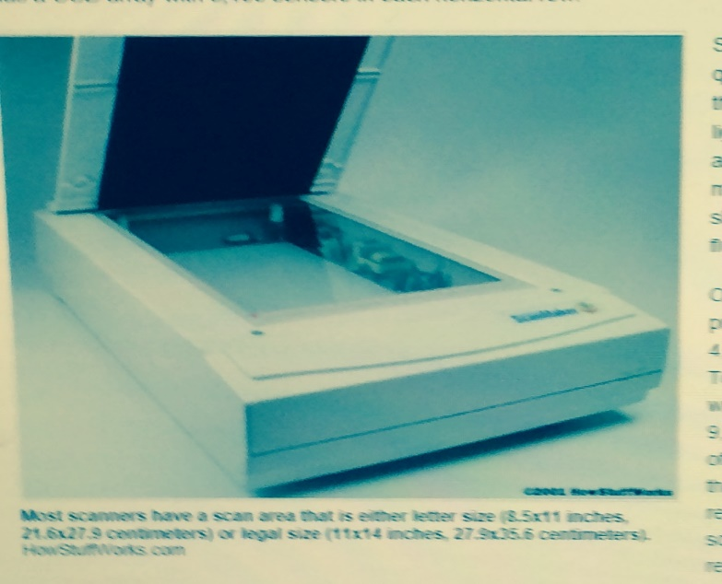
Sharpness depends mainly on the quality of the optics used to make the lens and the brightness of the light source. A bright xenon lamp and high-quality lens will create a much clearer, and therefore sharper, image than a standard fluorescent lamp and basic lens.
Of course, many scanners proclaim resolutions of 4,800x4,800 or even 9,600x9,600. To achieve a hardware resolution with a x-direction sampling rate of 9,600 would require a CCD array of 81,600 sensors. If you look at the specifications, these high resolutions are usually labeled software-enhanced, interpolated resolution or something similar. What does that mean?
Interpolation is a process that the scanning software uses to increase the perceived resolution of an image. It does this by creating extra pixels in between the ones actually scanned by the CCD array. These extra pixels are an average of the adjacent pixels. For example, if the hardware resolution is 300x300 and the interpolated resolution is 600x300, then the software is adding a pixel between every one scanned by a CCD sensor in each row.
Another term used when talking about scanners is bit depth, also called color depth. This simply refers to the number of colors that the scanner is capable of reproducing. Each pixel requires 24 bits to create standard true color and virtually all scanners on the market support this. Many of them offer bit depths of 30 or 36 bits. They still only output in 24-bit color, but perform internal processing to select the best possible choice out of the colors available in the increased palette. There are many opinions about whether there is a noticeable difference in quality between 24-, 30- and 36-bit scanners.

Slide 11
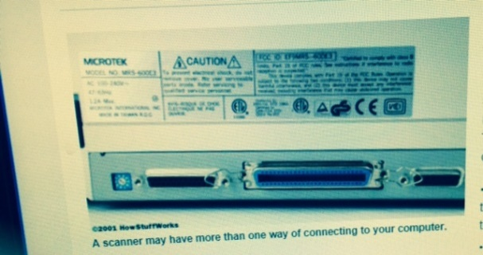
Image Transfer
Scanning the document is only one part of the process. For the scanned image to be useful, it must be transferred to your computer. There are three common connections used by scanners:
Parallel - Connecting through the parallel port is the slowest transfer method available.
Small Computer System Interface (SCSI) - SCSI requires a special SCSI connection. Most SCSI scanners include a dedicated SCSI card to insert into your computer and connect the scanner to, but you can use a standard SCSI controller instead.
Universal Serial Bus (USB) - USB scanners combine good speed, ease of use and affordability in a single package.
FireWire - Usually found on higher-end scanners,FireWire connections are faster than USB and SCSI. FireWire is ideal for scanning high-resolution images.

Slide 12
On your computer, you need software, called a driver, that knows how to communicate with the scanner. Most scanners speak a common language, TWAIN. The TWAIN driver acts as an interpreter between any application that supports the TWAIN standard and the scanner. This means that the application does not need to know the specific details of the scanner in order to access it directly. For example, you can choose to acquire an image from the scanner from within Adobe Photoshop because Photoshop supports the TWAIN standard.
In addition to the driver, most scanners come with other software. Typically, a scanning utility and some type of image editing application are included. A lot of scanners include OCR software. OCR allows you to scan in words from a document and convert them into computer-based text. It uses an averaging process to determine what the shape of a character is and match it to the correct letter or number.
The great thing about scanner technology today is that you can get exactly what you need. You can find a decent scanner with good software for less than $200, or get a fantastic scanner with incredible software for less than $1,000. It all depends on your needs and budget.

