Slide 1
THE HARD WORK AND PRODUCTION OF MANGA/ANIME
KARINA BUDHU

Slide 2
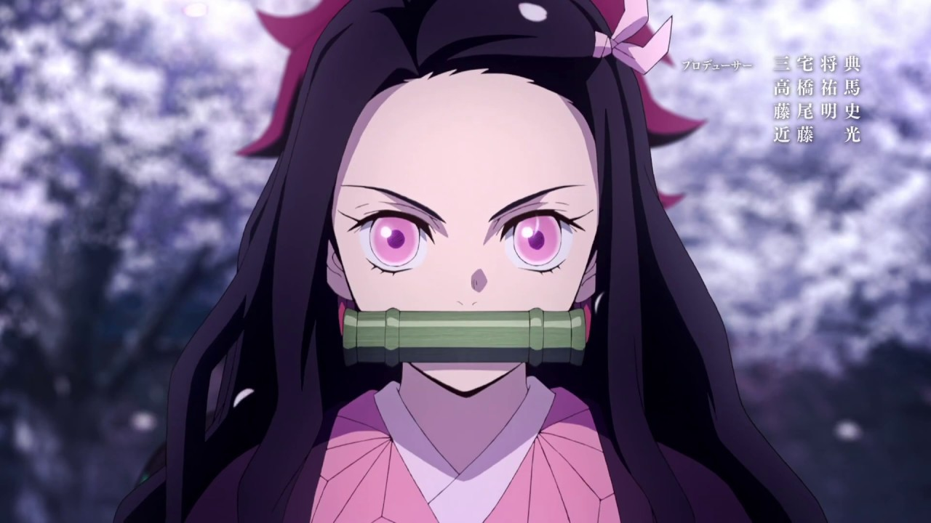
INTRO…...
Being a first hand manga and anime fan myself, I always found an interest in the creation as well as development behind the anime and manga. However, it had never dawned on me about the hard work and long hours that these creators put into creating their pieces of work. Whilst researching, I grew shocked and believed it was something I wanted to share with the rest of the anime community who also may be unaware.
Additionally, as I continued to watch anime after learning about the hard work creators put into their pieces, it has allowed me to gain a deeper appreciation for the anime and manga I later began to indulge in, in life.

