Slide 1
Paula Scher
Graphic designer and painter
By: Christopher Navarrete

Slide 2
Who is Paula Scher?
Paula Scher is a popular American graphic designer,
painter and art educator.
She was born in 1948 in Virginia.
She is mostly known for her typographic posters and hand printed maps.
Her typographic posters were inspired by the Russian constructivism and art deco styles.
Paula received more than 300 awards from various design associations for her works.

Slide 3
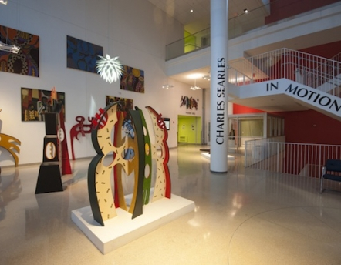
Education
Paula Scher studied at the Tyler School of Art, in Elkins Park, Pennsylvania and earned a Bachelors degree of Fine Arts in 1970.
She become the first principle at Pentagram in 1991, an art school.
In 1992, she became a design teacher at the School of Visual Arts in New York.
Tyler School of Art

Slide 4
Paula’s Maps
Paula generally paints typographic maps of the world, its continents, countries, islands, oceans, cities, streets and neighborhoods.
These maps take several months to create
Most of her maps are as tall as 12 feet.
She was Inspired by her father to create hand-printed maps.

Slide 5
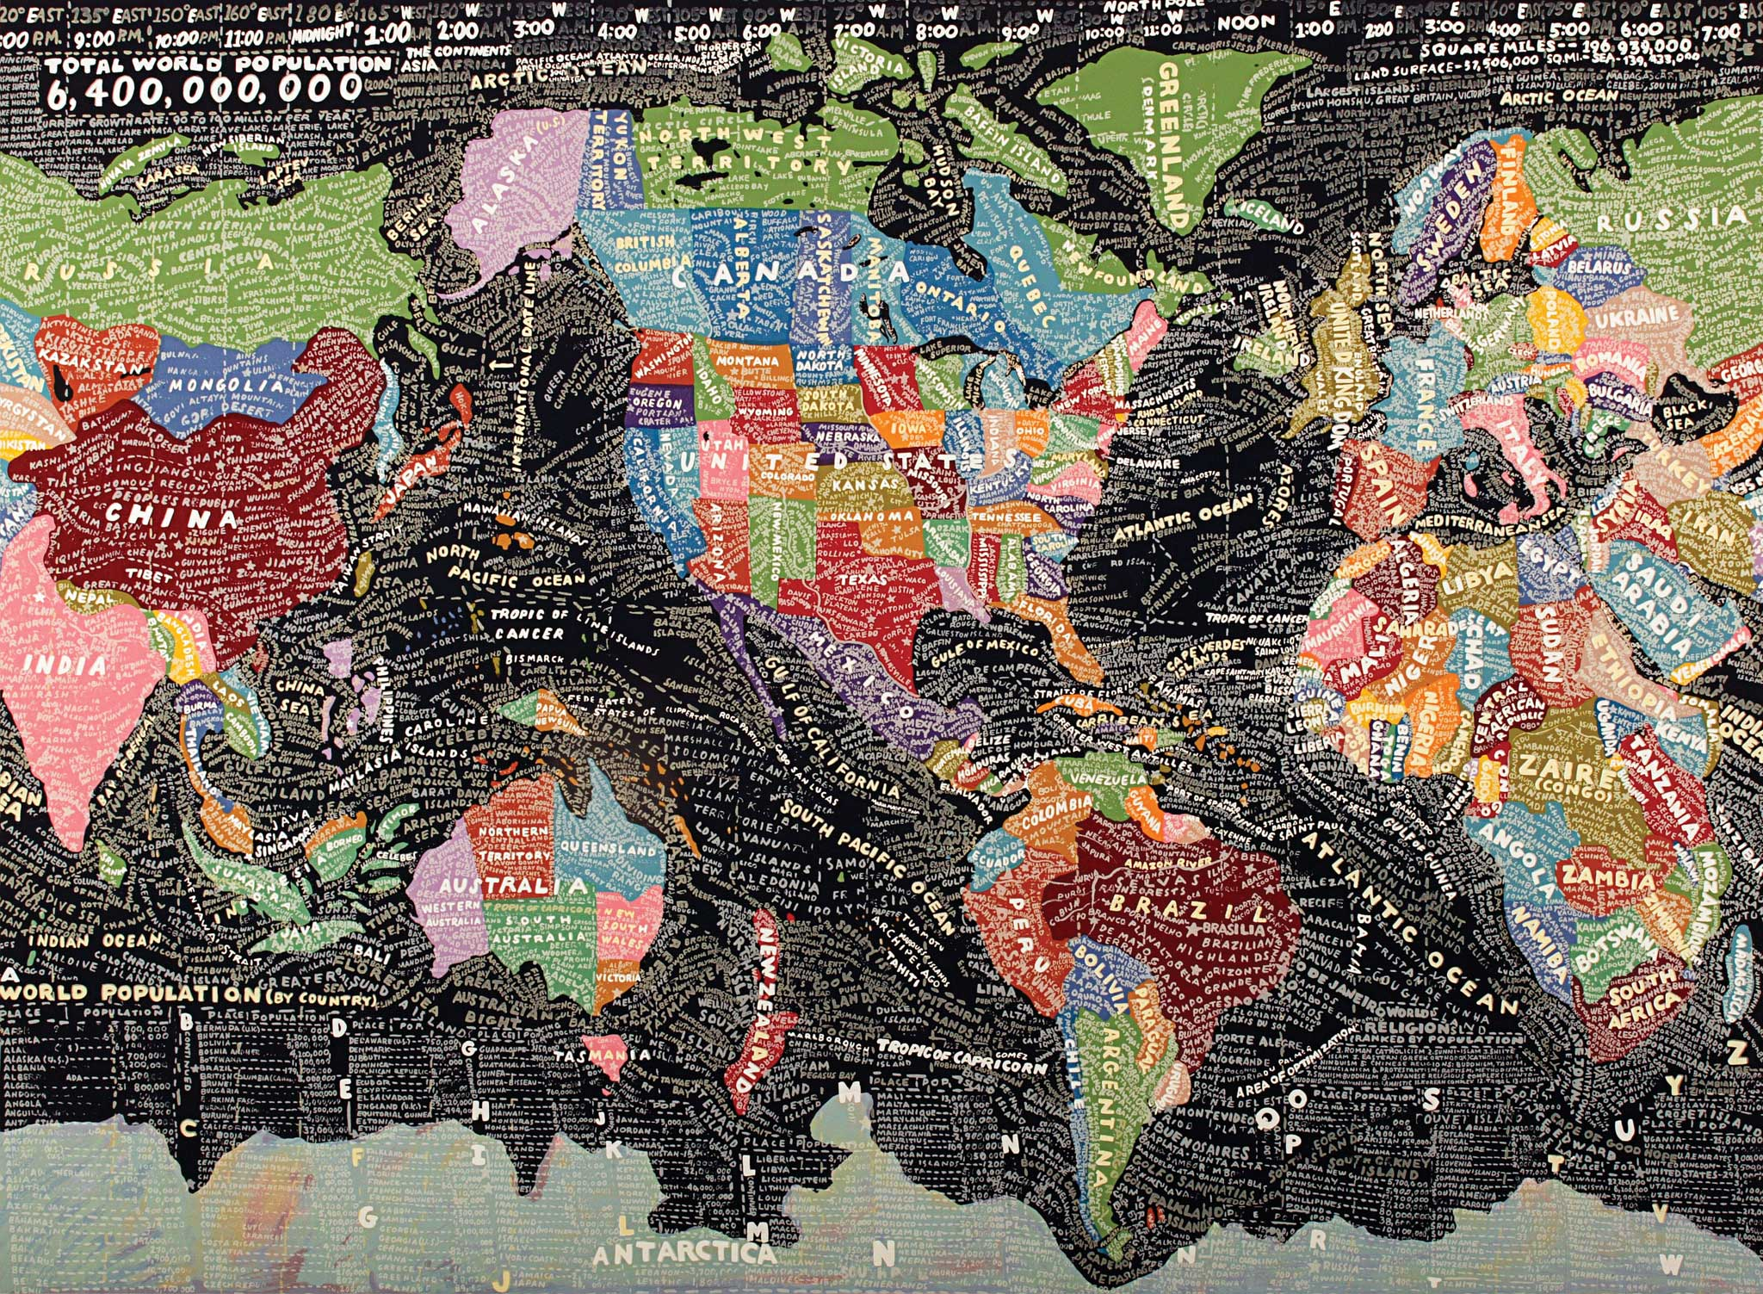

Slide 6
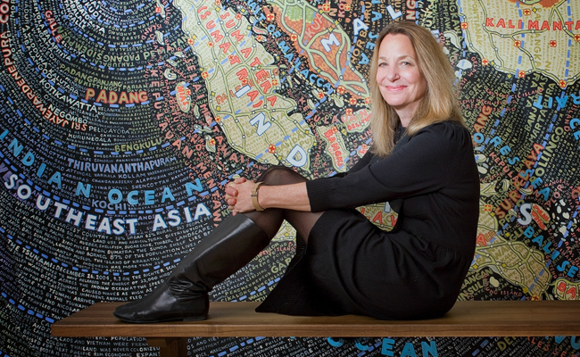

Slide 7
Typographic Posters
She is widely known for her typographic posters for the Public Theatre.
In 1994, she was the first designer to create an identity for the Public Theatre. She did so with typographic posters.
Her most famous piece is the Bring in 'da Noise, Bring in 'da Funk poster.

Slide 9
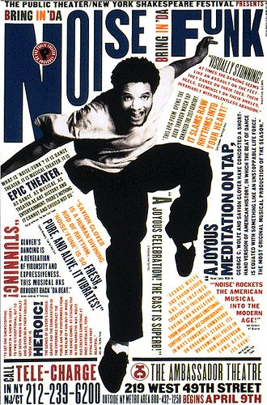

Slide 11
Video
https://www.youtube.com/watch?v=KbuFBe23gk0

Slide 12
Sources
https://www.curbed.com/2016/2/22/11094204/paula-scher-maps-us-new
https://www.pentagram.com/news/paula-scher-maps
http://www.historygraphicdesign.com/the-age-of-information/postmodern-design/207-paula-scher
https://en.wikipedia.org/wiki/Paula_Scher
http://www.famousgraphicdesigners.org/paula-scher

