Slide 1
Debut collection: Statement
Crystal Llerena

Slide 2
Introduction
“Statement” bags
Creating a line that encourages self-expression
Envisioning to be the go-to brand for fashion-forward handbags
Product category- small to medium size leather handbags

Slide 3
Consumer markets
demographics | psychographics | lifestyle
Young woman | Ambitious | Active social life
19-30 | Has a passion for fashion | Shops at places like Zara and Nordstrom's.
Lives in a major city | outgoing | Experiments with her fashion sense

Slide 4
Pre-production and planning
inputs
outputs
Top competitors-Coach, Marc Jacobs, JW Pei, Kate spade etc.
Market position-brand recognition, quality and channels
Advertising
Our market position-brand identity
Price range-contemporary
Customer service
Competitive advantage: speed to market brand in a contemporary field

Slide 5
Merchandising & Assortment planning
Micro bag- a small leather handbag
Bucket bag- leather circular bag with a wooden handle
Belt bag- leather small bag that is belted around
PVC handbag- transparent bag with removable pouch
Circle bag- leather circular bag the opens all around with a handle and long strap
Drawstring bag- leather bag with shoulder strap
Looped single-handle bag- a leather handbag with a handle that cinches at the top of the bag.
Mini duffle bag- made with leather with clasps
Classic snap clasp bag- leather bag with either a handle or strap
Box handbag- with cross body strap and handle
10 SKUs

Slide 6
Color palette
Warm earth tones

Slide 7
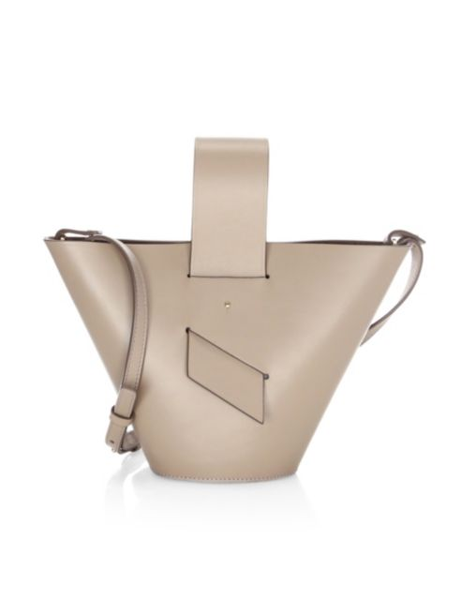
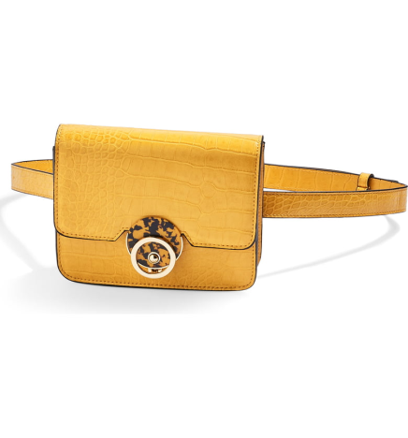
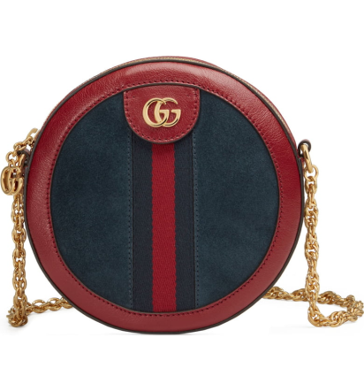
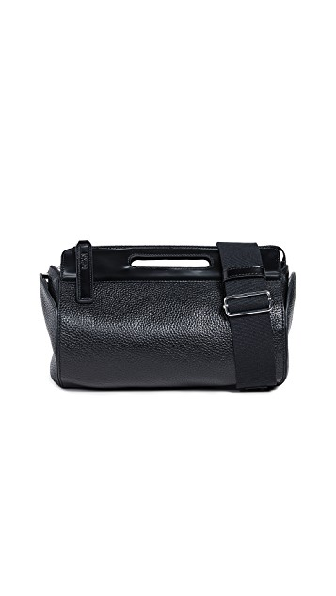
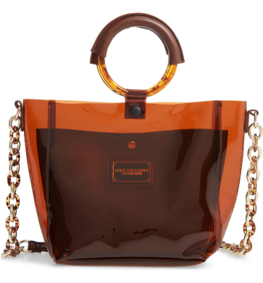
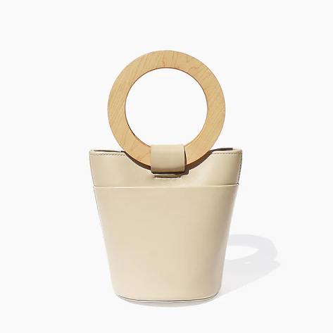
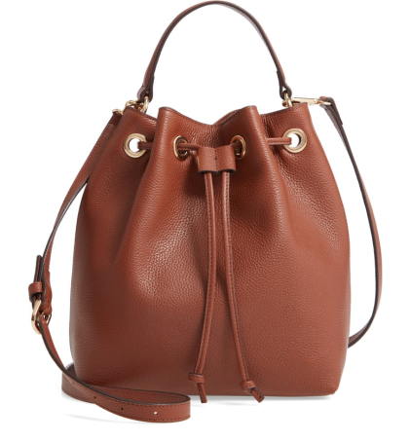
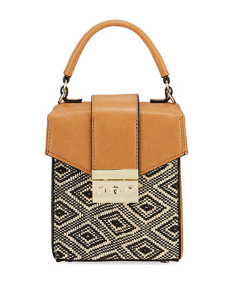
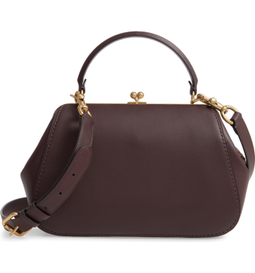
Ten Handbags

