Slide 1
Alexander McQueen
An iconic avant-garde designer and his memorable moments in fashion

Slide 2
introduction
Lee Alexander was born on March 17, 1969, he came from working class family, his father working as a taxi driver .
McQueen started working with clothes at a young age, at 16 he had apprenticeship with Gieves & Hawkes at the well renowned Saville row, an area in London that is known for making well tailored suits.
He attended the Central Saint Martins College of Art and Design and in 1992 he graduated with an M.A in Fashion Design.
Between 1996 and 2001, McQueen was the chief designer for Louis Vuitton owned Givenchy.

Slide 3
McQueen won many prestigious awards for his designs. He won the British designer of the year in 1996,1997, and 2001. He was also named commander of the Order of the British Empire by Queen Elizabeth.
In 2010, McQueen unfortunately took his own life right after the death of his mother. However his legacy still lives on, his longtime friend and co-designer Sarah Burton took over as creative director for his line that same year.
He made a huge impact in the fashion industry and was even honored in 2011 by exhibiting his creations in the Metropolitan Museum of Art .

Slide 4
Storyteller
Every collection he made was always followed with a theme or story, Not just for the collection itself but also for his runway presentation as he felt it was just as important.
McQueen's aesthetic approach to his designs were always referenced by literature, theatre, art or music, and presented in his own way that was innovative and experimental His unconventional approach to runway shows illustrated how he

Slide 5
Graduation collection 1992
The collection was called “Jack the Ripper stalks his victims” inspired by the story of Jack the Ripper’s Whitechapel victims of 1888.
He was inspired by the style and culture of the Victorian era. Interestingly enough he incorporated locks of hair in the lining of his garment to reference the fact that prostitutes during the Victorian times would sell their hair.
Isabella Blow a prominent stylist and magazine editor, was so enamored with his collection that she actually bought it for him.

Slide 6
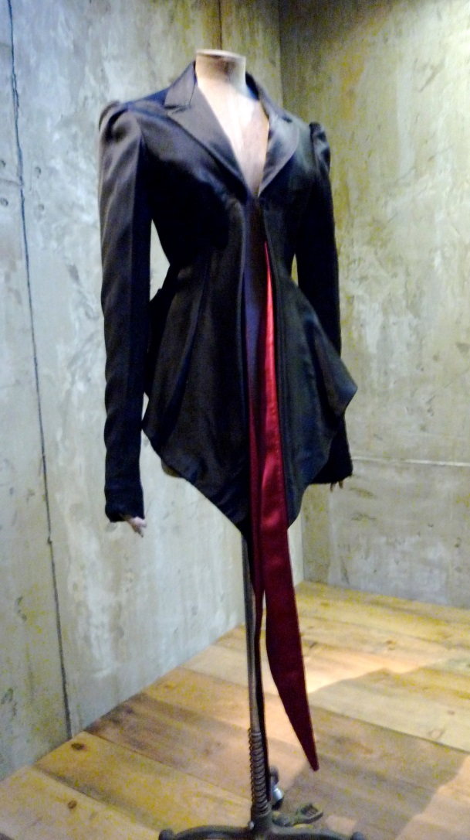

Slide 7
“No.13” 1999 s/s
This collection was based on the Arts and Craft movement. Elements of lace and lightweight wood was used in his garments. The clothes were well tailored however gave an effect of lightness.
The runway show feature two memorable moments of McQueen’s career. the first moment was model Aimee Mullins, an amputee wearing a pair of wooden craved legs and the second was model Shalom Harlow wearing a white dress rotating on stage while two robotic arm spray painted her dress.

Slide 9
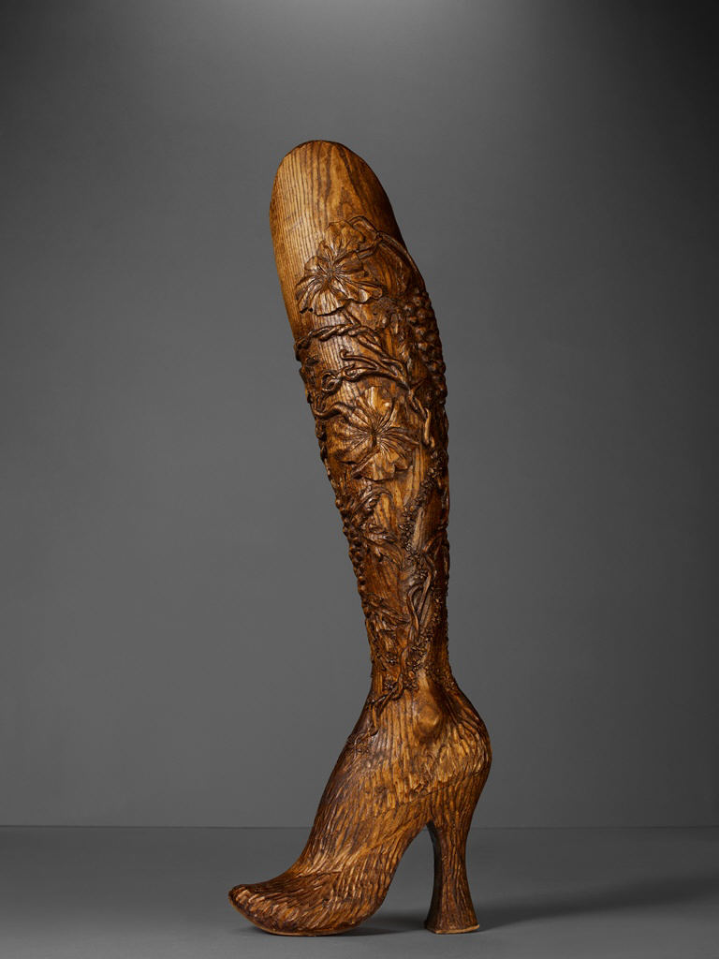

Slide 10
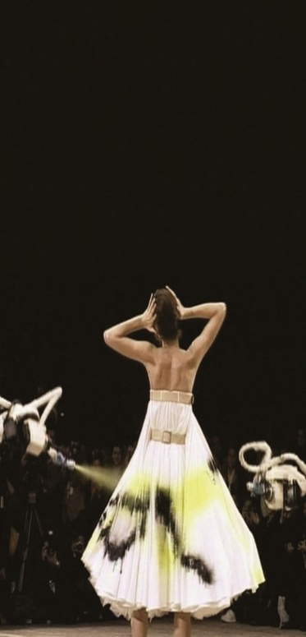

Slide 11
“Voss” 2001 s/s
One of his most celebrated shows, demonstrating his Avant-garde style.
Instead of a traditionally runway stage, McQueen used an enormous mirrored box in the center of the stage. Inside the box was a room that looked like mental-hospital holding cell.
Models were walking in the box, wearing a gauze-y fabric wrapped around their heads.
With this collection McQueen wanted to question the notion of conventional beauty.
The finale featured the glass box inside the mirrored box open to reveal Michelle Olley

Slide 12
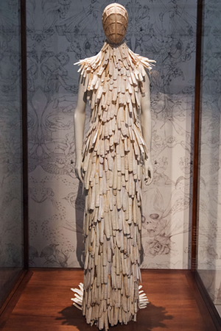
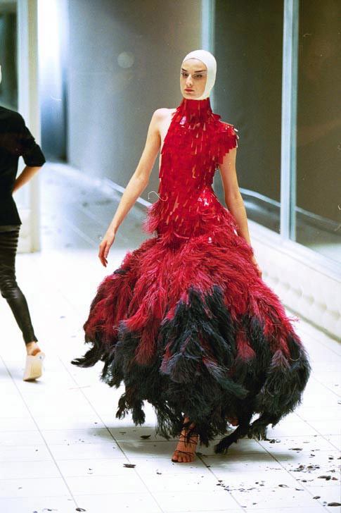

Slide 14
“widows of Culloden” 2006 A/W
The collection was very autobiographical, concerning that of McQueen’s Scottish heritage. Referencing the Jacobite risings which gave way to the battle of Culloden.
The collection was a memorial to the widows who lost their husbands in the bloody conflict.
Memorable moment was a hologram of Kate Moss.

Slide 15
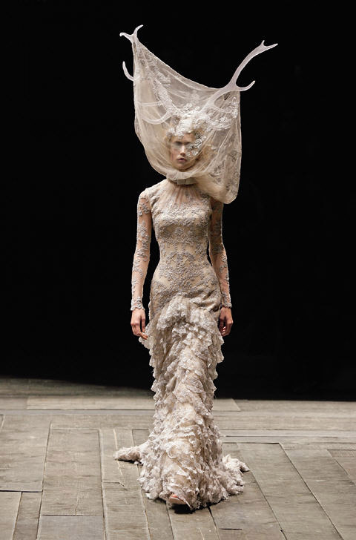
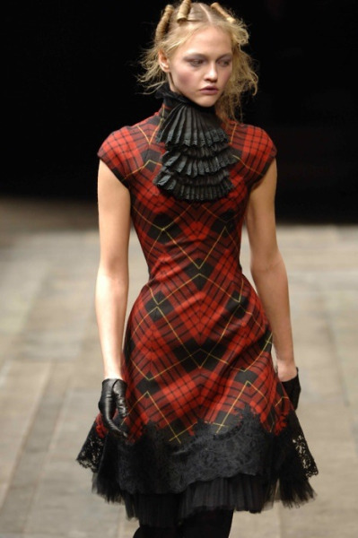

Slide 17
“The horn of plenty” 2009 A/W
This was a retrospective of his own fashion aesthetic, McQueen look backed at his design legacy while incorporating classic couture designs famous in the fashion world.
All of this was centered in the juxtaposition of extreme glamour vs. trash. A centerpiece in the middle of the stage was a large pile “trash” made up of old pieces from past collections spray painted black.
The models had exaggerated features of overdrawn lips, skin painted white with no eyebrows or lashes. It was a reference of Terry Gilliam’s “Brazil”
<iframe width="560" height="315" src="https://www.youtube.com/embed/R7SYx7TtDkM" frameborder="0" allowfullscreen></iframe>

Slide 18
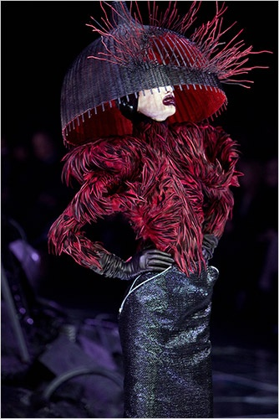
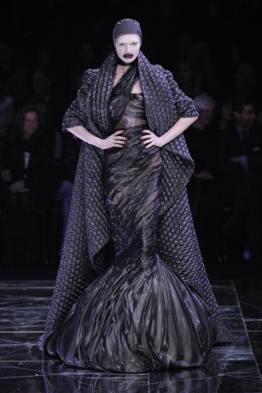

Slide 19
Plato’s Atlantis 2010 s/s
This was his last fully created collection
This collection was inspired by Charles Darwin’s On The Origin of Species.
This was the first time a runway show was streaming live online.
The short dresses that were featured in the collection were made by using distinctive computer-generated designs.

Slide 20
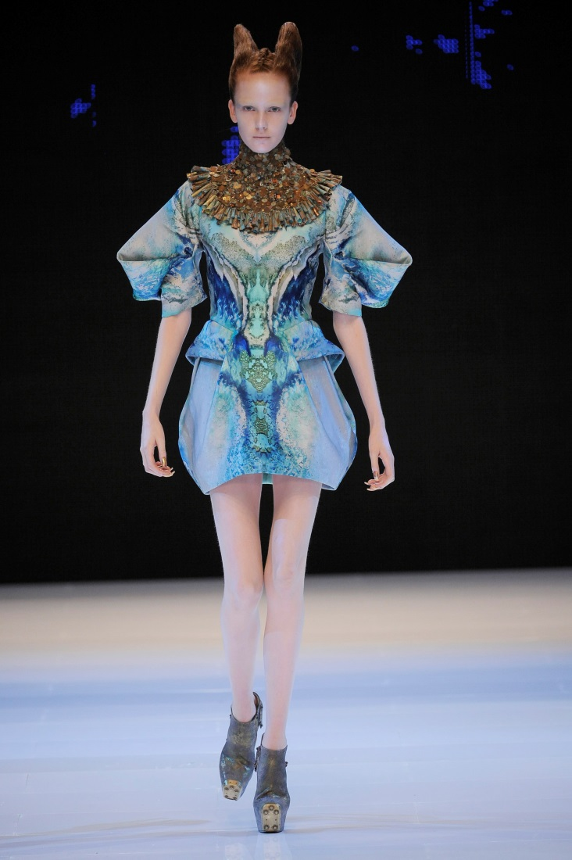
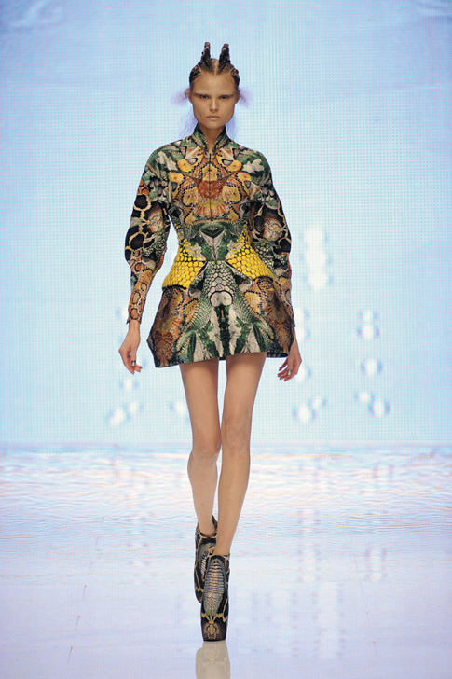

Slide 22
Video about exhibition
https://youtu.be/Q8TzBItATow

