Slide 1
80’s trend;
Acid
wash jeans
By: Crystal Llerena

Slide 2
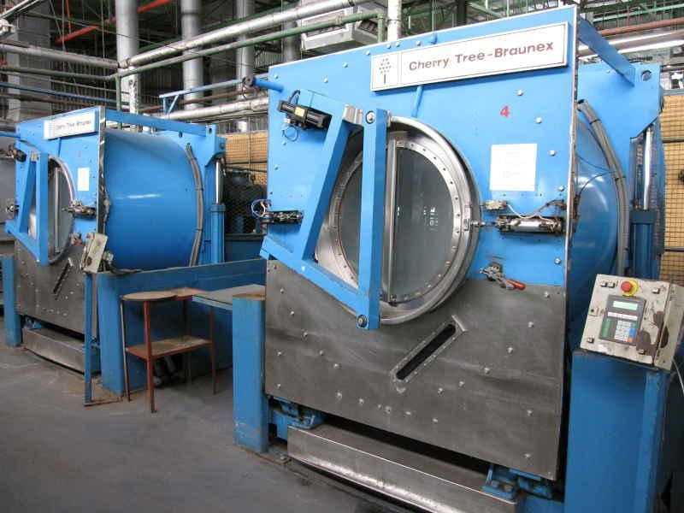
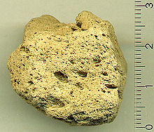
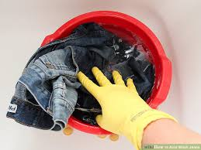
The textile and process
Acid wash jeans is a form of stone-wash denim, it's a textile manufacturing process.
The textile: Denim
This process is called stone-washing., a procedure that gives denim a more flexible and softer feel.
Acid wash denim is actually a misnomer. In the technique, chlorine is used.
Its D.I.Y friendly

Slide 3
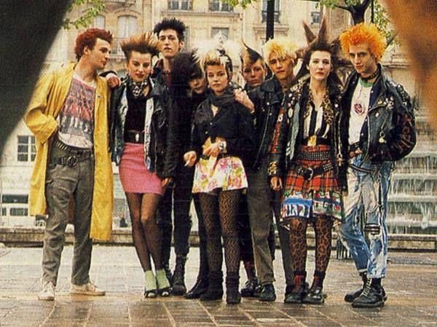
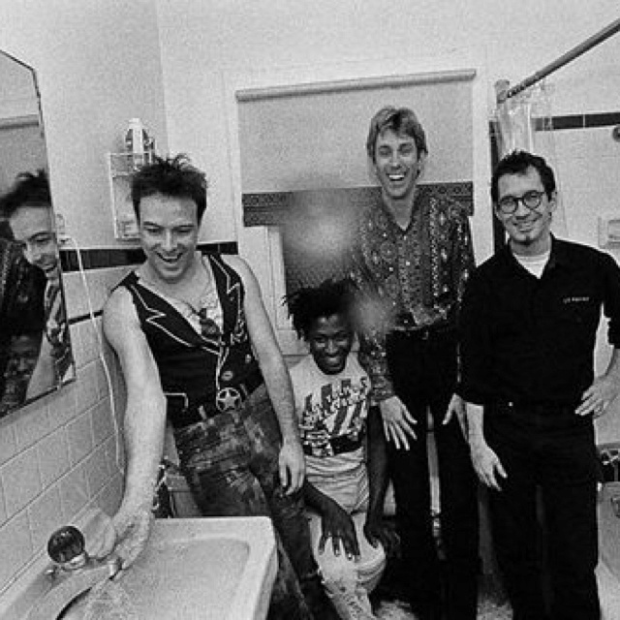
The punk rock connection
During the late 70’s and early 80’s, the punk rock subculture started to form.
A way to promote self-expression
Centered on punk-rock music
The “punk” fashion concept was to be original and rebellious.
Popularized acid wash jeans as a street style.

Slide 4
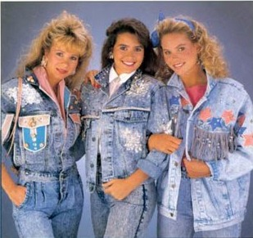
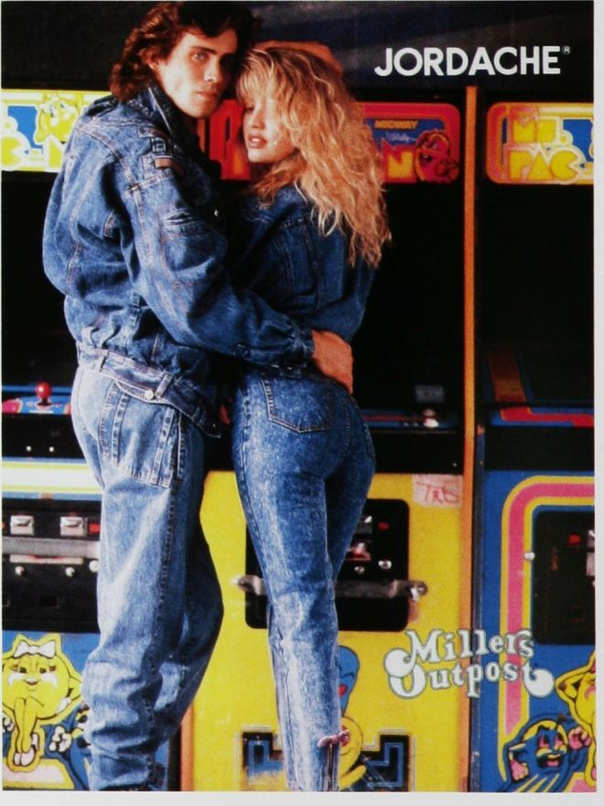
Totally trendy

Slide 5
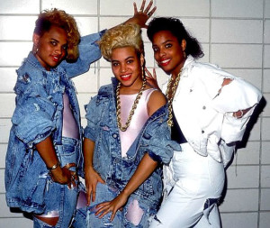
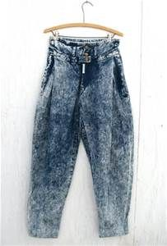
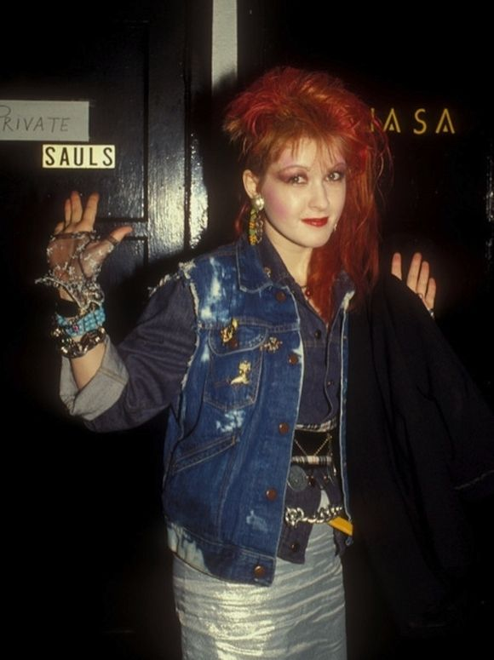
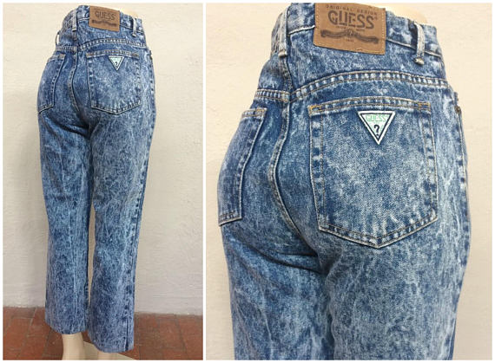
Acid wash then;
Z.Cavaricci, a jean brand 1980’s.
Guess jeans ,1981.

Slide 6
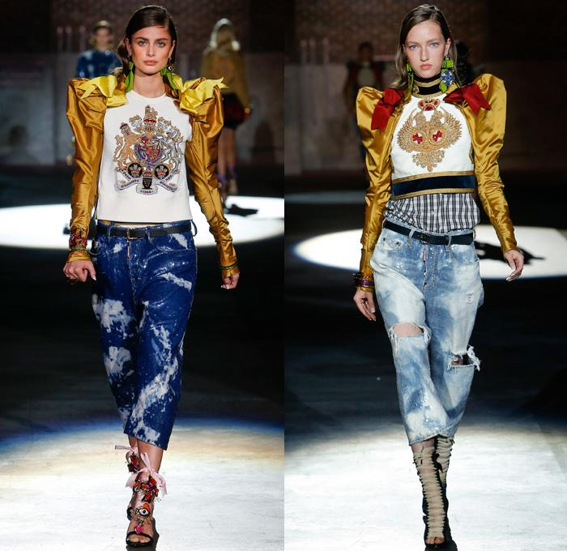
A revival trend
Left; Gucci 2017 resort collection. right ; Marc jacobs 2017 resort collection.
Dsquared2 spring 2017 ready to wear collection

Slide 7
Acid wash
now:

