Slide 1
WHY ARE BLACK BUISNESS LOOK DOWN UPON BY THE MEDIA OF AMERICA?
CRAIG JOSEPH
PROFESSOR CORVERT
FINAL PROJECT

Slide 2
HOW BLACK PEOPLE ARE LOOKED DOWN UPON
People look down upon Black people because they’re different which is good, but parts we don’t like are impeding on our freedoms.
This of course makes it harder to appreciate their many good aspects.
If blacks and whites all mixed together there would only be on race of people

Slide 3
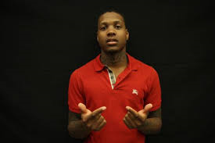
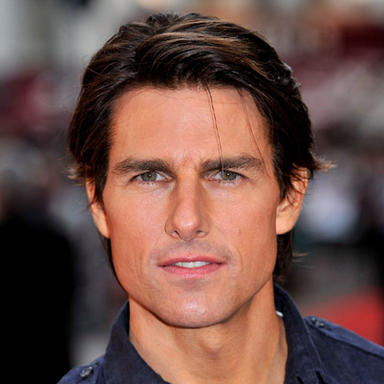
White people
Black people

Slide 4
How some white people think of black people intelligence
Most white people think that blacks are intellectually inferior
You may not think that because you don’t, you associate with people who share your opinion.
We live in a society that papers to be open for al people.

Slide 5
Types of folklore
In this case it deals with oral folklore .
It also demonstrates customary folklore.

Slide 6
The struggle of black owned businesses
One fact is that Black families tend to push their family to become workers rather than being a creator.
If children insist on becoming a entrepreneurs they are discouraged from doing it and told it’s a risky thing
They will sonly bound to fail
Another is the amount of racism in America

Slide 7
Relating to my career
I want to become a business owner
Also it would be around a black community

