Slide 1
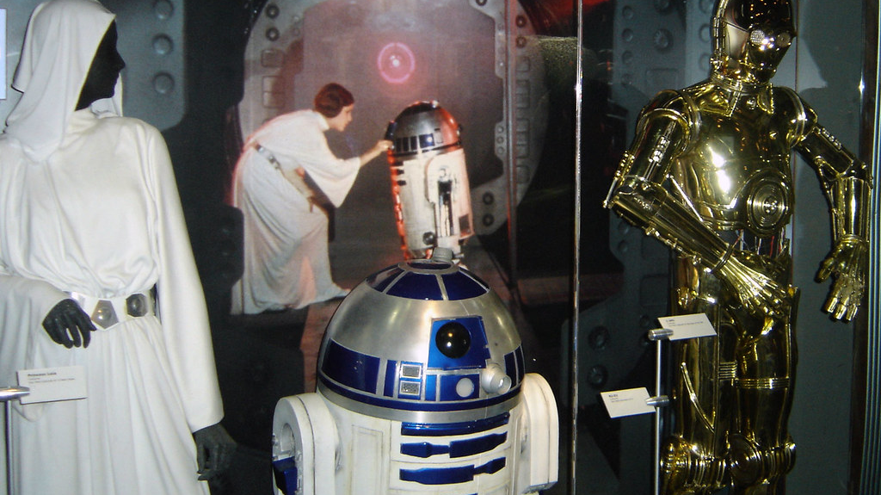
The storytelling of clothes in film
By Citlalli Villanueva

Slide 2
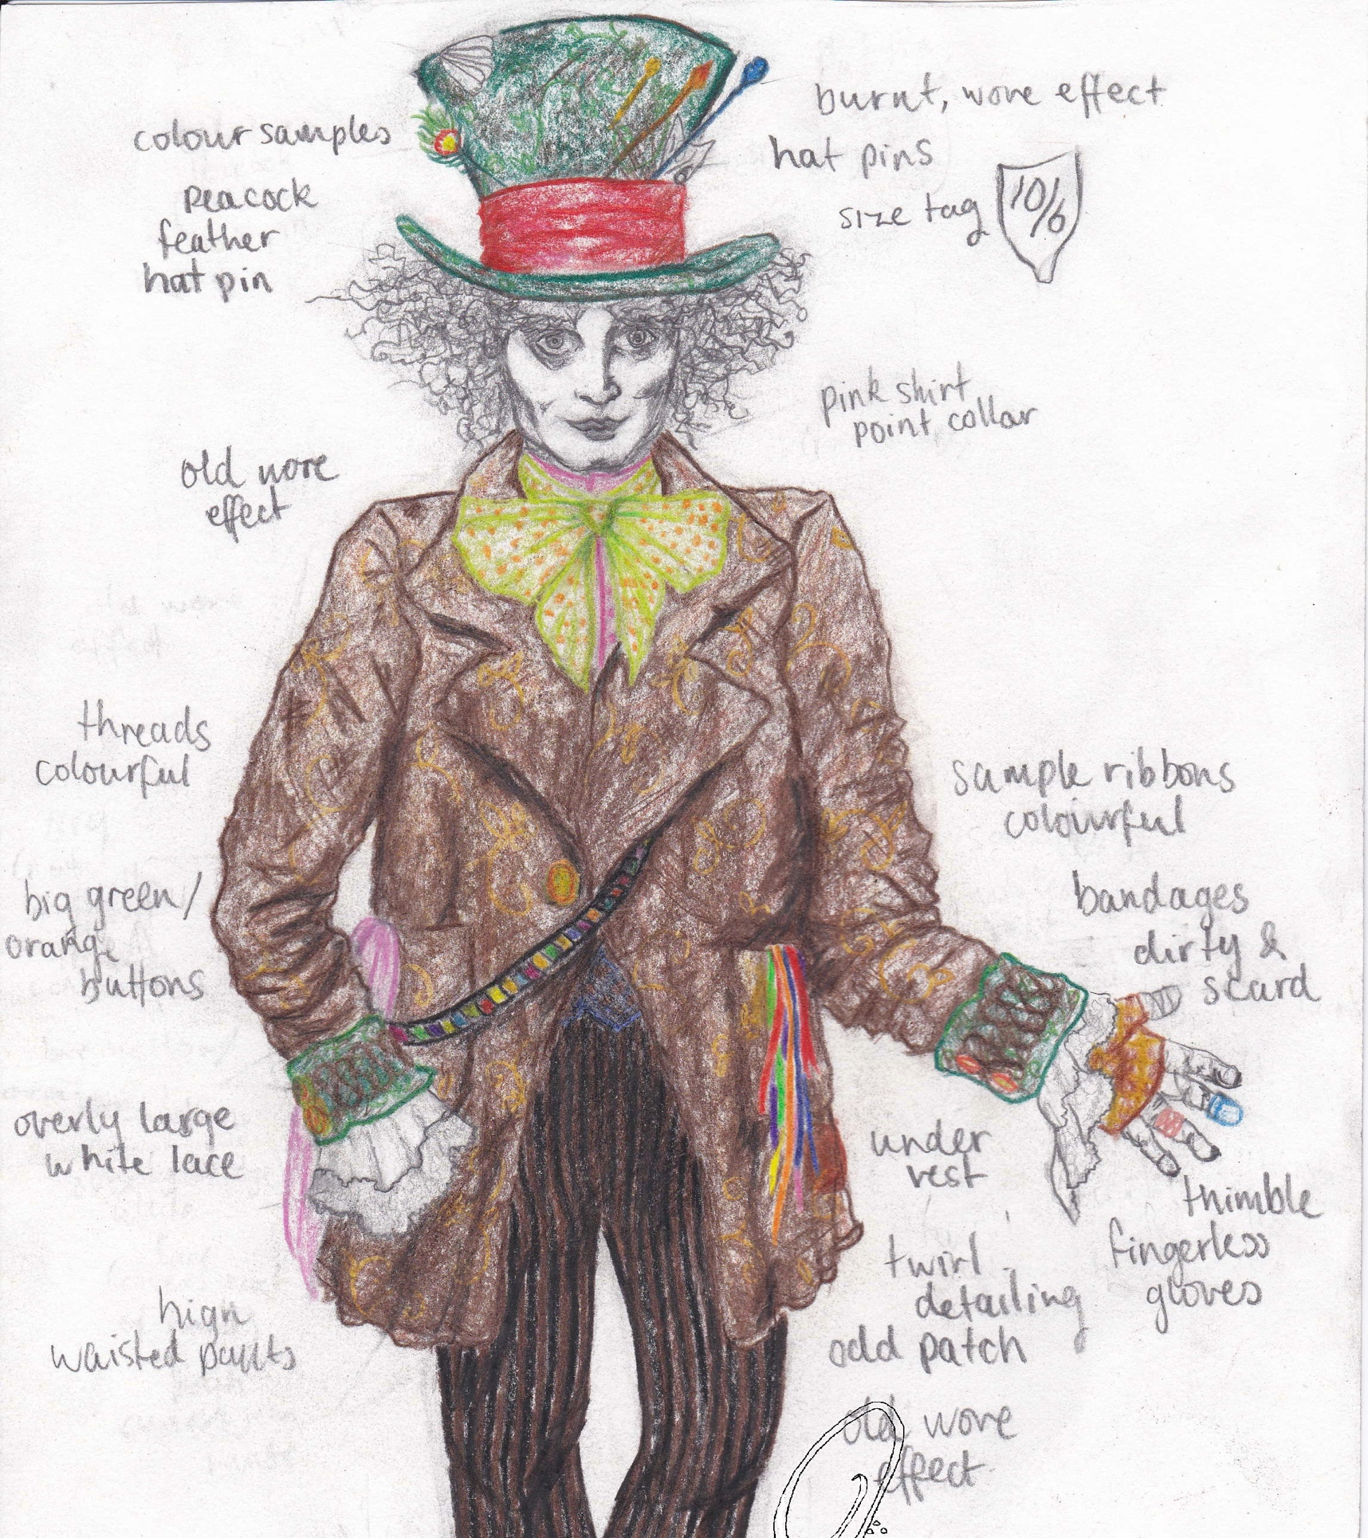
What is Costume Design?
Costume design is the creation of clothing and accessories for characters in movies and TV shows.

Slide 3
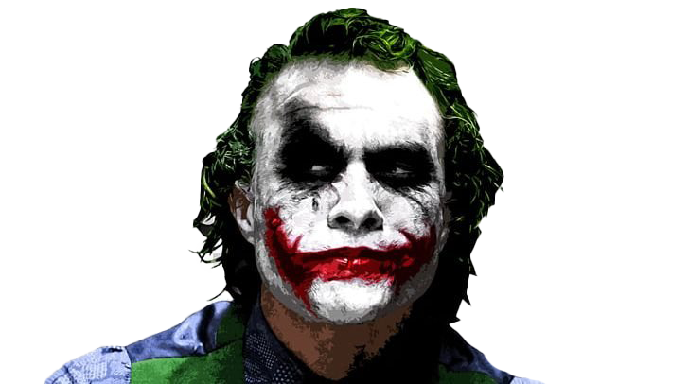
What is the importance in Costume Design?
Costume design plays a big role in movies, without it the character would lack personality, context, authenticity and it would be hard for the audience to know more about the plot of the movie, timeline, culture, etc.

Slide 4
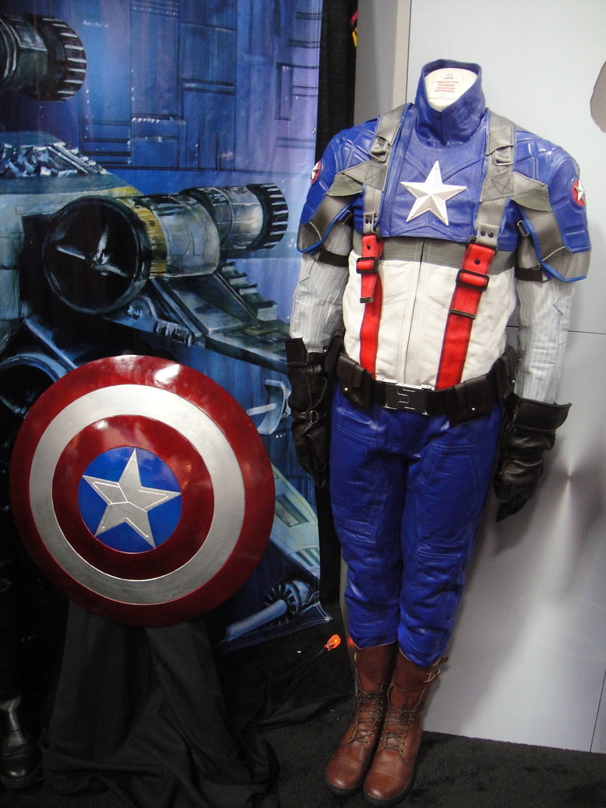
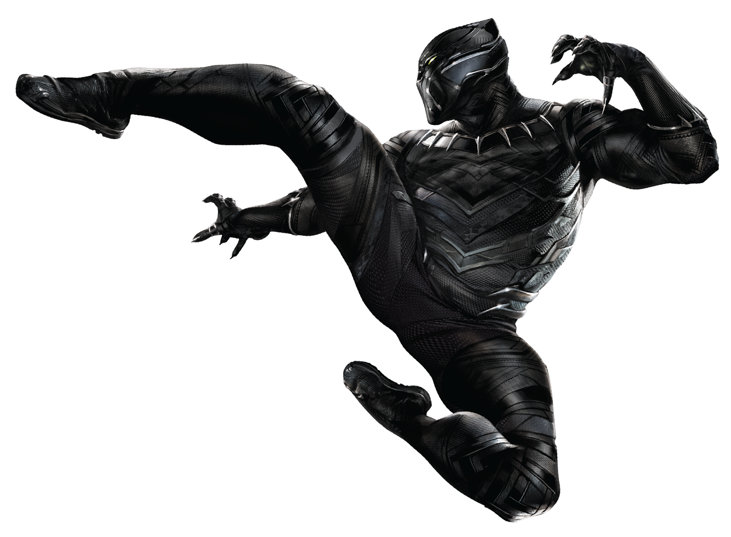
How does costume design impacts film?
It helps the audience to get to know better the audience, plot, and sometimes even to relate to them. Costumes tell a silent story about the character’s life, background, emotional state, and preferences.

Slide 5
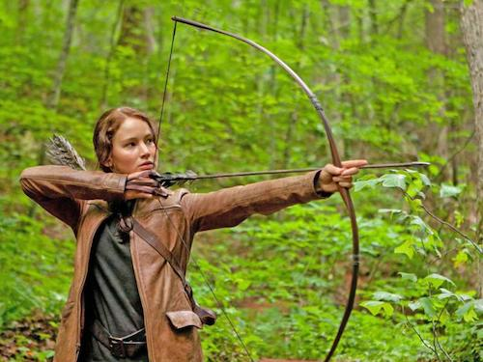
Katniss Everdeen
She is the main character of The Hunger Games sagas. She is a 16 year old from District 12 that often wears earthy looks except during her apperiances in the Capitol.

Slide 6
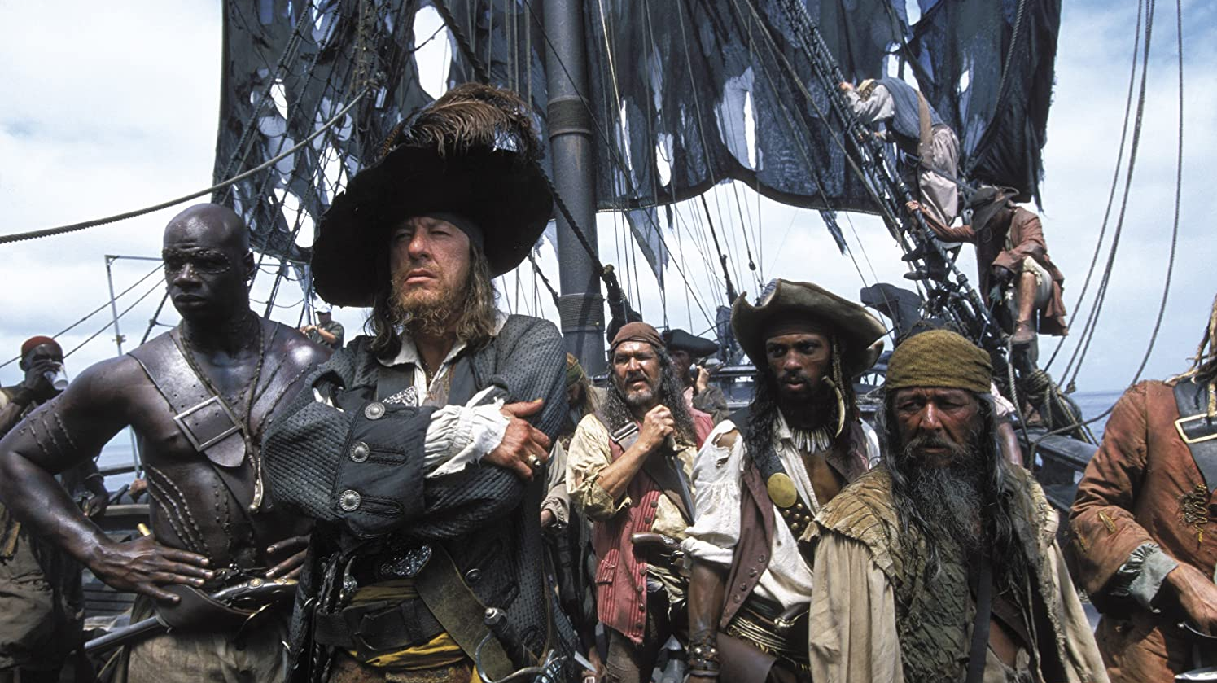
Thank you for your attention

