Slide 1
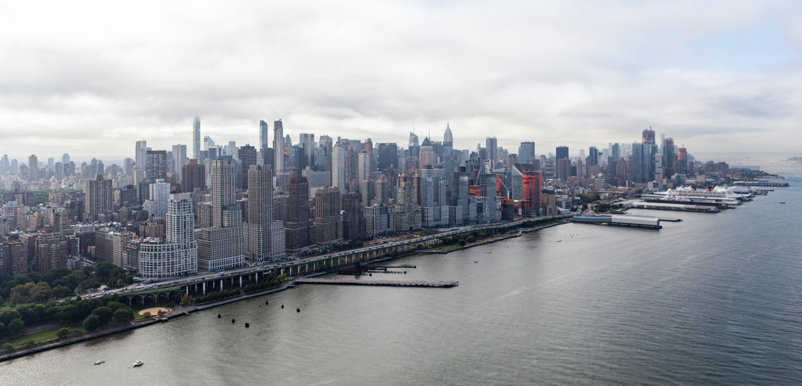
THE URBAN EXPERIENCE

Slide 2
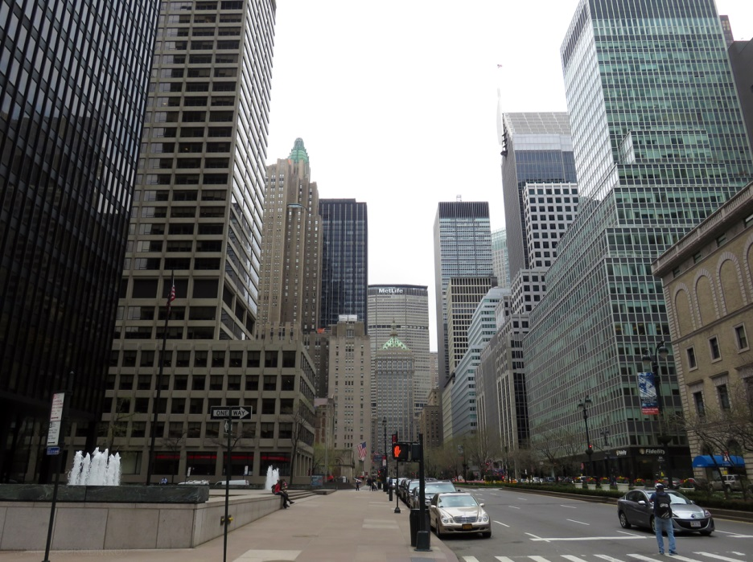
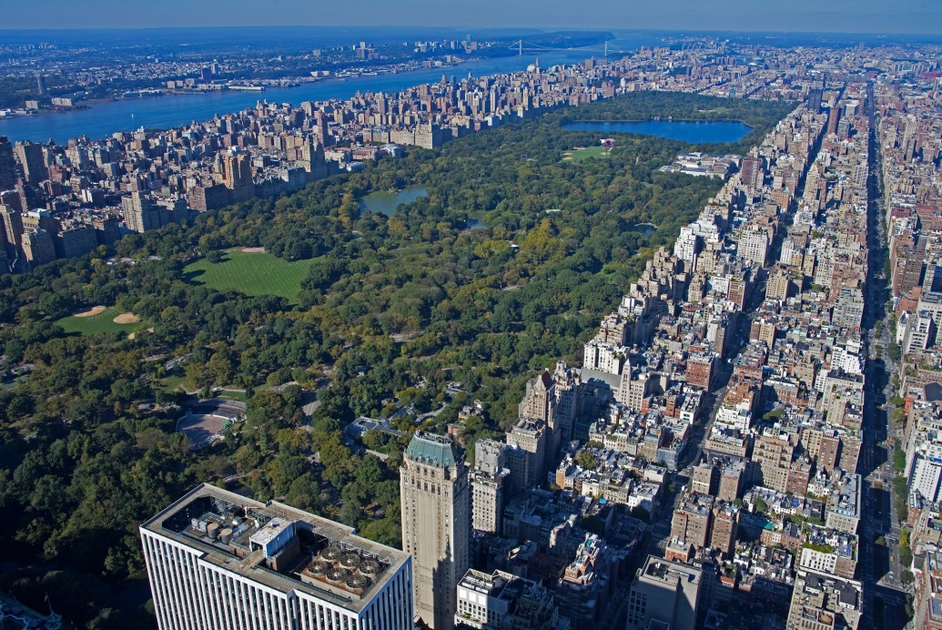
What defines the urban experience?
Building Masses Open Space

Slide 3
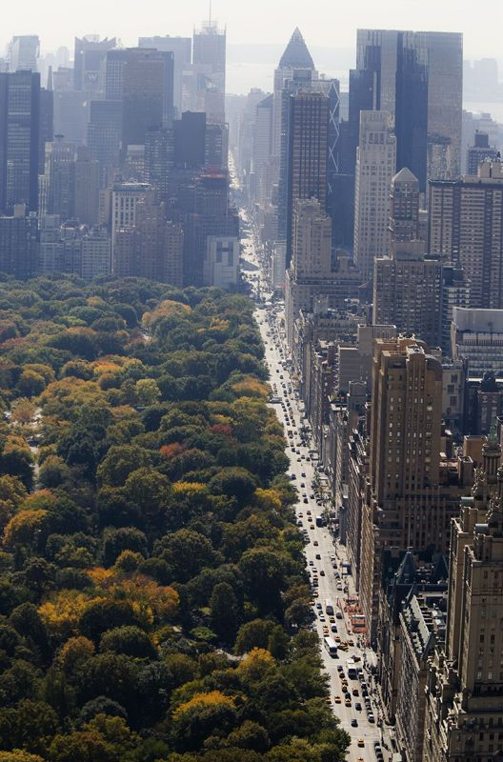
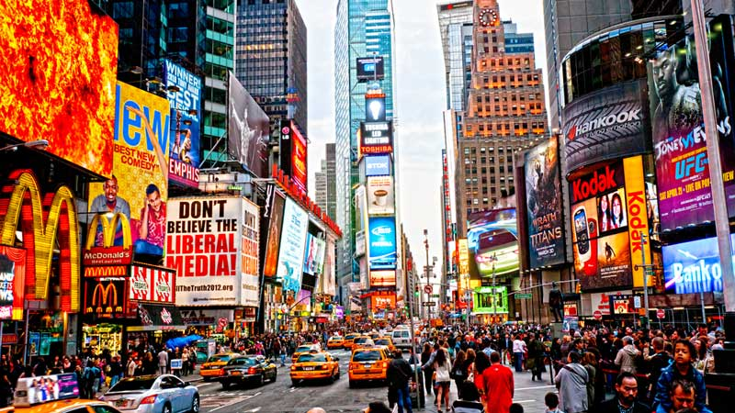
Architecture
Defining Territories Defining Character

Slide 4
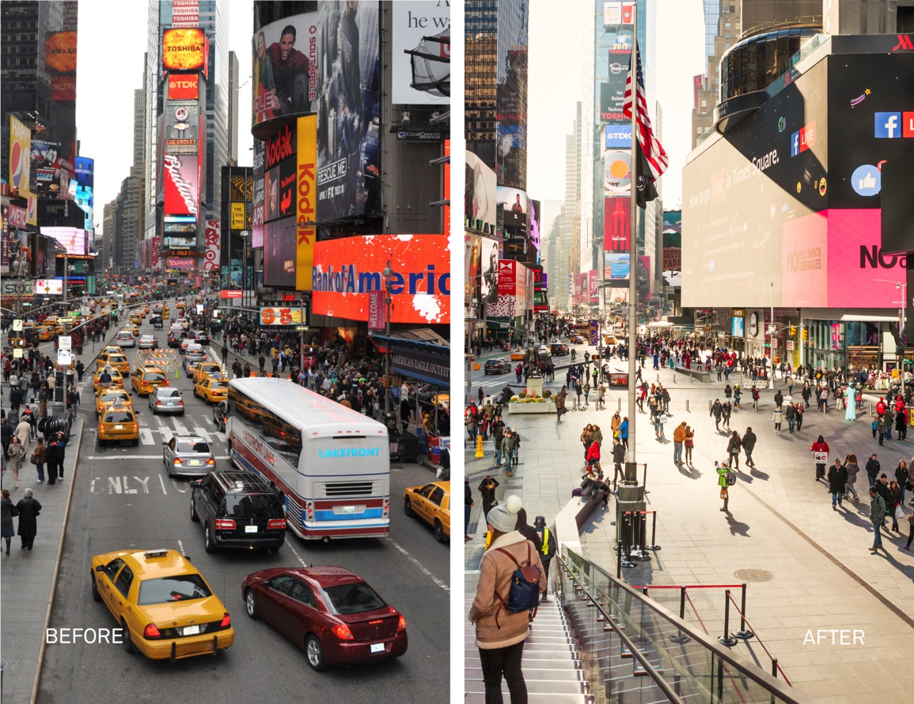
Open Space: Streets
Vehicles Pedestrians

Slide 5
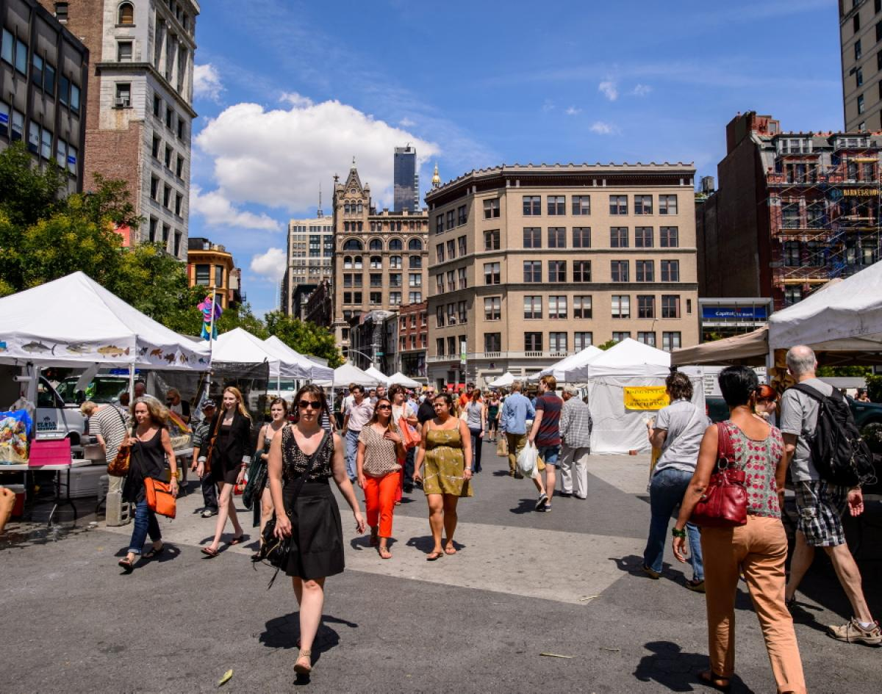
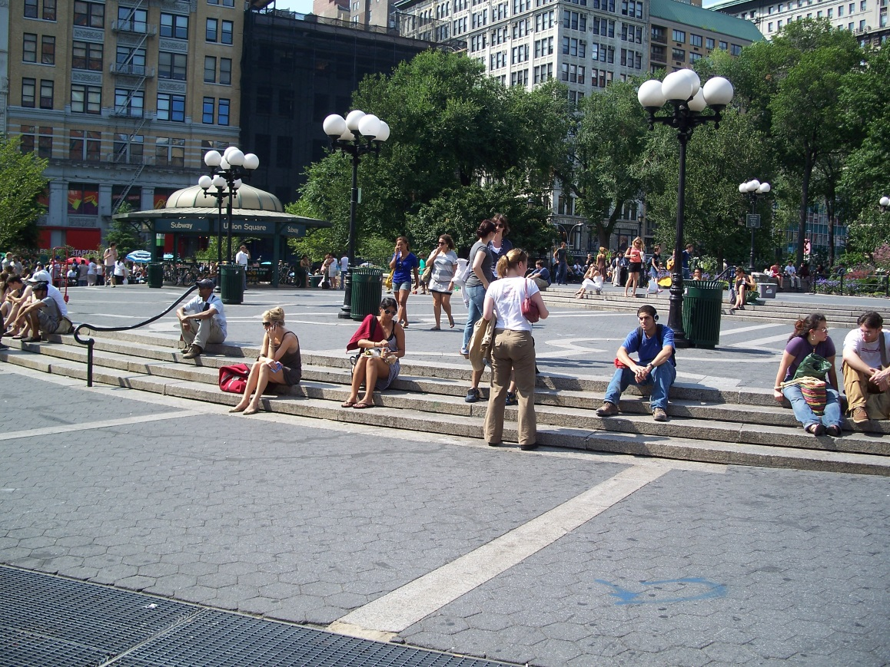
Open Space: Plazas & Squares
Circulation Relaxation

Slide 6
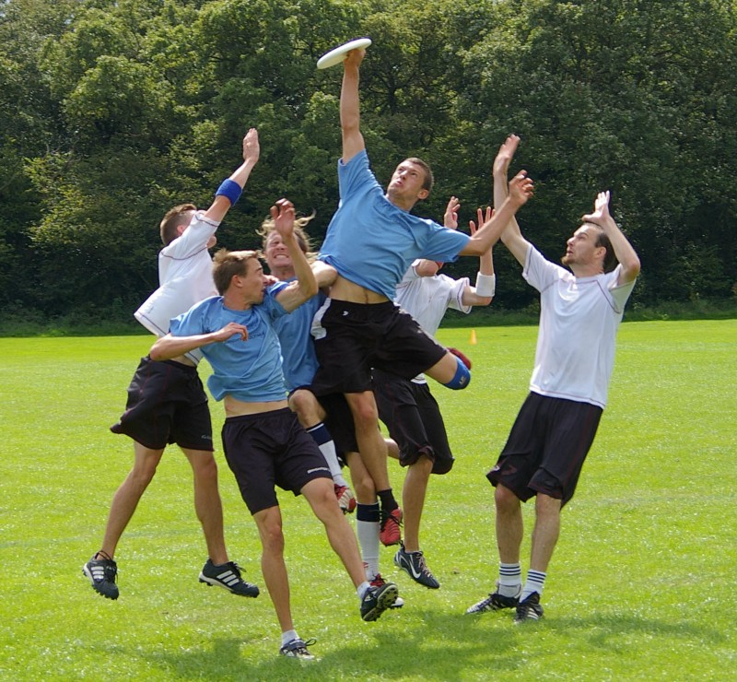
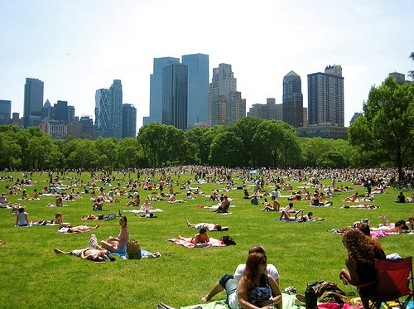
Open Space: Parks
Activity Relaxation

Slide 7
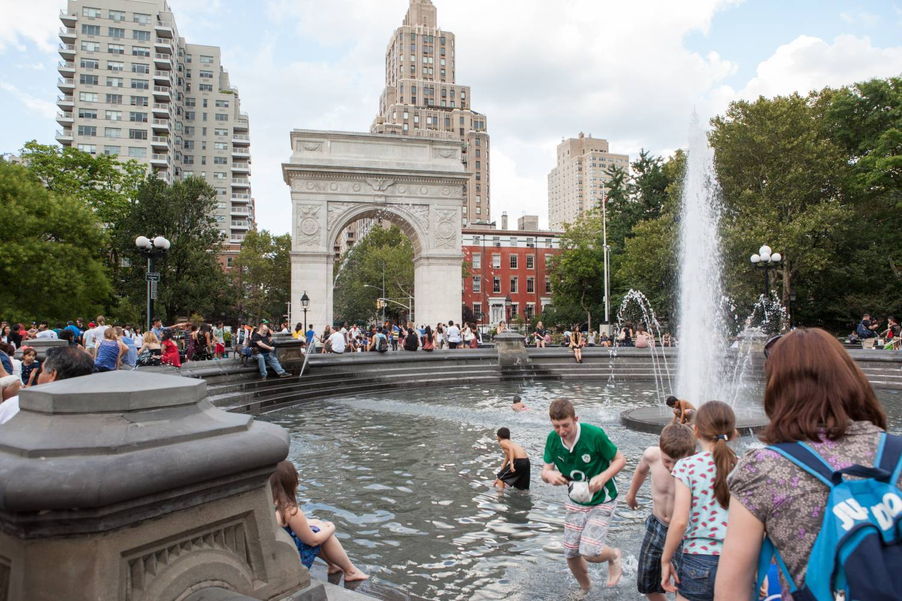
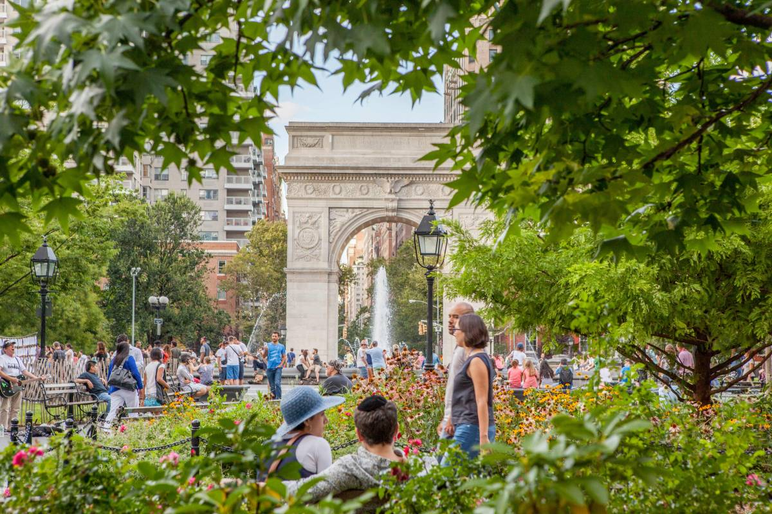
Landscaping
Hard Surfaces Vegetation

Slide 8
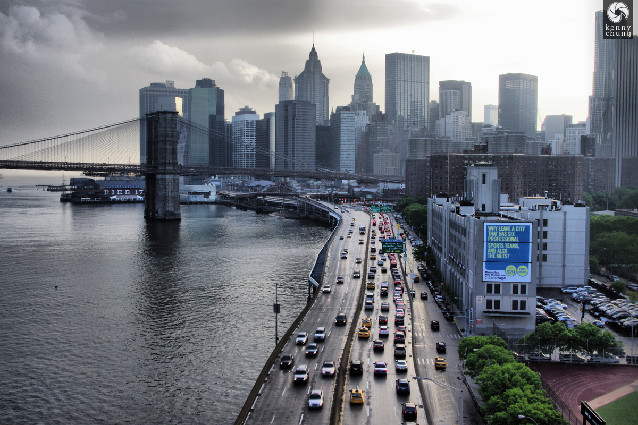
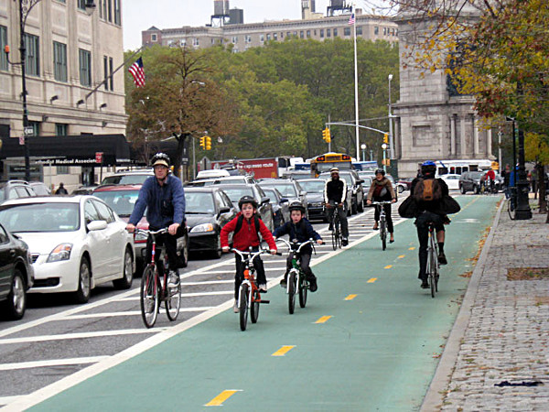
Infrastructure
Highways & Bridges Bike Lanes

Slide 9
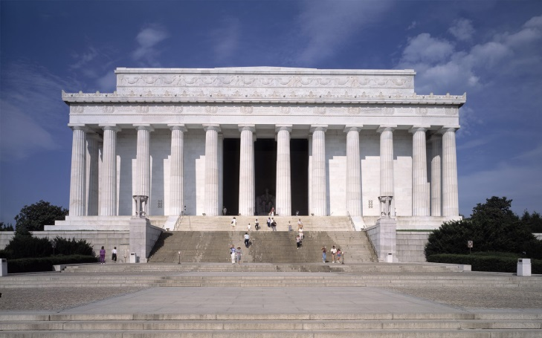
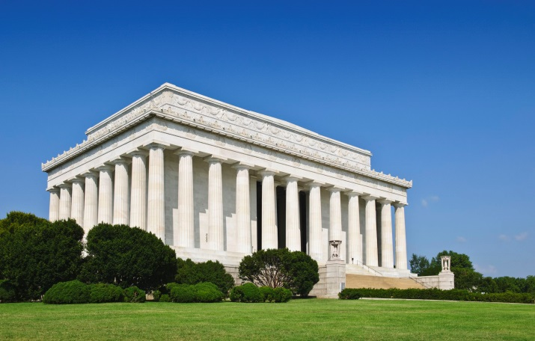
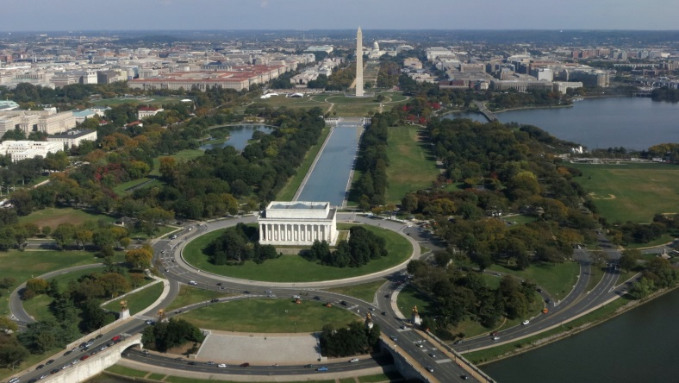
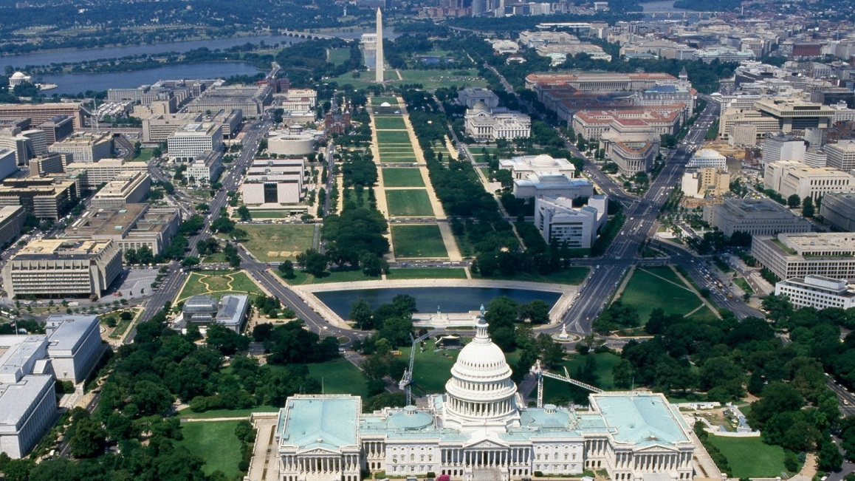
Architecture + Landscape + Infrastructure
URBAN DESIGN

Slide 10
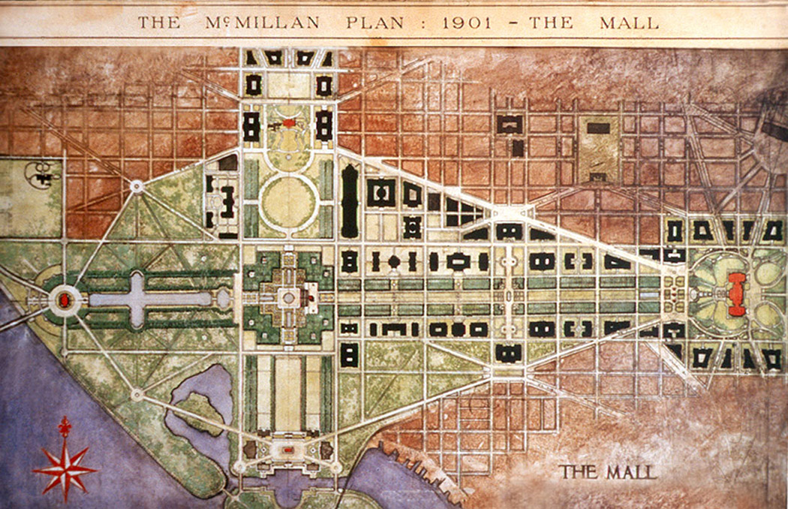
Planning and Designing a City Washington
Pierre L’Enfant Plan of Washington DC : 1791

Slide 11
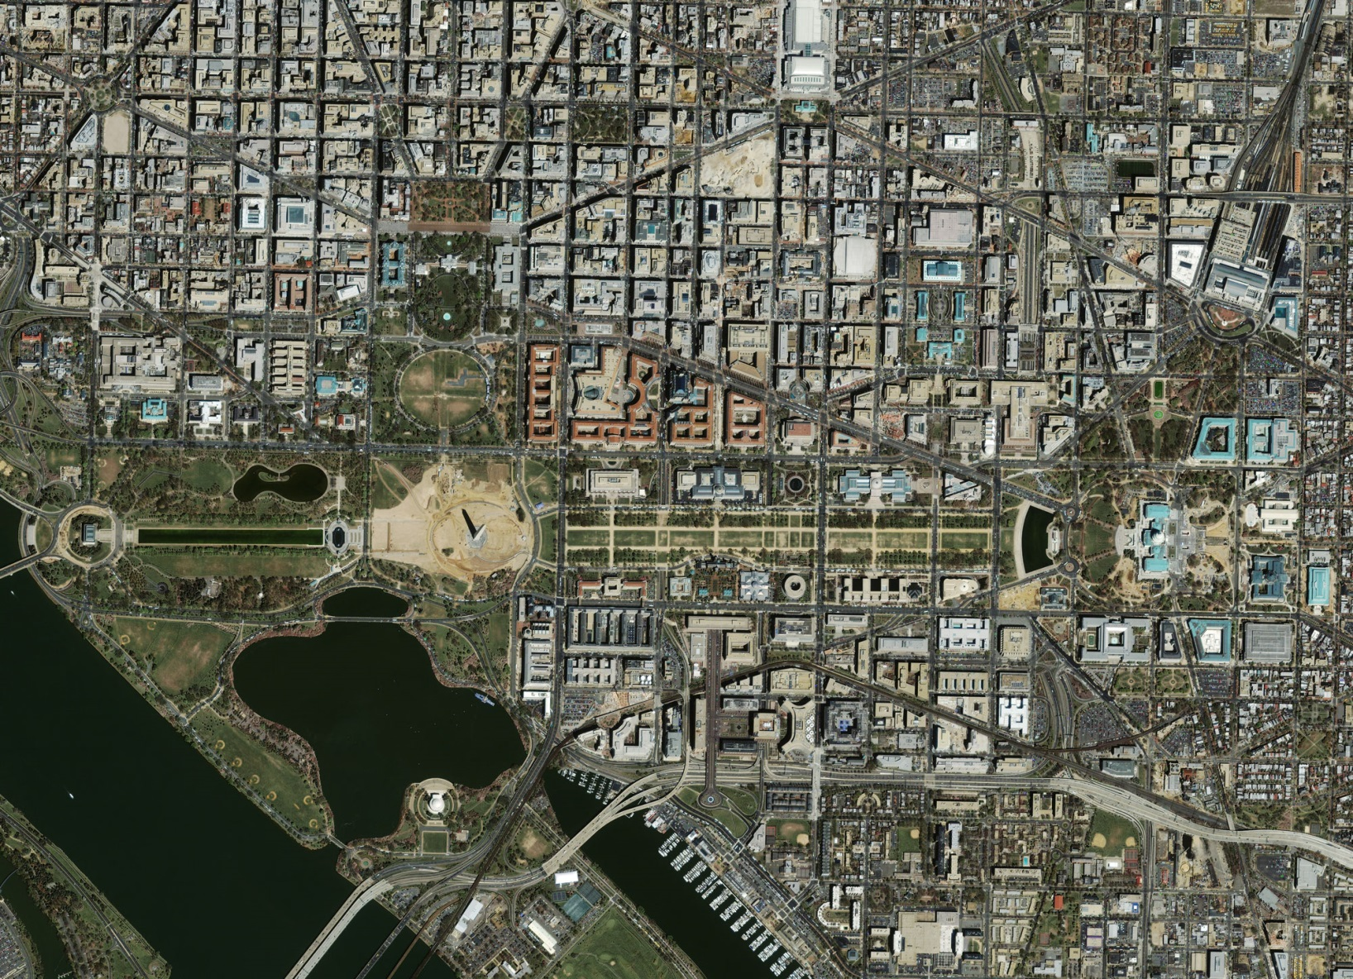
Planning and Designing a City Washington

Slide 12
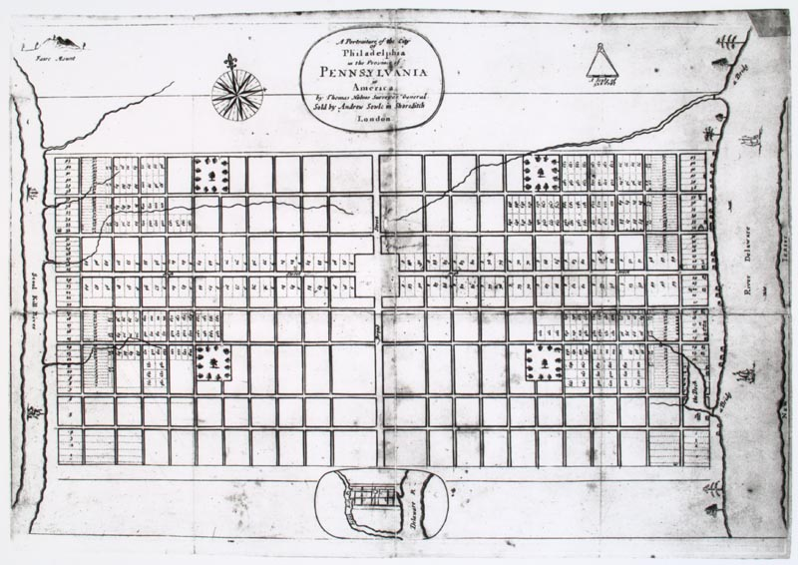
Planning and Designing a City Philadelphia
William Penn Plan for Philadelphia : 1682

Slide 13
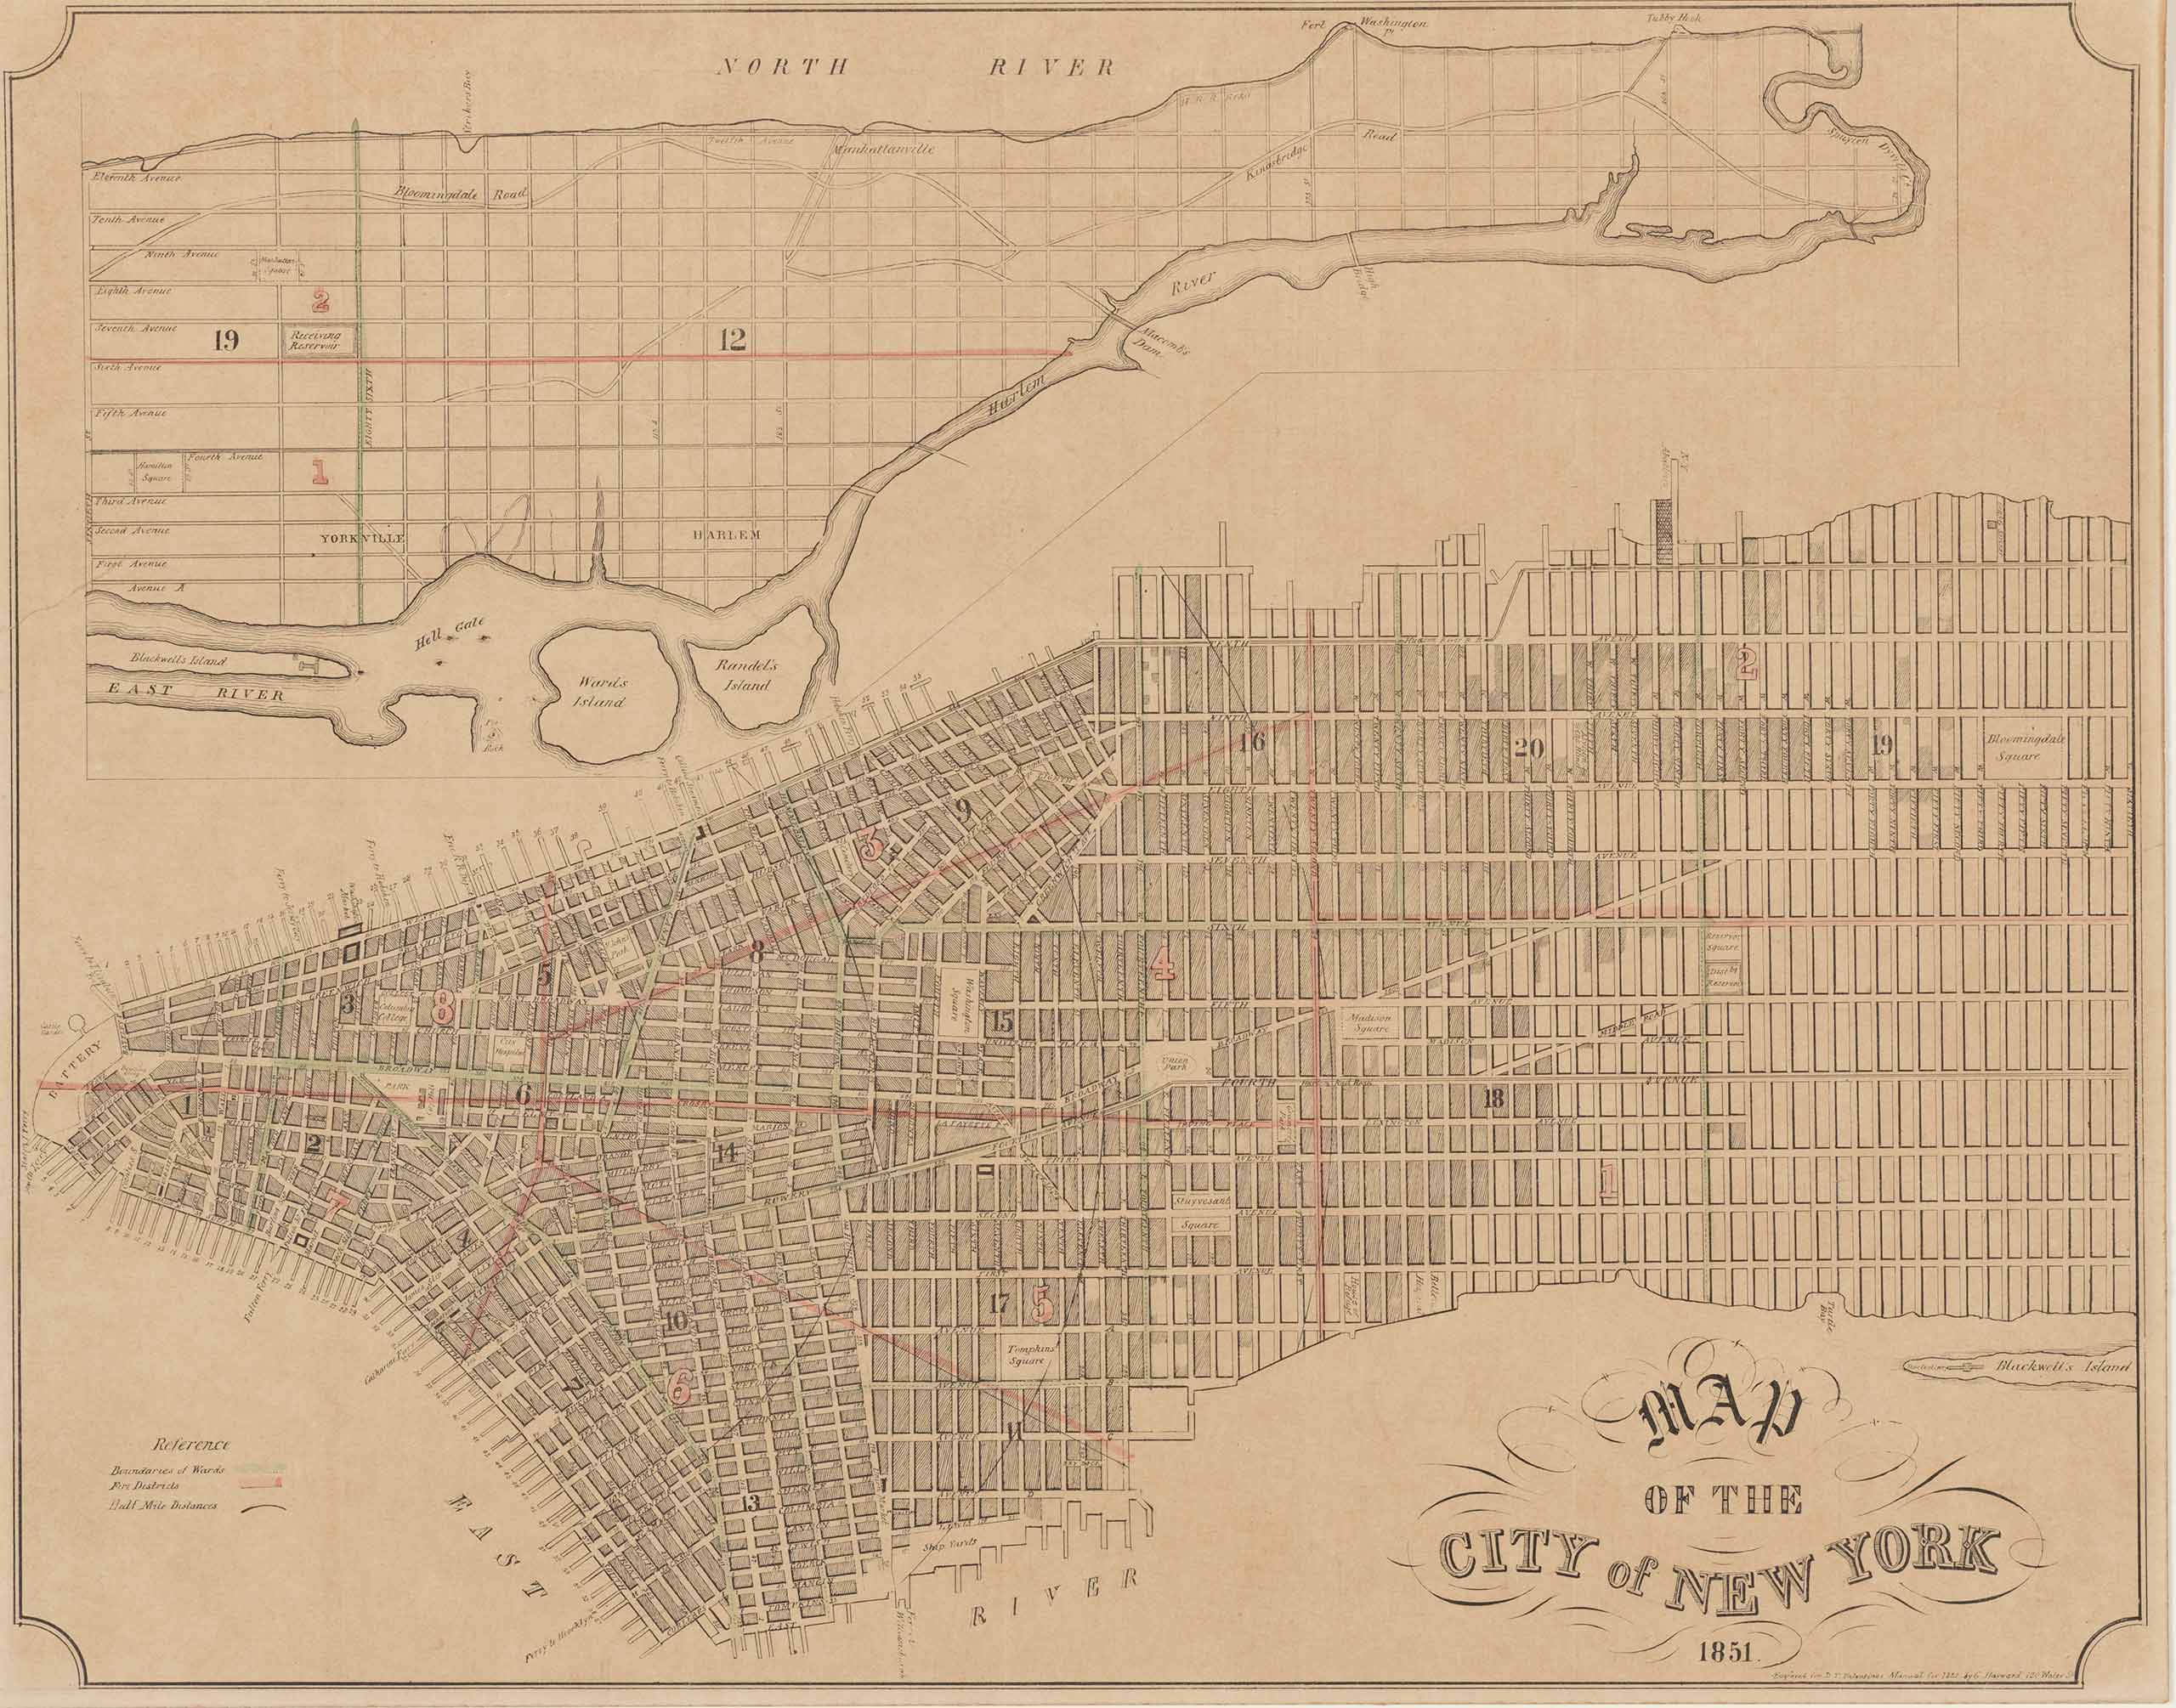
Planning and Designing a City New York City
Gridiron Plan of New York : 1814

Slide 14
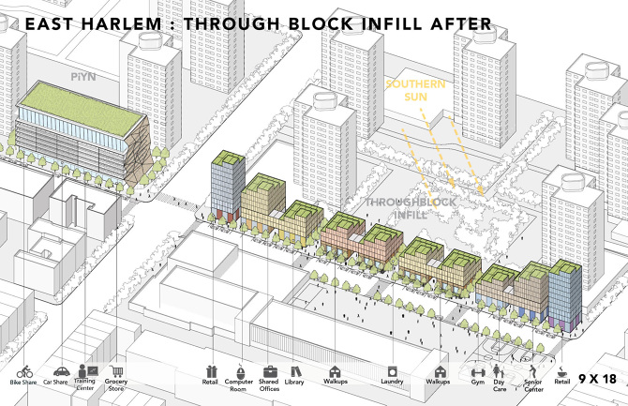
The Master Plan
Context: Relationship to adjacent structures
Programmatic Relationship: Use
Scale: Bulk/Density
ZONING

Slide 15
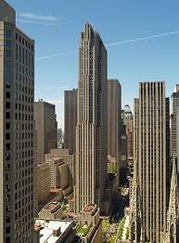
Rockefeller Center

Slide 16
Lincoln Center

Slide 17
Times Square

Slide 18
Columbia University

Slide 19
Battery Park City

Slide 20
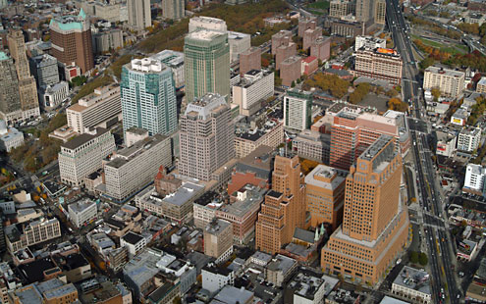
Class Lab: Metrotech

Slide 21
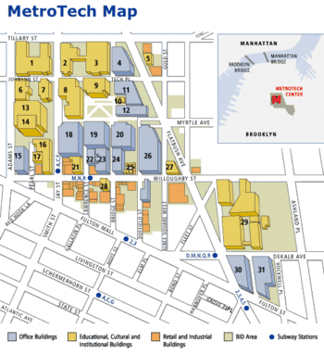
METROTECH was begun in the 1990s when developer Forest City Ratner and Brooklyn Poly (now NYU Tannon) got together to create a campus of office and educational buildings in an underused area of downtown Brooklyn.

Slide 22
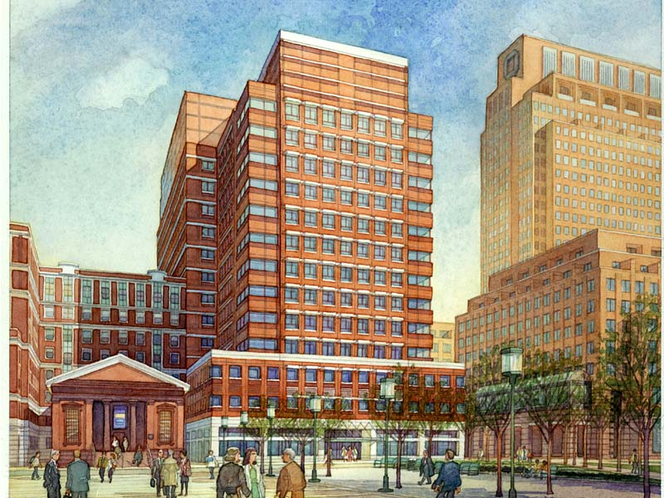
Things To Look For
Scale of buildings
Hierarchy of buildings
Relation of buildings to existing buildings
Types of public space
Buildings’ relation to public space
Pedestrian circulation patterns
Relation of pedestrian and vehicular circulation

