Slide 1
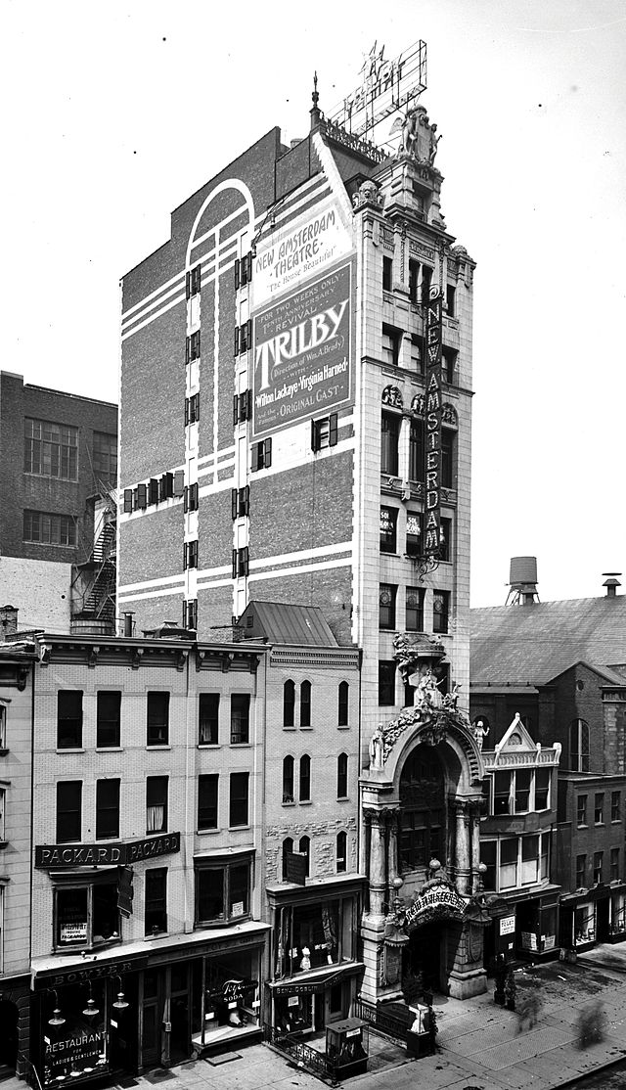
New amsterdam:

Slide 2
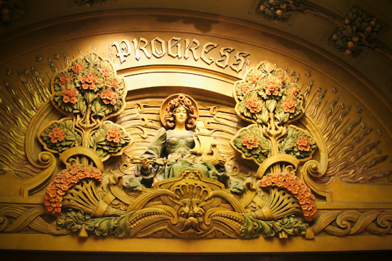
beaux arts

Slide 3
beaux arts cont.

Slide 6
Midsummer’s night dream 1903

Slide 7
Midsummer’s night dream play

Slide 8
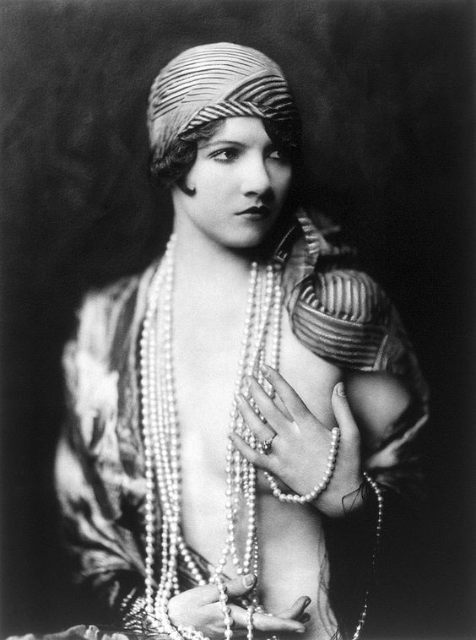
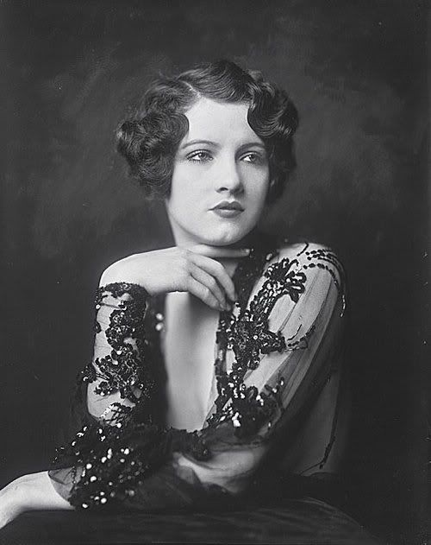
Zigfeld follies : 1920’s - 1937

Slide 9
Zigfeld follies

Slide 10
Zigfeld follies

Slide 11
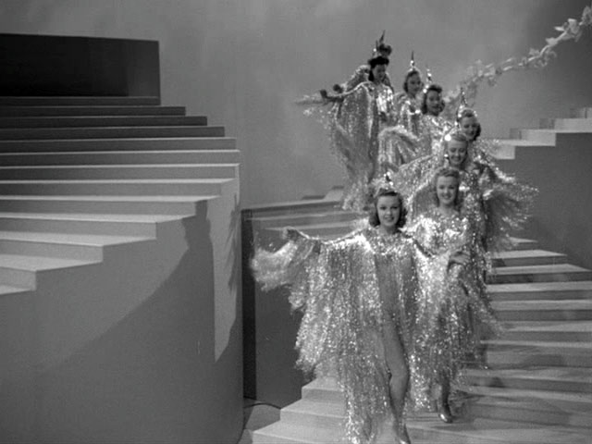
zigfeld stairs

Slide 12
https://www.youtube.com/watch?v=BjExqlkld3k

Slide 13
Cinema: 1940-1980.

Slide 14
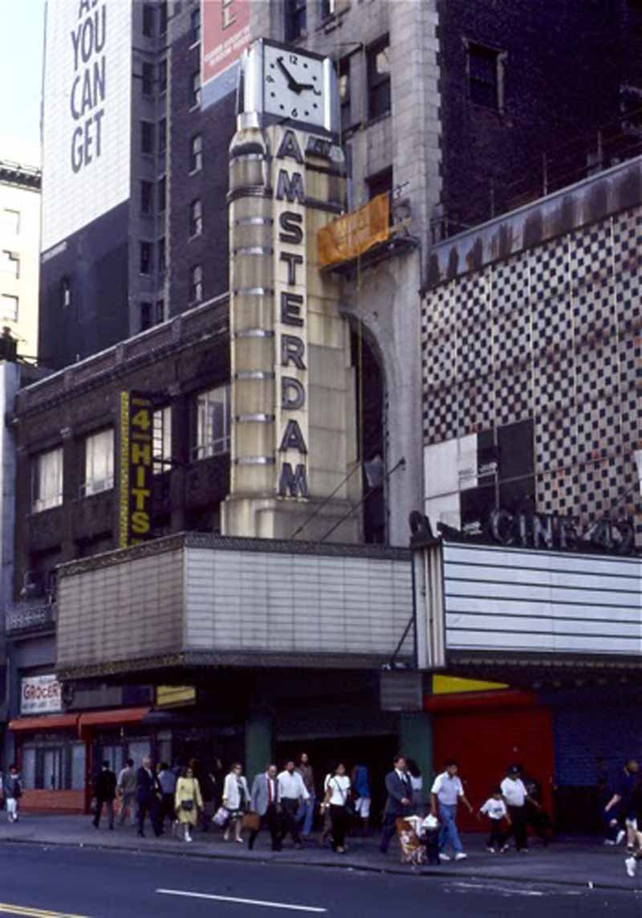
1985: new amsterdam

Slide 15
Then and now 1903 and 2006

Slide 17
Today at new amsterdam

