Slide 1
The Sam Shubert Theatre
Opened in September 29, 1913

Slide 2
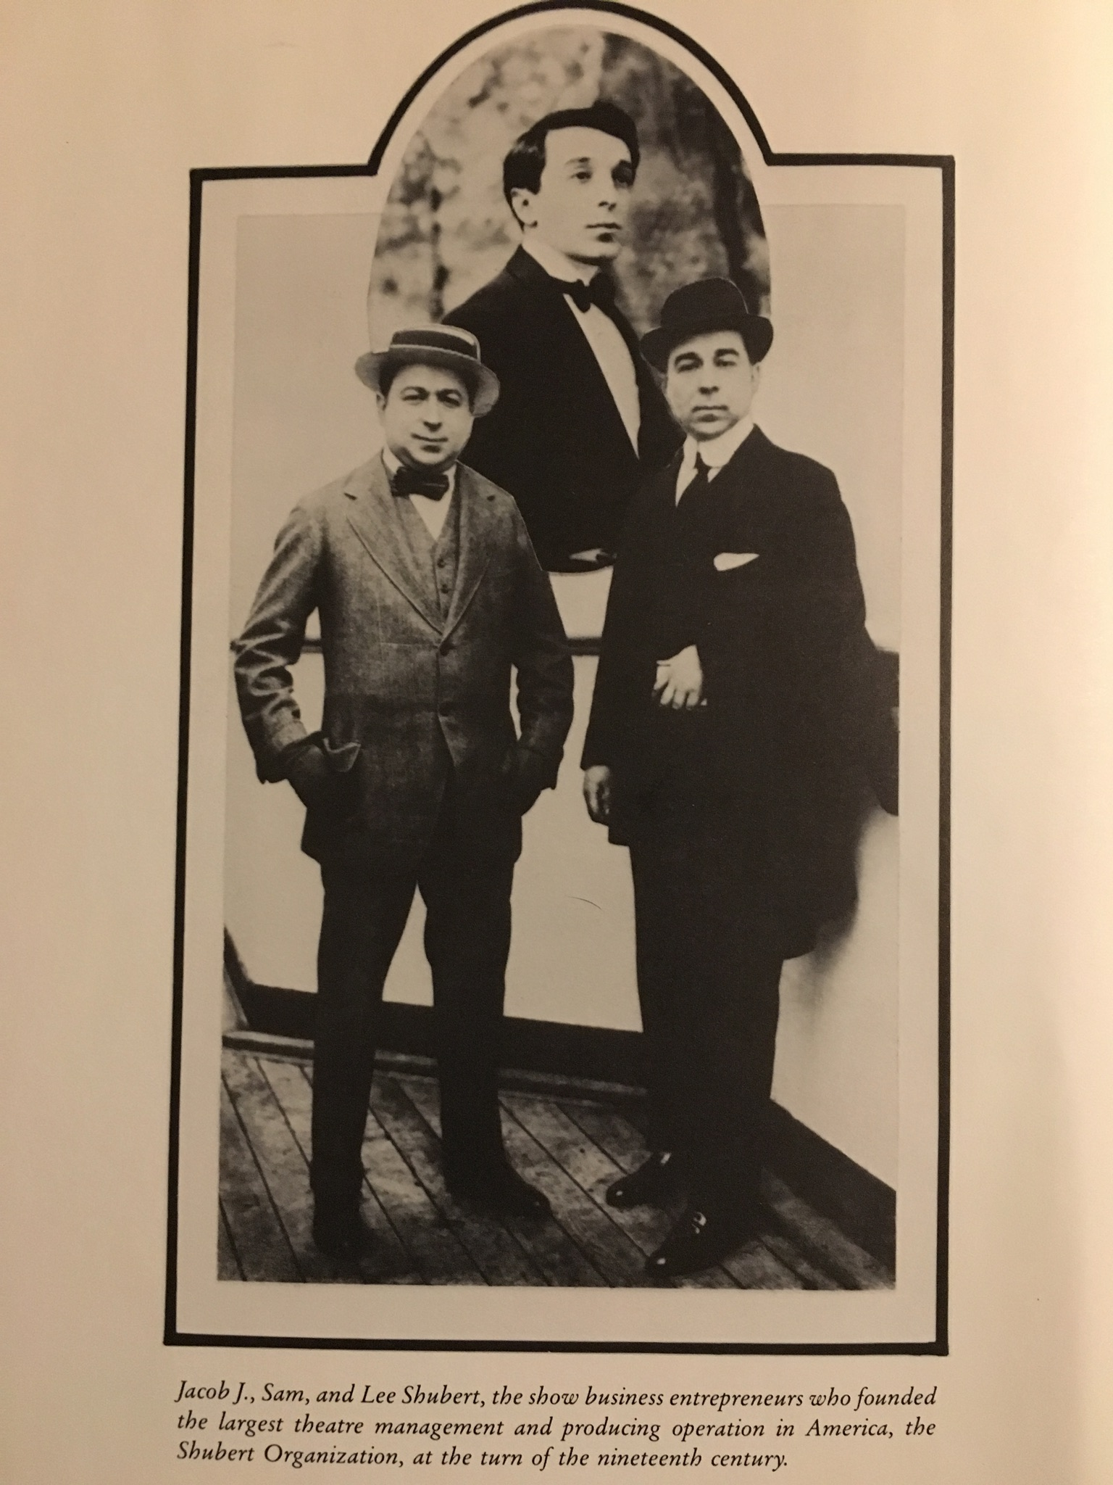
Before The Sam Shubert Theatre
Sam work history
Lee/ J.J work history
How it began

Slide 3
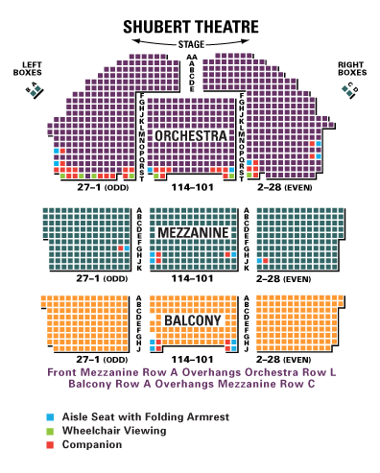
About the Sam Shubert Theatre
Total Number of Seats 1460
Orchestra 670
Mezzanine 410
Balcony 351
Box seats 7
Pitseats 13
Aisle transfer arms 16
Standing26
Wheelchair 7

