Slide 1
Hawa Kamara BOOTH THEATRE 1913

Slide 2
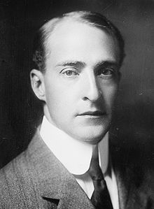
BOOTH THEATRE 1913
222 West 45st Street
The theater was created by Winthrop Amos

Slide 3
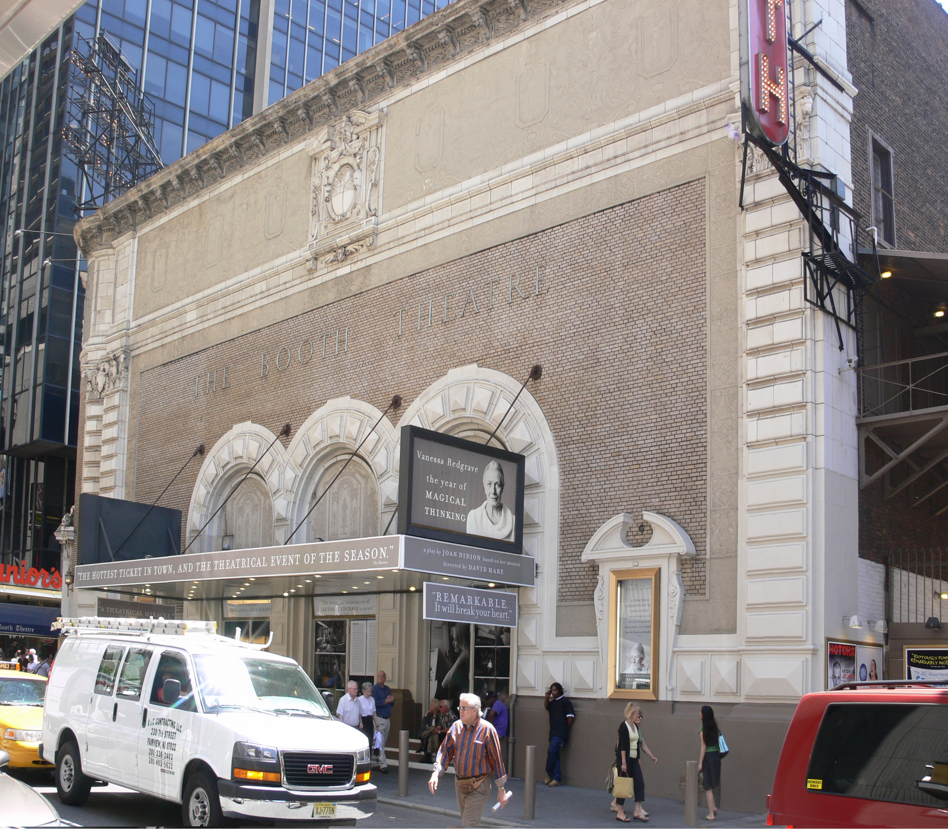
Henry B. Herts is the Architect who build the Booth theater Amos wanted a contemporary European style theater so Herts use the Beaux Arts style. The façade of the building is a Tan brick, stone and terra cotta type in early Italian Renaissance style, with designs in graffito in brown and ivory colors which harmonize with the exterior of the theatre, An unusual feature of the Booth was a wall that partitioned the entrance from the auditorium, preventing street and lobby noises and drafts from coming to the interior of the house.

Slide 4
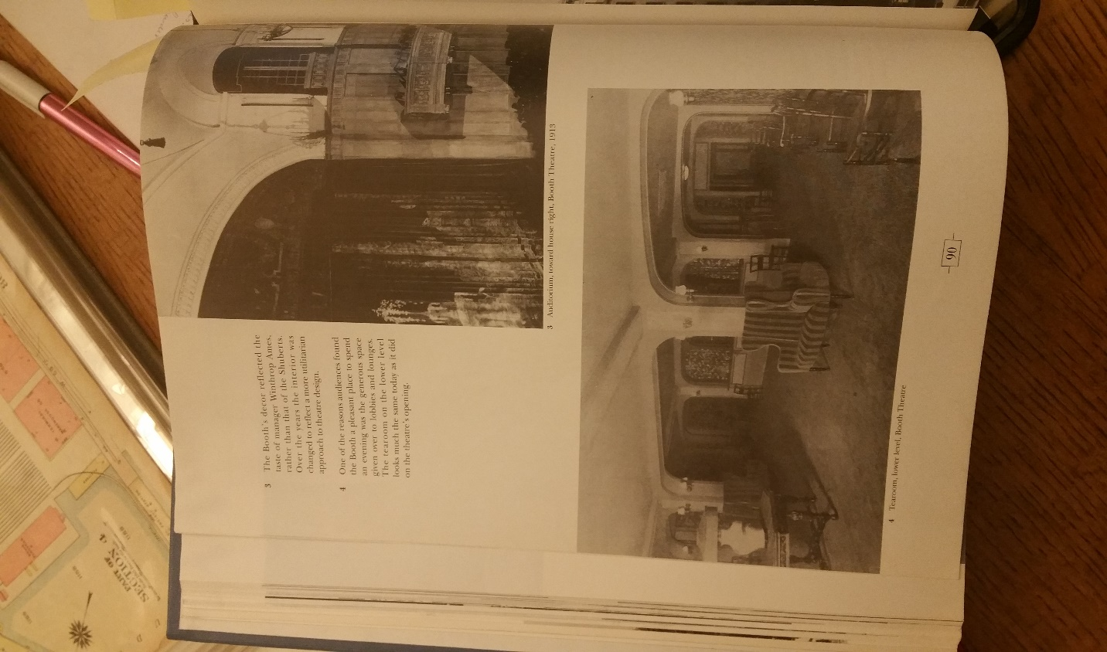
The Booth’s décor reflated the taste of Winthrop Ames. Woodwork and walls were in neutral tints of driftwood gray; draperies, upholstery, carpeting, and the house curtain were in various shades of mulberry. The theatre had wooden wainscoting two thirds up the side walls. Three set of false French windows were paned in mirrored glass. The celling was cover in four chandeliers Empire in style. There were 9 dressing rooms on the right side of the stage, an Orchestra pit, a tearoom, an owner level and two level with box seating.

Slide 5
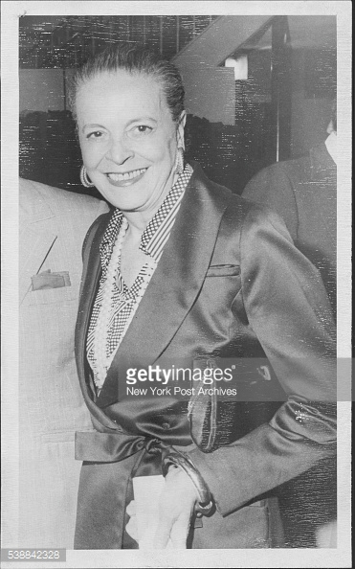
Renovation
In 1979 interior designer Melie Kahane did some updates

Slide 6
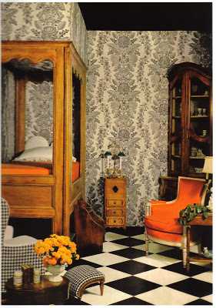
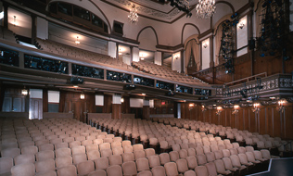
This is an example of her work…

Slide 7
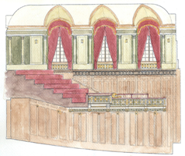
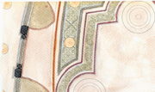
Renovation 2012
the restoration was completed by Francesca Russo. Francesca wanted this restoration to recreated the intimate, gracious ambiance of the original 1913 interior.

Slide 8
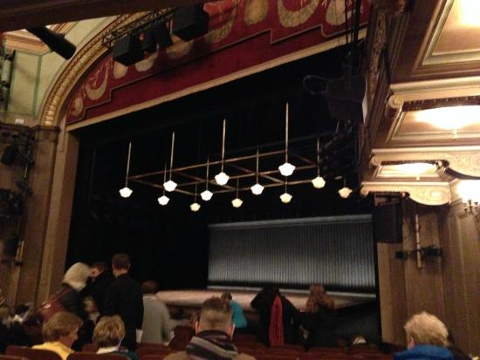
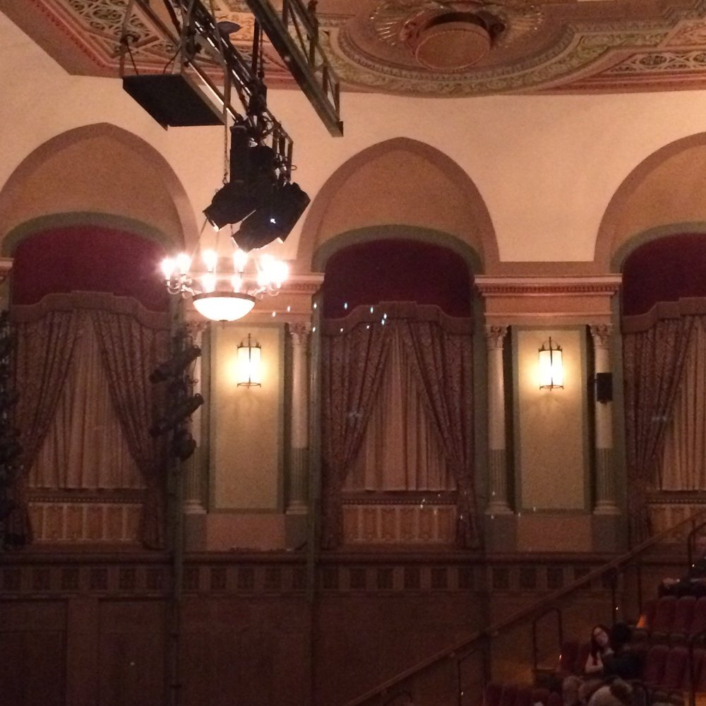
More examples..

Slide 9
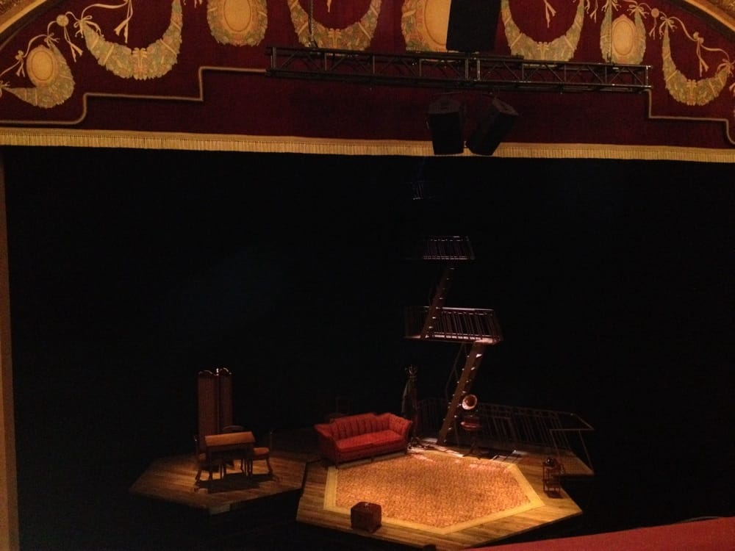
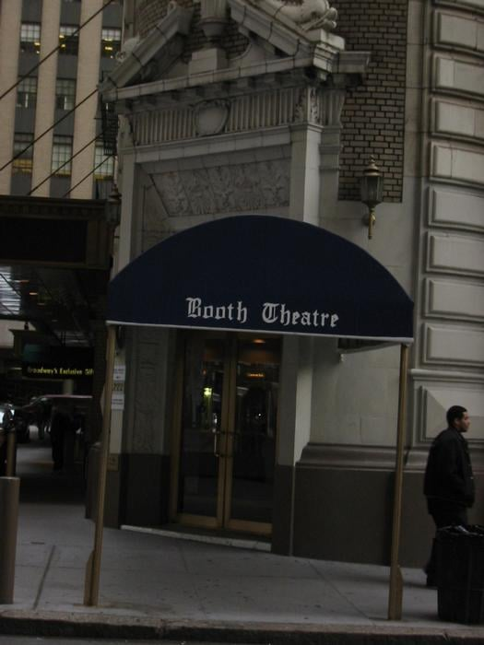
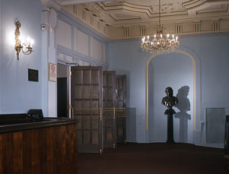
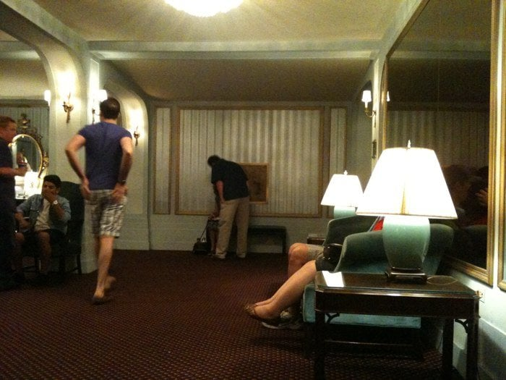

Slide 10
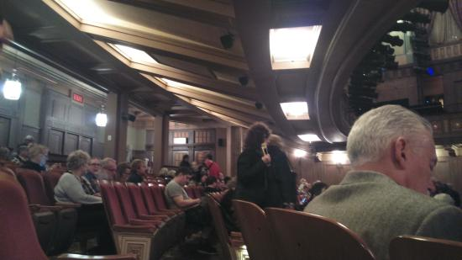
The Booth Theater is a Beautiful Theater
The currently playing now is “Les Liaisons Dangereuses” a Play by Christopher Hampton until January 08, 2017 and “Significant Other” an original play written by Joshua Harmon Is expected to start March 02, 2017.

Slide 11
