Slide 1
Lyceum
Defined as a school
of high prestige and revered traditions.

Slide 2
Lyceum old Lyceum theatre
Why
is this
theatre relevant ?
This is
NOT
ON BROAWAY

Slide 3
Lyceum great depression
Many theatres were forced to close/
rent space for other types of productions
(tv, radio, film)
The Lyceum remained open, producing 39 legitimate plays thanks to Daniel frohman.

Slide 4
Lyceum ownership
Frohman → George Kaufman → Shubert
Moss Hart organization
Max Gordon.

Slide 5
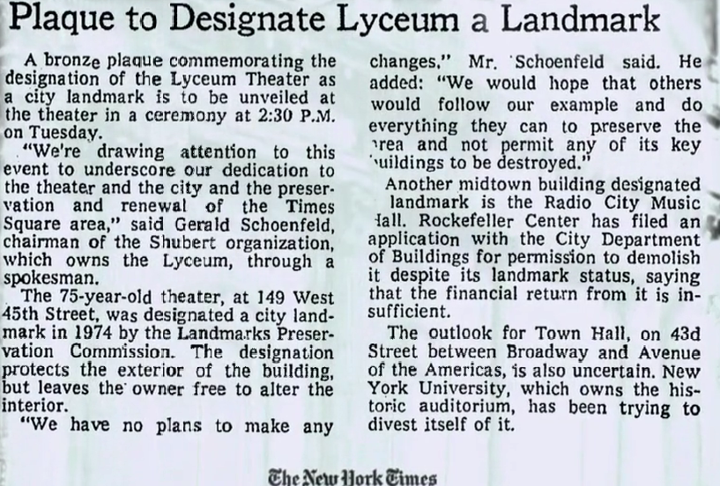
LYCEUM

