Slide 1
Hypercementosis and Ankylosis
Chodren Ghale

Slide 2
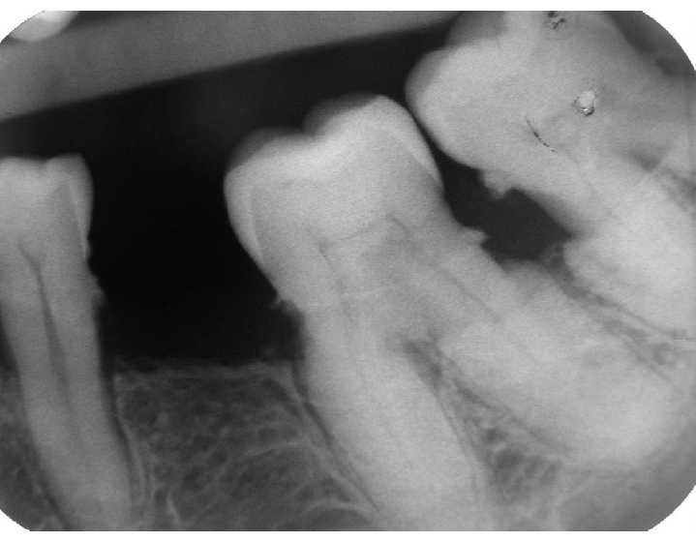
Hypercementosis:
Hypercementosis is an idiopathic condition that is indicated by excessive amount of cementum on the root surfaces of one or more teeth.

Slide 3
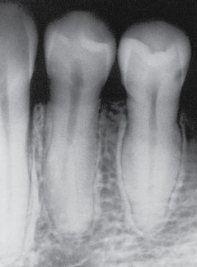
It can be caused by local or systemic factors like occlusal trauma, arthritis, calcinosis, etc.

Slide 4
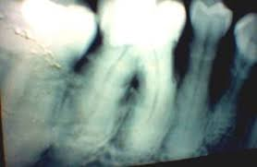
Clinically, it does not show signs or symptoms. Hypercementosis may interfere extraction of the affected teeth.

Slide 5
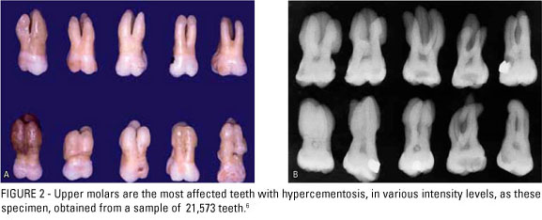

Slide 6
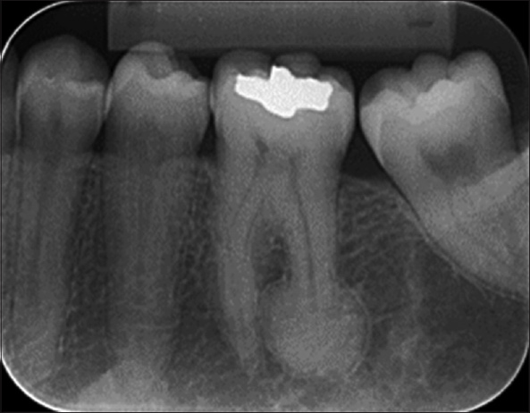
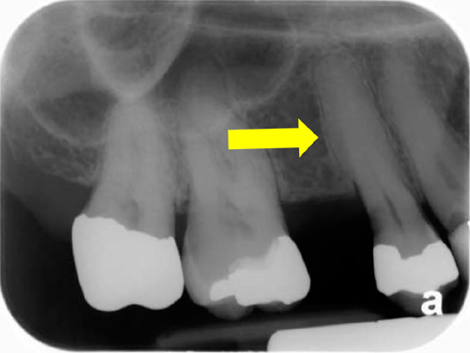
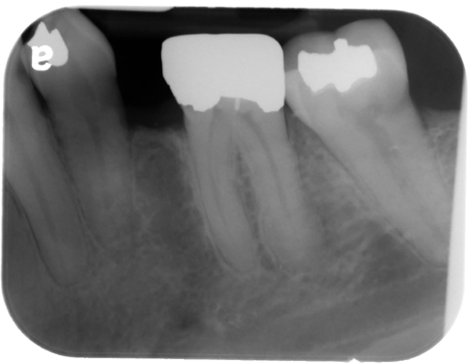
It usually affects maxillary premolars and mandibular first molars.

Slide 7
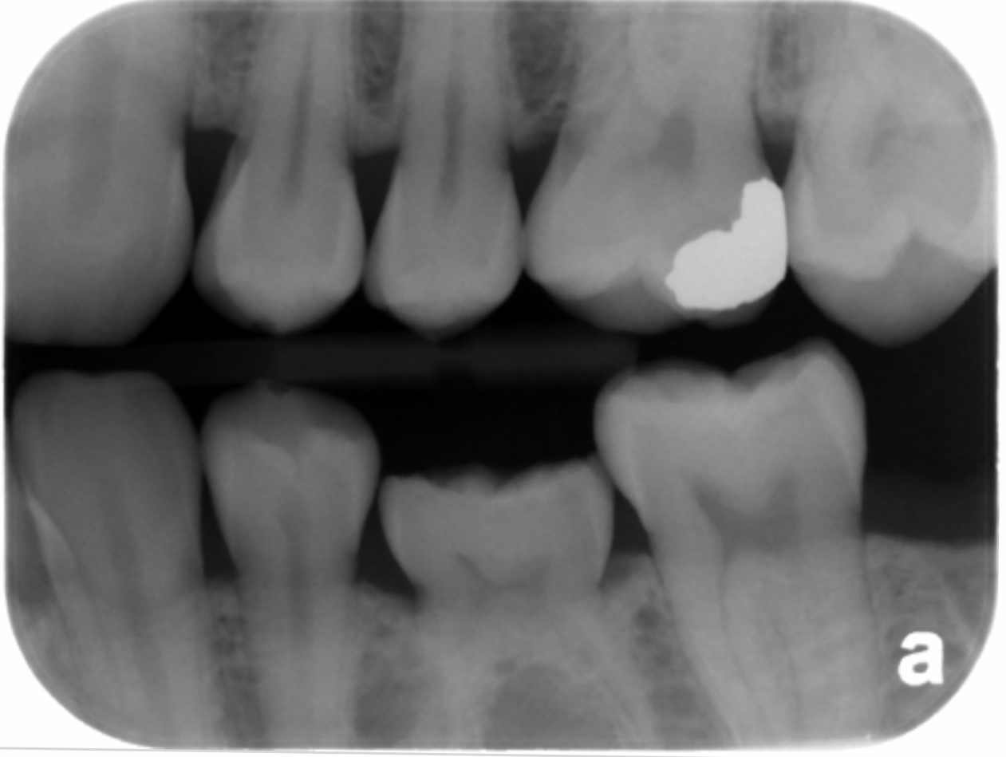
Ankylosis
It is a rare disorder characterized by fusion of a tooth to the surrounding bone.

Slide 8
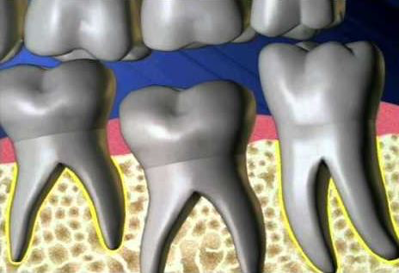
In tooth/ teeth with extensive Ankylosis, we cannot see lamina dura. The yellow line shown in the picture below are periodontal ligament spaces.

Slide 9
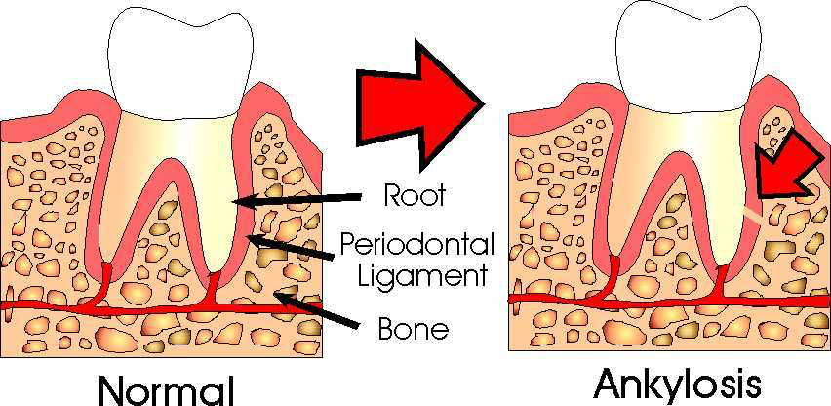

Slide 10
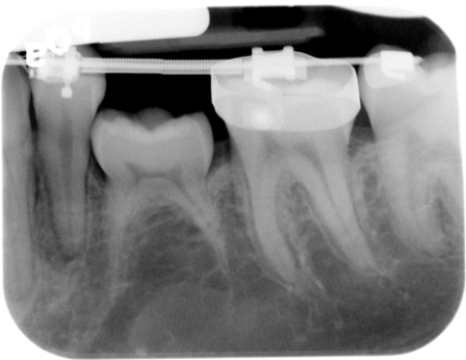
It can occur in both primary or permanent teeth.

Slide 11
References:
“Tooth Ankylosis.” Wikipedia, Wikimedia Foundation, 14 Feb. 2019, en.m.wikipedia.org/wiki/Tooth_ankylosis.
“Hypercementosis.” Wikipedia, Wikimedia Foundation, 14 Feb. 2019, en.wikipedia.org/wiki/Hypercementosis.

