Slide 1
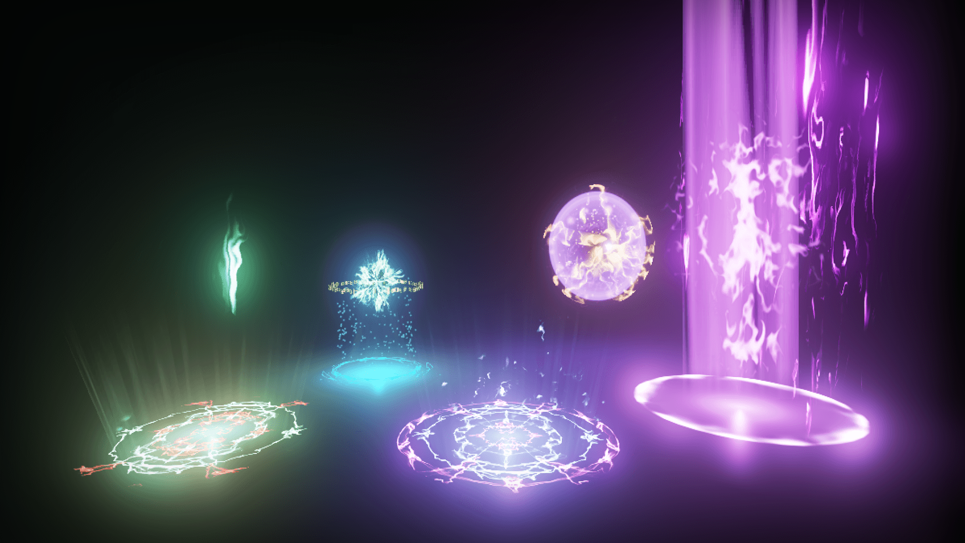
Horizon

Slide 2
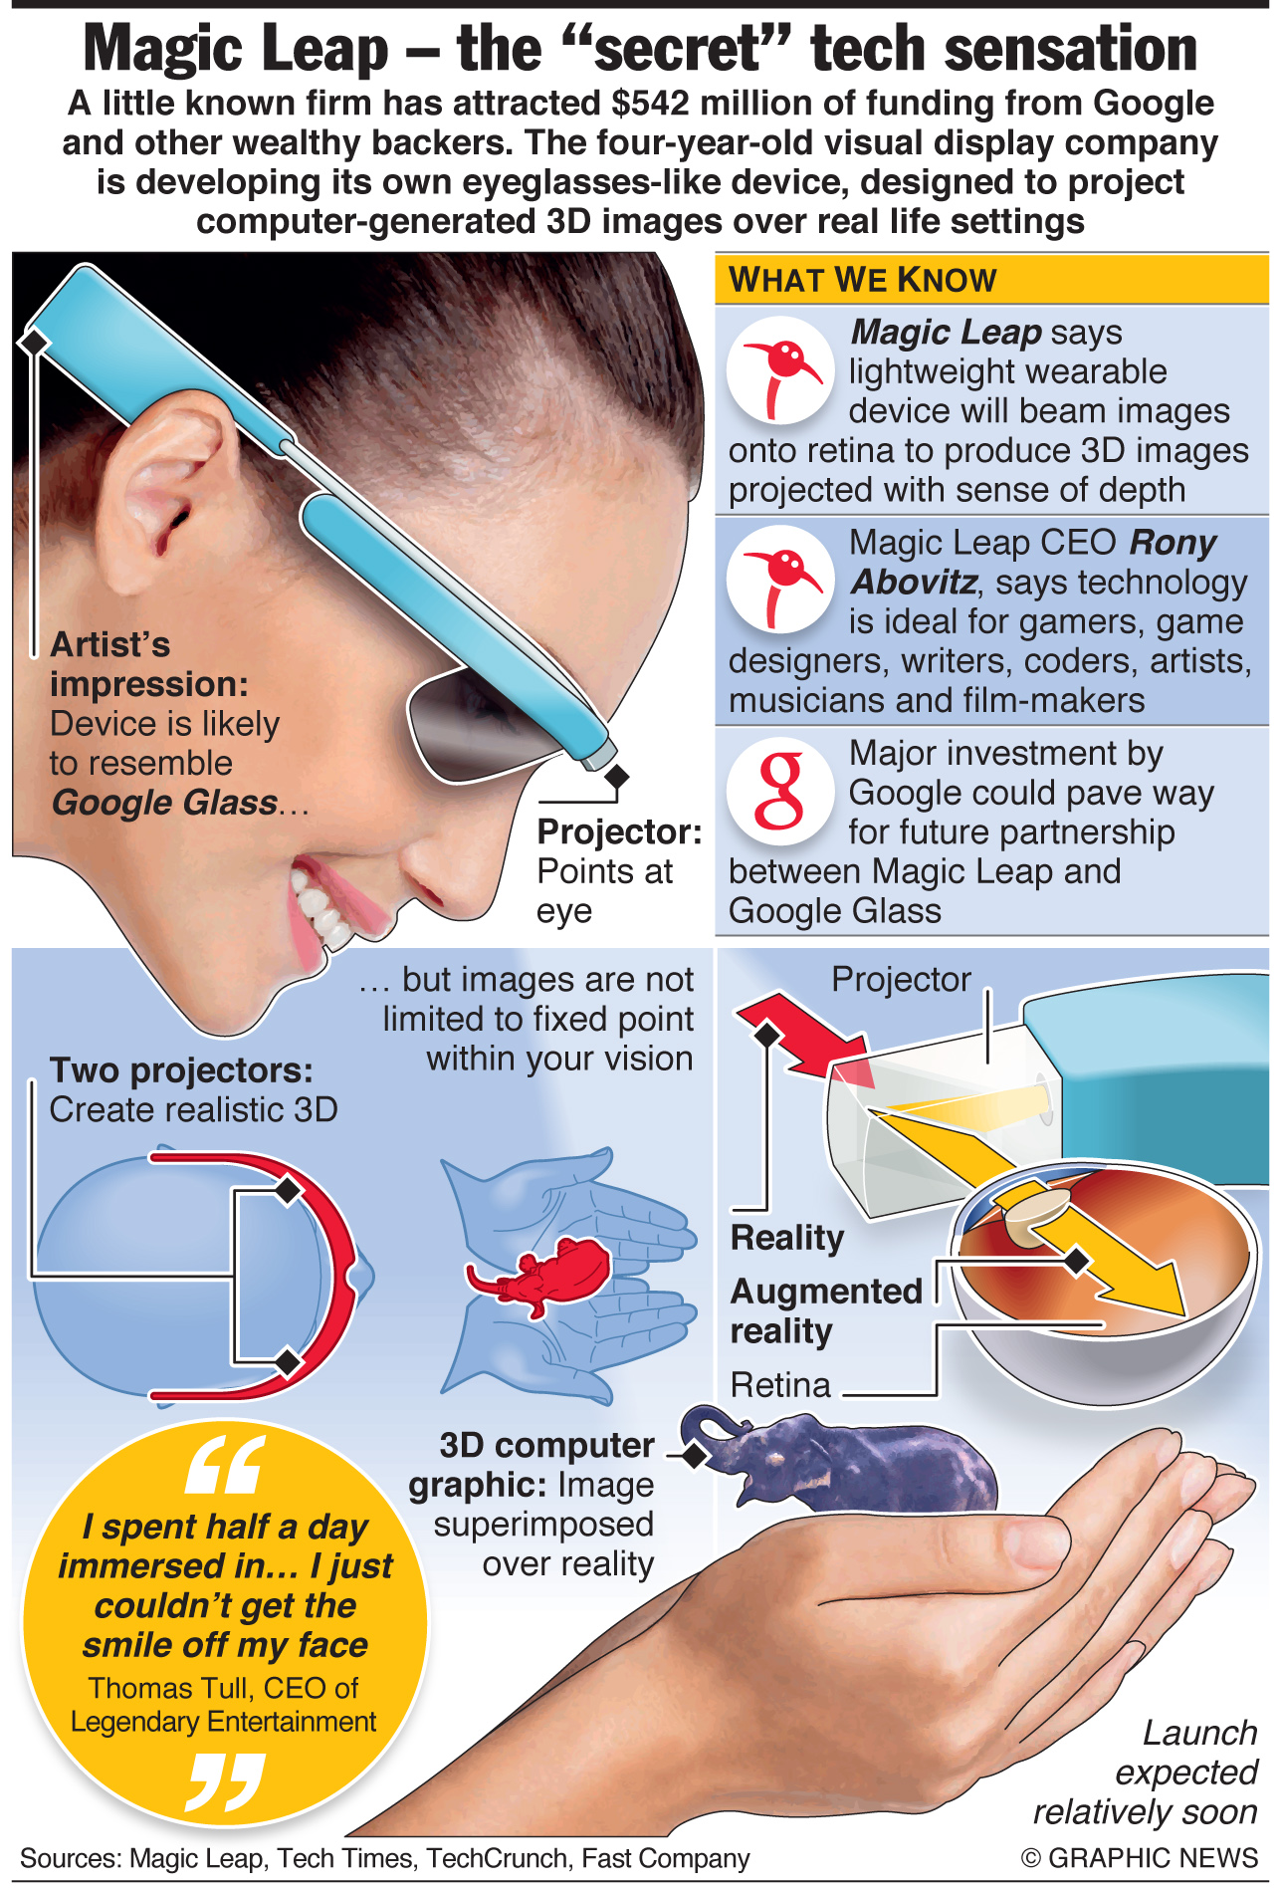

Slide 3
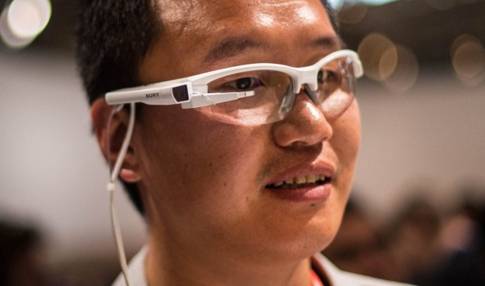
An example of what Magic leap glasses would look like

Slide 4
A visual form Magic Leap

Slide 5
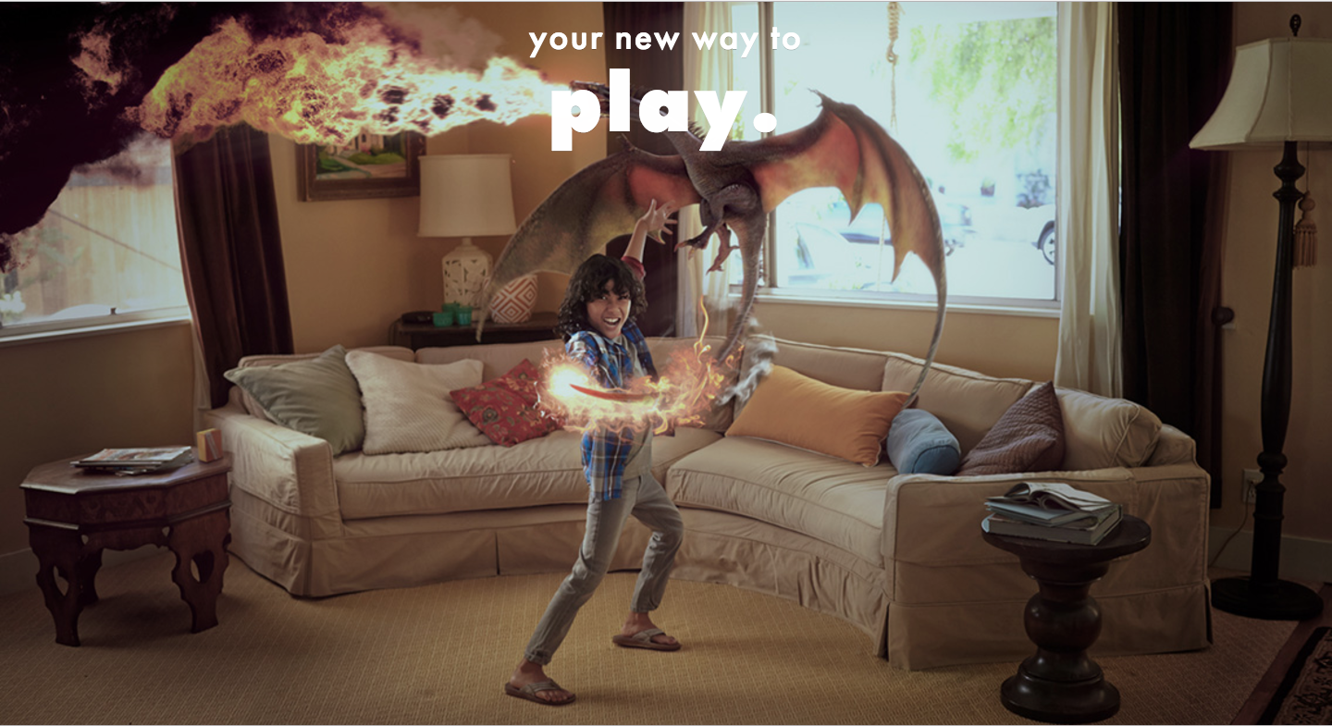
Using Magic Leap technology, the game Horizon was thought of. Allowing players to use their magic in battles against each other in open spaces.

Slide 6
Choosing spells of your choice

Slide 7
First person using Magic on Horizon

