Slide 1
Chapter 10 Object-Oriented Programming: Polymorphism
Java™ How to Program, 9/e
Presented by: Dr. Reyes Álamo

Slide 2
10.7 Case Study: Creating and Using Interfaces (Cont.)
Interfaces offer a capability requiring that unrelated classes implement a set of common methods.
Interfaces define and standardize the ways in which things such as people and systems can interact with one another.
Example: The controls on a radio serve as an interface between radio users and a radio’s internal components.
Can perform only a limited set of operations (e.g., change the station, adjust the volume, choose between AM and FM)
Different radios may implement the controls in different ways (e.g., using push buttons, dials, voice commands).

Slide 3
10.7 Case Study: Creating and Using Interfaces (Cont.)
The interface specifies what operations a radio must permit users to perform but does not specify how the operations are performed.
A Java interface describes a set of methods that can be called on an object.

Slide 4
10.7 Case Study: Creating and Using Interfaces (Cont.)
An interface declaration begins with the keyword interface and contains only constants and abstract methods.
All interface members must be public.
Interfaces may not specify any implementation details.
All methods declared in an interface are implicitly public abstract methods.
All fields are implicitly public, static and final.
To use an interface, a concrete class must specify that it implements the interface and must declare each method in the interface with specified signature.
Add the implements keyword and the name of the interface to the end of your class declaration.

Slide 5
10.7 Case Study: Creating and Using Interfaces (Cont.)
An interface is often used when unrelated classes need to share common methods and constants.
Allows objects of unrelated classes to be processed polymorphically by responding to the same method calls.
You can create an interface that describes the desired functionality, then implement this interface in any classes that require that functionality.

Slide 6
10.7 Case Study: Creating and Using Interfaces (Cont.)
An interface is often used in place of an abstract class when there is no default implementation to inherit—that is, no fields and no default method implementations.
Like public abstract classes, interfaces are typically public types.
A public interface must be declared in a file with the same name as the interface and the .java file-name extension.

Slide 7
10.7.1 Developing a Payable Hierarchy
Next example builds an application that can determine payments for employees and invoices alike.
Classes Invoice and Employee both represent things for which the company must be able to calculate a payment amount.
Both classes implement the Payable interface, so a program can invoke method getPaymentAmount on Invoice objects and Employee objects alike.
Enables the polymorphic processing of Invoices and Employees.

Slide 8
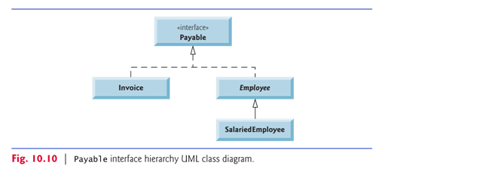
10.7.1 Developing a Payable Hierarchy (Cont.)
Fig. 10.10 shows the accounts payable hierarchy.
A subclass inherits its superclass’s realization relationships.

Slide 9
10.7.2 Interface Payable
Fig. 10.11 shows the declaration of interface Payable.

Slide 10
10.7.3 Class Invoice
Java does not allow subclasses to inherit from more than one superclass, but it allows a class to inherit from one superclass and implement as many interfaces as it needs.
To implement more than one interface, use a comma-separated list of interface names after keyword implements in the class declaration, as in:
public class ClassName extends SuperclassName implements FirstInterface, SecondInterface, …

Slide 12
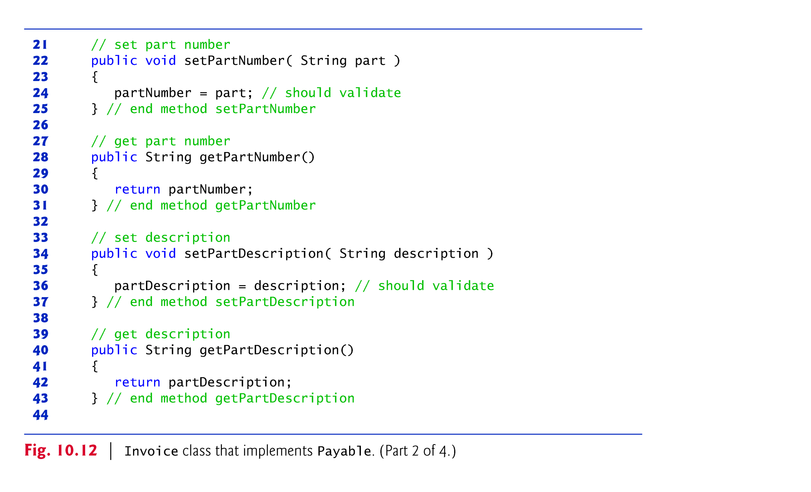

Slide 13
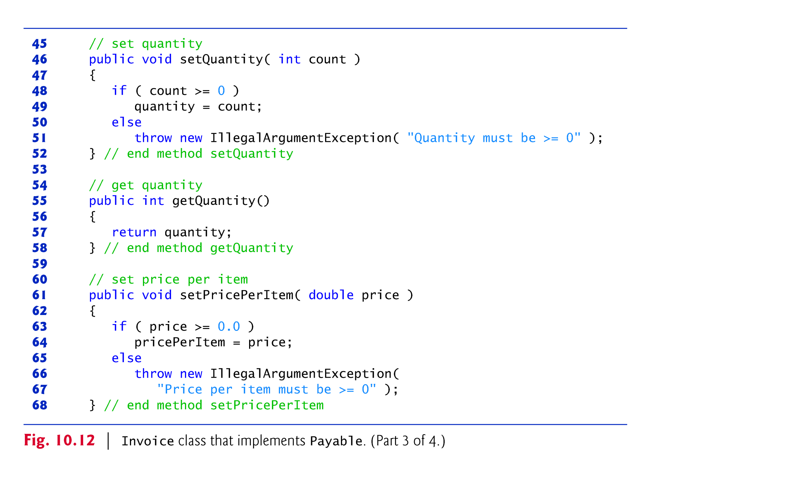

Slide 14
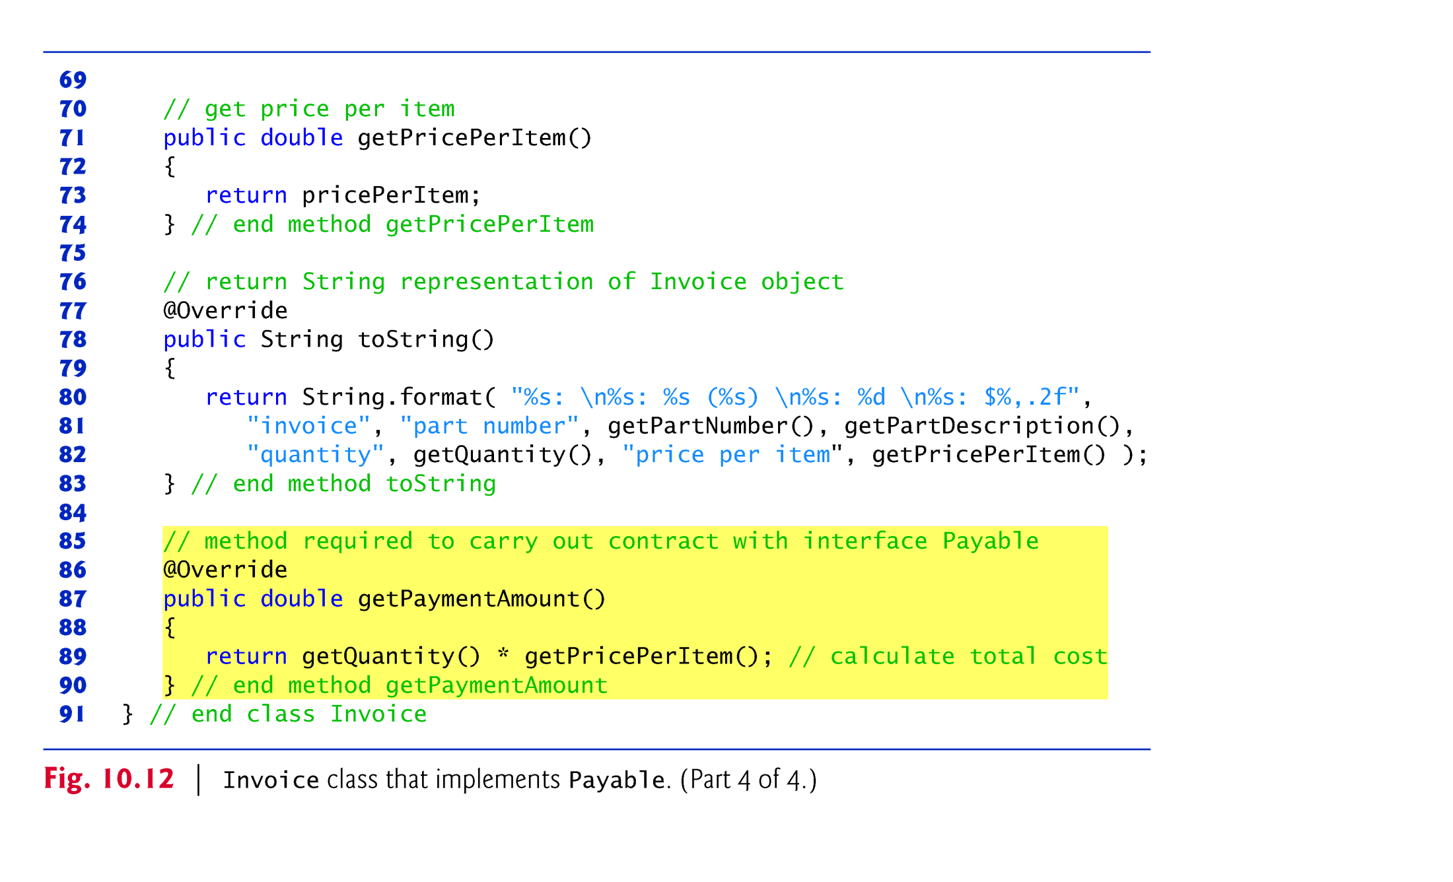

Slide 15
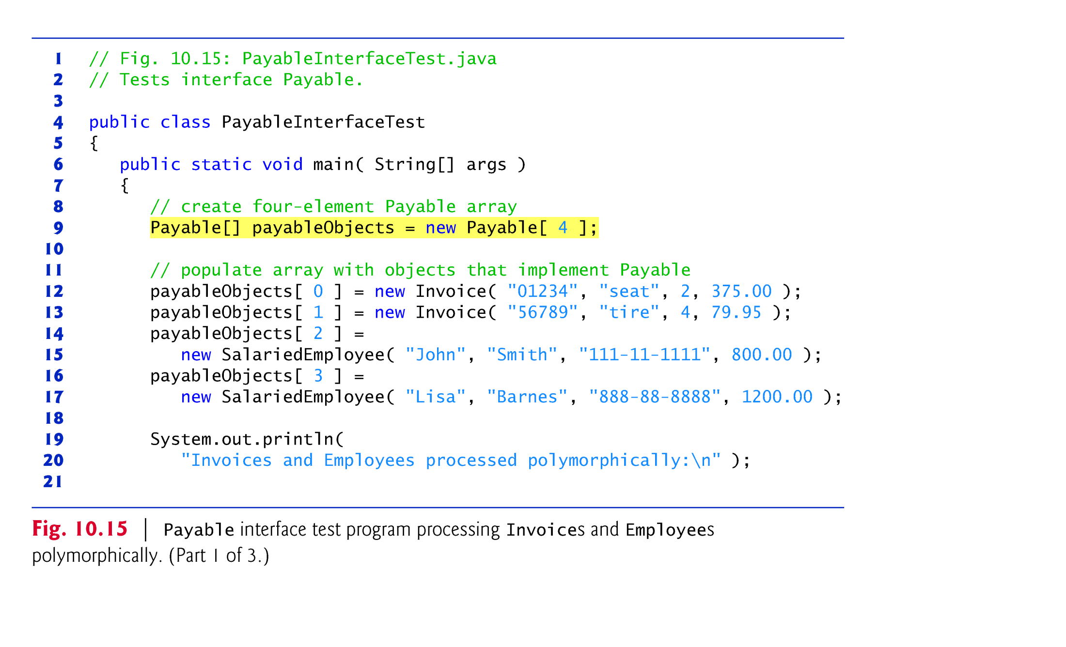
10.7.6 Using Interface Payable to Process Invoices and Employees Polymorphically

Slide 16
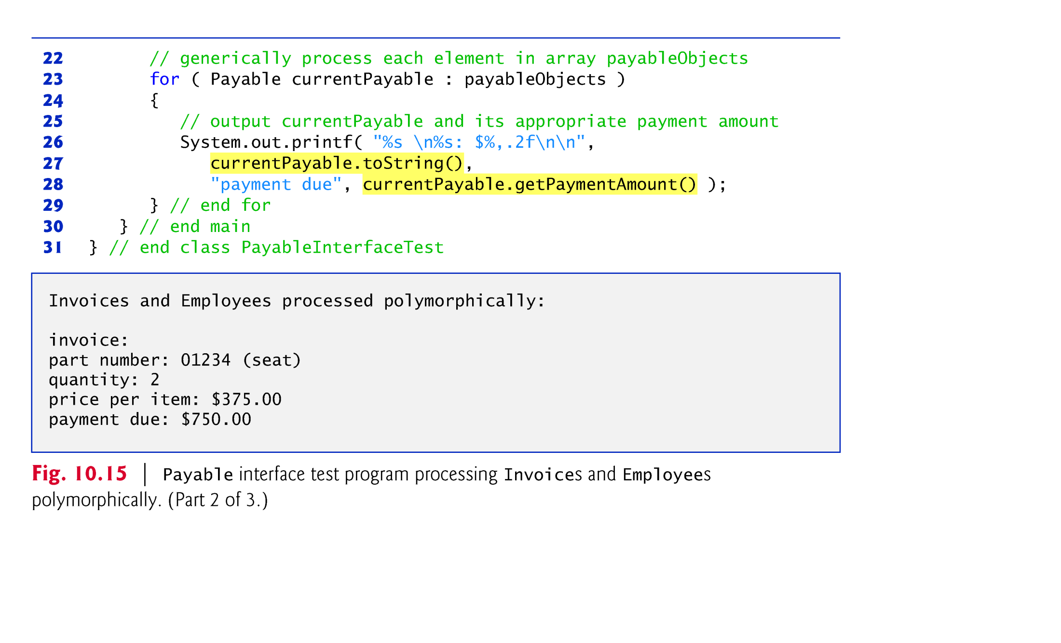

Slide 17
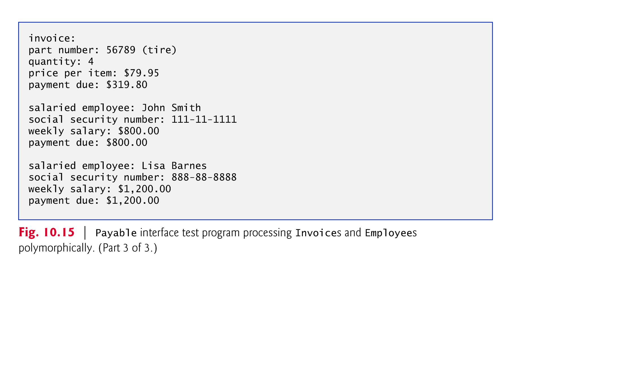

Slide 18
10.7.7 Common Interfaces of the Java API
The Java API’s interfaces enable you to use your own classes within the frameworks provided by Java, such as comparing objects of your own types and creating tasks that can execute concurrently with other tasks in the same program.
Figure 10.16 presents a brief overview of a few of the more popular interfaces of the Java API that we use in Java How to Program, Ninth Edition.

Slide 19
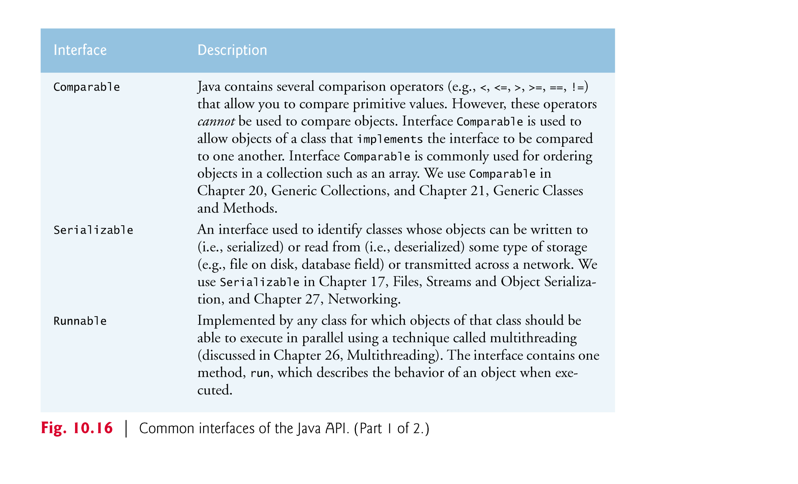

Slide 20
Assignments
Check OpenLab for new labs
Check Blackboard for new quizzes
Midterm on March 22 (1 week)
Topics in the next slides
Exam will have multiple choice, questions, and programming problems.
Absolutely no electronic devices. You bring one you get 0 (zero) automatically.
Study, do the quizzes, do the labs, ask questions.

Slide 21
Midterm Review Topics
Java basics
Commands and how they compare to C++ (i.e. if, while, switch, Scanner vs. cin etc.)
What is the Java Virtual Machine (JVM)
Commands to compile and run an application
Java Application Programming Interface (API)
Data Types
Primitive data types
Reference data types
Initial values

Slide 22
Midterm Review Topics
Object-Oriented programming
What is a class
What is an object
Static data and why the main method is static
What are fields
What are methods
What is a constructor
Method overloading
Encapsulation
Inheritance
Polymorphism
Abstract classes
Interfaces

