Slide 1
Chapter 8 Classes and Objects: A Deeper Look
Java™ How to Program, 9/e
Presented by: Dr. José M. Reyes Álamo

Slide 2
Outline
Deeper look at building classes, controlling access to members of a class, and creating constructors.
Composition—a capability that allows a class to have references to objects of other classes.
static class members and final instance variables in detail.
How to organize classes in packages.

Slide 3
8.3 Controlling Access to Members
Access modifiers public and private control access to a class’s variables and methods.
public methods present the services the class provides.
Clients need not be concerned with implementation details.
private class members are not accessible outside the class.

Slide 4
8.4 Referring to the Current Object’s Members with the this Reference
Every object can access a reference to itself with keyword this.
Enables the class’s code to know which object should be manipulated.
Can use the this reference implicitly and explicitly.

Slide 5
8.4 Referring to the Current Object’s Members with the this Reference (Cont.)
When you compile a .java file containing more than one class, the compiler produces a separate class file with the .class extension for every compiled class.
When one source-code (.java) file contains multiple class declarations, the compiler places both class files for those classes in the same directory.
A source-code file can contain only one public class—otherwise, a compilation error occurs.
Non-public classes can be used only by other classes in the same package.

Slide 6
8.5 Overloaded Constructors
Overloaded constructors enable objects of a class to be initialized in different ways.
To overload constructors, provide multiple constructor declarations with different signatures.
The compiler differentiates signatures by the number, the types, and the order of the parameter types in each signature.

Slide 8
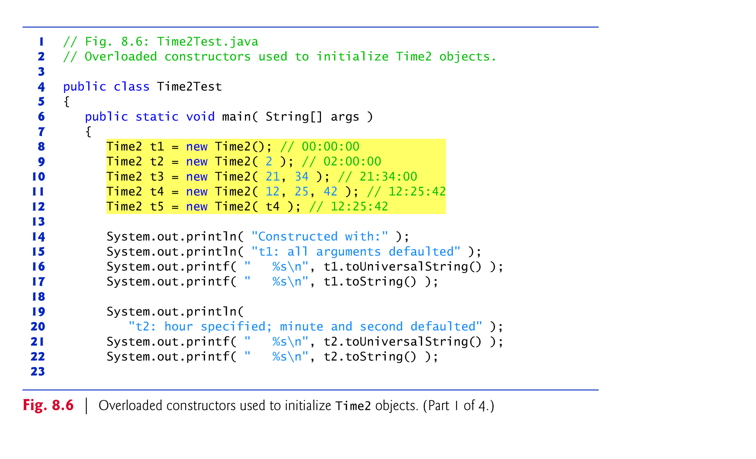

Slide 9
8.6 Default and No-Argument Constructors
Every class must have at least one constructor.
If you do not provide any constructors, the compiler creates a default constructor that takes no arguments and initializes instance variables to their default values
Zero for numeric types
false for boolean
null for references
If your class declares constructors, the compiler will not create a default constructor.
You must explicitly declare a no-argument constructor if default initialization is required.

Slide 11
8.7 Notes on Set and Get Methods
Classes often provide public methods to allow clients of the class to set or get private instance variables.
Set methods are also commonly called mutator methods, because they typically change an object’s state
Get methods are also commonly called accessor methods or query methods.

Slide 12
8.7 Notes on Set and Get Methods (Cont.)
It would seem that providing set and get capabilities is essentially the same as making the instance variables public.
A public instance variable can be read or written by any method that has a reference to an object that contains that variable.
If an instance variable is declared private, a public get method allows other methods to access it, but the get method controls access.
A public set method can—and should—carefully scrutinize at-tempts to modify the variable to ensure valid values.
Although set and get methods provide access to private data, it is restricted by the implementation of the methods.

Slide 13
8.8 Composition
A class can have references to objects of other classes.
This is called composition and is sometimes referred to as a has-a relationship.
Example: An AlarmClock object needs to know the current time and when it is supposed to sound its alarm
It’s reasonable to include two references to Time objects in an AlarmClock object.

Slide 14
8.10 Garbage Collection and Method finalize
Every class in Java has a set of default methods one of which is the finalize method.
Every object uses system resources, such as memory.
Need a disciplined way to give resources back to the system when they’re no longer needed; otherwise, “resource leaks” might occur.
The JVM performs automatic garbage collection to reclaim the memory occupied by objects that are no longer used.
When there are no more references to an object, the object is eligible to be collected.
This typically occurs when the JVM executes its garbage collector.

Slide 15
8.10 Garbage Collection and Method finalize (Cont.)
Memory leaks that are common in other languages like C and C++ are less likely in Java, but some can still happen in subtle ways.
Memory is not automatically reclaimed in those languages
Other types of resource leaks can occur.
An application may open a file on disk to modify its contents.
If it does not close the file, the application must terminate before any other application can use it.

Slide 16
8.10 Garbage Collection and Method finalize (Cont.)
The finalize method is called by the garbage collector to perform termination housekeeping on an object just before the garbage collector reclaims the object’s memory.
Method finalize does not take parameters and has return type void.
A problem with method finalize is that the garbage collector is not guaranteed to execute at a specified time.
The garbage collector may never execute before a program terminates.
Thus, it’s unclear if, or when, method finalize will be called.
For this reason, most programmers should avoid method finalize.

Slide 17
8.11 static Class Members
In certain cases, only one copy of a particular variable should be shared by all objects of a class.
A static field is used in such cases.
Also called a class variable.
A static variable represents classwide information — all objects of the class share the same piece of data.
The declaration of a static variable begins with the keyword static.

Slide 18
8.11 static Class Members (Cont.)
Static variables have class scope.
public static class members can be accessed through a reference to any object of the class, or by using the class name and a dot (.), as in Math.random().
private static class members can be accessed only through methods of the class.
static class members are available as soon as the class is loaded into memory.
To access a public static member when no objects of the class exist, use the class name and a dot (.) followed by the static member (e.g. Math.PI)
To access a private static member when no objects of the class exist, provide a public static get method.

Slide 19
8.11 static Class Members (Cont.)
A static method cannot access non-static class members, because a static method can be called even when no objects of the class have been instantiated.
If a static variable is not initialized, the compiler assigns it a default value.

Slide 22
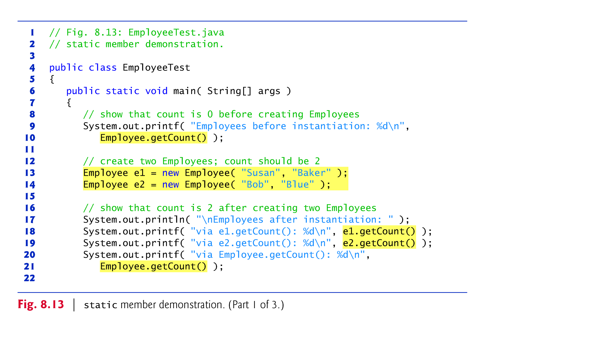
Accessing static Class Members

Slide 23
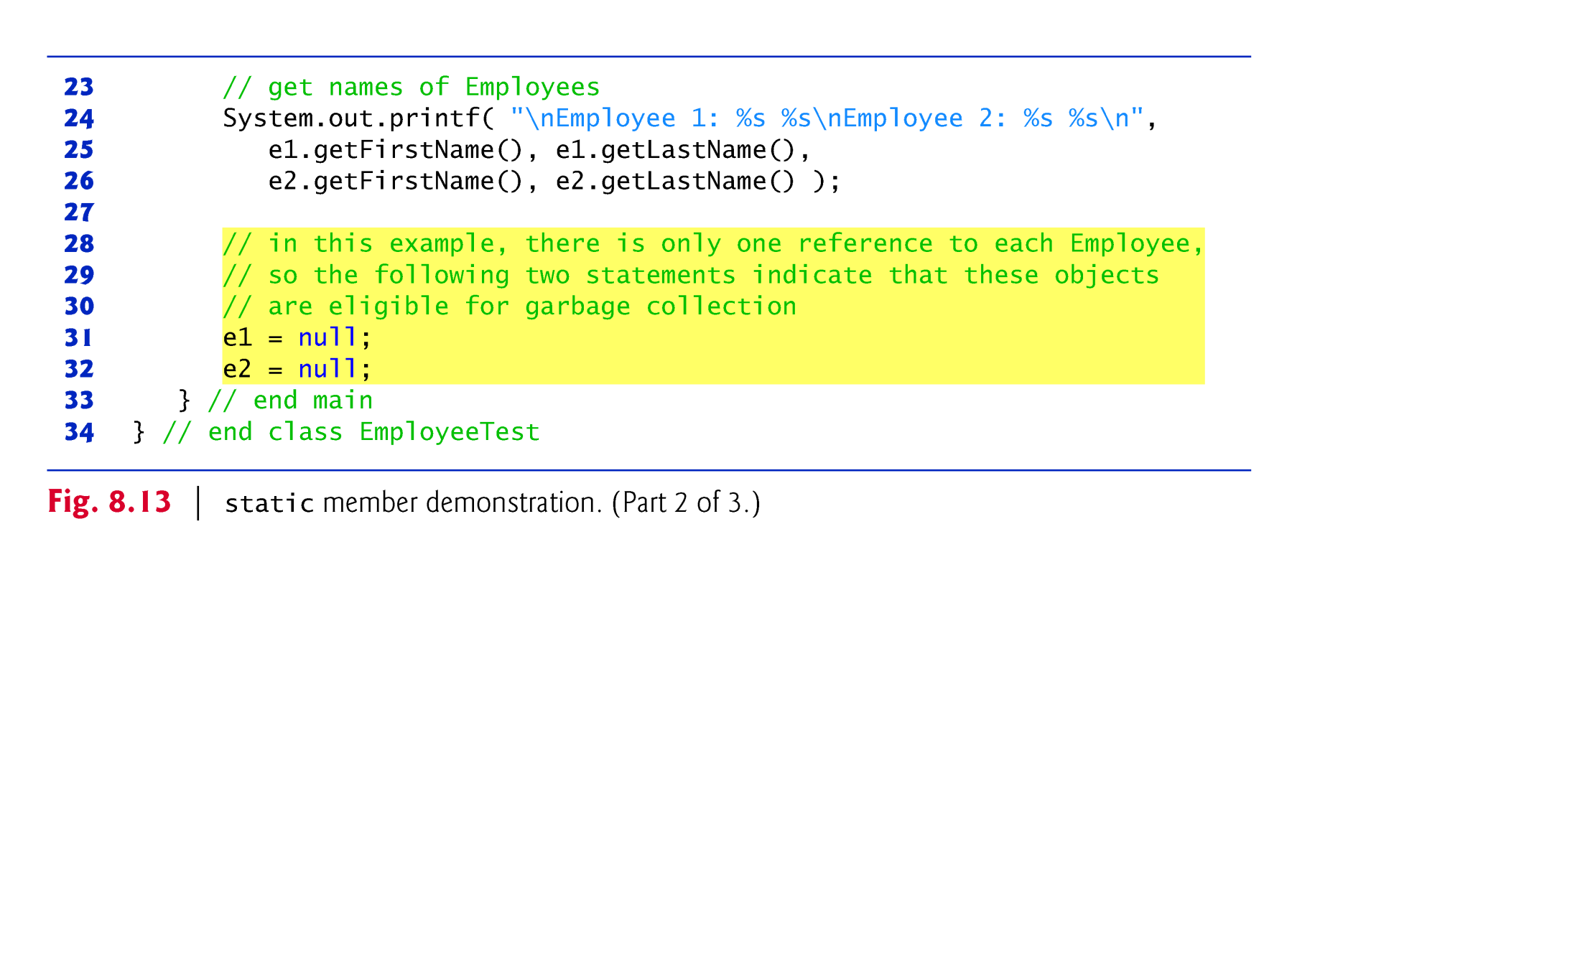
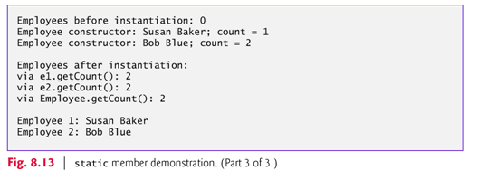

Slide 24
8.13 final Instance Variables
The principle of least privilege is fundamental to good software engineering.
Code should be granted only the amount of privilege and access that it needs to accomplish its designated task, but no more.
Makes your programs more robust by preventing code from accidentally (or maliciously) modifying variable values and calling methods that should not be accessible.
Keyword final specifies that a variable is not modifiable (i.e., it’s a constant).
e.g. private final int INCREMENT;

Slide 25
8.13 final Instance Variables (cont.)
final variables can be initialized when they are declared or by the constructor(s).
If a class provides multiple constructors, every one would be required to initialize each final variable.
A final variable cannot be modified by assignment after it’s initialized.
If a final variable is not initialized, a compilation error occurs.

Slide 26
e.g. Math.PI

Slide 27
Strings are final
String objects in Java are immutable—they cannot be modified after they are created.
String concatenation actually creates a new String object containing the concatenated values.
Strings are final.

Slide 28
8.14 Creating Packages
A package is a group of related classes
Each class in the Java API belongs to a package.
Packages help programmers manage the complexity of application components.
Packages facilitate software reuse by enabling programs to import classes from other packages, rather than copying the classes into each program that uses them.
Packages provide a convention for unique class names, which helps prevent class-name conflicts.

Slide 29
8.14 Creating Packages (Cont.)
Steps for creating a reusable class:
Declare a public class.
Choose a unique package name and add a package declaration.
In each Java source-code file there can be only one package declaration, and it must precede all other declarations and statements.
Compile the class so that it’s placed in the appropriate package directory.
Import the reusable class into a program and use the class.

Slide 30
8.15 Time Class Case Study: Creating Packages (Cont.)
Placing a package declaration at the beginning of a Java source file indicates that the class declared in the file is part of the specified package.
A Java source-code file must have the following order:
package declaration (if any),
import declarations (if any),
class declaration (required).

Slide 31
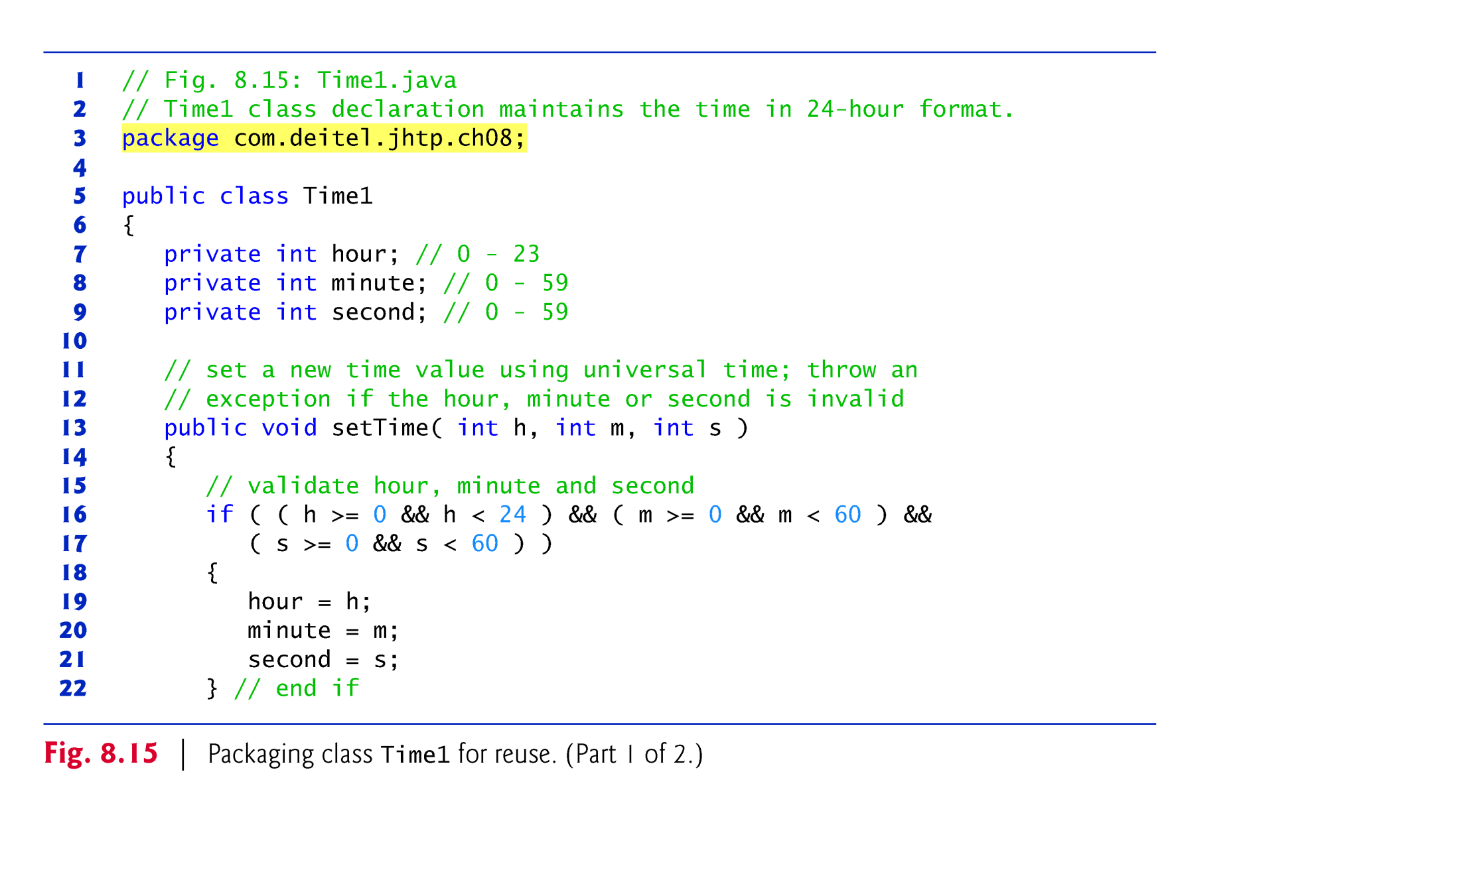

Slide 32
8.14 Creating Packages (Cont.)
Usually a package name start with your Internet domain name in reverse order.
For example, our domain name is citytech.cuny.edu, so our package names begin with edu.cuny.citytech.
After the domain name is reversed, you can choose any other names you want for your package.
Previous example use jhtp as the next name in the package name to indicate that this class is from Java How to Program followed by an indication to Chapter 8 (ch08).
In our case, packages would look something like citytech.cuny.edu.cet3640.s13.lab2

Slide 33
8.14 Creating Packages (Cont.)
Compile the class so that it’s stored in the appropriate package.
When a Java file containing a package declaration is compiled, the resulting class file is placed in the directory specified by the declaration.
The package declaration
package edu.cuny.citytech;
indicates that class should be placed in the directory
edu cuny
citytech
The directory names in the package declaration specify the exact location of the classes in the package.
Eclipse allows you to create packages very easily.

Slide 34
8.14 Creating Packages (Cont.)
The package name is part of the fully qualified class name.
Class Scanner name is actually
java.util.Scanner
You can use the fully qualified name, or import the class and use its simple name.
If another package contains a class by the same name, the fully qualified class names should be used to differentiate them.
When your program uses multiple classes from the same package, you can import those classes with a type-import-on-demand declaration.
e.g. import java.util.*;

Slide 35
Assignments
Check OpenLab for new labs
Check Blackboard for new quizzes

