Slide 1
Chapter 3 Introduction to Classes, Objects Methods and Strings
Java™ How to Program, 9/e
Presented by: Dr. José M. Reyes Álamo
CET 3640

Slide 2
3.2 Declaring a Class with a Method and Instantiating an Object of a Class
Everything in Java is a class
Classes are used to create objects.
Each class declaration that begins with keyword public must be stored in a file that has the same name as the class and ends with the .java extension.
Keyword public is an access modifier.
Indicates that the class is “available to the public”
Keyword private also exists, we will study it later.

Slide 3
3.2 Declaring a Class with a Method and Instantiating an Object of a Class (Cont.)
A class with a main method is known as an application
The main method is called automatically by the Java Virtual Machine (JVM).
Normally, you call methods explicitly to perform their tasks.
A public method is “available to the public”
It can be called from methods of other classes.
The return type specifies the type of data the method returns after performing its task.
Return type void indicates that a method will perform a task but will not return any information to its calling method when it completes its task.

Slide 4
3.2 Declaring a Class with a Method and Instantiating an Object of a Class (Cont.)
Method name follows the return type.
By convention, method names begin with a lowercase first letter and subsequent words in the name begin with a capital letter.
Empty parentheses after the method name indicate that the method does not require additional information to perform its task.
The first line of the method is called the Method header
Every method’s body is delimited by left and right braces.
The method body contains one or more statements.

Slide 6
3.2 Declaring a Class with a Method and Instantiating an Object of a Class (Cont.)
Class GradeBook is not an application because it does not contain a main method.
If you try to execute it you will receive an error message like this:
Exception in thread "main" java.lang.NoSuchMethodError: main
Must either declare a separate class that contains a main method or place a main method in class GradeBook.
When writing large programs, a separate class containing method main is used to test each new class.

Slide 8
3.2 Declaring a Class with a Method and Instantiating an Object of a Class (Cont.)
A static method (such as main) can be called without first creating an object of the class.
Typically, you cannot call a method that belongs to another class until you create an object.
When declaring a new class, you declare a new type
You can declare variables and create objects of the new class type.
You can declare as many new class types as needed; this is one reason why Java is an extensible language.

Slide 9
3.2 Declaring a Class with a Method and Instantiating an Object of a Class (Cont.)
Class instance creation expression
Keyword new creates a new object of the class specified and initializes a variable of the class type.
The parentheses to the right of the class name are required.
Parentheses in combination with a class name represent a call to a constructor, which is similar to a method but is used only at object creation time to initialize the object’s data.

Slide 10
3.2 Declaring a Class with a Method and Instantiating an Object of a Class (Cont.)
Call a method using the class-type variable, followed by a dot separator (.), the method name, and parentheses.
e.g. myVariable.myMethod();
Any class can contain a main method.
The JVM invokes the main method only in the class used to execute the application.
If multiple classes contain a main method, only the first one found is invoked.

Slide 11
3.3 Declaring a Method with a Parameter
A method can require more information to perform its task.
These are called parameters
Defined in a comma-separated parameter list
Located in the parentheses that follow the method name
Each parameter must specify a type and an identifier
In a method call, the values supplied that correspond to the parameters are called arguments.

Slide 12
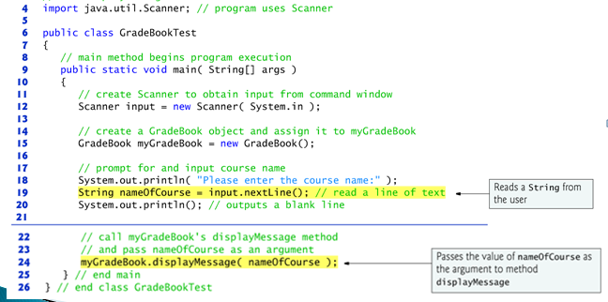

Slide 13
3.3 Declaring a Method with a Parameter (Cont.)
More on Arguments and Parameters
The number of arguments in a method call must match the number of parameters in the parameter list.
The argument types in the method call must be “consistent with” the types of the corresponding parameters.

Slide 14
3.3 Declaring a Method with a Parameter (Cont.)
Packages are set of classes organized in the same directory
You can reuse classes by creating packages and importing them
Notes on import Declarations
Classes in package java.lang (System, String) are implicitly imported
Most classes you’ll use in Java programs must be imported explicitly.
Classes that are compiled in the same directory are in the same package—known as the default package.
Classes in the same package are implicitly imported into the other classes in the same package.
An import declaration is not required if you always refer to a class via its fully qualified class name
Package name followed by a dot (.) and the class name.

Slide 15
3.4 Instance Variables, set Methods and get Methods
Local variables
Variables declared in the body of a particular method.
When a method terminates, the values of its local variables are lost.

Slide 16
3.4 Instance Variables, set Methods and get Methods (Cont.)
A class normally consists of one or more methods that manipulate the attributes that belong to a particular object of the class.
Attributes are the variables in a class declaration, also known ad fields.
Declared inside a class but outside the methods’ bodies.
Instance variable
Each object maintains its own copy of an attribute, a separate instance of the variable in memory.

Slide 18
3.4 Instance Variables, set Methods and get Methods (Cont.)
Every object contains a copy of each instance variable.
Instance variables are typically declared private.
private variables and methods are accessible only to methods in the same class.
Declaring instance private is known as data hiding or information hiding.
private variables are encapsulated (hidden) in the object and can be accessed only by methods of the object’s class.
Prevents instance variables from being modified accidentally.
Set and get methods are used to access instance variables.

Slide 20
3.4 Instance Variables, set Methods and get Methods (Cont.)
When a method that specifies a return type other than void completes its task, the method returns a result to its caller.
Method setCourseName and getCourseName each use variable courseName even though it was not declared in any of the methods.
Methods can use instance variables.
The order in which methods are declared in a class does not determine when they are called at execution time.
One big difference of object-oriented languages vs. procedural languages.
One method of a class can call another method of the same class by using just the method name.

Slide 21
3.4 Instance Variables, set Methods and get Methods (Cont.)
Unlike local variables, which are not automatically initialized, every field has a default initial value.
Fields are not required to be explicitly initialized before they are used in a program—unless they must be initialized to values other than their default values.

Slide 22
3.4 Instance Variables, set Methods and get Methods (Cont.)
set and get methods
A class’s private fields can be manipulated only by methods.
A client of an object calls public methods to manipulate the private fields of an object of the class.
Why not declare the fields public and give access to clients to manipulate the variables directly?
Classes often provide public methods to allow clients to set or get private instance variables.
The names of these methods need not begin with set or get, but this naming convention is highly recommended and it’s the standard.

Slide 23
3.5 Primitive Types vs. Reference Types
Types are divided into primitive types and reference types.
The primitive types are boolean, byte, char, short, int, long, float and double.
All nonprimitive types are reference types.
A primitive-type variable can store exactly one value of its declared type at a time.
Primitive-type instance variables are initialized by default—variables of types byte, char, short, int, long, float and double are initialized to 0, and variables of type boolean are initialized to false.
You can specify your own initial value for a primitive-type variable by assigning the variable a value in its declaration.

Slide 24
3.5 Primitive Types vs. Reference Types
Programs use variables of reference types (normally called references) to store the locations of objects in the computer’s memory.
Such a variable is said to refer to an object in the program.
Reference-type instance variables are initialized by default to the value null
A reserved word that represents a “reference to nothing.”
When using an object of another class, a reference to the object is required to invoke its methods.

Slide 25
3.6 Initializing Objects with Constructors
When an object of a class is created, its instance variables are initialized by default.
Each class can provide a constructor that initializes an object of a class when the object is created.
Java requires a constructor call for every object that is created.
Keyword new requests memory from the system to store an object, then calls the corresponding class’s constructor to initialize the object.
A constructor must have the same name as the class.

Slide 26
3.6 Initializing Objects with Constructors (Cont.)
By default, the compiler provides a default constructor with no parameters in any class without explicit constructor.
This constructor initializes instance variables to their default values.
You can provide your own constructor to specify custom initialization.
A constructor’s parameter list specifies the data it requires to initiate.
Constructors cannot return values, so they have no return type.
Normally, constructors are declared public.

Slide 27
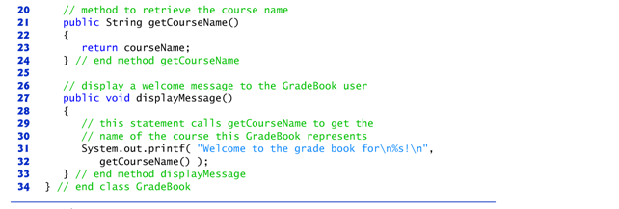

Slide 29
Chapter 6 Methods: A Deeper Look
Java™ How to Program, 9/e
Presented by: Dr. José M. Reyes Álamo
CET 3640

Slide 30
6.1 Introduction
Methods are known as functions, modules, or procedures in other programming languages.
Topics in this chapter
static methods
Declare a method with more than one parameter
Method-call stack
Simulation techniques.
How to declare values that cannot change (i.e., constants) in your programs.
Method overloading.

Slide 31
6.2 Program Modules in Java
Java programs combine new methods and classes that you write with predefined methods and classes available in the Java Application Programming Interface (API) and in other class libraries.
Related classes are typically grouped into packages so that they can be imported into programs and reused.

Slide 32
6.2 Java API
Search for: Java API
Java 6 API:
http://docs.oracle.com/javase/6/docs/api/
Java 7 API:
http://docs.oracle.com/javase/7/docs/api/

Slide 33
6.2 Program Modules in Java (Cont.)
Methods help you modularize a program by separating its tasks into self-contained units.
Statements in method bodies
Written only once
Hidden from other methods
Can be reused from several locations in a program
Divide-and-conquer approach
Constructing programs from small, simple pieces
Software reusability
Use existing methods as building blocks to create new programs.
Dividing a program into meaningful methods makes the program easier to debug and maintain.

Slide 34
6.2 Program Modules in Java (Cont.)
Hierarchical form of management.
A boss (the caller) asks a worker (the called method) to perform a task and report back (return) the results after completing the task.
The boss method does not know how the worker method performs its designated tasks.
The worker may also call other worker methods, unknown to the boss.
“Hiding” of implementation details promotes good software engineering.

Slide 35
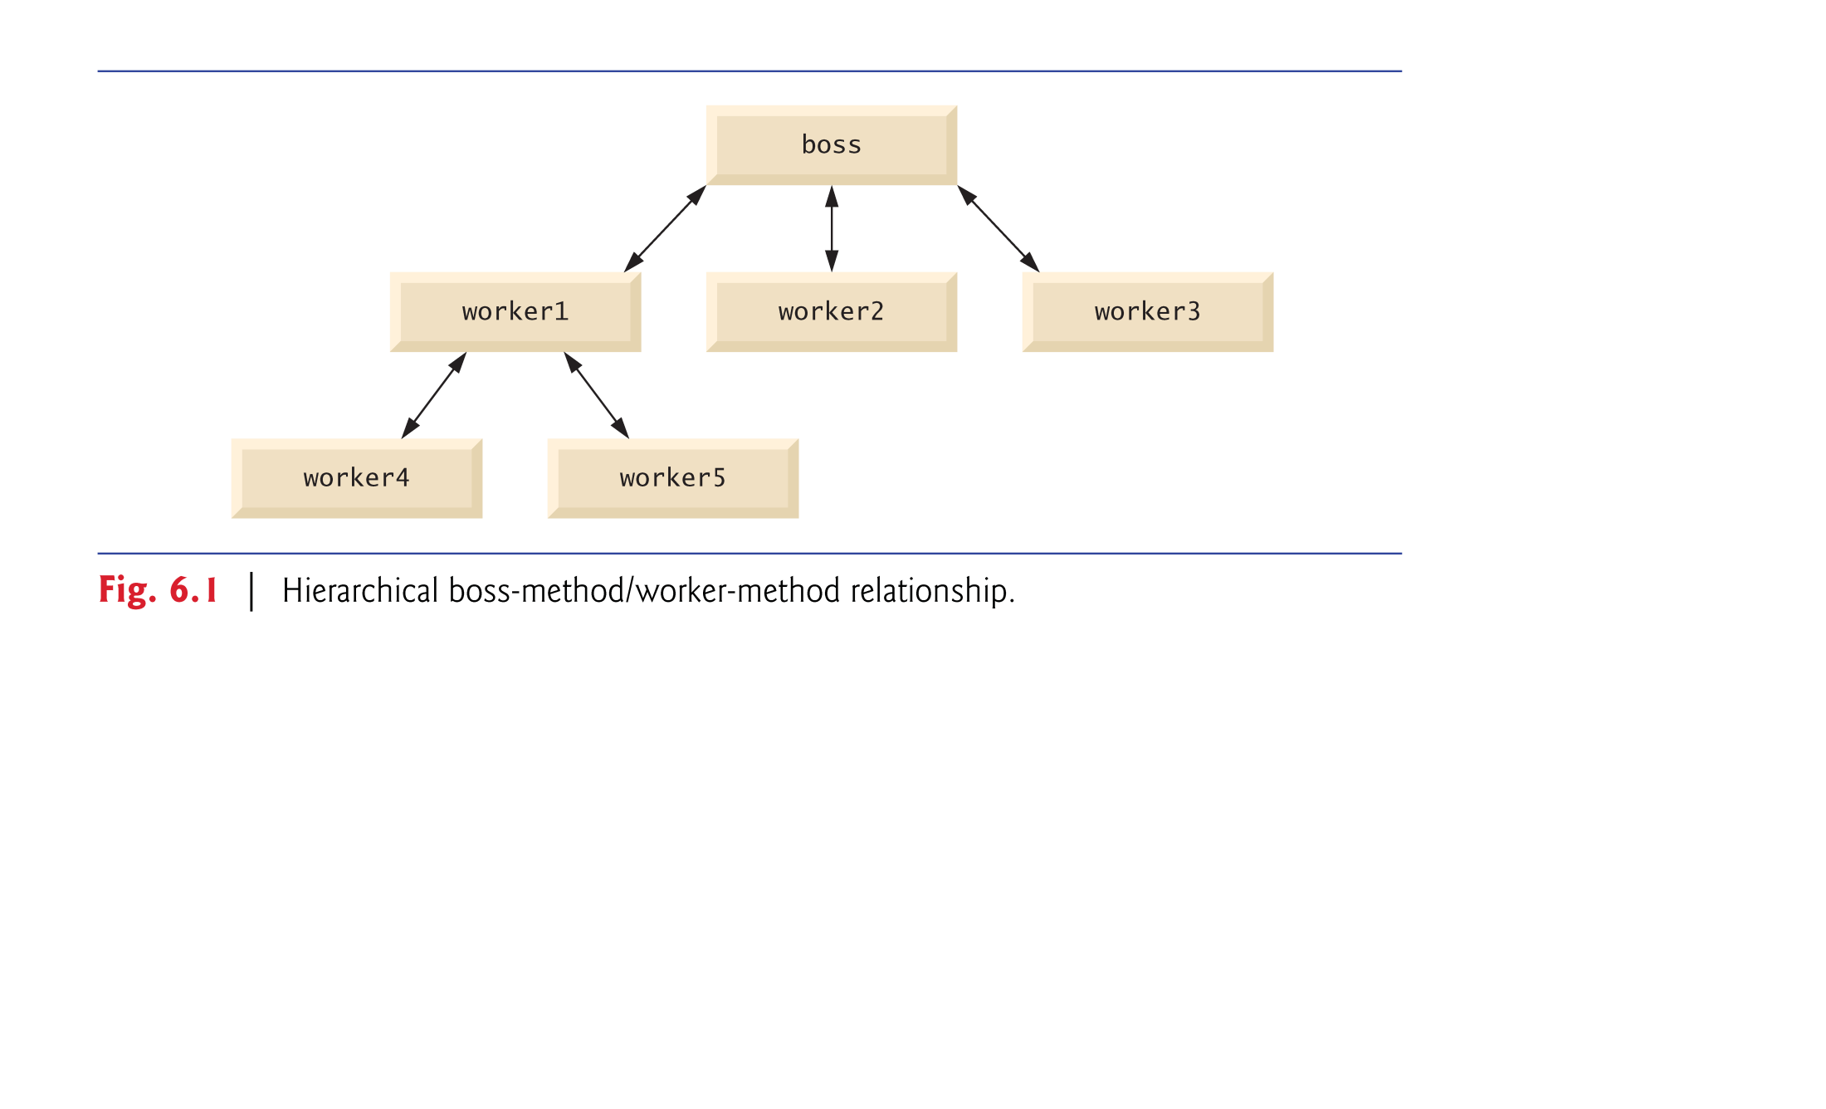

Slide 36
6.3 static Methods, static Fields and Class Math
Sometimes a method performs a task that does not depend on the contents of any object.
Applies to the class in which it’s declared as a whole
Known as a static method or a class method
It’s common for classes to contain convenient static methods to perform common tasks.
To declare a method as static, place the keyword static before the return type in the method’s declaration.
Calling a static method
ClassName.methodName( arguments )
Class Math provides a collection of static methods that enable you to perform common mathematical calculations without creating an object of it first.

Slide 37
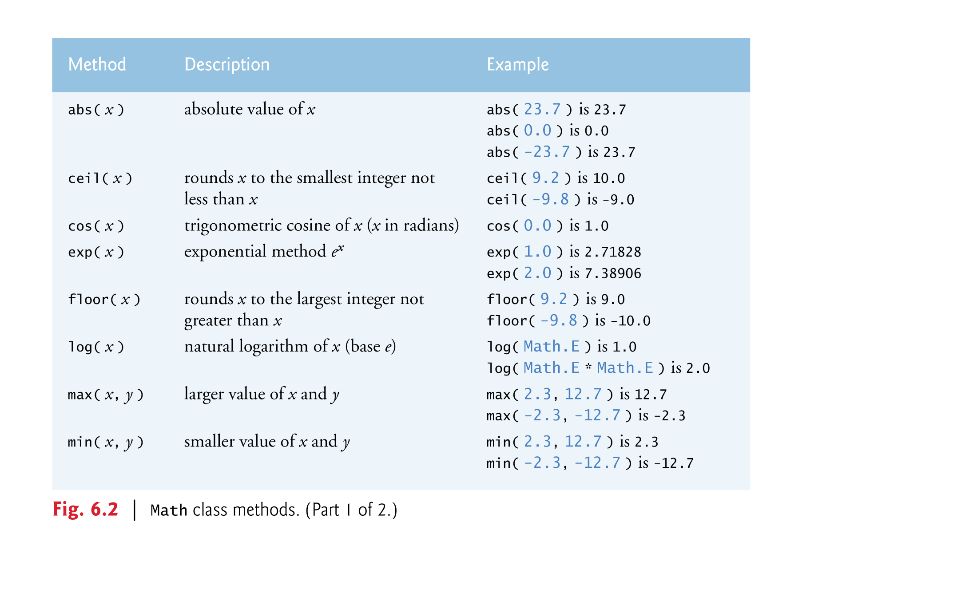

Slide 38
6.3 static Methods, static Fields and Class Math (Cont.)
Math fields for common mathematical constants
Math.PI (3.141592653589793)
Math.E (2.718281828459045)
Declared in class Math with the modifiers public, final and static
public allows you to use these fields in your own classes.
A field declared with keyword final is constant—its value cannot change after the field is initialized.
PI and E are declared final because their values never change.

Slide 39
6.3 static Methods, static Fields and Class Math (Cont.)
A field that represents an attribute is also known as an instance variable—each object (instance) of the class has a separate instance of the variable in memory.
Fields for which each object of a class does not have a separate instance of the field are declared static and are also known as class variables.
All objects of a class containing static fields share one copy of those fields.
Together the class variables (i.e., static variables) and instance variables represent the fields of a class.

Slide 40
6.3 static Methods, static Fields and Class Math (Cont.)
Why is method main declared static?
The JVM attempts to invoke the main method of the class you specify—when no objects of the class have been created.
Declaring main as static allows the JVM to invoke main without creating an instance of the class.

Slide 41
6.4 Declaring Methods with Multiple Parameters
Multiple parameters are specified as a comma-separated list.
There must be one argument in the method call for each parameter (sometimes called a formal parameter) in the method declaration.
Each argument must be consistent with the type of the corresponding parameter.

Slide 42
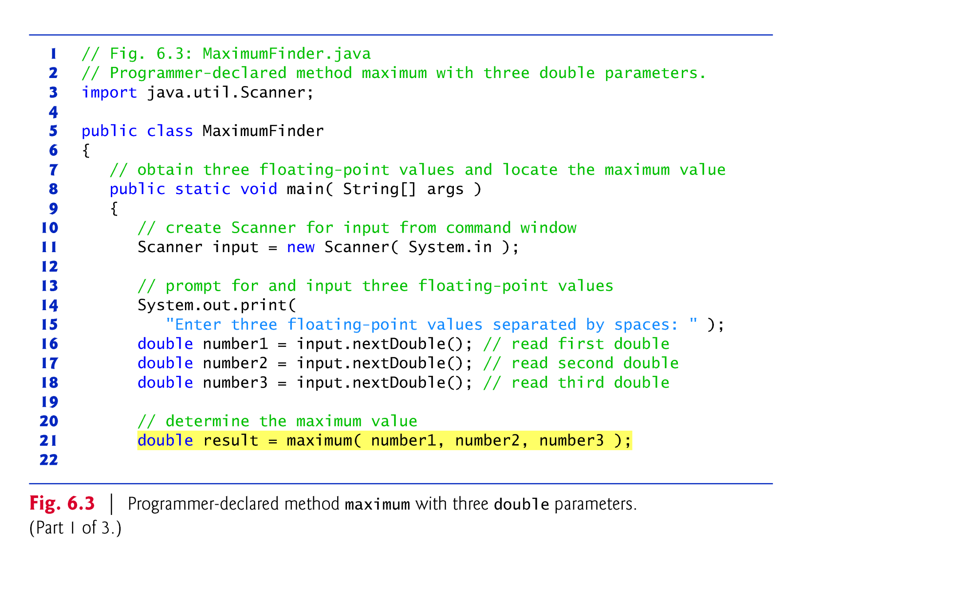

Slide 44
6.4 Declaring Methods with Multiple Parameters (Cont.)
String concatenation
Assemble String objects into larger strings with operators + or +=.
When both operands of operator + are Strings, operator + creates a new String object
characters of the right operand are placed at the end of those in the left operand
Every primitive value and object in Java has a String representation.
When one of the operands is a String, using + will convert the other to a String also, then the two are concatenated.
If a boolean is concatenated with a String, the boolean is converted to the String "true" or "false".
All objects have a toString method that returns a String representation of the object.

Slide 45
6.5 Notes on Declaring and Using Methods
Three ways to call a method:
Using a method name by itself if the call is in the same class
Using a variable that contains a reference to an object, followed by a dot (.) and the method name to call a method of the referenced object
Using the class name and a dot (.) to call a static method of a class

Slide 46
6.5 Notes on Declaring and Using Methods (Cont.)
A non-static method can call any method of the same class directly and can manipulate any of the class’s fields directly.
A static method can call only other static methods of the same class directly and can manipulate only static fields in the same class directly.
To access the class’s non-static members, a static method must use a reference to an object of the class.

Slide 47
6.5 Notes on Declaring and Using Methods (Cont.)
Three ways to return control to the statement that calls a method:
When the program flow reaches the method-ending right brace
When the following statement executes
return;
When the method returns a result with a statement like
return expression;

Slide 48
6.7 Argument Promotion and Casting
Argument promotion
Converting an argument’s value, if possible, to the type that the method expects to receive in its corresponding parameter.
Conversions may lead to compilation errors if Java’s promotion rules are not satisfied.
Promotion rules
specify which conversions are allowed.
apply to expressions containing values of two or more primitive types and to primitive-type values passed as arguments to methods.
Each value is promoted to the “highest” type in the expression.
Figure 6.4 lists the primitive types and the types to which each can be promoted.

Slide 50
6.11 Scope of Declarations (Cont.)
Basic scope rules:
The scope of a parameter declaration is the body of the method in which the declaration appears.
The scope of a local variable declaration is from the point at which the declaration appears to the end of that block.
The scope of a local variable declaration that appears in the initialization section of a for statement’s header is the body of the for statement and the other expressions in the header.
A method or field’s scope is the entire body of the class.
Any block may contain variable declarations.
If a local variable or parameter in a method has the same name as a field of the class, the field is “hidden” until the block terminates execution—this is called shadowing.

Slide 51
6.12 Method Overloading
Method overloading
Methods of the same name declared in the same class
Must have different sets of parameters
Compiler selects the appropriate method to call by examining the number, types and order of the arguments in the call.
Used to create several methods with the same name that perform the same or similar tasks, but on different types or different numbers of arguments.
Literal integer values are treated as type int, literal floating-point values are treated as type double, and so on.

Slide 52
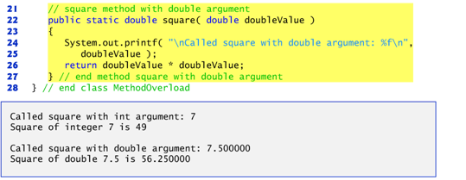

Slide 53
6.12 Method Overloading (cont.)
Distinguishing Between Overloaded Methods
The compiler distinguishes overloaded methods by their
signatures: the methods’ names and the number, types and order of their parameters.
Return types of overloaded methods
Method calls cannot be distinguished by return type.
Overloaded methods can have different return types if the methods have different parameter lists.
Overloaded methods need not have the same number of parameters, only the same name.

