Slide 1
Chapter 7 Arrays and ArrayLists
Java™ How to Program, 9/e
Presented by: Dr. José M. Reyes Álamo

Slide 2
7.1 Introduction
Data structures
Collections of related data items.
Arrays
Data structures consisting of related data items of the same type.
Make it convenient to process related groups of values.
Remain the same length once they are created.
Common array manipulations with static methods of class Arrays from the java.util package.
ArrayList collection
Similar to arrays
Dynamic resizing
They automatically increase their size at execution time to accommodate additional elements

Slide 3
7.4 Array Example

Slide 4
7.13 Class Arrays
Arrays class
Provides static methods for common array manipulations.
Methods include
sort for sorting an array (ascending order by default)
binarySearch for searching a sorted array (need to sort it first)
equals for comparing arrays
fill for placing values into an array.
Methods are overloaded for primitive-type arrays and for arrays of objects.
System class static arraycopy method
Copies contents of one array into another.

Slide 5
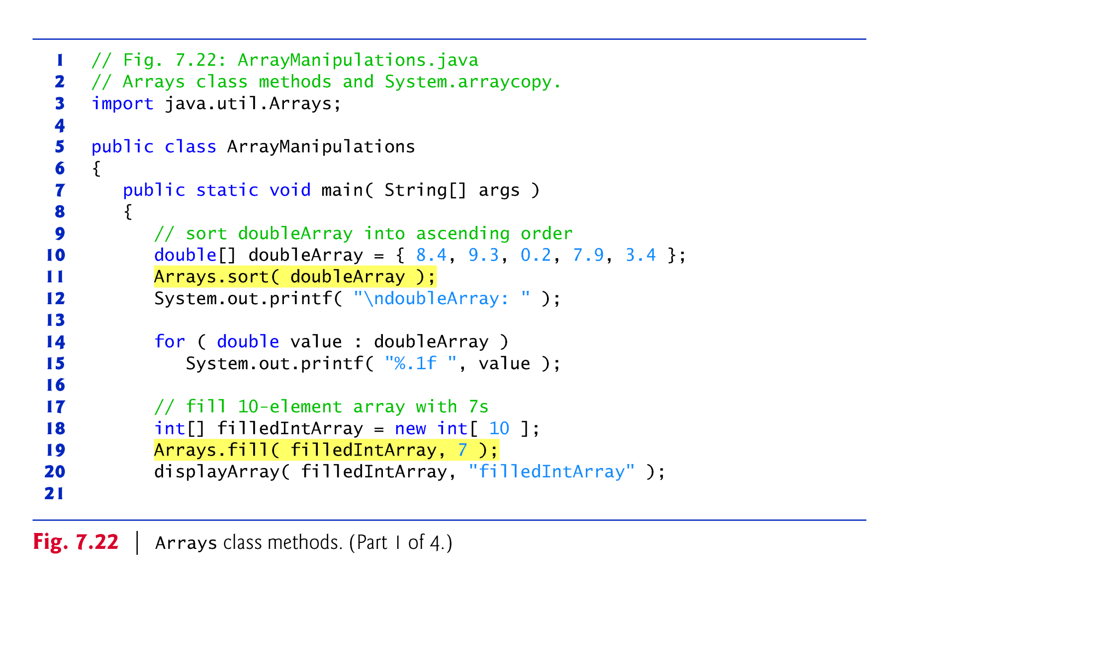

Slide 6
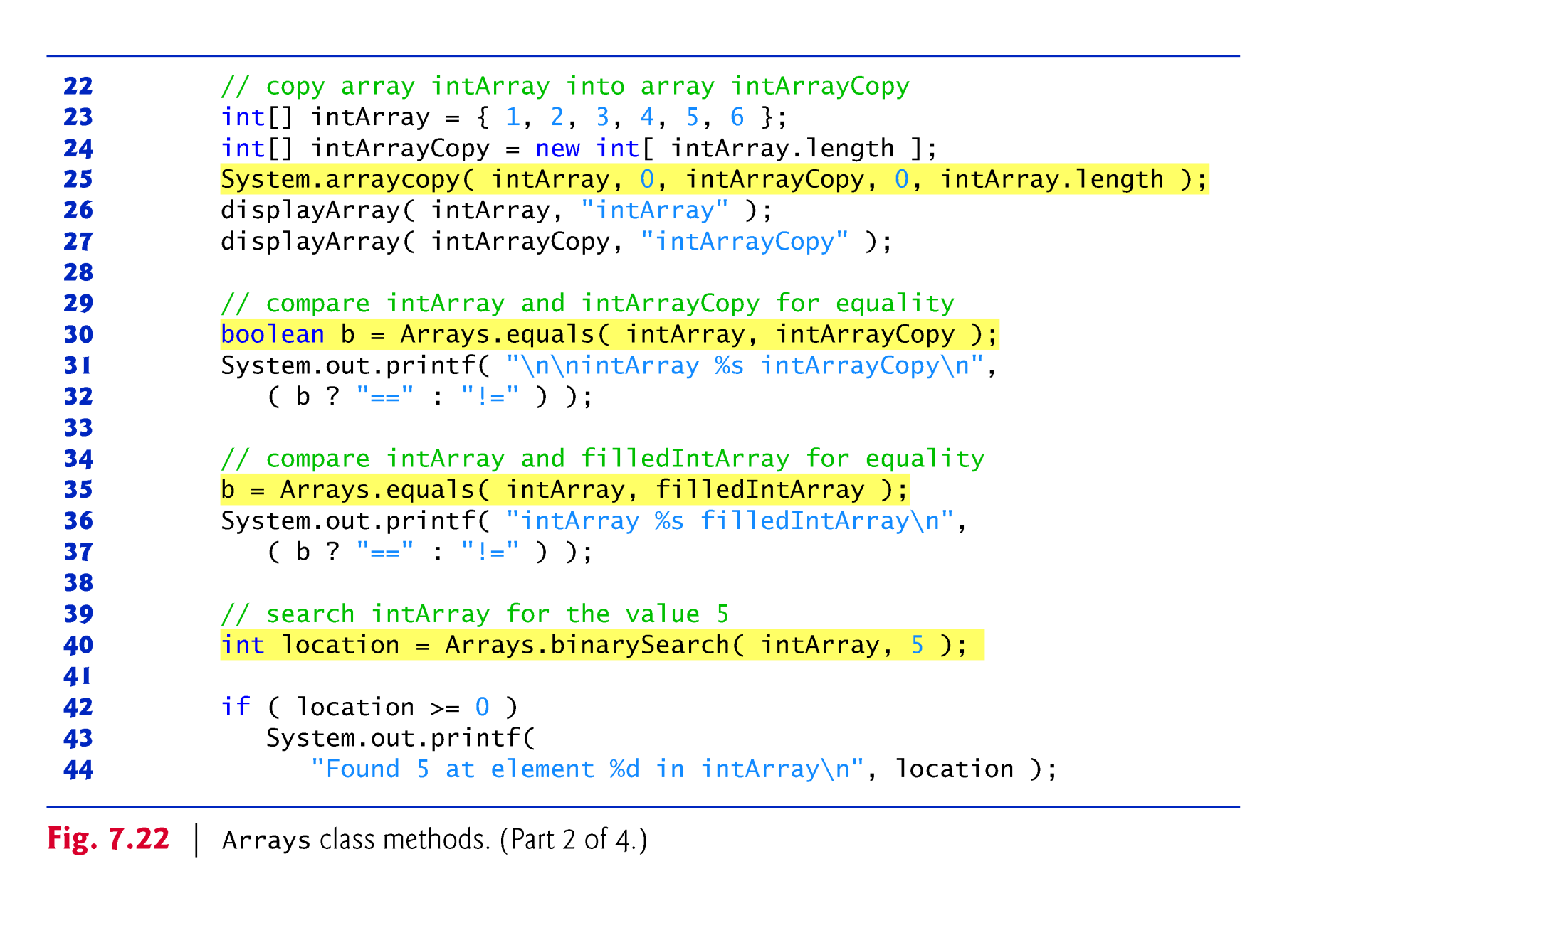

Slide 8
7.14 Introduction to Collections and Class ArrayList
Java API provides several predefined data structures, called collections, used to store groups of related objects.
Each provides efficient methods that organize, store and retrieve your data without requiring knowledge of how the data is being stored.
Reduce application-development time.
Arrays do not automatically change their size at execution time to accommodate additional elements.
ArrayList<T> (package java.util) can dynamically change its size to accommodate more elements.
T is a placeholder for the type of element stored in the collection.
This is similar to specifying the type when declaring an array, except that only nonprimitive types can be used with these collection classes.
Classes with this kind of placeholder that can be used with any type are called generic classes.

Slide 9
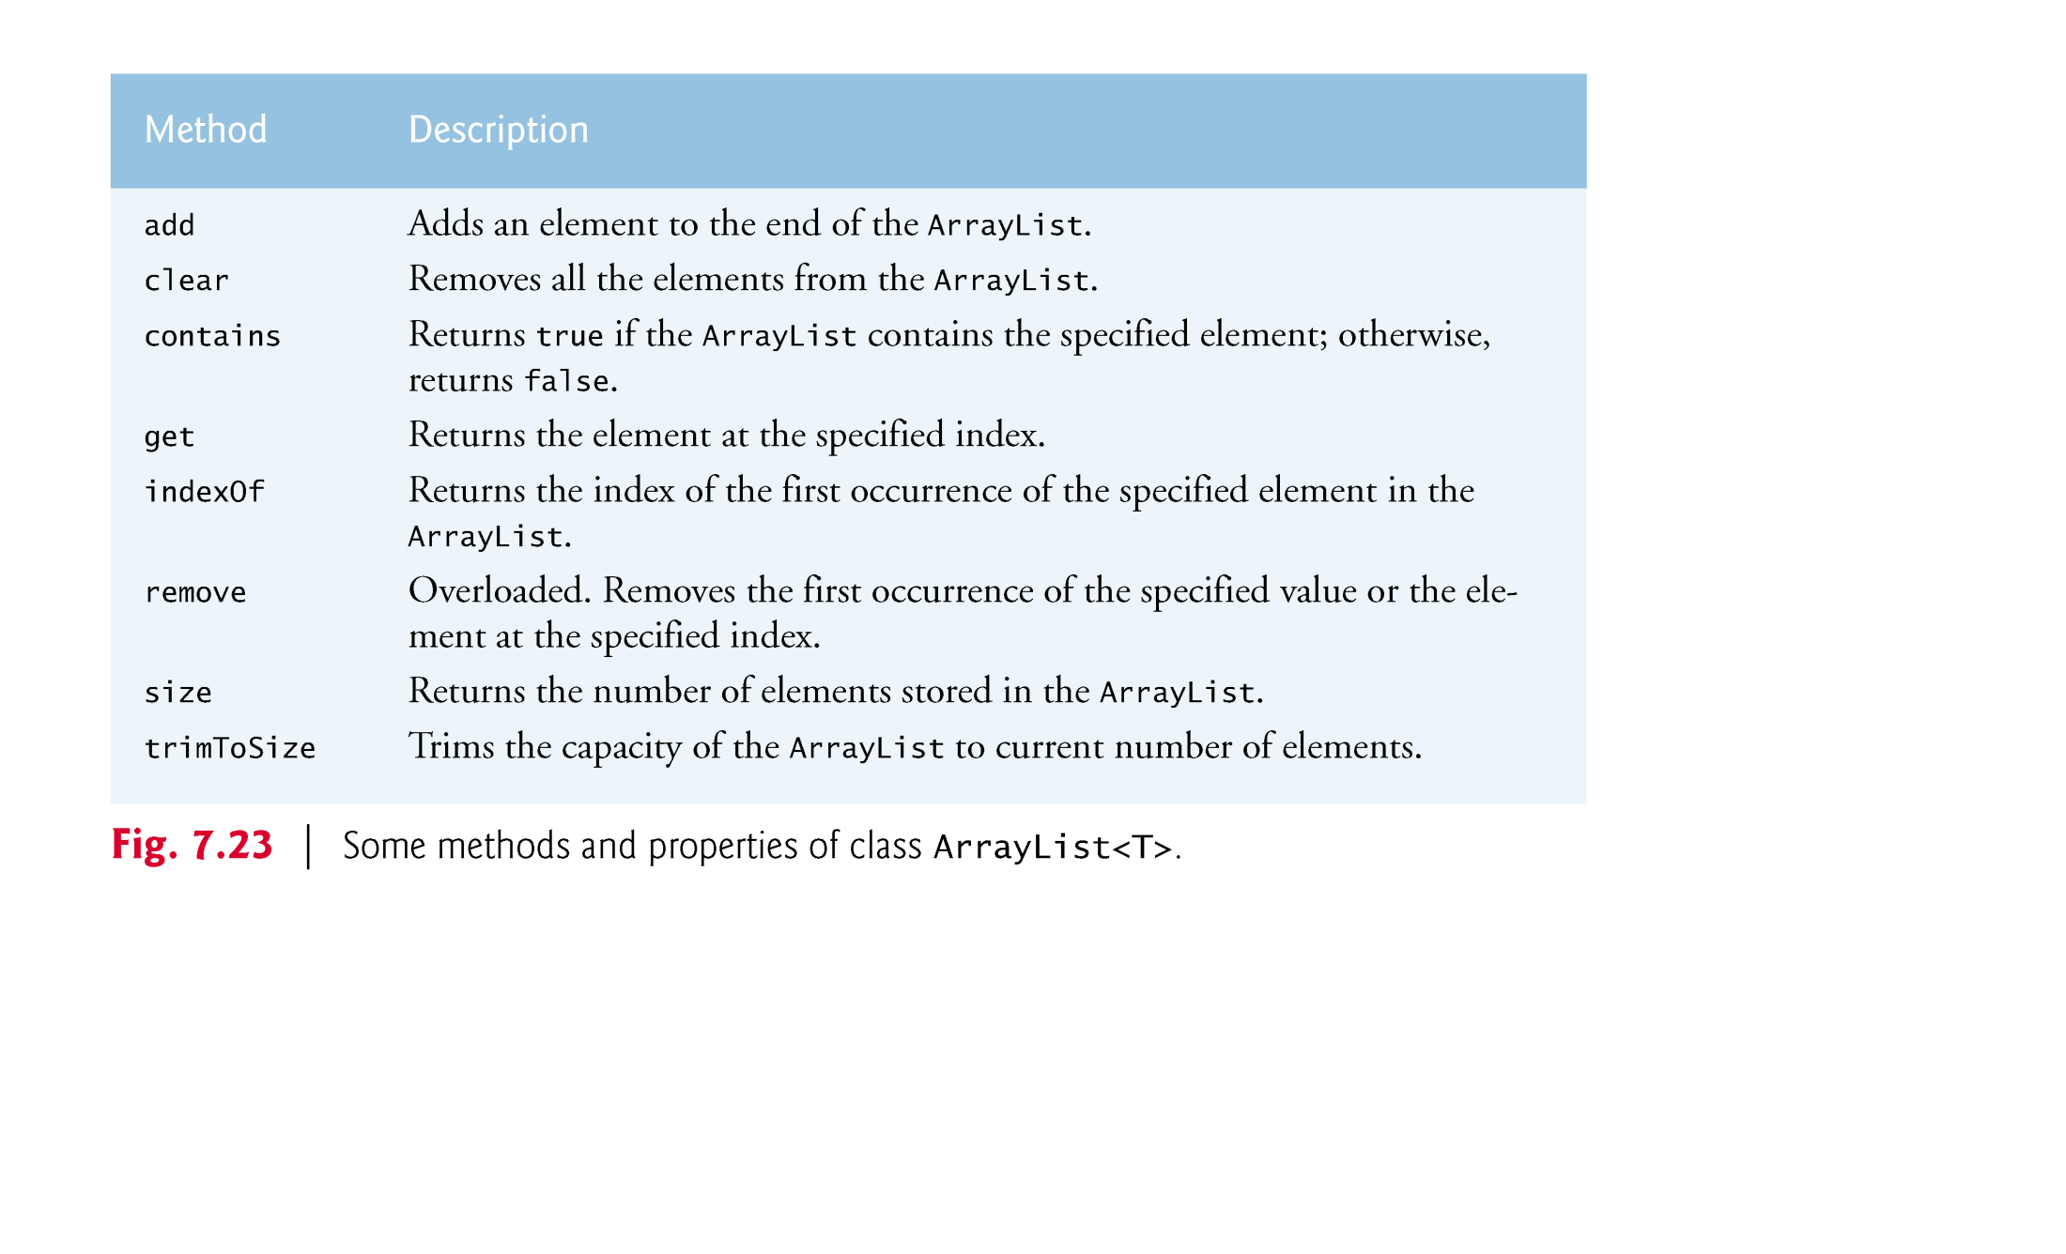

Slide 10
7.14 Introduction to Collections and Class ArrayList (Cont.)
Figure 7.23 demonstrates some common ArrayList capabilities.
An ArrayList’s capacity indicates how many items it can hold without growing.
When the ArrayList grows, it must create a larger internal array and copy each element to the new array.
This is a time-consuming operation. It would be inefficient for the ArrayList to grow each time an element is added.
An ArrayList grows only when an element is added and the number of elements is equal to the capacity—i.e., there is no space for the new element.

Slide 11
7.14 Introduction to Collections and Class ArrayList (Cont.)
Method add adds elements to the ArrayList.
One-argument version appends its argument to the end of the ArrayList.
Two-argument version inserts a new element at the specified position.
Collections indices start at zero.
Method size returns the number of elements in the ArrayList.
Method get obtains the element at a specified index.
Method remove deletes an element with a specific value.
An overloaded version of the method removes the element at the specified index.
Method contains determines if an item is in the ArrayList.

Slide 12
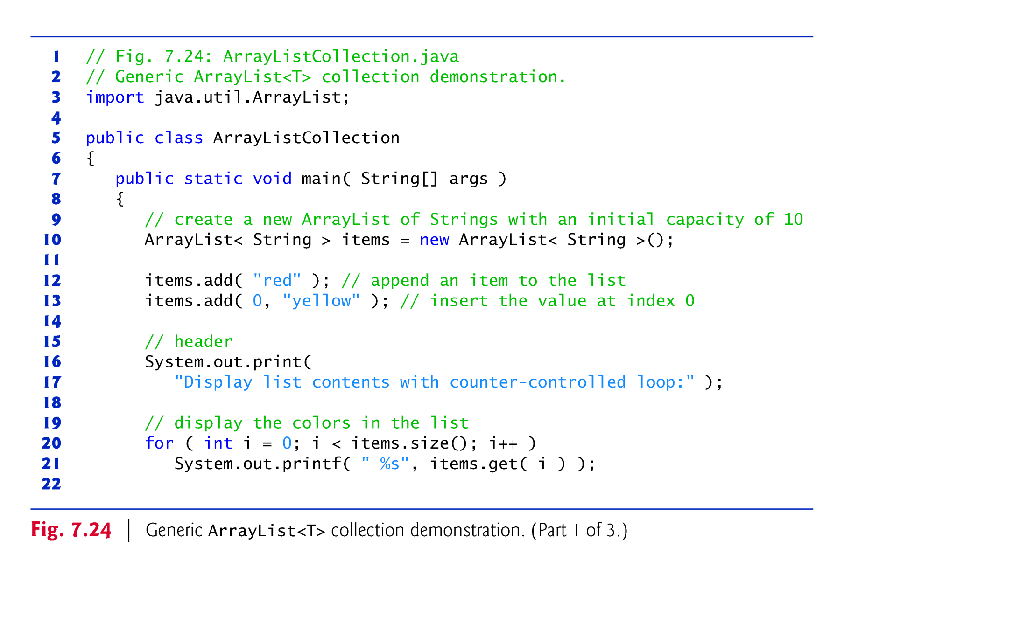

Slide 13
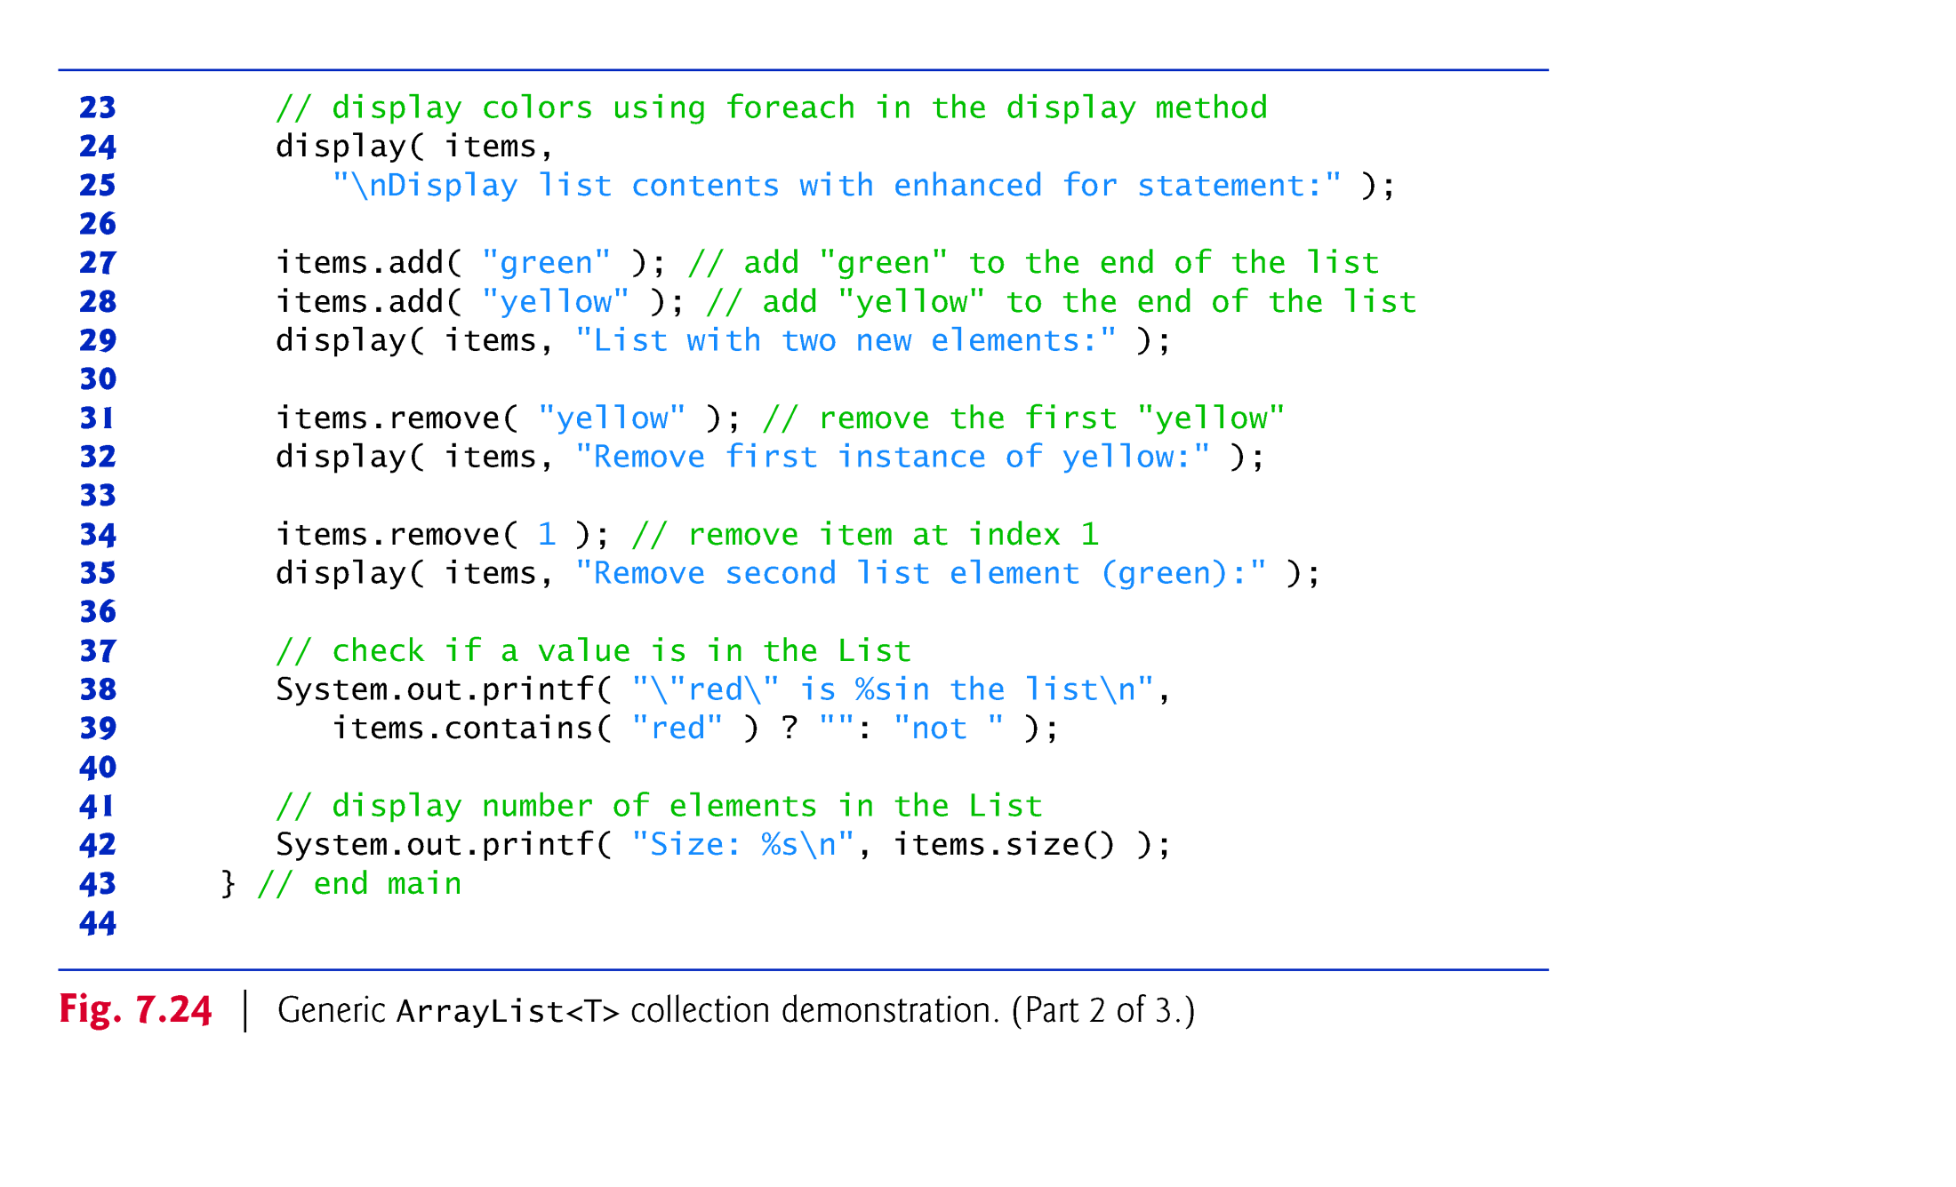

Slide 14
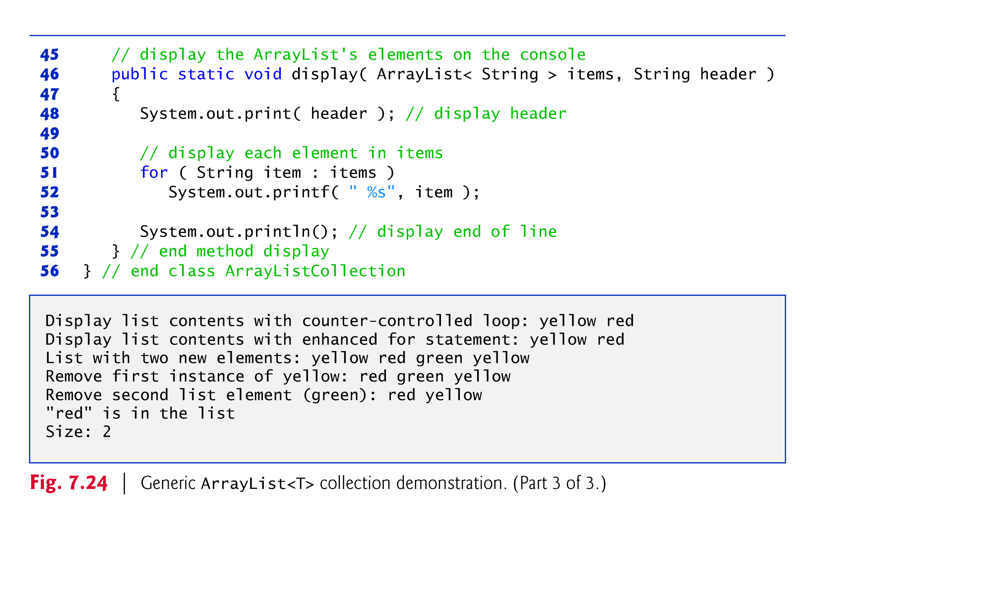

Slide 15
Chapter 20 Generic Collections
Java How to Program, 9/e Instructor: José M. Reyes Álamo

Slide 16
20.2 Collections Overview
Java collections framework
prebuilt data structures
interfaces and methods for manipulating those data structures
A collection is a data structure that can hold references to other objects.
Usually, collections contain references to objects that are all of the same type.
Figure 20.1 lists some of the interfaces of the collections framework.
Package java.util.

Slide 18
20.3 Type-Wrapper Classes for Primitive Types
Each primitive type has a corresponding type-wrapper class (in package java.lang).
Boolean, Byte, Character, Double, Float, Integer, Long and Short.
Each type-wrapper class enables you to manipulate primitive-type values as objects.
Collections cannot manipulate variables of primitive types.
They can manipulate objects of the type-wrapper classes, because every class ultimately derives from Object.

Slide 19
20.3 Type-Wrapper Classes for Primitive Types (cont.)
Each of the numeric type-wrapper classes—Byte, Short, Integer, Long, Float and Double—extends class Number.
The type-wrapper classes are final classes, so you cannot extend them.
Primitive types do not have methods, so the methods related to a primitive type are located in the corresponding type-wrapper class.

Slide 20
20.4 Autoboxing and Auto-Unboxing
A boxing conversion converts a value of a primitive type to an object of the corresponding type-wrapper class.
An unboxing conversion converts an object of a type-wrapper class to a value of the corresponding primitive type.
These conversions can be performed automatically (called autoboxing and auto-unboxing).
Example:
// create integerArray Integer[] integerArray = new Integer[ 5 ]; // assign Integer 10 to integerArray[ 0 ] integerArray[ 0 ] = 10; // get int value of Integer int value = integerArray[ 0 ];

Slide 21
20.5 Interface Collection and Class Collections
Interface Collection is the root interface from which interfaces Set, Queue and List are derived.
Interface Collection contains bulk operations for adding, clearing and comparing objects in a collection.
A Collection can be converted to an array.
Class Collections provides static methods that search, sort and perform other operations on collections.

Slide 22
20.6 Lists
A List (sometimes called a sequence) is a Collection that can contain duplicate elements.
List indices are zero based.
List also provides methods for manipulating elements via their indices, manipulating a specified range of elements, and searching for elements.
Interface List is implemented by several classes, including ArrayList, LinkedList and Vector.

Slide 23
20.6.2 LinkedList
List method addAll appends all elements of a collection to the end of a List.
String method toUpperCase gets an uppercase version of a String.
String method toLowerCase returns a lowercase version of a String.
List method subList obtains a portion of a List.
This is a so-called range-view method, which enables the program to view a portion of the list.

Slide 24
20.6.2 LinkedList (cont.)
List method clear remove the elements of a List.
List method size returns the number of items in the List.
LinkedList method addLast adds an element to the end of a List.
LinkedList method add also adds an element to the end of a List.
LinkedList method addFirst adds an element to the beginning of a List.

Slide 25
20.7 Collections Methods
Class Collections provides several high-performance algorithms for manipulating collection elements.
The algorithms (Fig. 20.5) are implemented as static methods.

Slide 28
20.7.4 Method binarySearch
static Collections method binarySearch locates an object in a List.
If the object is found, its index is returned.
If the object is not found, binarySearch returns a negative value.
Method binarySearch determines this negative value by first calculating the insertion point and making its sign negative.
Then, binarySearch subtracts 1 from the insertion point to obtain the return value, which guarantees that method binarySearch returns positive numbers (>= 0) if and only if the object is found.
List MUST be sorted binarySearch to work.

Slide 29
20.8 Stack Class of Package java.util
Class Stack in the Java utilities package (java.util) extends class Vector to implement a stack data structure.
Stack method push adds an element to the top of the stack.
Stack method pop removes the top element of the stack.
If there are no elements in the Stack, method pop throws an EmptyStackException, which terminates the loop.
Method peek returns the top element of the stack without popping the element off the stack.
Method isEmpty determines whether the stack is empty.

Slide 30
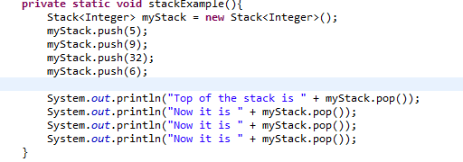
Stack Example

Slide 31
20.9 Class PriorityQueue and Interface Queue
Interface Queue extends interface Collection and provides additional operations for inserting, removing and inspecting elements in a queue.
PriorityQueue orders elements by their natural ordering.
Elements are inserted in priority order such that the highest-priority element (i.e., the largest value) will be the first element removed from the PriorityQueue.
Common PriorityQueue operations are
offer to insert an element at the appropriate location based on priority order
poll to remove the highest-priority element of the priority queue
peek to get a reference to the highest-priority element of the priority queue
clear to remove all elements in the priority queue
size to get the number of elements in the queue.

Slide 32
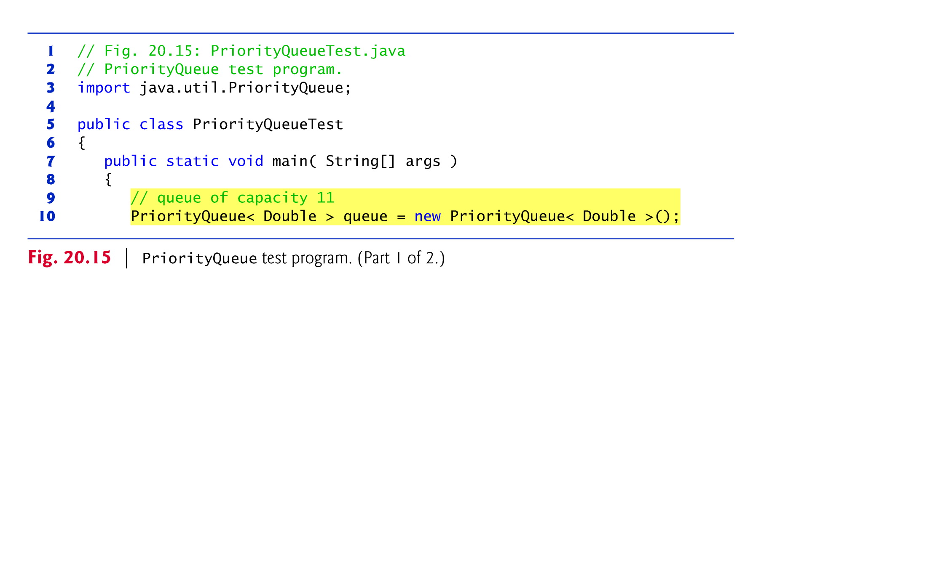
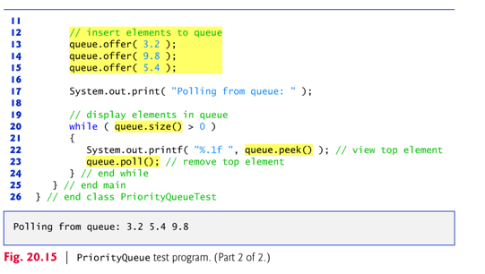

Slide 33
20.10 Sets
A Set is an unordered Collection of unique elements (i.e., no duplicate elements).
The collections framework contains several Set implementations, including HashSet and TreeSet.
HashSet stores its elements in a hash table (a data structure that uses a function to compute an index to locate an element)
TreeSet stores its elements in a tree (a data structure that uses a hierarchy to store elements)

Slide 34
20.10 Sets (cont.)
The collections framework also includes the SortedSet interface (which extends Set) for sets that maintain their elements in sorted order.
Class TreeSet implements SortedSet.
TreeSet method headSet gets a subset of the TreeSet in which every element is less than the specified value.
TreeSet method tailSet gets a subset in which each element is greater than or equal to the specified value.
SortedSet methods first and last get the smallest and largest elements of the set, respectively.

Slide 35
20.11 Maps
Maps associate keys to values.
The keys in a Map must be unique, but the associated values need not be.
If a Map contains both unique keys and unique values, it is said to implement a one-to-one mapping.
If only the keys are unique, the Map is said to implement a many-to-one mapping—many keys can map to one value.
Three of the several classes that implement interface Map are Hashtable, HashMap and TreeMap.
Hashtables and HashMaps store elements in hash tables, and TreeMaps store elements in trees.

Slide 36
20.11 Maps (Cont.)
Interface SortedMap extends Map and maintains its keys in sorted order—either the elements’ natural order or an order specified by a Comparator.
Class TreeMap implements SortedMap.
Hashing is a high-speed scheme for converting keys into unique array indices.
A hash table’s load factor affects the performance of hashing schemes.
The load factor is the ratio of the number of occupied cells in the hash table to the total number of cells in the hash table.
The closer this ratio gets to 1.0, the greater the chance of collisions.

Slide 37
20.11 Maps (Cont.)
Map method containsKey determines whether a key is in a map.
Map method put creates a new entry in the map or replaces an existing entry’s value.
Method put returns the key’s prior associated value, or null if the key was not in the map.
Map method get obtain the specified key’s associated value in the map.
HashMap method keySet returns a set of the keys.
Map method size returns the number of key/value pairs in the Map.
Map method isEmpty returns a boolean indicating whether the Map is empty.

Slide 38
Assignments
Check OpenLab for new labs
Check Blackboard for new quizzes
Work on your Project
Proposal due today

