Slide 1
CET 3640 - Lecture 1 Chapter 1 Introduction to Java
Java How to Program, 9/e
Presented by: José M. Reyes Álamo

Slide 2
Outline
Syllabus
Motivation for Java
Tools to be used: Blackboard, OpenLab, Eclipse

Slide 3
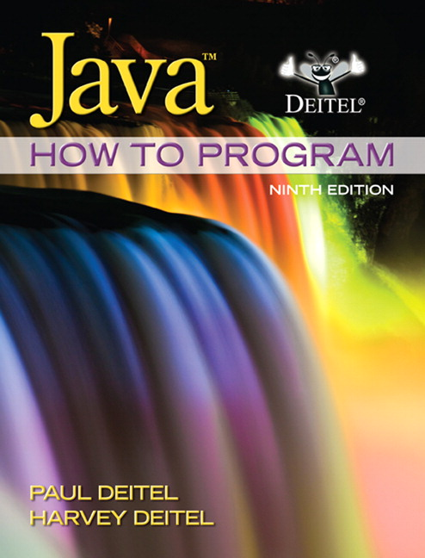
Book →

Slide 4
1.1 Introduction
Java is the world’s most widely used computer programming language.
You’ll learn to write instructions commanding computers to perform tasks.
You’ll learn object-oriented programming—today’s key programming methodology.
You’ll create and work with many software objects in this text.
You will learn data structures and the Java Application Programming Interface (API)

Slide 5
1.1 Introduction (Cont.)
Java is the preferred language for meeting many organizations’ enterprise programming needs.
Java has become the language of choice for implementing Internet-based applications and software for devices that communicate over a network.
In use today are more than a billion general-purpose computers and billions more Java-enabled cell phones, smartphones and handheld devices (such as tablet computers).

Slide 6
1.6 Introduction to Object Technology
Objects are essentially reusable software components.
There are date objects, time objects, audio objects, video objects, automobile objects, people objects, etc.
Software object have attributes (e.g., name, color and size) and behaviors (e.g., calculating, moving and communicating).
Using a modular, object-oriented design and implementation approach can make software-development groups much more productive than was possible with earlier popular techniques like “structured programming”
Object-oriented programs are often easier to understand, correct and modify.

Slide 7
1.6 Introduction to Object Technology (Cont.)
The Automobile as an Object
Someone designed the car, built the car.
You use the car (pedal, steering wheel) without the need to know the details how it works.
Smartphone
Someone designed and built the phone
You use the phone interface without the need to know the internal details how it works.

Slide 8
1.6 Introduction to Object Technology (Cont.)
Methods
A set of statements that perform a particular task, similar to a function
Implementation is hidden from its user
Attributes
Attributes are specified as part of the object’s class, also known as instance variables.
Classes
A set of methods and attributes to perform class related tasks.
A class is similar in concept to a car/smartphone design.
Object
An instance of a class.
Instantiation means that the Operating System (OS) allocates resources such as memory and processor for class methods to execute.
Just as someone has to build a car based on its design, you must build an object of a class before a program can execute the class’s methods.

Slide 9
1.6 Introduction to Object Technology (Cont.)
Reuse
Just as a car’s engineering design can be reused many times to build many cars, you can reuse a class many times to build many objects.
Reusing classes saves time and effort.
Reuse also helps you build more reliable and effective systems, because existing classes and components often have gone through extensive testing, debugging and performance tuning.

Slide 10
1.6 Introduction to Object Technology (Cont.)
Messages and Methods Calls
When you drive a car, pressing the gas pedal sends a message to the car (to go faster).
Similarly, you send messages to an object.
Each message is implemented as a method call that tells a method of the object to perform its task.

Slide 11
1.6 Introduction to Object Technology (Cont.)
Encapsulation
Classes encapsulate (i.e. wrap) attributes and methods into objects—an object’s attributes and methods are intimately related.
Objects may communicate with one another, but they’re normally not allowed to know how other objects are implemented—implementation details are hidden within the objects themselves.
Information hiding, as we’ll see, is crucial to good software engineering.

Slide 12
1.6 Introduction to Object Technology (Cont.)
Inheritance
A new class of objects can be created quickly and conveniently by inheritance—the new class absorbs the characteristics of an existing class, possibly customizing them and adding unique characteristics of its own.
Using the car analogy, an object of class “convertible” certainly is an object of the more general class “automobile”.

Slide 13
1.6 Introduction
Polymorphism
Enables you to “program in the general” rather than “program in the specific.”
Polymorphism enables you to write objects that can take more than one form.
Process different objects that share the same properties as if they’re all objects of the same class, simplifying programming.

Slide 14
1.9 Java and a Typical Java Development Environment (Cont.)
Java is the most widely used software development language in the world.
Java Class Libraries
Rich collections of existing classes and methods
Also known as the Java APIs (Application Programming Interfaces).

Slide 15
1.9 Java and a Typical Java Development Environment (Cont.)
Java programs normally go through five phases
edit
compile
load
verify
execute

Slide 16
1.9 Java and a Typical Java Development Environment (Cont.)
Writing a Java program (The hard way!!!)
Type a Java program (source code) using a text editor (Notepad in Windows; vi, emacs in Linux)
Save the program with the .java extension
e.g. HelloWorld.java
Compile the program using the java command
e.g. javac HelloWorld.java
If no errors, run the compiled program without the extension
e.g. java HelloWorld

Slide 17
1.9 Java and a Typical Java Development Environment (Cont.)
Writing a Java program (The easy way!!!)
Use and Integrated Development Environment (IDE)
Provide tools for software development process, including editors, debuggers, and compilers all together.
Popular IDEs
***Eclipse (www.eclipse.org)
NetBeans (www.netbeans.org).

Slide 18
1.9 Java and a Typical Java Development Environment (Cont.)
Java compiler translates Java source code into bytecodes that represent the tasks to execute.
Bytecodes are executed by the Java Virtual Machine (JVM)—a part of the JDK and the foundation of the Java platform.
Virtual machine (VM)—a software application that simulates a computer
Hides the underlying operating system and hardware from the programs that interact with it.
If the same VM is implemented on many computer platforms, applications that it executes can be used on all those platforms.

Slide 19
1.9 Java and a Typical Java Development Environment (Cont.)
Bytecodes are platform independent
They do not depend on a particular hardware platform.
Bytecodes are portable
The same bytecodes can execute on any platform containing a JVM that understands the version of Java in which the bytecodes were compiled.
The JVM is invoked by the java command. For example, to execute a Java application called Welcome, you’d type the command
java Welcome

Slide 20
1.9 Java and a Typical Java Development Environment (Cont.)
The JVM executes the program’s bytecodes.
JVMs typically execute bytecodes using a combination of interpretation and so-called just-in-time (JIT) compilation.
Analyzes the bytecodes as they’re interpreted
A just-in-time (JIT) compiler—known as the Java HotSpot compiler—translates the bytecodes into the underlying computer’s machine language.

Slide 21
Blackboard
Blackboard will be used to take quizzes and submit assignments.
Grades will also be posted on Blackboard.
It is your responsibility to check Blackboard constantly.
OpenLab
OpenLab will be used to post you lab reports.
Class website is also hosted on the OpenLab.

Slide 22
Lab #1
Create an OpenLab portfolio
Install Java
Creating a simple HelloWorld kind of program
Post it in your OpenLab portfolio

