Slide 1
Chapter 26 Multithreading
Java How to Program, 9/e
CET 3640
Professor: Dr. José M. Reyes Álamo

Slide 2
26.1 Introduction
Operating systems on single-processor computers create the illusion of concurrent execution by rapidly switching between activities, but only a single instruction can execute at once.
Java makes concurrency available through the APIs.
You specify that an application contains separate threads of execution
each thread has its own method-call stack and program counter
can execute concurrently with other threads while sharing application-wide resources such as memory with them.
This capability is called multithreading.
Newest C++ Standard Library (v. 11, ratified in August 2011) supports multithreading, previous standard does not.

Slide 3
26.1 Introduction (cont.)
Programming concurrent applications is difficult and error prone.
Guidelines:
Use existing classes from the Java API that manage synchronization for you.

Slide 4
26.2 Thread States: Life Cycle of a Thread
A thread can be in one of several thread states (new, runnable, waiting, time waiting, blocked, terminated).
A new thread begins in the new state.
Remains there until started, which places it in the runnable state.
A runnable thread can transition to the waiting state while it waits for another thread to perform a task.
Transitions back to the runnable state only when another thread notifies it to continue executing.

Slide 5
26.2 Thread States: Life Cycle of a Thread (cont.)
A runnable thread can enter the timed waiting state for a specified interval of time.
Transitions back to the runnable state when that time interval expires or when the event it’s waiting for occurs.
Cannot use a processor, even if one is available.
A sleeping thread remains in the timed waiting state for a designated period of time (called a sleep interval), after which it returns to the runnable state.
A runnable thread transitions to the blocked state when it attempts to perform a task that cannot be completed immediately and it must temporarily wait until that task completes.
A runnable thread enters the terminated state when it successfully completes its task or otherwise terminates (perhaps due to an error).

Slide 6
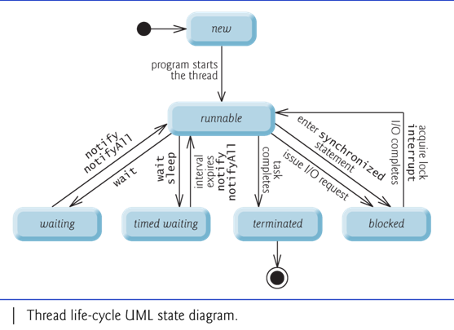

Slide 7
26.2 Thread States: Life Cycle of a Thread (cont.)
At the operating-system level, Java’s runnable state typically encompasses two separate states: ready or running.
When a thread first transitions to the runnable state from the new state, it is in the ready state.
A ready thread enters the running state (i.e., begins executing) when the operating system assigns it to a processor (known as dispatching the thread).
Typically, each thread is given a quantum or timeslice to perform its task.
This process is called thread scheduling.

Slide 8
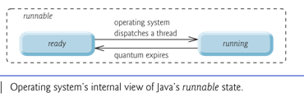

Slide 9
26.2 Thread States: Lifecycle of a Thread (cont.)
Every Java thread has a thread priority that determines the order in which threads are scheduled.
Higher-priority threads should be allocated processor time before lower-priority threads.
Thread priorities cannot guarantee the order in which threads execute.

Slide 10
26.2 Thread States: Lifecycle of a Thread (cont.)
Most operating systems support time slicing, which enables threads of equal priority to share a processor.
An operating system’s thread scheduler determines which thread runs next.
One simple thread-scheduler implementation keeps the highest-priority thread running at all times and, if there’s more than one highest-priority thread, ensures that all such threads execute for a quantum each in round-robin fashion. This process continues until all threads run to completion.

Slide 11
26.2 Thread States: Lifecycle of a Thread (cont.)
When a higher-priority thread enters the ready state, the operating system generally preempts the currently running thread (an operation known as preemptive scheduling).
Higher-priority threads could postpone—possibly indefinitely—the execution of lower-priority threads.
A situation known as starvation.
Operating systems generally employ a technique called aging to prevent starvation.
Increasing the priority of a thread based on its waiting time.

Slide 12
26.2 Thread States: Lifecycle of a Thread (cont.)
Java provides higher-level concurrency utilities to hide much of this complexity and prevent errors in multithreaded programming.
Thread priorities are used behind the scenes to, but you will not be concerned with this as Java takes care of it.

Slide 13
How to Program Threads in Java

Slide 14
26.3 Creating and Executing Threads with Executor Framework
The Runnable interface declares the single method run, which contains the code that defines the task that a Runnable object should perform.
A Runnable object represents a “task” that can execute concurrently with other tasks.
When a thread executing a Runnable is created and started, the thread calls the Runnable object’s run method, which executes in the new thread.
To make your life even easier, Java provides the Executor interface to manage Threads.

Slide 15
26.3 Creating and Executing Threads with Executor Framework (cont.)
Class PrintTask (Fig. 26.3) implements Runnable (line 5), so that multiple PrintTasks can execute concurrently.
Thread static method sleep places a thread in the timed waiting state for the specified amount of time.
Can throw a checked exception of type InterruptedException if the sleeping thread’s interrupt method is called.
The code in main executes in the main thread, a thread created by the JVM.
The code in the run method of PrintTask executes in the threads created in main.
When method main terminates, the program itself continues running because there are still threads that are alive.
The program will not terminate until its last thread completes execution.

Slide 18
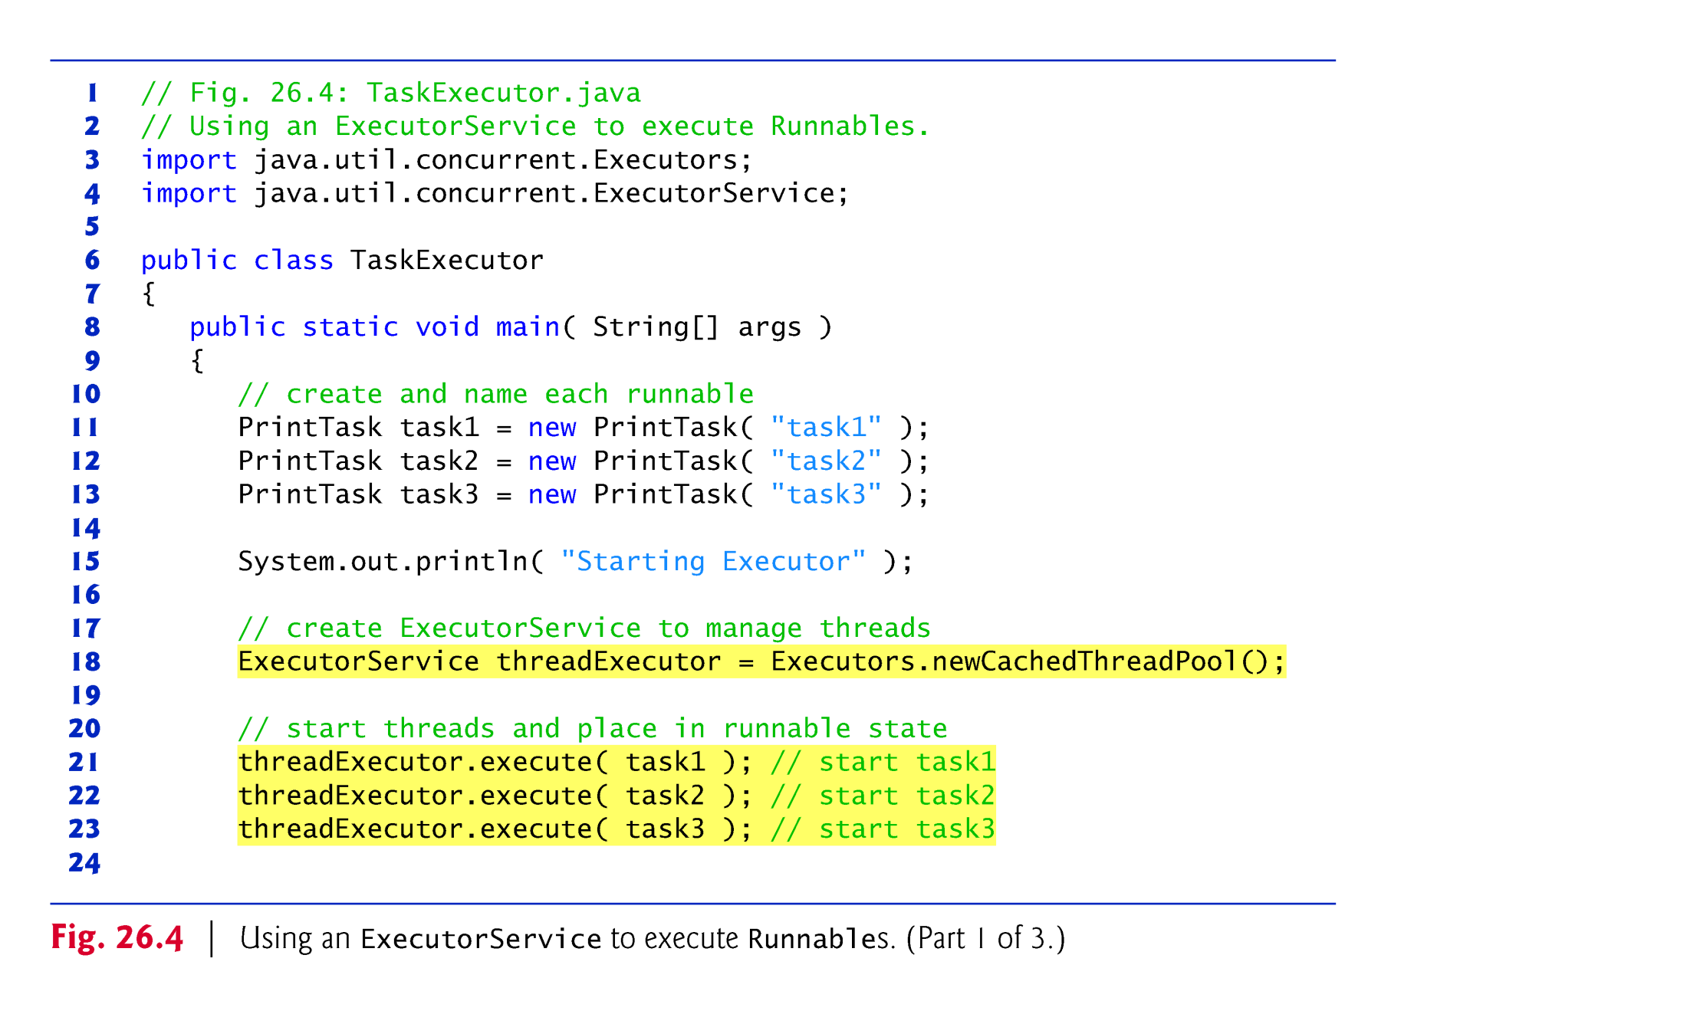

Slide 20
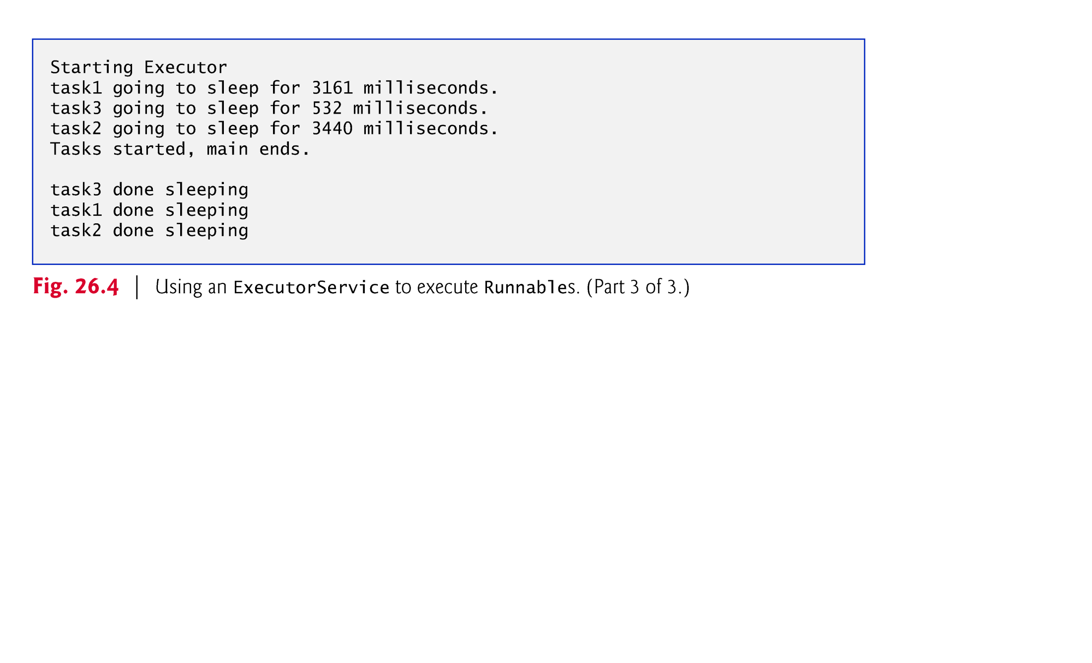

Slide 21
26.4 Thread Synchronization
When multiple threads share an object and it is modified by one or more of them, indeterminate results may occur unless access to the shared object is managed properly.
The problem can be solved by giving only one thread at a time exclusive access to code that manipulates the shared object.
During that time, other threads desiring to manipulate the object are kept waiting.
When the thread with exclusive access to the object finishes manipulating it, one of the waiting threads is allowed to proceed.
This process, called thread synchronization, coordinates access to shared data by multiple concurrent threads.
Ensures that each thread accessing a shared object excludes all other threads from doing so simultaneously—this is called mutual exclusion.

Slide 22
26.4 Thread Synchronization (cont.)
A common way to perform synchronization is to use Java’s built-in monitors.
Every object has a monitor and a monitor lock (or intrinsic lock).
Can be held by a maximum of only one thread at any time.
A thread must acquire the lock before proceeding with the operation.
Other threads attempting to perform an operation that requires the same lock will be blocked.
To specify that a thread must hold a monitor lock to execute a block of code, the code should be placed in a synchronized statement.
Said to be guarded by the monitor lock

Slide 23
26.4 Thread Synchronization (cont.)
The synchronized statements are declared using the synchronized keyword:
synchronized ( object ) { statements } // end synchronized statement
where object is the object whose monitor lock will be acquired
normally refers to this (i.e. the current object) if it’s the object in which the synchronized statement appears.
When a synchronized statement finishes executing, the object’s monitor lock is released.
Java also allows synchronized methods.
For performance reasons, synchronized methods and synchronized blocks should be as short as possible.

Slide 24
26.4 Synchronization Method

