Slide 1
Chapter 10 Object-Oriented Programming: Polymorphism
Java™ How to Program, 9/e
Presented by: Dr. José M. Reyes Álamo

Slide 2
10.1 Introduction
Polymorphism
Enables you to “program in the general” rather than “program in the specific.”
Polymorphism enables you to write programs that process objects that share the same superclass as if they’re all objects of that superclass, simplifying programming.
With polymorphism systems are easily extensible.

Slide 3
10.2 Polymorphism Examples
Example: Quadrilaterals
If Rectangle is derived from Quadrilateral, then a Rectangle object is a more specific version of a Quadrilateral.
Any operation that can be performed on a Quadrilateral can also be performed on a Rectangle.
These operations can also be performed on other Quadrilaterals, such as Squares, Parallelograms and Trapezoids.
Polymorphism occurs when a program invokes a method through a superclass Quadrilateral variable—at execution time, the correct subclass version of the method is called, based on the type of the reference stored in the superclass variable.

Slide 4
10.3 Demonstrating Polymorphic Behavior
In the next example, we aim a superclass reference at a subclass object.
Invoking a method on a subclass object via a superclass reference invokes the subclass functionality
The type of the referenced object, not the type of the variable, determines which method is called
This example demonstrates that an object of a subclass can be treated as an object of its superclass, enabling various interesting manipulations.
A program can create an array of superclass variables that refer to objects of many subclass types.
Allowed because each subclass object is an object of its superclass.

Slide 5
10.3 Demonstrating Polymorphic Behavior (Cont.)
A superclass object cannot be treated as a subclass object, because a superclass object is not an object of any of its subclasses.
The is-a relationship applies only up the hierarchy from a subclass to its direct (and indirect) superclasses.

Slide 6
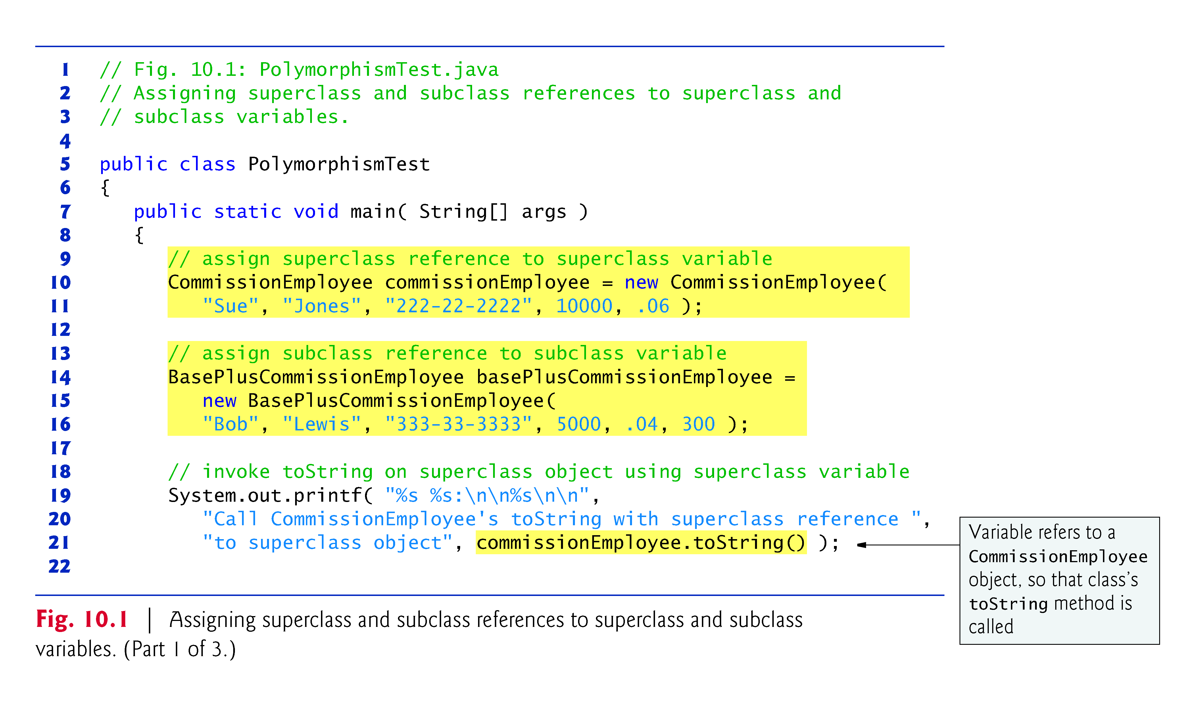
10.3 Before

Slide 7
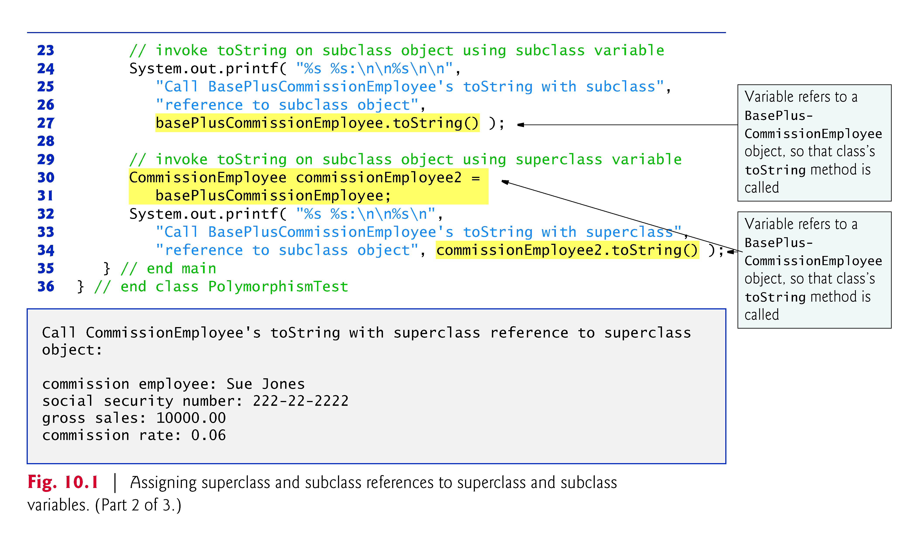
10.3 Now With Polymorphism

Slide 8
10.3 Demonstrating Polymorphic Behavior (Cont.)
When a superclass variable contains a reference to a subclass object, and that reference is used to call a method, the subclass version of the method is called.
The Java compiler allows this “crossover” because an object of a subclass is an object of its superclass (but not vice versa).
When the compiler encounters a method call made through a variable, the compiler determines if the method can be called by checking the variable’s class type.
If that class contains the proper method declaration (or inherits one), the call is compiled.
At execution time, the type of the object to which the variable refers determines the actual method to use.
This process is called dynamic binding.

Slide 9
10.4 Abstract Classes and Methods
Abstract classes
Sometimes it’s useful to declare classes for which you never intend to create objects.
Used only as superclasses in inheritance hierarchies, so they are sometimes called abstract superclasses.
Cannot be used to instantiate objects—abstract classes are incomplete.
Subclasses must declare the “missing pieces” to become “concrete” classes, from which you can instantiate objects; otherwise, these subclasses too, will be abstract.
An abstract class provides a superclass from which other classes can inherit and thus share a common design.

Slide 10
10.4 Abstract Classes and Methods (Cont.)
Classes that can be used to instantiate objects are called concrete classes.
Such classes provide implementations of every method they declare (including those inherited).
Concrete classes provide the specifics that make it reasonable to instantiate objects.
Not all hierarchies contain abstract classes.

Slide 11
10.4 Abstract Classes and Methods (Cont.)
Programmers often write client code that uses only abstract superclass types to reduce client code’s dependencies on a range of subclass types.
You can write a method with a parameter of an abstract superclass type.
When called, such a method can receive an object of any concrete class that directly or indirectly extends the superclass specified as the parameter’s type.
Abstract classes sometimes constitute several levels of a hierarchy.

Slide 12
10.4 Abstract Classes and Methods (Cont.)
You make a class abstract by declaring it with keyword abstract.
An abstract class contains one or more abstract methods.
An abstract method is one with keyword abstract in its declaration, as in
public abstract void draw(); // abstract method
Abstract methods do not provide implementations.
A class that contains abstract methods must be an abstract class even if that class contains some concrete (non-abstract) methods.
Each concrete subclass of an abstract superclass, must provide concrete implementations of each of the superclass’s abstract methods.
Constructors and static methods cannot be declared abstract.

Slide 13
10.5 Case Study: Payroll System Using Polymorphism
Use an abstract method and polymorphism to perform payroll calculations based on the type of inheritance hierarchy headed by an employee.
Enhanced employee inheritance hierarchy requirements:
Salaried employees are paid a fixed weekly salary
Hourly employees are paid by the hour and receive overtime pay (i.e., 1.5 times their hourly salary rate) for all hours worked in excess of 40 hours
Commission employees are paid a percentage of their sales
Base-salaried commission employees receive a base salary plus a percentage of their sales.
For the current pay period employees will receive an additional 10% to their base salaries.

Slide 14
10.5 Case Study: Payroll System Using Polymorphism (Cont.)
abstract class Employee represents the general concept of an employee.
Subclasses: SalariedEmployee, CommissionEmployee , HourlyEmployee and BasePlusCommissionEmployee (an indirect subclass)
Fig. 10.2 shows the inheritance hierarchy for our polymorphic employee-payroll application.

Slide 15
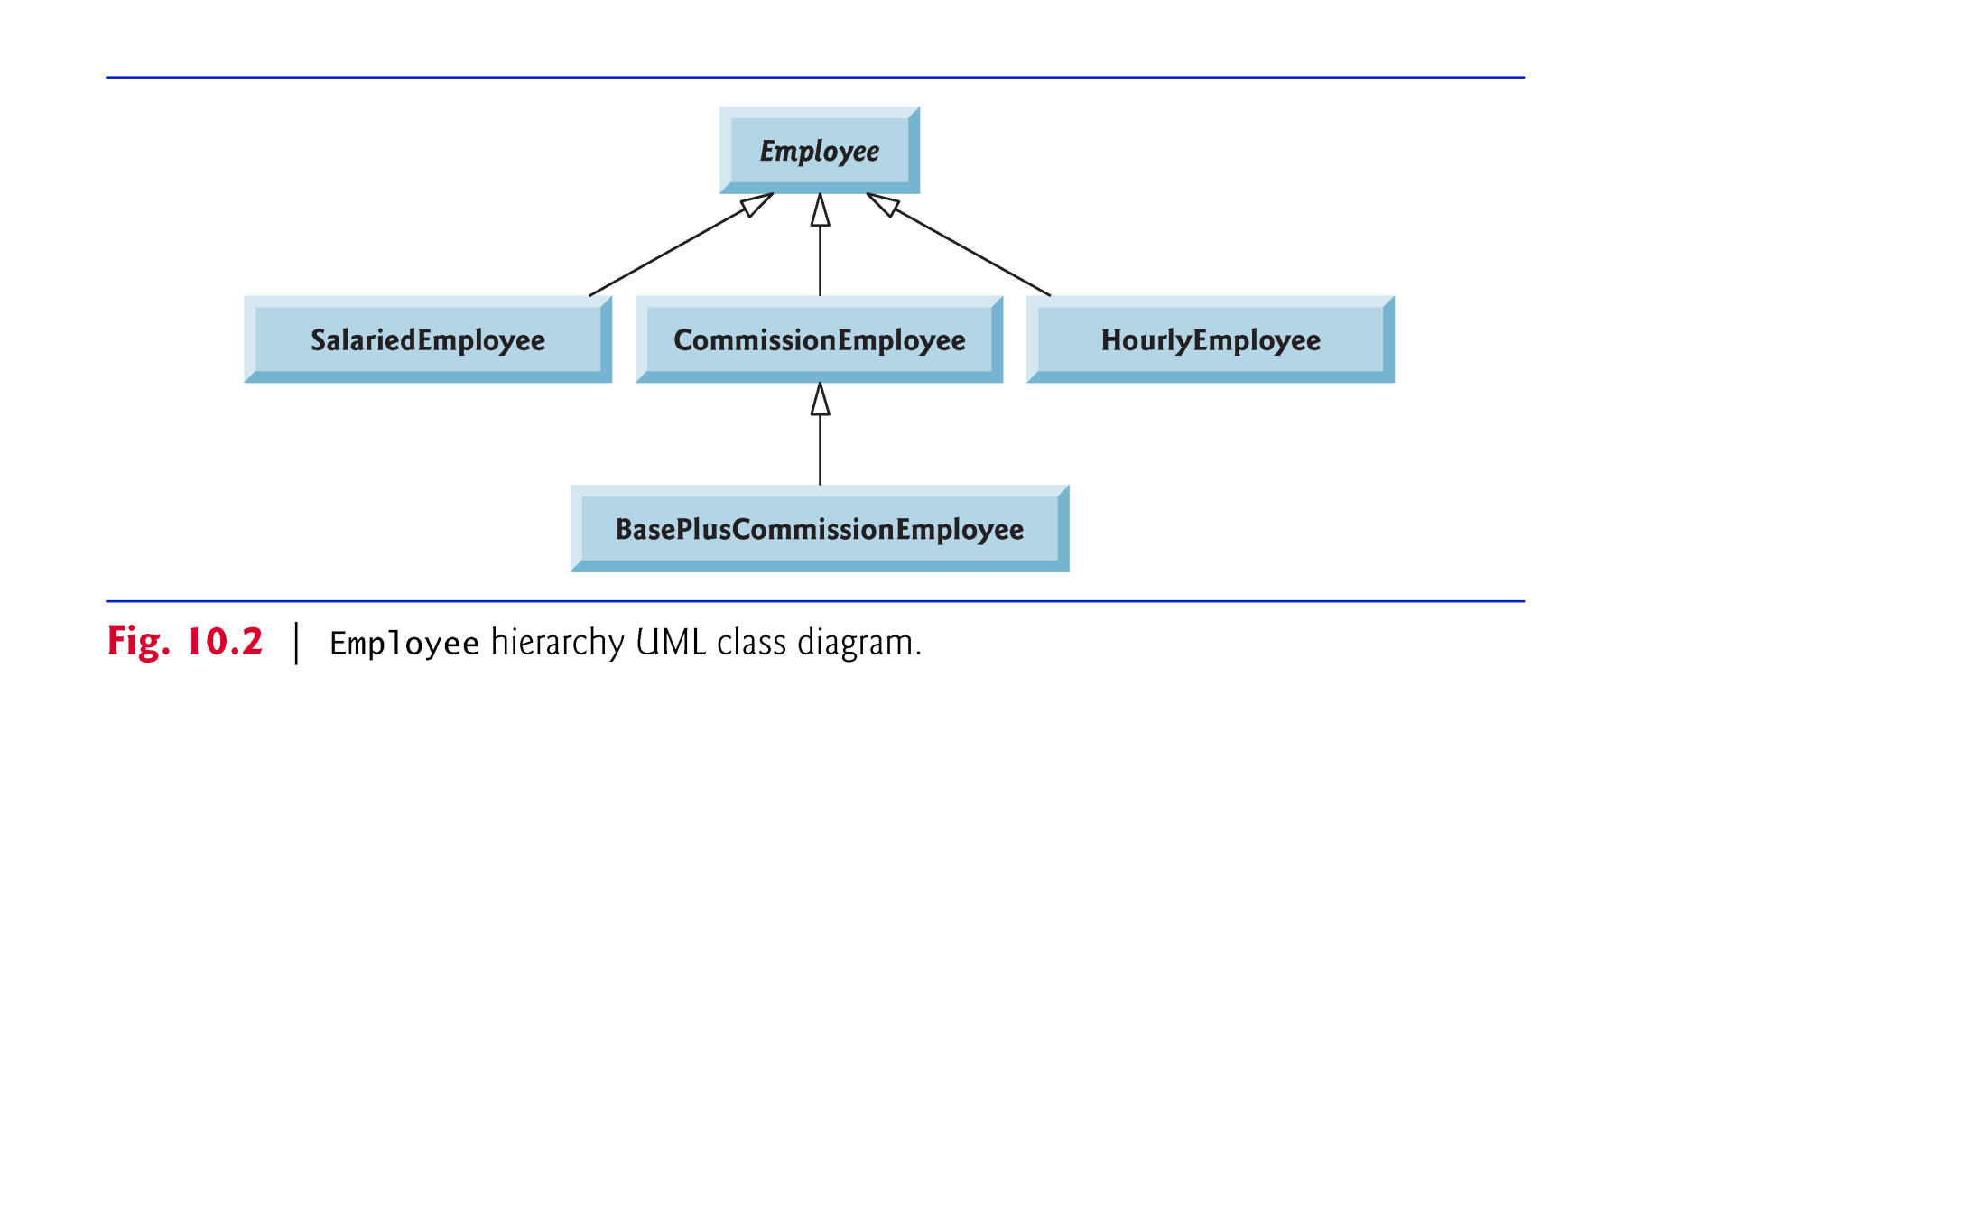

Slide 16
10.5 Case Study: Payroll System Using Polymorphism (Cont.)
Abstract superclass Employee declares the methods that are common down the hierarchy.
Each employee has a first name, a last name and a social security number defined in abstract superclass Employee.

Slide 17
10.5.1 Abstract Superclass Employee
Class Employee provides methods earnings and toString, in addition to the get and set methods that manipulate Employee’s instance variables.
An earnings method applies to all employees, but each earnings calculation depends on the employee’s class.
An abstract method—there is not enough information to determine what amount earnings should return.
Each subclass overrides earnings with an appropriate implementation.
Iterate through the array of Employees and call method earnings for each Employee subclass object.
Method calls processed polymorphically.

Slide 19
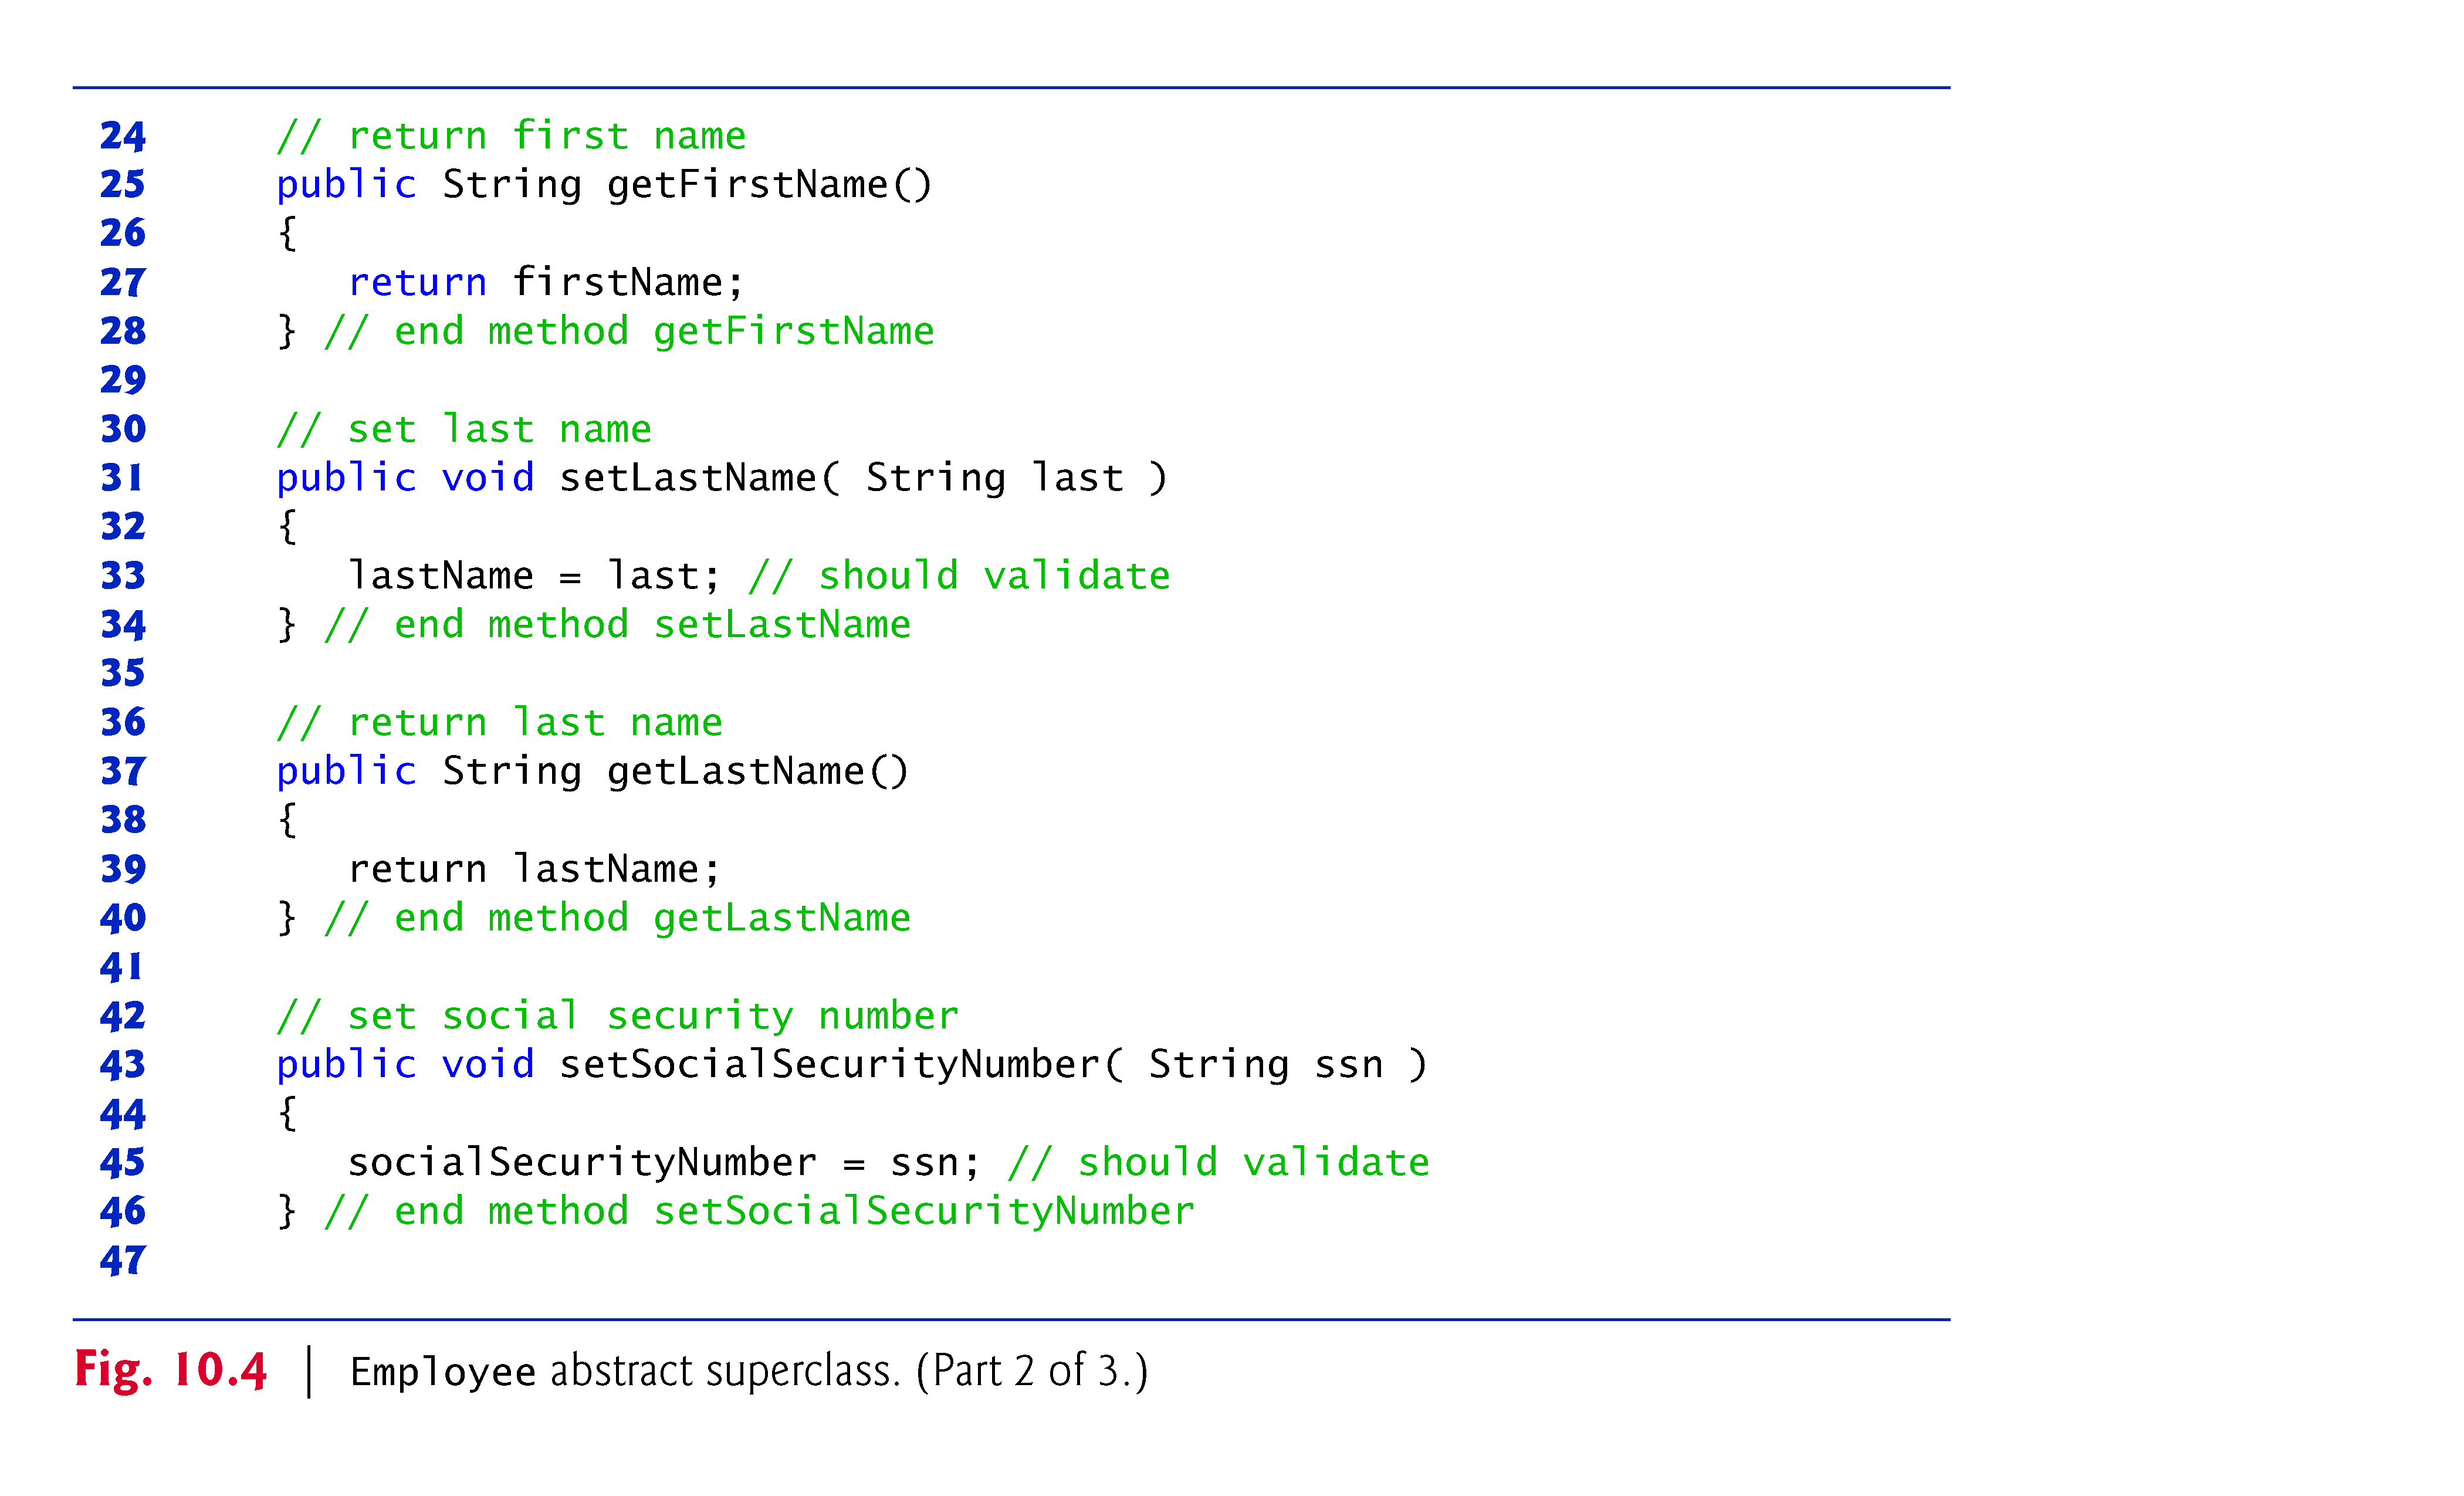

Slide 20
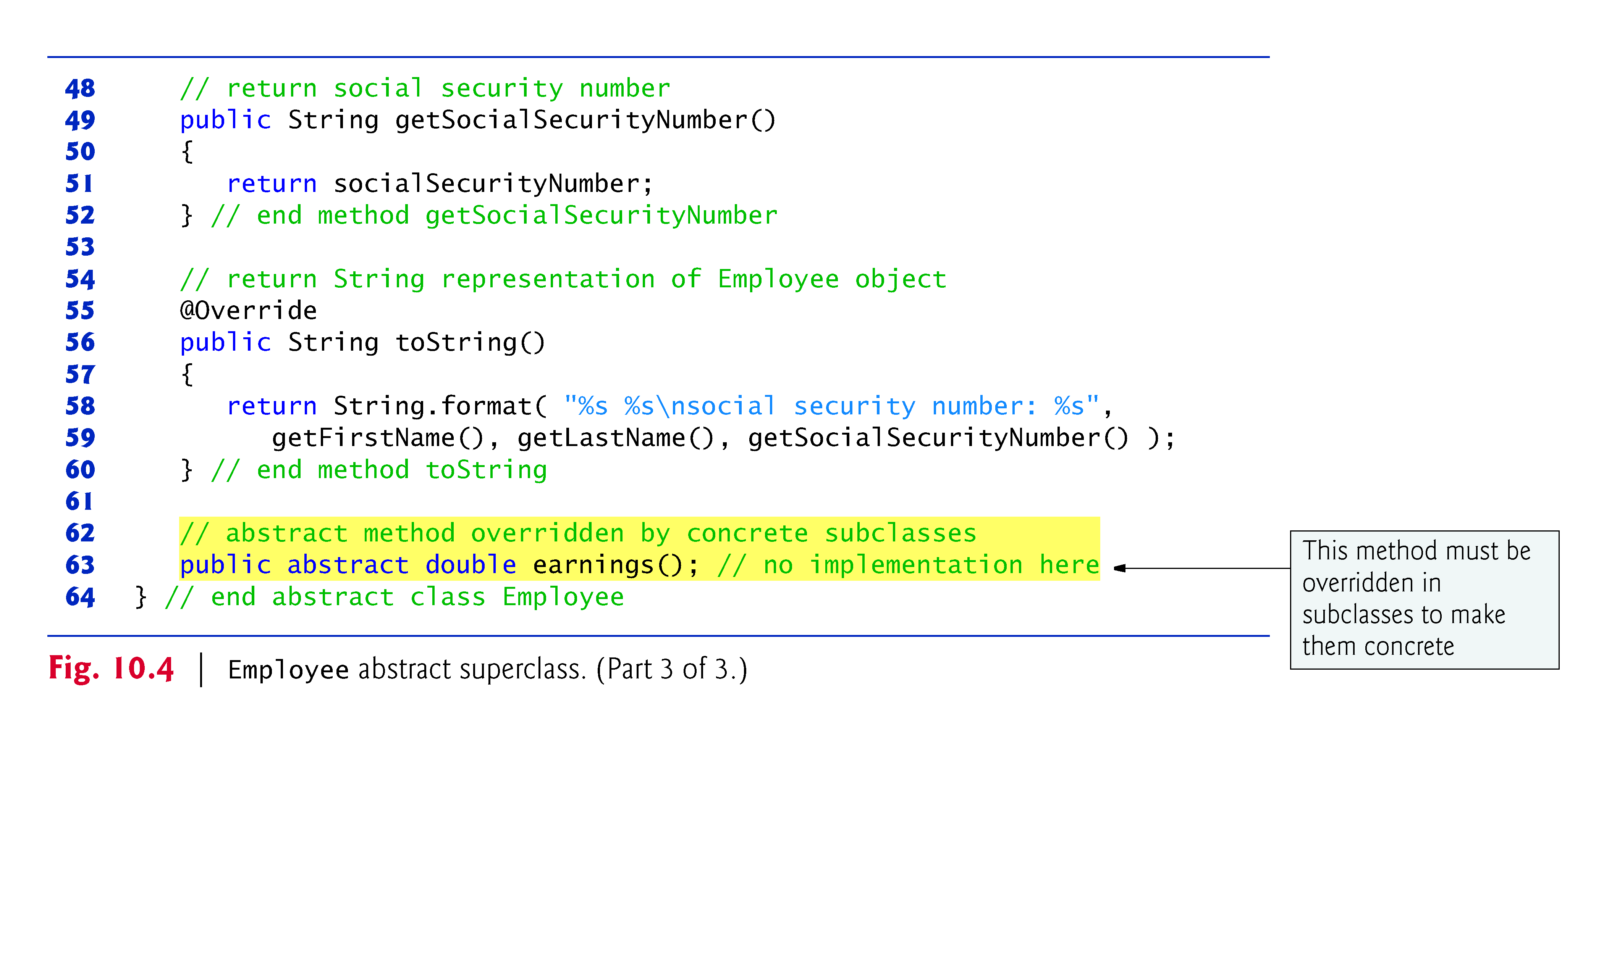

Slide 21
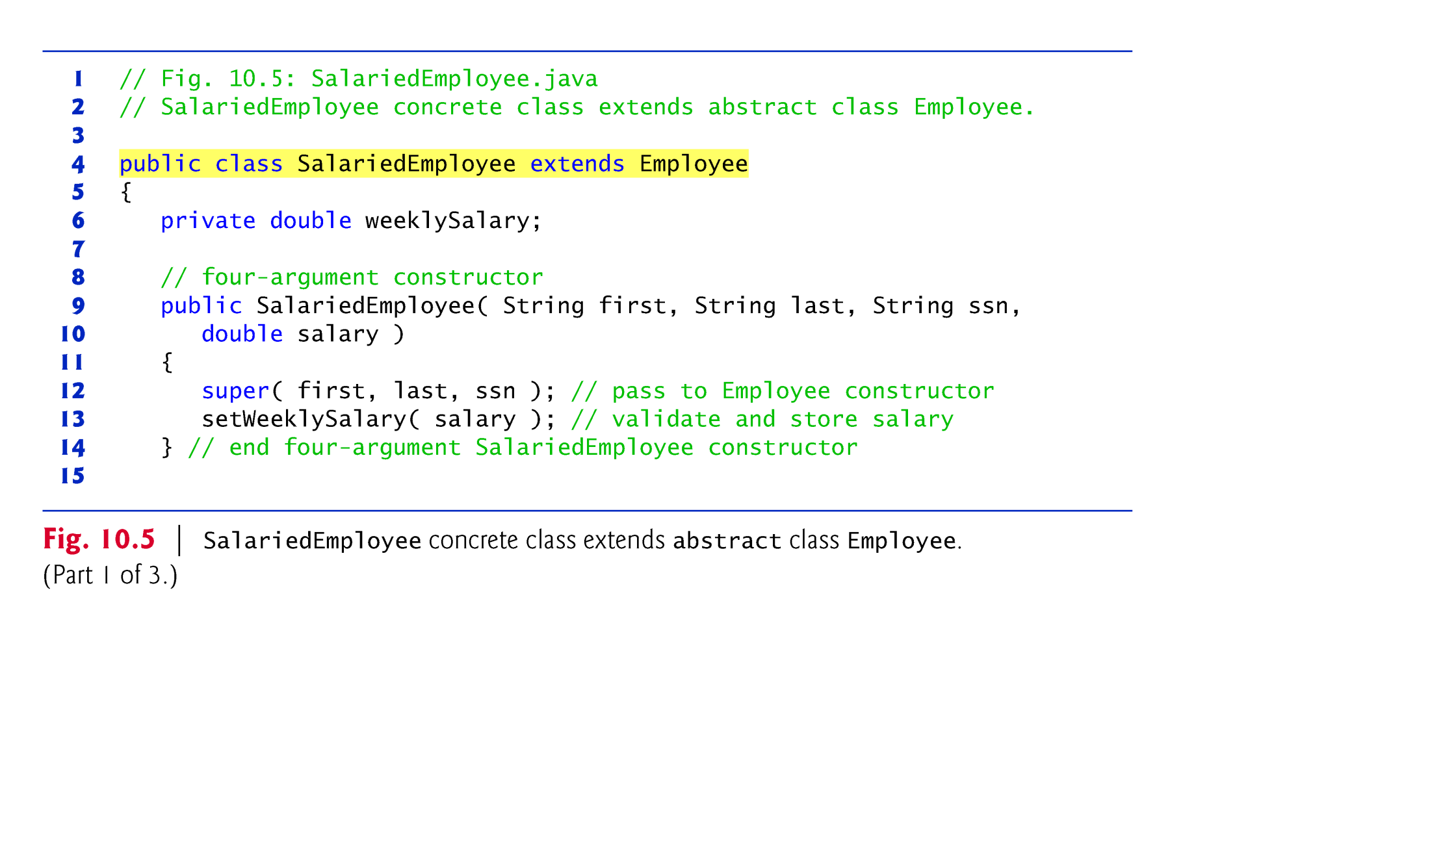
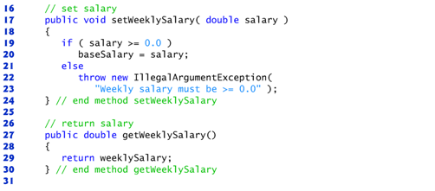
10.5.2 Concrete Subclass SalariedEmployee

Slide 22
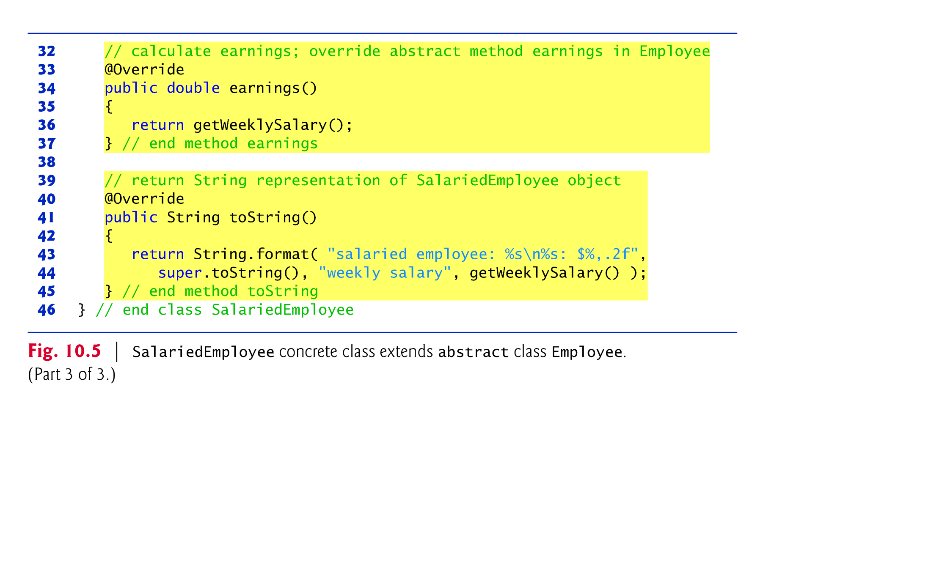

Slide 23
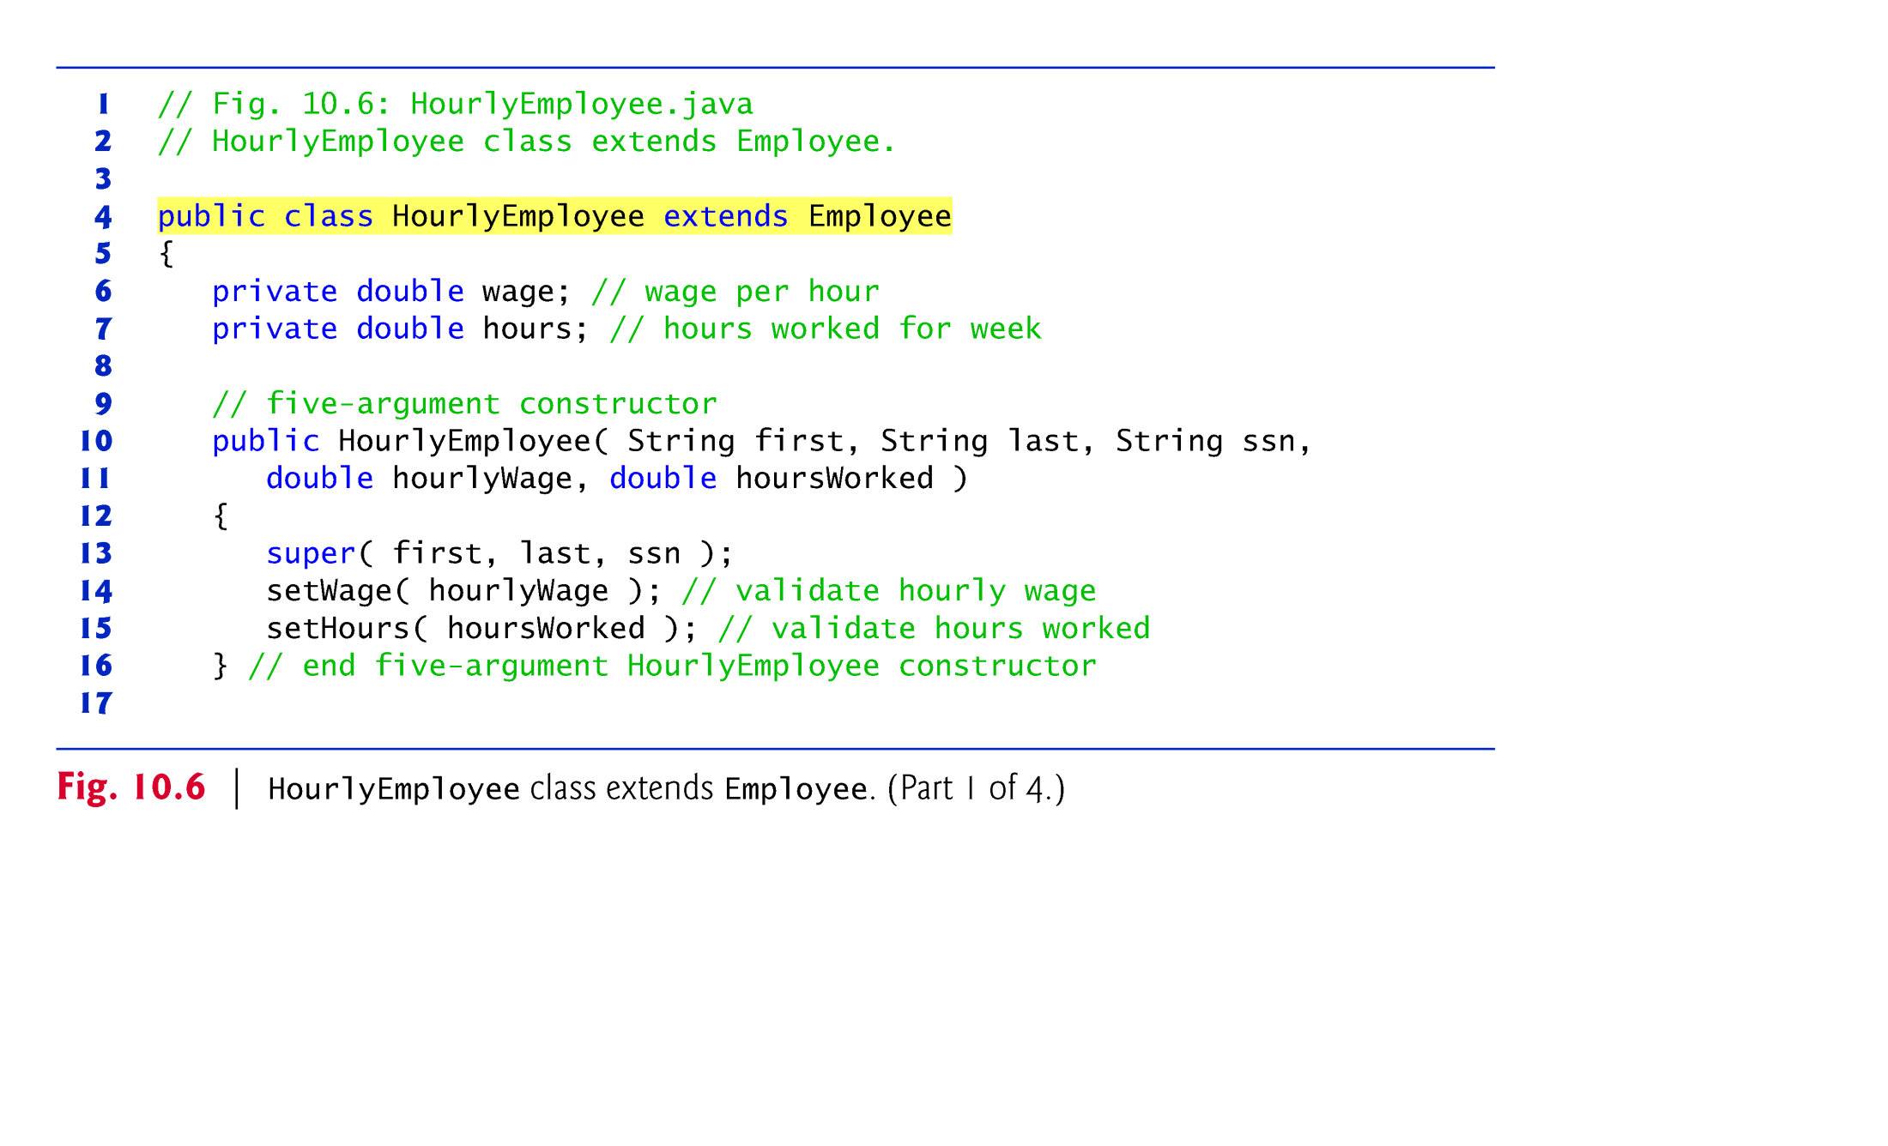
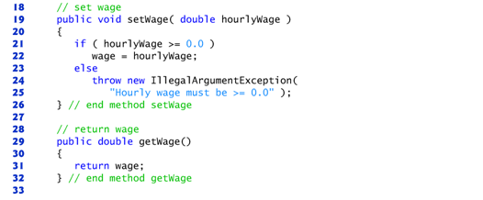
10.5.3 Concrete Subclass HourlyEmployee

Slide 24
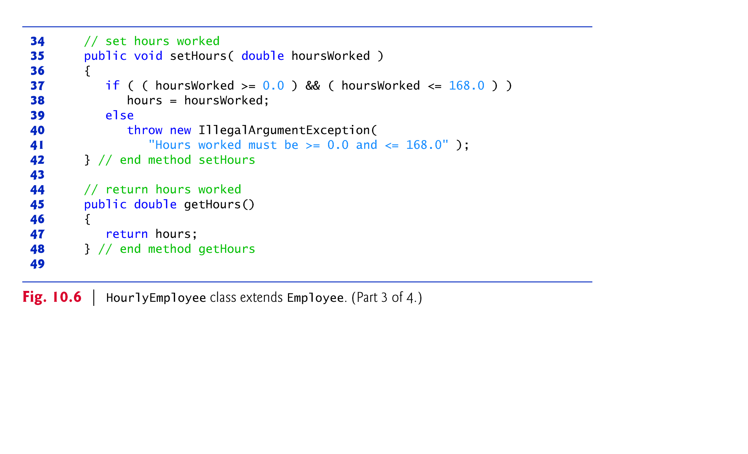
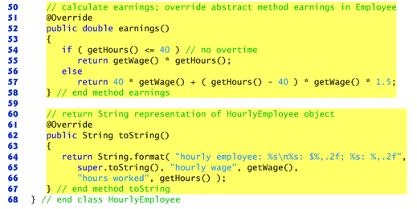

Slide 25
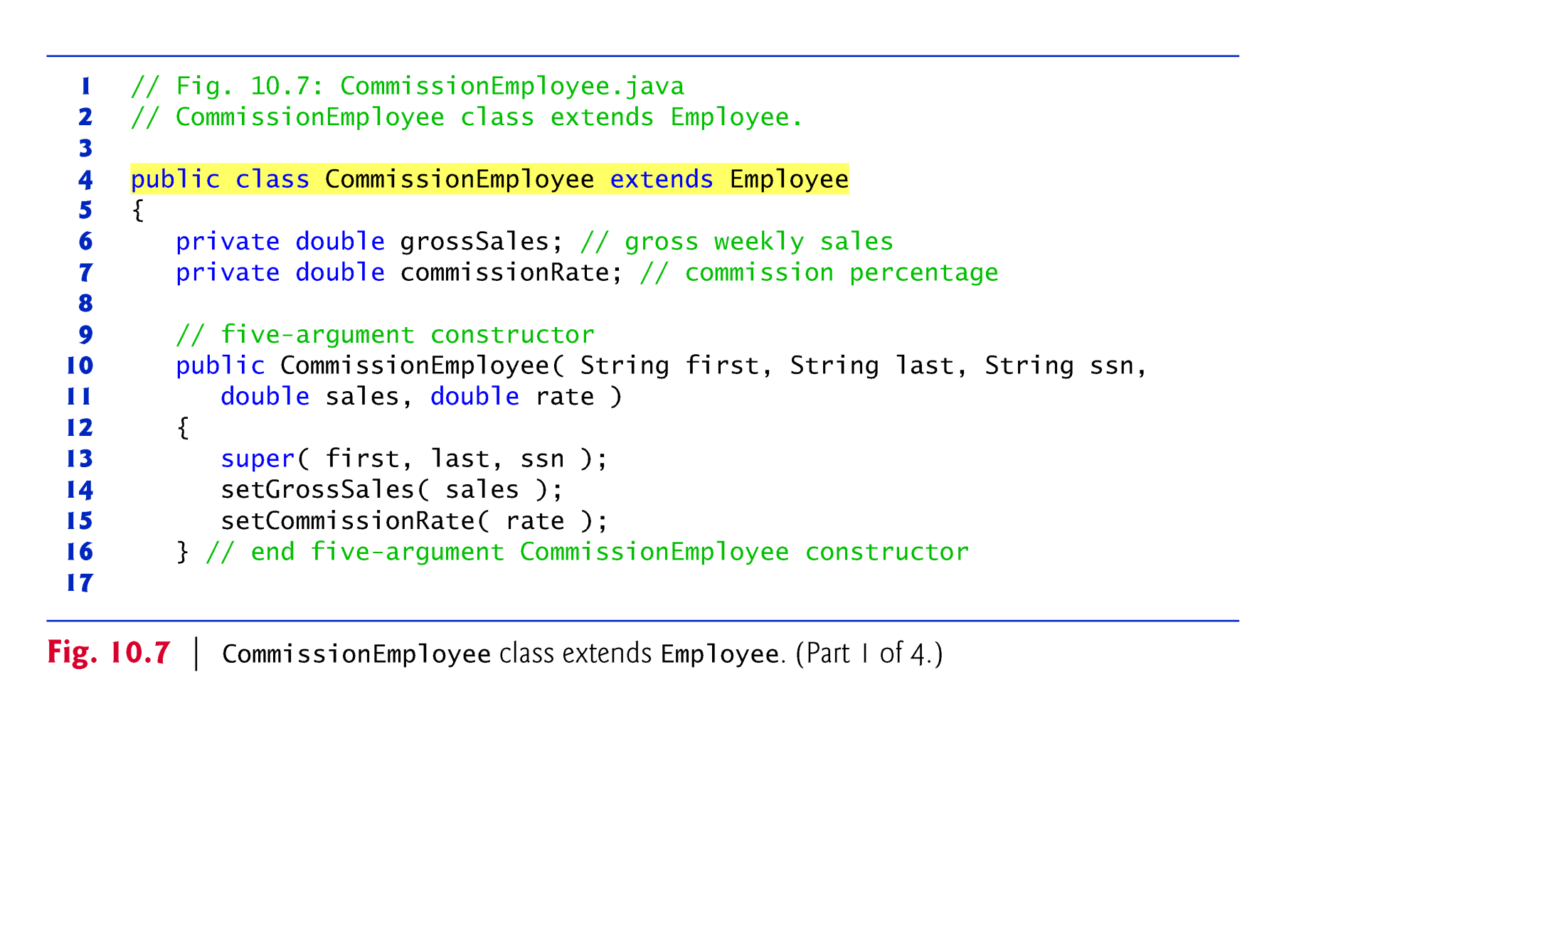
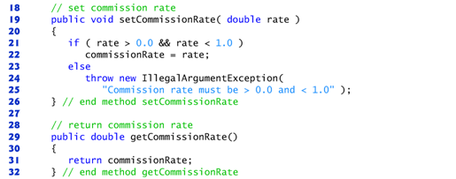
10.5.4 Concrete Subclass CommissionEmployee

Slide 26
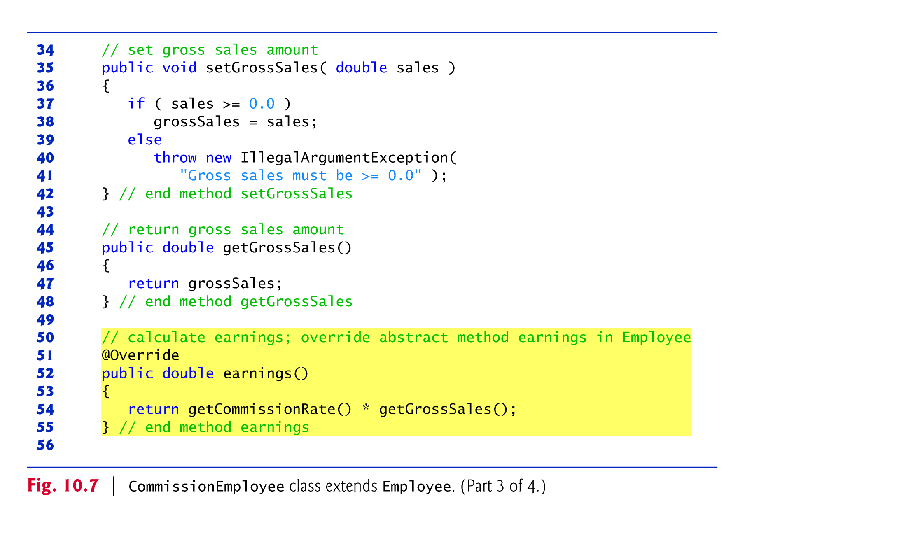

Slide 27
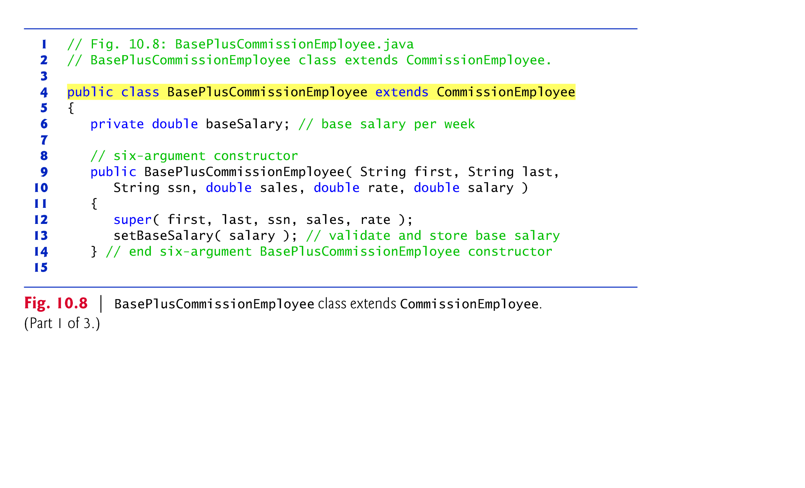
10.5.5 Indirect Concrete Subclass BasePlusCommissionEmployee

Slide 28
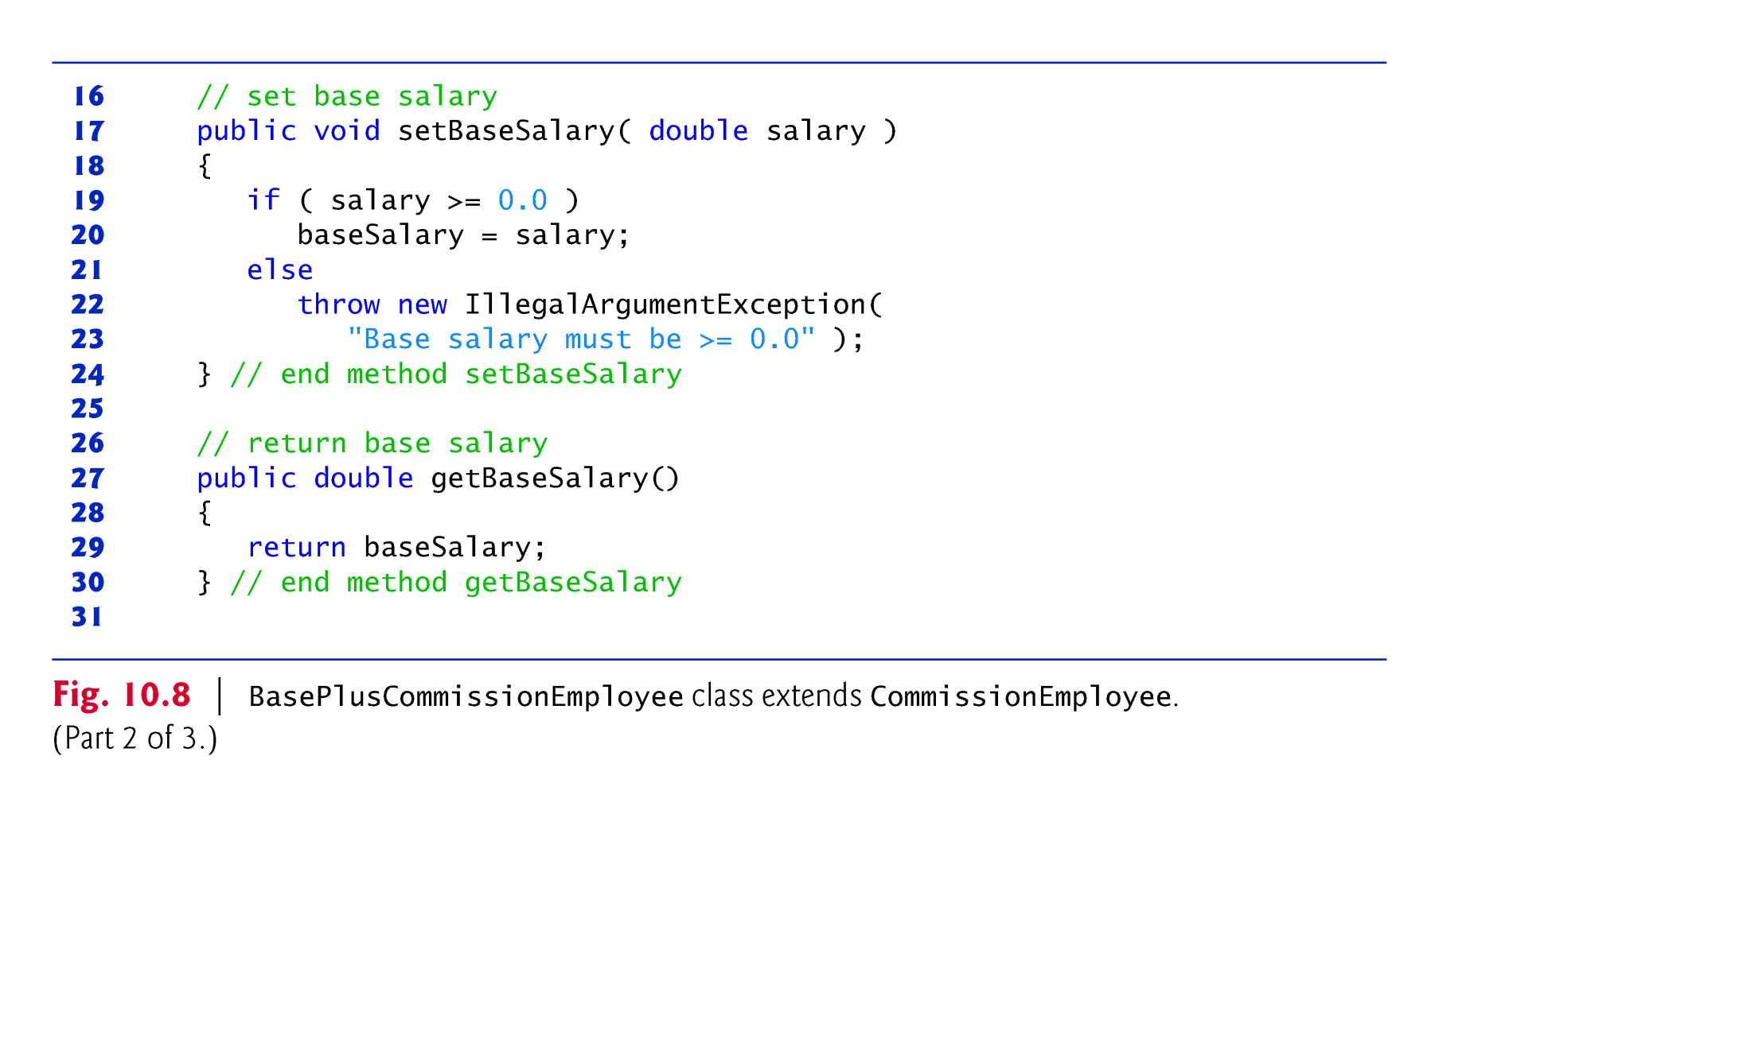
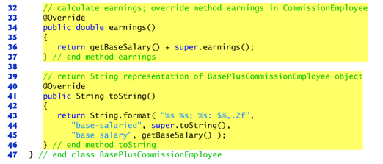

Slide 29
10.5.6 Polymorphic Processing
Fig. 10.9 creates an object of each of the four concrete.
Manipulates these objects non-polymorphically, via variables of each object’s own type, then polymorphically, using an array of Employee variables.
Finally, the program polymorphically determines and outputs the type of each object in the Employee array.

Slide 30
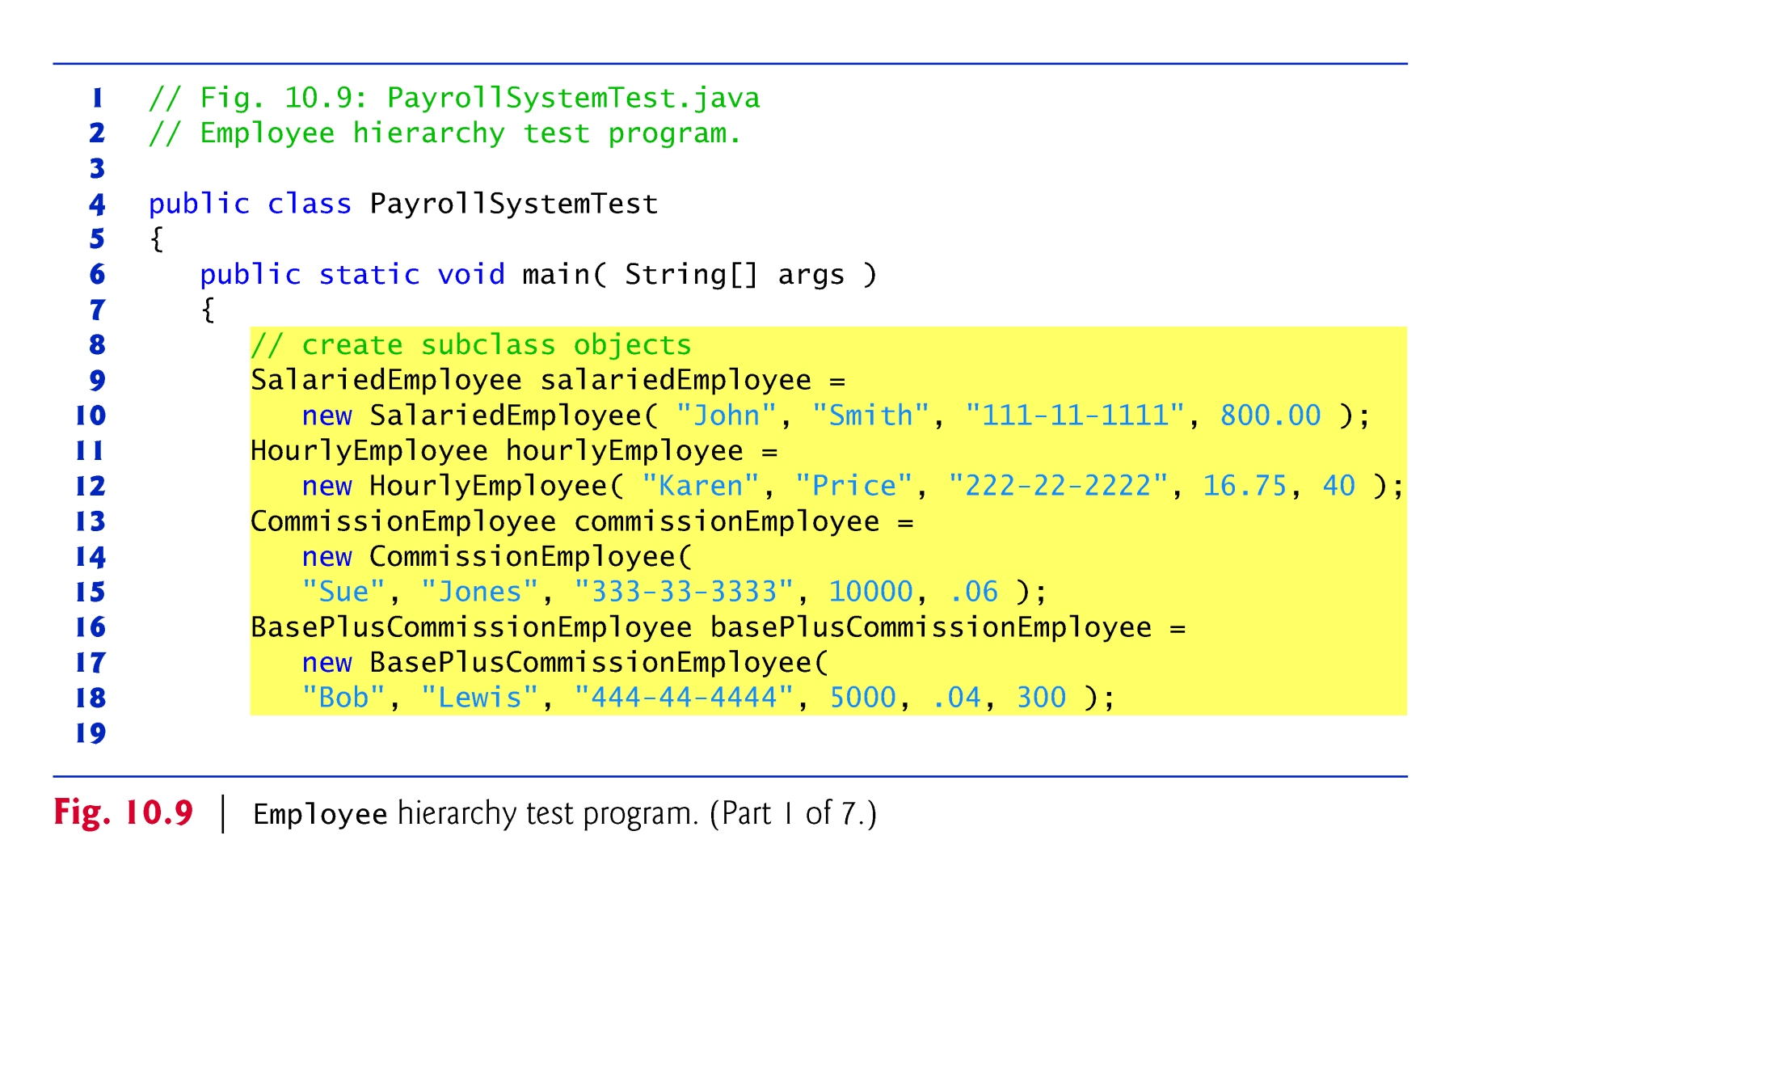

Slide 31
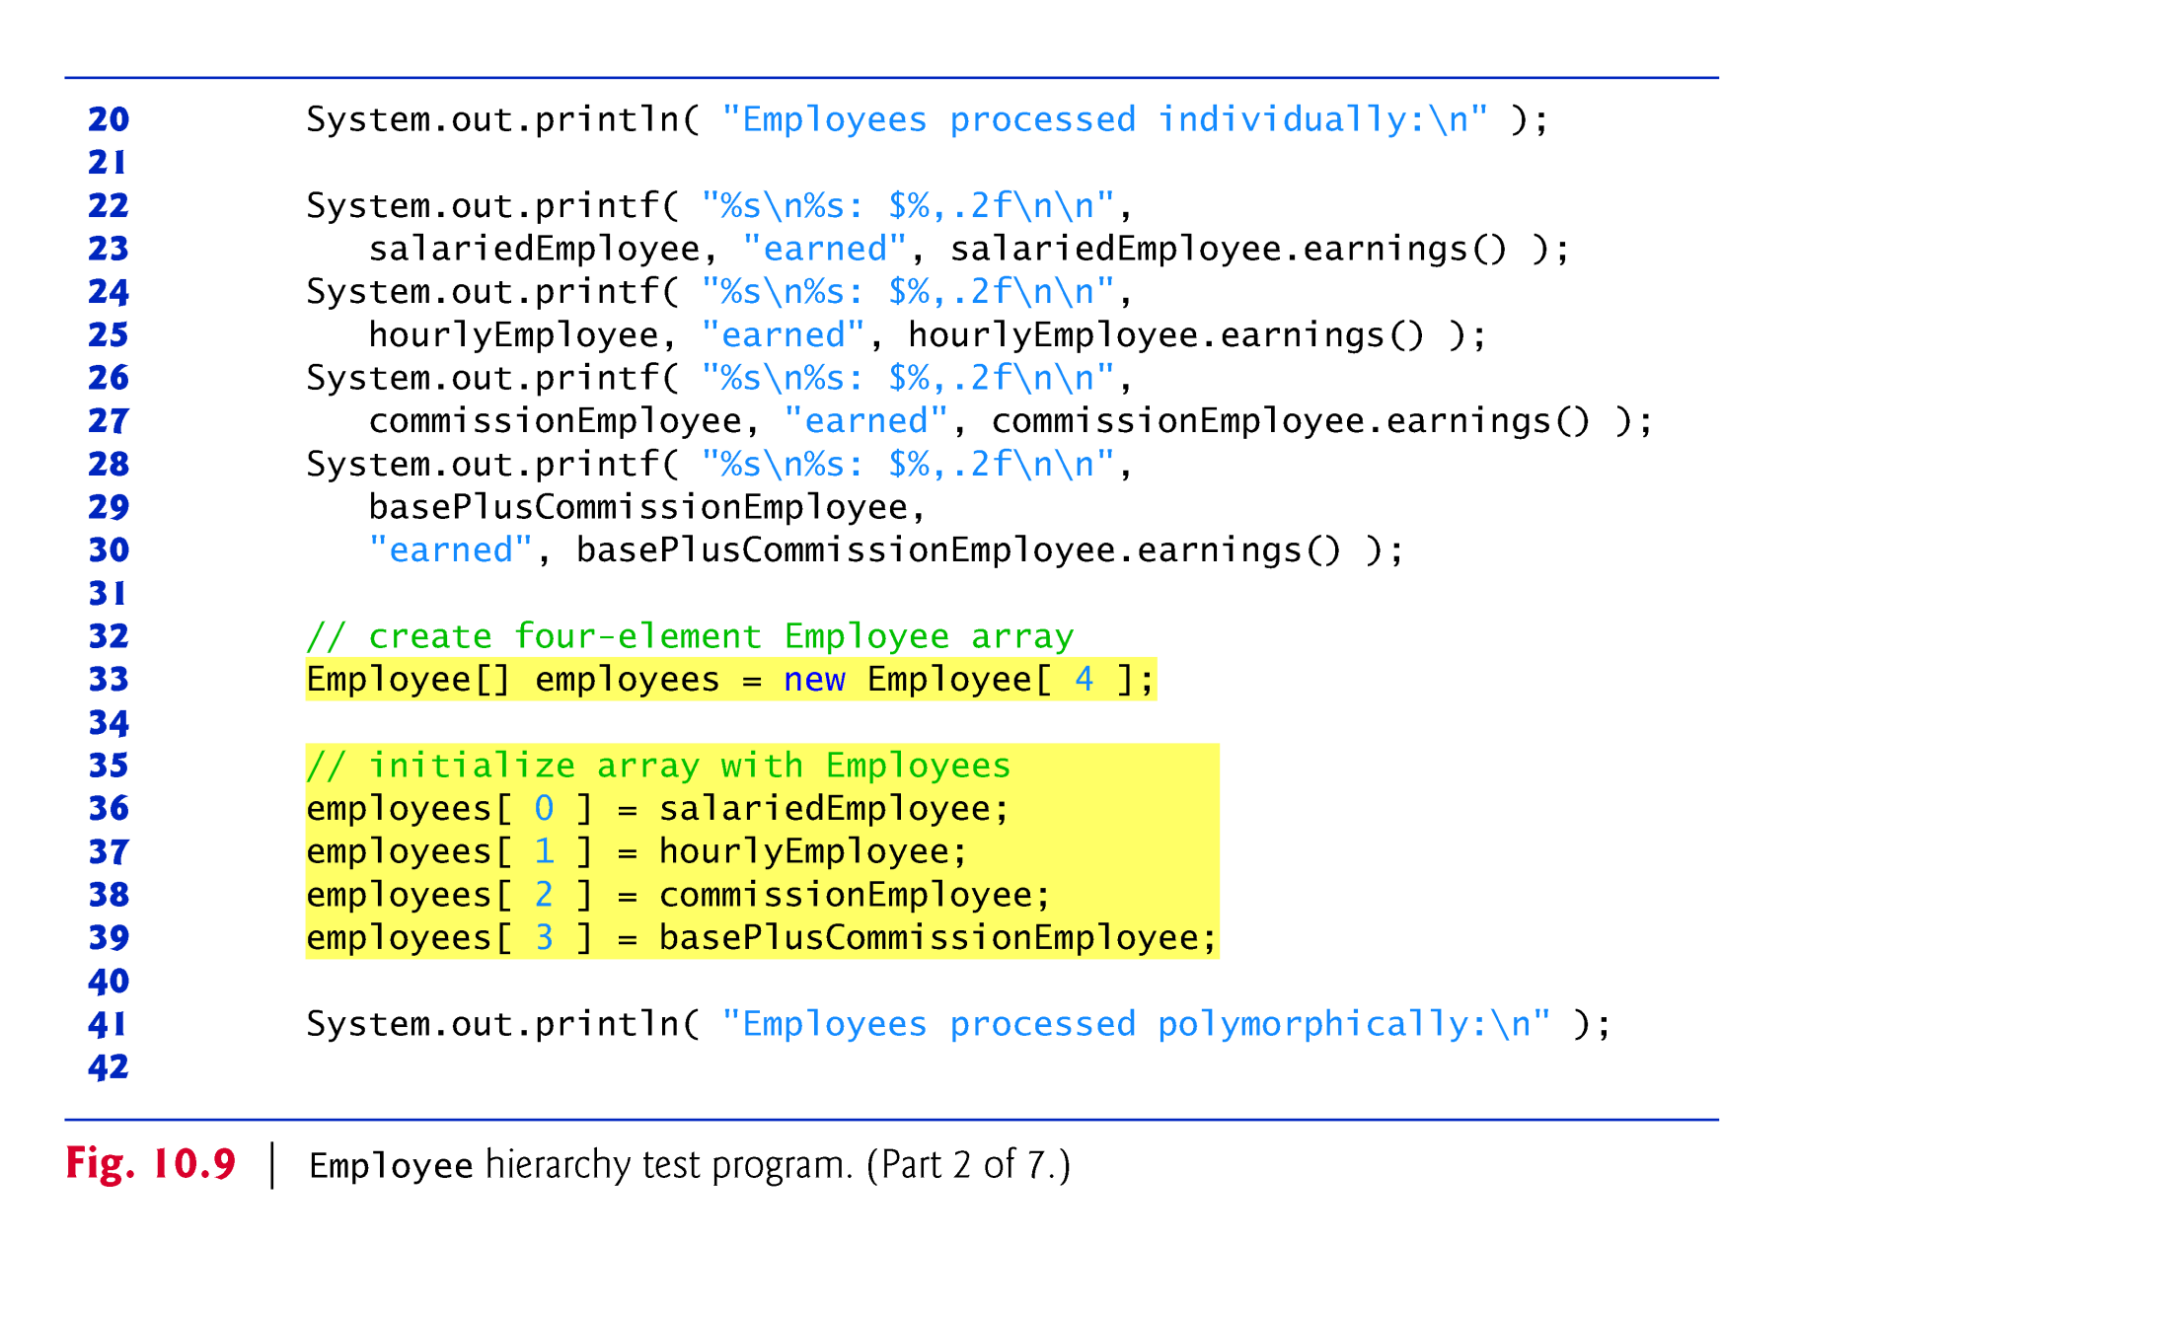

Slide 32
10.5.6 Polymorphic Processing
All calls to method toString and earnings are resolved at execution time, based on the type of the object to which currentEmployee refers.
Known as dynamic binding.
A superclass reference can be used to invoke only methods of the superclass—the subclass method are invoked polymorphically.
Attempting to invoke a subclass-only method directly on a superclass reference is a compilation error.

Slide 33
10.5.7 Summary of the Allowed Assignments Between Superclass and Subclass Variables
There are four ways to assign superclass and subclass references to variables of superclass and subclass types.
Assigning a superclass reference to a superclass variable is straightforward.
Assigning a subclass reference to a subclass variable is straightforward.
Assigning a subclass reference to a superclass variable is safe, because the subclass object is an object of its superclass.
The superclass variable can be used to refer only to superclass members.
If this code refers to subclass-only members through the superclass variable, the compiler reports errors.
Attempting to assign a superclass reference to a subclass variable is a compilation error.

Slide 34
Assignments
Check OpenLab for new labs
Check Blackboard for new quizzes
Midterm on October 28th (two weeks)
Official review next week
Topics in the next slides
Exam will include questions and programming problems
Absolutely no electronic devices. You use one you’ll get 0 (zero).
Study, do the quizzes, do the labs, ask questions.

Slide 35
Midterm Review Topics
Java basics
Basic commands (i.e. if, while, switch, println, Scanner etc.)
What is the Java Virtual Machine (JVM)
Commands to compile and run an application
Java Application Programming Interface (API)
Data Types
Primitive data types
Reference data types
Initial values

Slide 36
Midterm Review Topics
Object-Oriented programming
What is a class
What is an object
Static data and why the main method is static
What are fields
What are methods
What is a constructor
Method overloading
Encapsulation
Inheritance
Polymorphism
Abstract classes
Interfaces

