Slide 1
CET 3640 – Lecture 2 Java Syntax Chapters 2, 4, 5
Java™ How to Program, 9/e

Slide 2
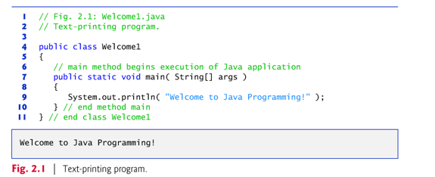
2.2 Our First Program in Java: Hello World
Java application
A computer program that executes when you use the java command to launch the Java Virtual Machine (JVM).

Slide 3
2.2 Our First Program in Java: Printing a Line of Text (Cont.)
Line Comments in Java
// indicates that from that point what follows is a comment.
Traditional or Block comment, can be spread over several lines as in
/* This is a traditional comment. It can be split over multiple lines */
This type of comment begins with /* and ends with */.
All text between the delimiters is ignored by the compiler.

Slide 4
2.2 Our First Program in Java: Printing a Line of Text (Cont.)
Class declaration
public class Welcome1
Every Java program consists of at least one class that you define.
class keyword introduces a class declaration and is immediately followed by the class name.
Java is completely object-oriented, for that reason everything is a class.

Slide 5
2.2 Our First Program in Java: Printing a Line of Text (Cont.)
Class names
By convention Pascal Case is used which begins with a capital letter and capitalize the first letter of each word
(e.g., SampleClassName).
A class name is an identifier—a series of characters consisting of letters, digits, underscores (_) and dollar signs ($) that does not begin with a digit and does not contain spaces.
Java is case sensitive—uppercase and lowercase letters are distinct—so a1 and A1 are different (but both valid) identifiers.

Slide 7
2.2 Our First Program in Java: Printing a Line of Text (Cont.)
Braces
A left brace, {, begins the body of every class declaration.
A corresponding right brace, }, must end each class declaration.
Code between braces should be indented.
It is Good Software Engineering to indent you code.
Eclipse IDE helps you with indentation and code completion.

Slide 8
2.2 Our First Program in Java: Printing a Line of Text (Cont.)
Declaring the main Method
public static void main( String[] args )
… YES, all that!!!
Starting point of every Java application.
Parentheses after the identifier main indicate that it’s a program building block called a method.
Java class declarations normally contain one or more methods.
main must be defined as shown; otherwise, the JVM will not execute the application.
Methods perform tasks and can return information when they complete their tasks.
Keyword void indicates that this method will not return any information.

Slide 9
2.2 Our First Program in Java: Printing a Line of Text (Cont.)
Body of the method declaration
Enclosed in left and right braces.
Output statements:
System.out object
Standard output object.
Allows Java applications to display strings in the command window from which the Java application executes.
System.out.println method
Displays (or prints) a line of text in the command window.
Positions the output cursor at the beginning of the next line.
System.out.println("Welcome to Java Programming!");

Slide 10
2.2 Our First Program in Java: Printing a Line of Text (Cont.)
Compiling and Executing Your First Java Application
Open a command window and change to the directory where the program is stored.
To compile the program, type
javac Welcome1.java
If the program contains no syntax errors, preceding command creates a.class file (known as the class file).
To run the program, type
java Welcome
The JVM calls method main in Welcome to execute the program.

Slide 12
Escape Sequences (Same as C++)

Slide 13
2.5 Another Application: Adding Integers
Integers
Whole numbers, like –22, 7, 0 and 1024)
Programs remember numbers and other data in the computer’s memory and access that data through program elements called variables.

Slide 14
2.5 Another Application: Adding Integers (Cont.)
Variable declaration statements
int number1; // first number to add int number2; // second number to add int sum; // sum of number1 and number2
declare that variables number1, number2 and sum hold data of type int
They can hold integer.
Range of values for an int is –2,147,483,648 to +2,147,483,647.
Actual int values may not contain commas.
Several variables of the same type may be declared in one declaration with the variable names separated by commas.

Slide 15
2.5 Another Application: Adding Integers (Cont.)
Arithmetic
sum = number1 + number2; // add numbers
Assignment statement that calculates the sum of the variables number1 and number2 then assigns the result to variable sum by using the assignment operator, =.
“sum gets the value of number1 + number2.”
Portions of statements that contain calculations are called expressions.

Slide 18
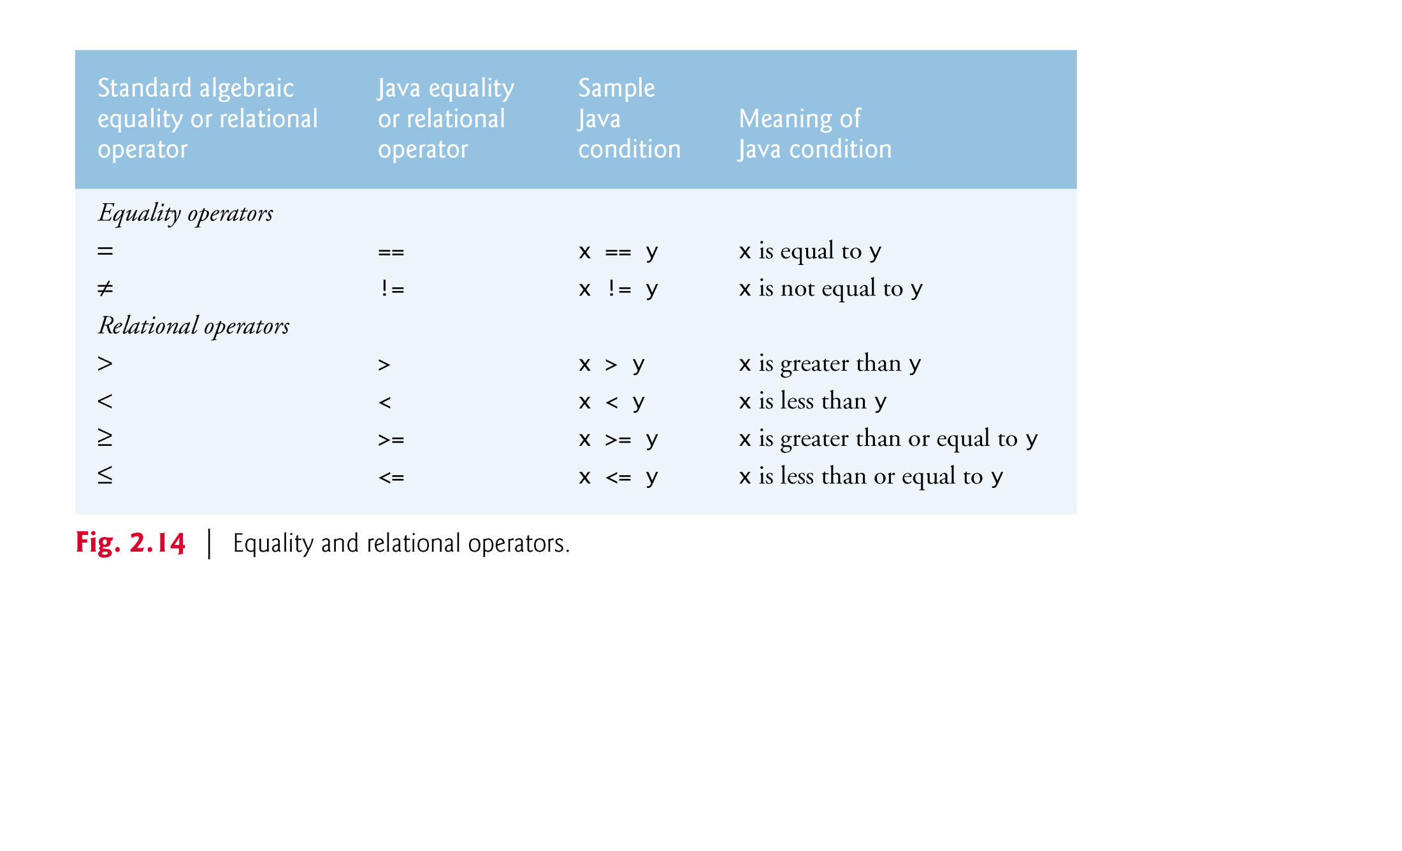

Slide 20
2.5 Another Application: Adding Integers (Cont.)
import declaration
Helps the compiler locate a class that is used in this program.
Rich set of predefined classes that you can reuse rather than “reinventing the wheel.”
Classes are grouped into packages—named groups of related classes—and are collectively referred to as the Java class library, or the Java Application Programming Interface (Java API).
You use import declarations to identify the predefined classes used in a Java program.

Slide 21
2.5 Another Application: Adding Integers (Cont.)
Scanner
Enables a program to read data for use in a program.
Data can come from many sources, such as keyboard or a file.
Before using a Scanner, you must create it and specify the source of the data.
Variable declaration statement
Scanner input = new Scanner( System.in );
Specifies the name (input) and type (Scanner) of the variable.
The equals sign (=) indicates that the variable should be initialized with the result of the expression to the right of the equals sign.
The new keyword creates an object.
Standard input object, System.in, enables applications to read bytes of information typed by the user.
Scanner object translates bytes into types that can be used in a program.

Slide 22
2.5 Another Application: Adding Integers (Cont.)
Scanner method nextInt
number1 = input.nextInt(); // read first number from user
Obtains an integer from the user at the keyboard.
Program waits for the user to type the number and press the Enter key to submit the number to the program.
The result of the call to method nextInt is placed in variable number1 by using the “ =“ operator.
“number1 gets the value of input.nextInt().”

Slide 23
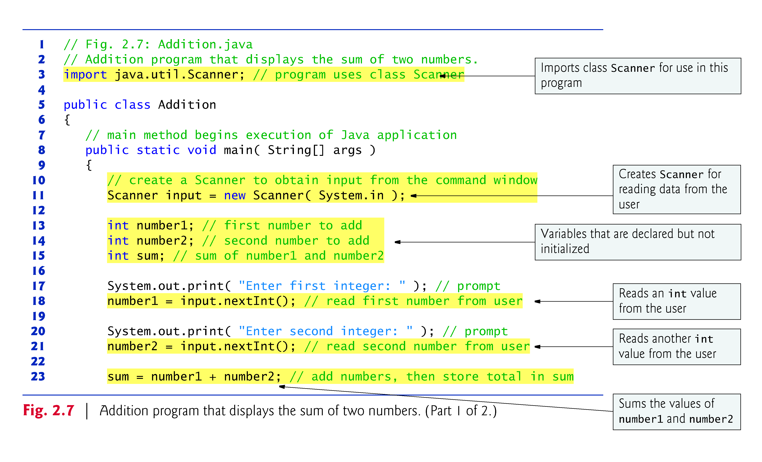

Slide 24
4.4 Control Structures
if, if/else statements:
switch statement
while loop
for loop
do…while

Slide 25
4.5 if Single-Selection Statement
An if statement in Java:
if ( studentGrade >= 60 ) System.out.println( "Passed" );
An If…Else statement in Java:
if ( grade >= 60 ) System.out.println( "Passed" ); else System.out.println( "Failed" );

Slide 26
4.6 if…else Double-Selection Statement (Cont.)
Nested If…else statements in Java
if ( studentGrade >= 90 ) System.out.println( "A" ); else if ( studentGrade >= 80 ) System.out.println( "B" ); else if ( studentGrade >= 70 ) System.out.println( "C" ); else if ( studentGrade >= 60 ) System.out.println( "D" ); else System.out.println( "F" );

Slide 27
4.6 if…else Double-Selection Statement (Cont.)
A more elegant way to write a nested if…else statement
if ( studentGrade >= 90 ) System.out.println( "A" ); else if ( studentGrade >= 80 ) System.out.println( "B" ); else if ( studentGrade >= 70 ) System.out.println( "C" ); else if ( studentGrade >= 60 ) System.out.println( "D" ); else System.out.println( "F" );
The two forms are identical except for the spacing and indentation, which the compiler ignores.

Slide 28
4.6 if…else Double-Selection Statement (Cont.)
The Java compiler always associates an else with the immediately preceding if unless told to do otherwise by the placement of braces ({ and }).
The following code is not what it appears:
if ( x > 5 ) if ( y > 5 ) System.out.println( "x and y are > 5" ); else System.out.println( "x is <= 5" );
Beware! This nested if…else statement does not execute as it appears. The compiler actually interprets the statement as
if ( x > 5 ) if ( y > 5 ) System.out.println( "x and y are > 5" ); else System.out.println( "x is <= 5" );

Slide 29
4.6 if…else Double-Selection Statement (Cont.)
To force the nested if…else statement to execute as it was originally intended, we must write it as follows:
if ( x > 5 ) { if ( y > 5 ) System.out.println( "x and y are > 5" ); } else System.out.println( "x is <= 5" );
The braces indicate that the second if is in the body of the first and that the else is associated with the first if.

Slide 30
4.7 while Repetition Statement
Syntax
while ( Boolean condition) Statements
Example of Java’s while repetition statement: find the first power of 3 larger than 100. Assume int variable product is initialized to 3.
while ( product <= 100 ) product = 3 * product;
Program execution continues with the next statement after the while statement.
Same rules for nested commands apply.

Slide 31
4.11 Compound Assignment Operators
Compound assignment operators abbreviate assignment expressions.
Statements like variable = variable operator expression; where operator is one of the binary operators +, -, *, / or % can be written in the form
variable operator= expression;
Example:
c = c + 3;
can be written with the addition compound assignment operator, +=, as
c += 3;
The += operator adds the value of the expression on its right to the value of the variable on its left and stores the result in the variable on the left of the operator.

Slide 33
4.12 Increment and Decrement Operators
Unary increment operator, ++, adds one to its operand
Unary decrement operator, --, subtracts one from its operand
An increment or decrement operator that is prefixed to (placed before) a variable is referred to as the prefix increment or prefix decrement operator, respectively.
An increment or decrement operator that is postfixed to (placed after) a variable is referred to as the postfix increment or postfix decrement operator, respectively.

Slide 35
4.13 Primitive Types
Java requires all variables to have a type.
Java is a strongly typed language.
Primitive types in Java are portable across all platforms.
Instance variables of types char, byte, short, int, long, float and double are all given the value 0 by default. Instance variables of type boolean are given the value false by default.
Reference-type instance variables are initialized by default to the value null.

Slide 36
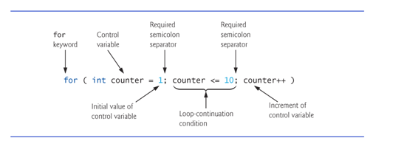
5.3 for Repetition Statement
for repetition statement
Specifies the counter-controlled-repetition details in a single line of code.

Slide 37
5.3 for Repetition Statement (Cont.)
When the for statement begins executing, the control variable is declared and initialized.
Next, the program checks the loop-continuation condition, which is between the two required semicolons.
If the condition initially is true, the body statement executes.
After executing the loop’s body, the program increments the control variable in the increment expression, which appears to the right of the second semicolon.
Then the loop-continuation test is performed again to determine whether the program should continue with the next iteration of the loop.

Slide 38
5.5 do…while Repetition Statement
The do…while repetition statement is similar to the while statement.
The do…while statement tests the loop-continuation condition after executing the loop’s body; therefore, the body always executes at least once.
When a do…while statement terminates, execution continues with the next statement in sequence.
Syntax:
do { statements } while ( condition );

Slide 40
5.6 switch Multiple-Selection Statement
switch multiple-selection statement performs different actions based on the possible values of a constant integral expression of type byte, short, int or char.

Slide 41
5.6 switch Multiple-Selection Statement (Cont.)
The switch statement consists of a block that contains a sequence of case labels and an optional default case.
The program evaluates the controlling expression in the parentheses following keyword switch.
The program compares the controlling expression’s value with each case label.
If a match occurs, the program executes that case’s statements.
The break statement causes program control to proceed with the first statement after the switch.

Slide 42
5.6 switch Multiple-Selection Statement (Cont.)
switch does not provide a mechanism for testing ranges of values—every value must be listed in a separate case label.
Each case can have multiple statements.
switch does not require braces around multiple statements in a case.
BEWARE: Without break statements will continue execution until a break or the end of the switch is encountered.
If no match occurs, the default case executes.
If no match occurs and there is no default case, program control continues with the first statement after the switch.

Slide 43
5.6 switch Multiple-Selection Statement
As of Java SE 7, you can use Strings in a switch statement :
Syntax:
switch( borough) { case “Manhattan": county = “New York"; break; case “The Bronx": county = “Bronx"; break; case “Brooklyn": county = “Kings"; break; case “Queens": county = “Queens"; break; case “Staten Island": county = “Richmond"; break; } // end switch

Slide 44
5.7 break and continue Statements
The break statement, when executed in a while, for, do…while or switch, causes immediate exit from that statement.
Execution continues with the first statement after the control statement.
Common uses of the break statement are to escape early from a loop or to skip the remainder of a switch.

Slide 45
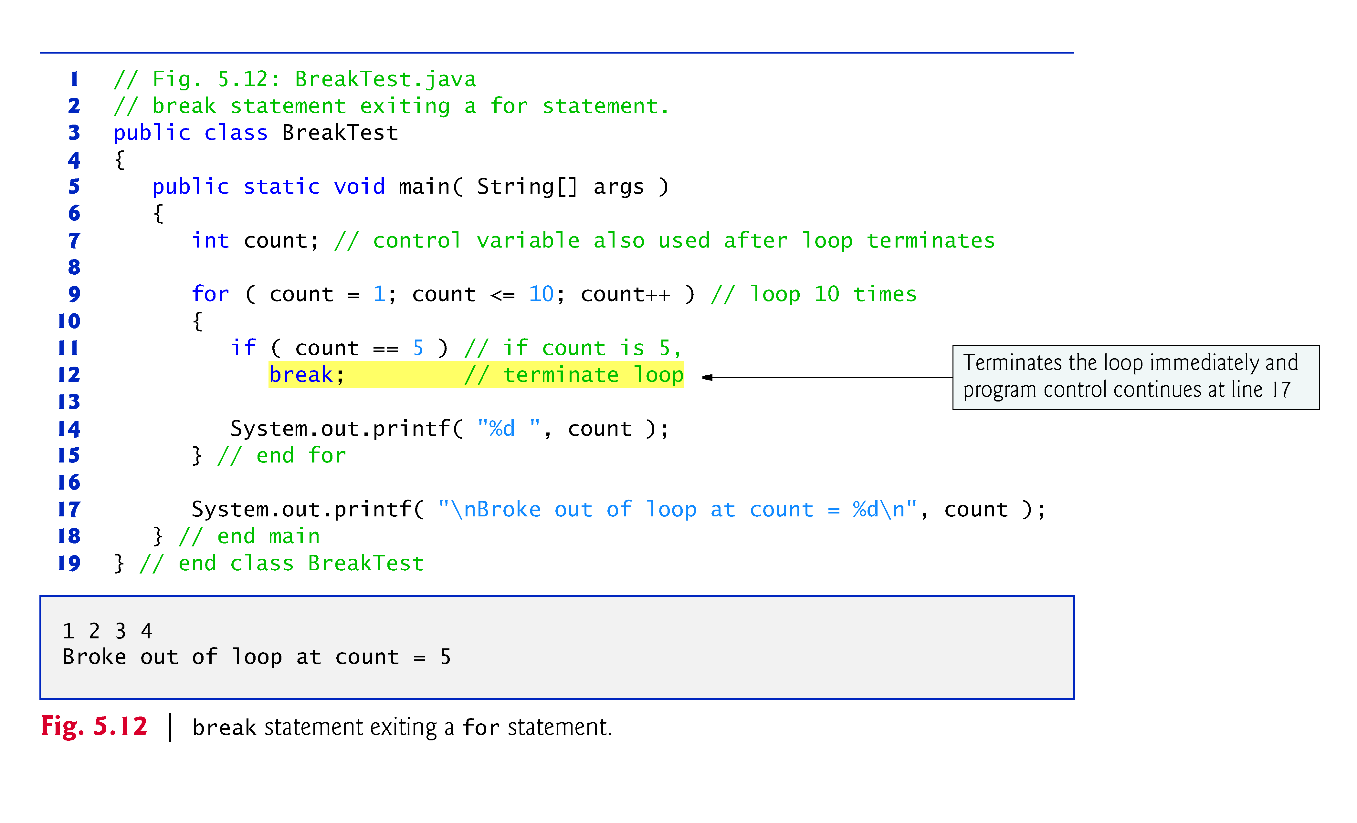

Slide 46
5.7 break and continue Statements (Cont.)
The continue statement, when executed in a while, for or do…while, skips the remaining statements in the loop body and proceeds with the next iteration of the loop.
In while and do…while statements, the program evaluates the loop-continuation test immediately after the continue statement executes.
In a for statement, the increment expression executes, then the program evaluates the loop-continuation test.

Slide 48
5.8 Logical Operators
Java’s logical operators enable you to form more complex conditions by combining simple conditions.
The logical operators are
&& (conditional AND)
|| (conditional OR)
& (boolean logical AND)
| (boolean logical OR)
^ (boolean logical exclusive OR)
! (logical NOT).
[Note: The &, | and ^ operators are also bitwise operators when they are applied to integral operands.]

Slide 49
