Slide 1
CET 3510 - Microcomputer Systems Technology Lecture 4
Dr. José M. Reyes Álamo

Slide 2
AND Truth Table
p | q | p AND q
True | True | True
True | False | False
False | True | False
False | False | False

Slide 3
OR Truth Table
p | q | p OR q
True | True | True
True | False | True
False | True | True
False | False | False

Slide 4
XOR Truth Table
p | q | p XOR q
True | True | False
True | False | True
False | True | True
False | False | False

Slide 5
NOT Truth Table
p | NOT p
True | False
False | True

Slide 6
HLA Commands for Logical Operations
and( source, dest );
or( source, dest );
xor( source, dest );
not( dest );
Source has to be a constant, memory, or register operand
dest operand must be a memory or register operand

Slide 7
Example for HLA AND
Assuming you already have variables p and q
C++ code for AND is r = p && q;
HLA Code:
mov( p, eax );
mov( q, ebx );
mov( eax, ecx );
and( ebx, ecx );
mov( ecx, r );

Slide 8
Example for HLA OR
Assuming you already have variables p and q
C++ code for OR is r = p || q;
HLA Code:
mov( p, eax );
mov( q, ebx );
mov( eax, ecx );
or( ebx, ecx );
mov( ecx, r );

Slide 9
Example for HLA XOR
Assuming you already have variables p and q
C++ code for XOR is r = (p && !q) || (!p && q);
HLA Code:
mov( p, eax );
mov( q, ebx );
mov( eax, ecx );
xor( ebx, ecx );
mov( ecx, r );

Slide 10
Example for HLA NOT
Assuming you already have variable p
C++ code for NOT is r = !p;
HLA Code:
mov( p, eax );
not( eax);
mov( eax, r );

Slide 11
Shift and Rotate

Slide 12
Shift Left
Shift left move each bit n positions to the left
Lower order bits becomes a 0
Higher order bit becomes a carry out

Slide 13
Shift Left in HLA
HLA code: shl( count, dest )
count = positions to shift (either CL or a constant)
dest = register or variable
Shifting n places to the left, is equivalent to multiplying by the base (radix) n times

Slide 14
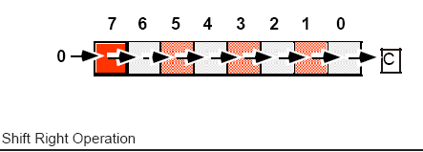
Shift Right
Shift right moves each bit n positions to the right
Higher order bits becomes a 0
Lower order bit becomes a carry out

Slide 15
Shift Right
HLA code: shr( count, dest )
count = positions to shift (either CL or a constant)
dest = register or variable
Shifting n places to the right is equivalent to dividing by the base (radix) n times

Slide 16
Be Careful with Shifting
Be careful with arithmetic (division)
Shifting right only works for unsigned number, as adding 0 to the high order bit might change the sign under two’s complement representation.
To solve this problem the shift arithmetic right operation preserves the higher order bit
HLA code: sar( count, dest )
count = positions to shift
dest = register or variable

Slide 17
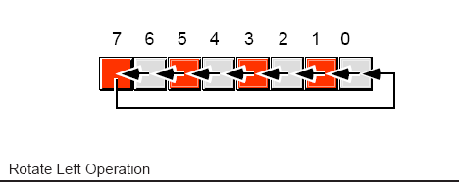
Rotate
Rotate Left: shift all the bits to the left and copies the carry bit to the Lower Order bit
HLA code rol ( count, dest )
count = positions to shift
dest = register or var

Slide 18
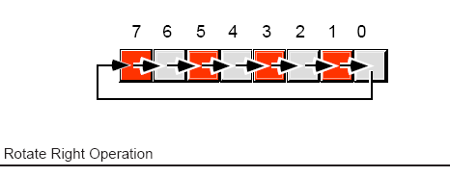
Rotate Right
Rotate Right: shift all the bits to the right and copies the carry bit to the Higher Order bit
HLA code ror ( count, dest )
count = positions to shift
dest = register or var

Slide 19
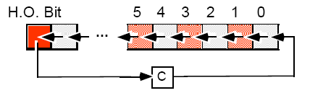
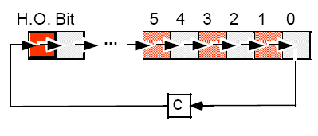
Rotate Through the Carry
To avoid an undefined state, is better to rotate through the carry rather than directly:
rcl( count, dest )
rcr( count, dest )

Slide 20
Bit Fields and Packed Data
Memory packing is space-efficient but computationally expensive
Example of a packed date

Slide 21
Packing Data
Assuming you have the values for: year, month, and day (int8 each) and a variable called packedDate (int16) then:
mov( 0, ax );
mov( ax, packedDate);
mov( month, al );
shl( 5, ax );
or( day, al );
shl( 7, ax );
or( year, al );
mov( ax, packedDate );

Slide 22
Unpacking the Data
mov( packedDate, ax );
and( $7f, al ); // Retrieve the year value.
mov( al, year );
mov( packedDate, ax ); // Retrieve the day value.
shr( 7, ax );
and( %1_1111, al );
mov( al, day );
mov( packedDate, ax ); // Retrive the month value.
rol( 4, ax );
and( %1111, al );
mov( al, month );

Slide 23
Life after Y2K
An example of a 4-byte date architecture
A byte for Day
A byte for Month
2-bytes for Year

Slide 24
Multiplication
Multiplication is a single-operand instruction
Signed and unsigned multiplication supported (mul, imul)
Need to load first the accumulator into a register
Has to be one of AL (8-bits), AX (16-bits), EAX (32-bits)
Result is stored in: AX, DX:AX, EDX:EAX
Results may require as many as 2*n bits
If numbers are too large might get overflow
HLA provides a modification to make multiplication easier
mul (source, register) | imul (source, register)
source can be a register, memory address or constant
register must be one of AL, AX, EAX

Slide 25
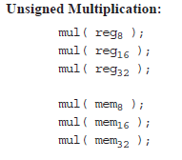
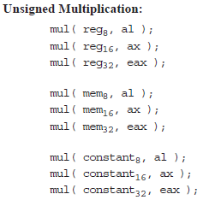
Unsigned Multiplication
Intel 80x86
HLA Modification

Slide 26
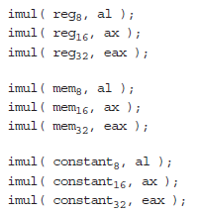
Signed Multiplication
Intel 80x86
HLA Modification

Slide 27
Division
Division performs a 64->32, 32->16, 16->8 operation
HLA commands: div, idiv
8-bit: divides AX by the operand, quotient into AL, remainder into AH
16-bit: divides DX:AX by the operand, quotient into AX, remainder into DX
32-bit: divides EDX:EAX by the operand, quotient into EAX, remainder into EDX
For unsigned, the numerator must be 16,32,64 when the denominator is 8,16,32 respectively
To accomplish this you need to zero extend the numerator (loading zeros to AH, DX, EDX respectively)
For signed integers you need to sign extend the numerator (using the commands cbw, cwd, cdq)
Be careful with: dividing by zero, overflow
Assembly doesn’t provide instructions for the remainder but HLA does: mod(operand)

Slide 28
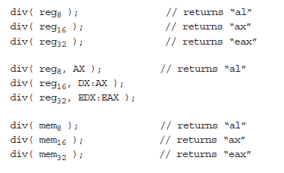
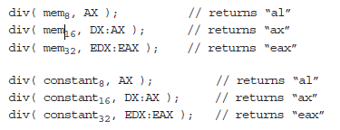
Unsigned Division

Slide 29
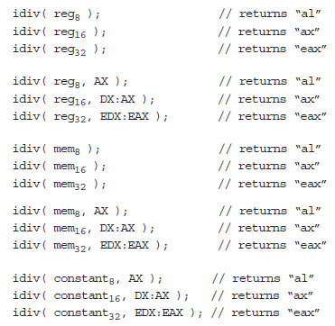
Signed Division

Slide 30
Comparison
HLA Syntax: cmp(Left, Right)
Used for comparisons, same as sub, but instead of returning the result only sets certain bits in the flags register.
Z: The zero flag is set if and only if Left = Right.
S:The sign flag is set to one if the result is negative.
O: The overflow flag is set if the difference of Left and Right produced an overflow or underflow.
C:The carry flag is set if subtracting Right from Left requires a borrow.

Slide 31
Comparison Syntax

Slide 32
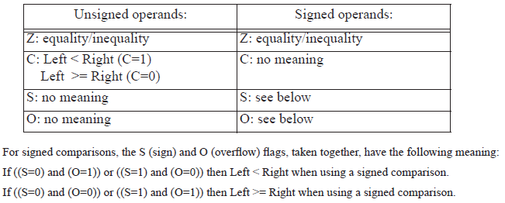
Comparison Interpretation

Slide 33
Set on Condition
The set on condition (or setcc) instructions set a single byte operand (register or memory location) to zero or one depending on the values in the flags register
These instructions store a zero into the operand if the condition is false, a one if the condition is true
Useful for mapping the result of a comparison to a Boolean value

Slide 34
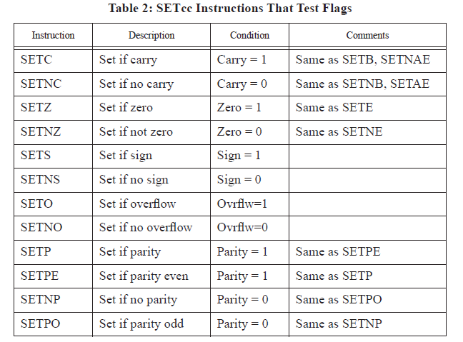
Set on Condition Syntax (many)

Slide 35
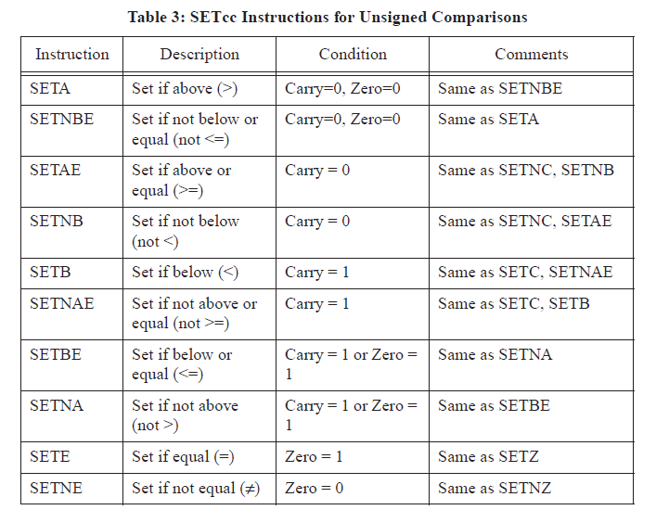
Set on Condition Syntax (more)

Slide 36
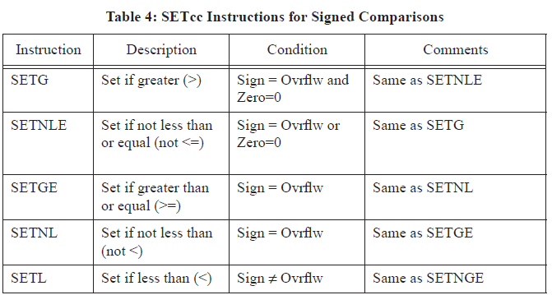
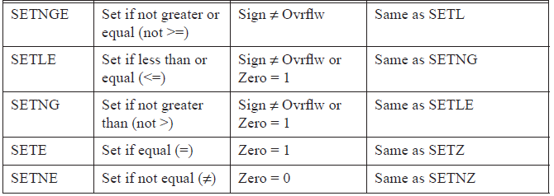
Set on Condition Syntax

